Slide 1
Agricultural water management using two-stage channels (TSCs): performance and policy recommendations based on northern European experiences
Deliverable 1.1
Contract number: 939642
21 June 2021

Slide 2
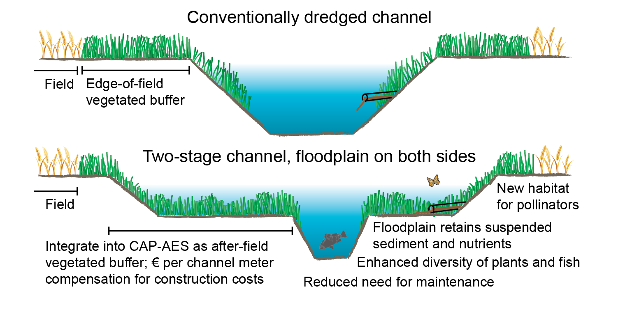
TSC design as an environmentally preferable alternative to conventional dredging for agricultural drainage and flood mitigation

Slide 3
Main benefits of TSCs compared to conventional dredging
Longer-term functioning of drainage because of enhanced self-cleansing of the low-flow channel
Retention of suspended sediment and phosphorus, and removal of nitrogen on the floodplain, which likely enhances water quality
Larger plant and fish biodiversity, more habitat for pollinators
Other taxa (e.g. macroinvertebrates) may benefit from improved connectivity to floodplain and more diverse vegetation
Landscape and recreational benefits through the more variable landscapes
Very limited studies on biodiversity impacts and long-term physico-chemical performance. E.g. only few works provide an experimentally obtained over-annual-scale mass balance for suspended sediment or nutrients while the processes in the low-flow channel are not well taken into account.

Slide 4
Wider potential of two-stage channel design for decreasing the harmful hydro-environmental impacts of agriculture
As an after-field type vegetated buffer, the design likely provides water quality improvements compared to edge-of-field buffers (especially in sub-surface drained areas) as it can treat both the lateral runoff and the loading from the upstream areas
The excavated floodplains appeared to enhance the riparian plant biodiversity while edge-of-field buffer strips harbor a low amount of wetland species (e.g. Hille et al. 2018) and usual agri-environment schemes do not necessarily have positive effect on plant biodiversity
Two-stage channels as a NBS address the emerging ecological paradigm proposing that ecosystems should be managed for adaptive and functional integrity rather than attempting to restore them to an idealized conception of the natural state (e.g. Barnosky et al. 2017), which is particularly true in the strongly modified drained agricultural landscapes (e.g. Rowinski et al. 2018)

Slide 5
Total costs and monetary environmental benefits up-scaled to catchment level in a 60-y period in comparison to conventional dredging
Variable | Units/Unit cost | Conventional dredging | Two-stage channel design
Project life | years | 60
Channel length | km | 14.8
Maintenance interval | years | 20 | 50
Maintenance costs | €5/€2.5 per meter | -222 000 | -44 000
Construction costs | €0/€21.6 per meter | 0 | -314 000
Adjacent land price | € 0/ €3.6 per m | 0 | -53 000
Lost crop value | € 0/ € 268 per km | 0 | -223 000
Environmental benefits for biodiversity | €50 per Unio crassus mussel | 0 | 594 000
Environmental benefits for water quality | € 249 per phosphorus kg retained on the floodplain | 0 | 951 000
Net costs in 60 years | € | -222 000 | 910 000
Equivalent annual cost (EAC) | € per year | -1 200 | 7 400
Large initial contruction cost, but lower maintenance costs
Costs related to lost field area because of non-integration to CAP-AES
Additional monetary environmental benefits related to water quality and biodiversity
Environmental benefits larger than the costs

Slide 6
Main bottlenecks in financing
There is no systematic nationwide approach for financing TSCs; most financing arranged through individual, externally funded research & development projects
The costs associated with the lost crop value largely result from the cross-compliance requirements of the present CAP-AES. Despite the presence of excavated, vegetated floodplain, edge-of-field buffer strips with a minimum width of 1 m along ditches and 3 m along streams are required on both sides of two-stage channels.
Because of the non-excludability and non-rivalry in consumption, there is very little interest for farmers to construct two-stage channels when they cost more than the conventional dredging. This is due to fact that the monetary markets for such environmental services do not exist or they are not always direct and obvious.

Slide 7
Proposed financing model
Because their monetary environmental benefits were larger than the associated costs, it appears justified to promote the construction of TSCs
The total costs of TSCs should be approximately the same for the landowners as those of conventional dredging in order to make TSCs an equally appealing alternative
To mitigate the costs caused by lost field area, we propose a straightforward and cost-effective method for integrating TSCs into CAP-AES based on the optimal targeting of different types of vegetated buffers
To mitigate the higher remaining costs, we recommend an €/channel meter public compensation based on the differences in the total costs
  This funding could be arranged either through the CAP-AES or through the national Agrifood Research and Development Fund (MAKERA), but an appropriate integration or consolidation of these two support systems would clarify the present situation
New innovative sources of private financing (e.g. ecological compensation, local residents’ or other stakeholders willingness to pay) should be developed and experimentally tested

Slide 8
Preliminary decision support tree for more efficient targeting of the various vegetated riparian buffers, including integration of two-stage channels into CAP-AES

Slide 9
Applicability and generalizability of the two-stage channel design
The design is widely applicable to small and medium-sized ditches, brooks and streams particularly under Boreal and Continental climates in areas requiring efficient flow conveyance
  well suited to lowland and mildly sloping areas with clay to sand soils
  favourable for channels having high biodiversity values, or where conventionally dredged channels are unstable or require frequent clean-outs
Climate change increases the need for efficient drainage, flow conveyance and such new methods for controlling the agricultural loading because the amount and intensity of precipitation and the leaching of suspended sediment and nutrients from fields is expected to rise in the Boreal zone
There are large needs to maintain the agricultural channel network in e.g. Central and Eastern Europe, which is a good opportunity to “think about green before investing in grey” (EEA 2015)

