Slide 1
LANDSCAPE ELEMENTS FOR WATER RETENTION (LWR) IN A MOUNTAINOUS ENVIRONMENT

Slide 2
Introduction
Climate change affects water availability with severe impacts on agricultural production
Water scarcity
Summer droughts
High irrigation needs
Nature-based solutions can address these challenges enhancing water retention, infiltration capacity and providing space for water storage
to collect water during winter and to store it for summer needs: strategic role for ensuring irrigation water availability while preserving the minimum environmental flow of rivers.
Water Retention Ponds
Need to assess effectiveness, costs and values of NBS
Need to plan NBS to be resilient and to maintain quality and ecosystem services provision over time
Business Model Scheme
Green Infrastructure Network

Slide 3
Objectives
Investigate the costs and benefits associated to the implementation of water retention ponds in agricultural land and possible mechanisms for their financing and management, at present and future climate change conditions
How?
Effects of water retention ponds on water availability for irrigation and on the flow regime of rivers
Implementation scenario for new ponds based on connectivity improvement of Green Infrastructure Network
Value and costs estimation in term of agricultural yields, water availability for irrigation, extra-costs to convert/build ponds in a greener approach
Business model schemes to incentivize and support adoption and costs of water retention ponds

Slide 4
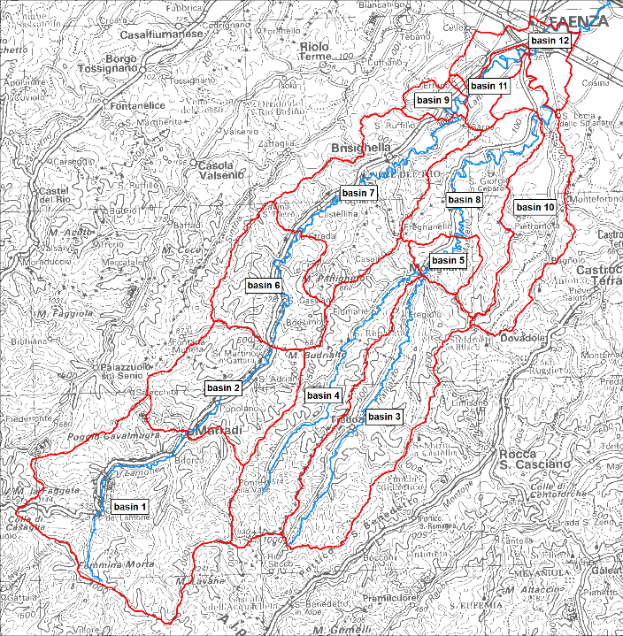
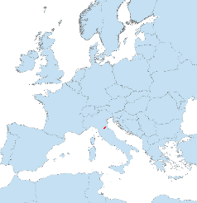
Case Study Area
Lamone River Basin (Italy)
Seasonal water flow and availability
Important agricultural area – kiwi and fruit production
Use of water retention ponds for irrigation needs
Traditional water retention ponds built in excavation, maximizing water storage with the minimum use of land.
Greener ponds to improve ecological functions are characterized by vegetation buffer, gentler side slopes, presence of floating islands.

Slide 5
Methods
Suitability analysis: to identify potential sites for new water retention ponds
Suitability Map based on feasibility criteria: linear distance from the river network, land cover type (agricultural land), terrain slope, shape and size of area
GI Network Connectivity: to assess existing network and most critical areas to improve connectivity and define ponds’ implementation scenario
Morphological Spatial Pattern Analysis and Integral Index of Connectivity.
GI Network elements considered: water retention ponds, Natura2000 sites, vegetated riparian zones
Water balance: to assess the effects of water retention ponds on water availability and river flow regime in present and climate change conditions with and without new ponds
Flow Duration Curves at sub-basin scale to estimate water availability, seasonal water exploitation index (sWEI+), days of no withdrawal. Summer season (May to September) and winter season (October to April).
Value and cost estimation to incentivize water retention ponds implementation
Value of new ponds for supporting agricultural yield and extra-cost estimation for greener ponds compared to traditional ponds construction costs. Interviews with farmers and experts.

Slide 6
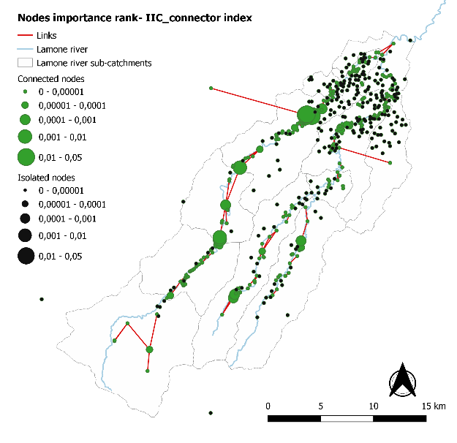
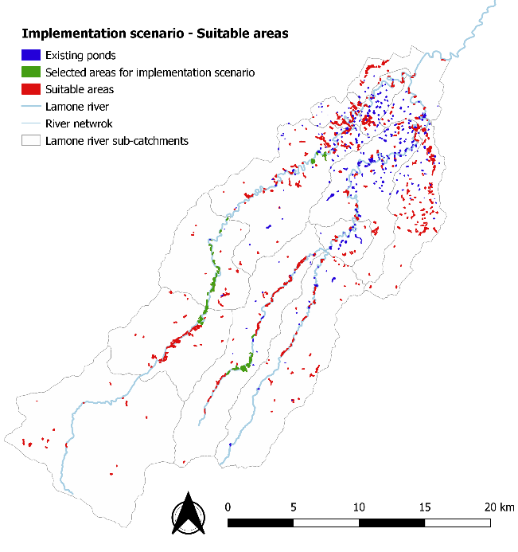
Connectivity &
Implementation scenario
Existing GI Network can be improved – overall low connectivity status
Rank of nodes with higher connector values that can facilitate connections improvement. These should be protected and restored
Suitable area for new nodes.
35 new ponds = 5.3 Mm³ of water (+40% of water volume)

Slide 7
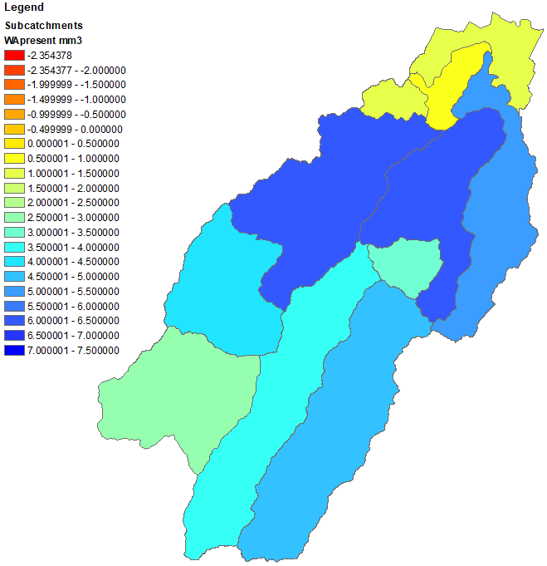
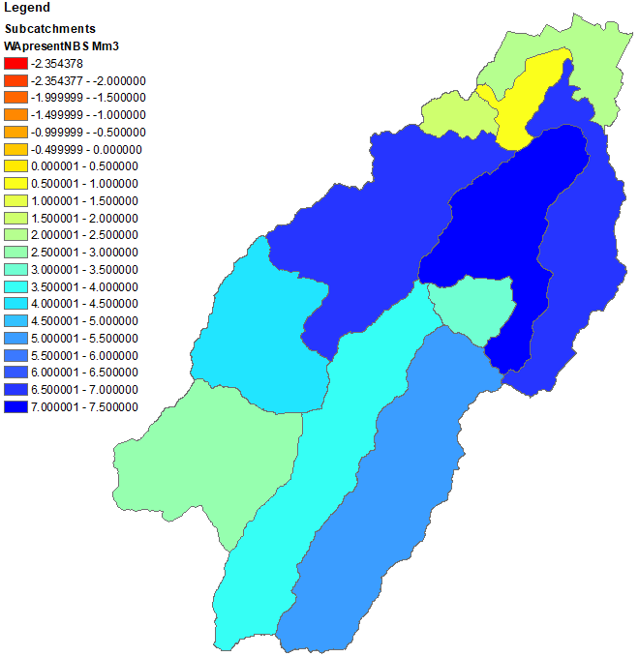
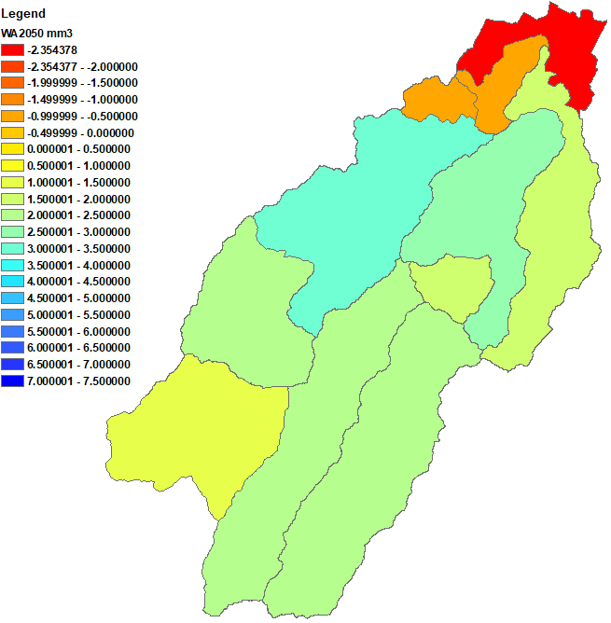
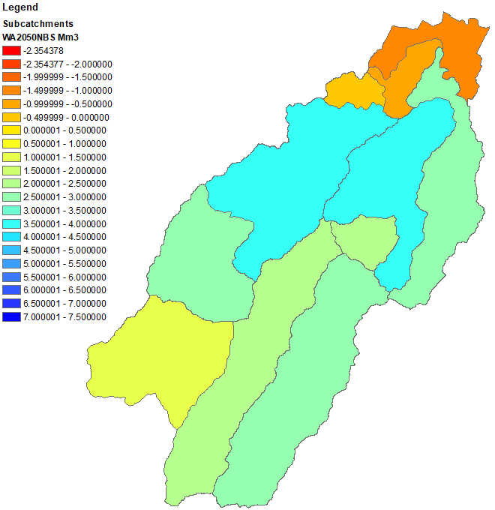
Water Balance
Water Availability in summer season
Present – without new ponds
Present – with new ponds
2050 – without new ponds
2050 – with new ponds
Appreciable improved variability of flows in summer when adopting new water retention ponds, especially in downstream basins, maintaining water in the river above the MEF (minimum environmental flow).
Other indexes show similar behaviour.

Slide 8
Value & Costs
Values and costs of ponds resulted for 1m3 of water
Value | 0.7-1.3 €/m³ | Extra revenues of kiwi production supported by ponds irrigation
Cost grey | 12 €/m³ | Construction cost for traditional ponds
Cost green | 14 €/m³ | Construction cost for green ponds
 | 0.03-0.05 €/m³/year* | Cost of loss production due to a reduction in crops area
*referred to a 50.000 m³ pond.
Co-benefits:
Increasing presence of vegetation and fauna around and within ponds
Ancillary social and economic activities (wood production, social and educational farms)
Barriers:
Higher space need
Mandatory fences installation for safety
Additional cost of vegetation maintenance, banks stability
Difficulties to access to funding support

Slide 9
Business model schemes
Incentive business models to compensate land and production lost due to construction or conversion of water retention ponds in a greener approach
Land swap (‘comunalie’)
compensation based on the corresponding to the farmers a share of publicly owned land or collectively produced crop yield from the common lands equivalent to the land lost.
In Lamone river basin, this scheme could compensate the construction of around 215 new ponds of 50.000 m³ of water volume.
Tradable Development Rights (TDR)
compensation based on rewarding farmers in monetary term converting the land lost in TDR. TDR represent a share of developable land rights to build.
In Lamone river basin, developable land TDR value around 30 €/m² and could compensate the construction of around 95 new ponds of 50.000m3 of water volume.

Slide 10
Conclusions
Water retention ponds showed a beneficial role in agricultural landscape, increasing water availability for agricultural production in a sustainable way.
GI Network is not well-connected and strategically-located ponds can facilitate connections, contributing positively to water balance and agricultural irrigation needs.
Water retention ponds provides additional co-benefits, both in social and environmental perspective, contributing to biodiversity and habitat quality.
However, greener ponds have additional costs for the farmers, both in term of construction and agricultural production loss.
Swap land and TDR schemes can support and compensate the extra-costs of a greener construction of ponds, providing social and economic benefits to the farmers and to the local community.

Slide 11
GECOsistema srl & Euro-Mediterranean Center on Climate Change
Funded by EC-JRC, Contract Number 937803 IPR 2019

