Slide 1
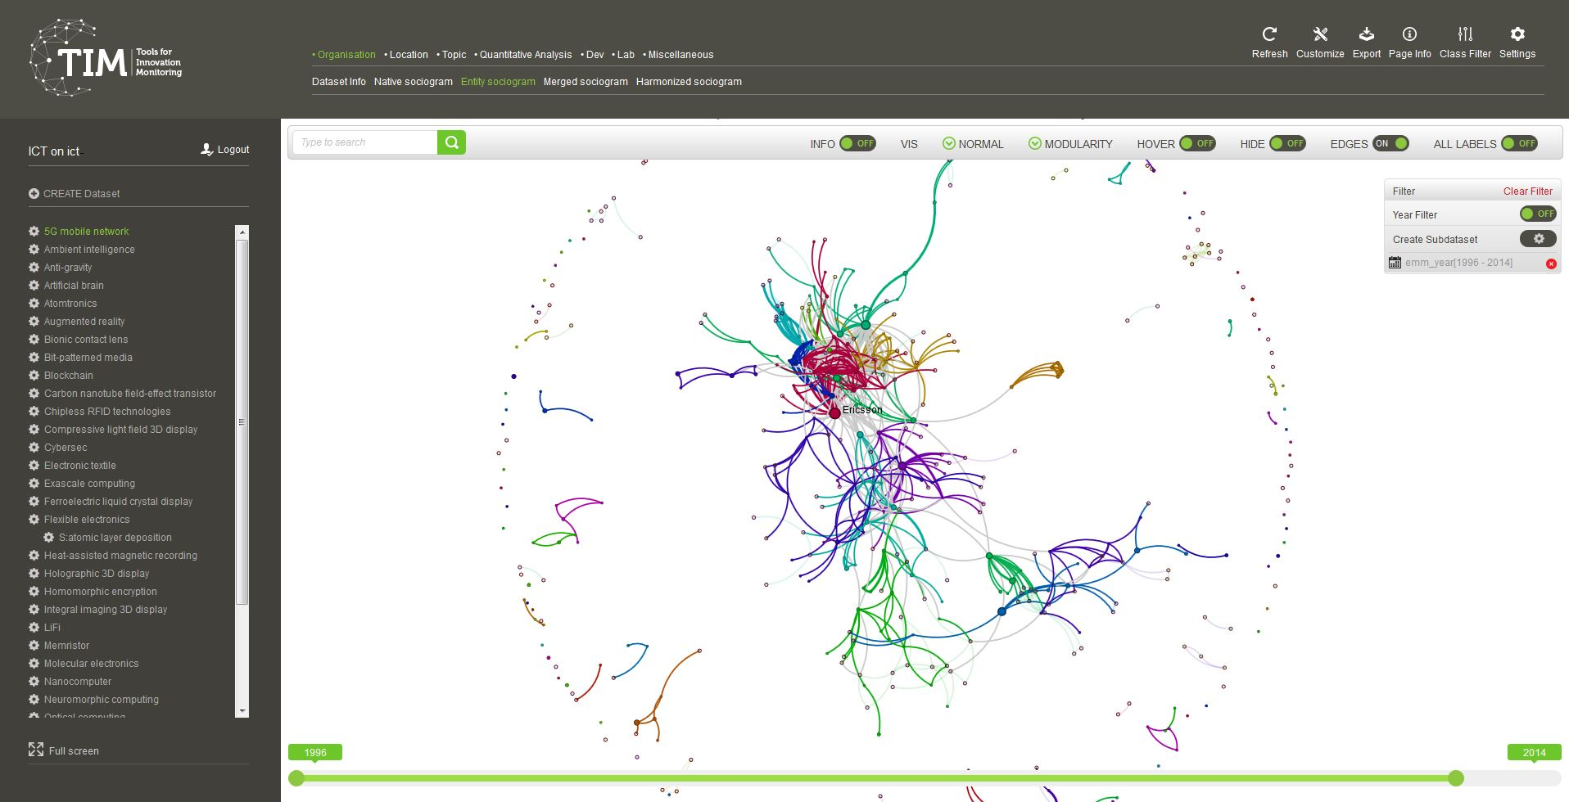
COVID-19 Open Research
Dataset (CORD-19)
Quick Start Guide
2. Create a new dataset
Define a search string to select the relevant documents from the CORD-19 dataset
4. Choose visualisation
Navigate through different types of graphs
https://www.timanalytics.eu/TimOpenAccess
Use Firefox or Chrome
Change your settings
Set a different background, straight edges or choose other available types of graphs
Search for a node in the graph
Filter your data
Manage your filters
1. Login (with EU login)
Change aspects of the graph
Modify parameters to change the visualisation
Full screen
Navigate in time
Move the selectors to adapt the view to different times frames
3. Browse your datasets
Select which dataset to visualise
jrc-tim-support@ec.europa.eu

Slide 2
Search
More than 52.000 publications on COVID-19 and coronavirus-related research (e.g. SARS, MERS, etc.) from the following sources:
PubMed's PMC open access corpus, using this query
Additional COVID-19 research articles from a corpus maintained by the WHO
bioRxiv and medRxiv pre-prints using the same query as PMC
Updated weekly
Fields
Used to choose in which field to search.
Find below the most used fields for CORD-19.
Searchable field | Description
title | Title of the article
description | Abstract of the article
text | Full text of the article (when available)
emm_year | Publication year of the article
emm_journal | Journal of publication
emm_autoKeywords | Automatic keywords generated by TIM
emm_doi | DOI of the article
guid | Unique TIM ID
emm_cord_uid | Unique CORD-19 ID
emm_affiliation__city | City of the organisation publishing
emm_affiliation__country | Country of the organisation publishing
emm_affiliation__countryCode | Country Code of the organisation publishing
emm_affiliation__name | Name of the organisation publishing
emm_author__name | Authors name
CREATE Dataset
To access CORD-19 select Type of Search: “Search on the CORD-19 dataset”
Define your search string
Use a combination of keywords (terms) in fields and link them with Boolean operators.
Use parentheses to structure your search.
Terms
These are the keywords you want to search for.
Use quotation marks for exact phrases like "infection rate".
You can introduce some flexibility with a proximity operator, ~ and the number of words apart the terms can be. For example: “disease impact“~2 allows for the terms to be 2 words apart and in a different order. Like for example in “the impact of the disease”.
Query examples:
description:((coronavirus OR "sars cov") AND chloroquine)
text: "malaria infection“~3 AND emm_year:[2018 TO 2019]
title:("covid 19" AND infection) AND emm_affiliation__country:spain
emm_affiliation__name:CNRS AND emm_year:2003
Operators
Use AND, OR, NOT to limit or include terms and fields.
Use TO and square brackets to delimit a range of a numerical value.

Slide 3
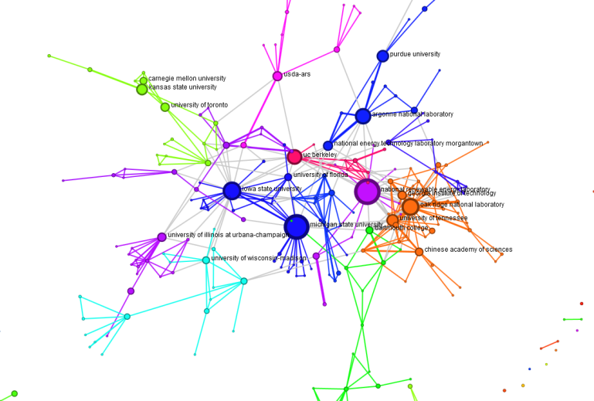
Explore
Network analysis
Navigate transversally through the data
Organisations: See the organisations that are publishing and the collaborations between them.
Location: See where those entities are located. Cities, NUTS regions, countries, Europe vs rest of the world, only EU countries.
Topics: Analyse the automatic keywords retrieved by TIM (field emm_autoKeywords).
+ see by years, types of documents and more…
Other visualisations and data
Geographical, Analytical Charts, Excel exports
How to interpret a network graph
Node Size:
Number of documents retrieved for an organisation, location, topic or other.
Edges (lines between two nodes):
Co-occurrence in the same document(s): edge thickness relative to number of documents in common
Colours:
Communities of nodes that tend to appear more together than with the others
Filtering
Double-click on a node from any network graph to filter for specific publications. The filter stays active when moving to another view.
Access documents
Use the documents page to get access to documents behind the trends. Read the abstract and access the publications by clicking on their title.
For more information: www.timanalytics.eu
or send an email to jrc-tim-support@ec.europa.eu
More information on the CORD-19 dataset: https://pages.semanticscholar.org/coronavirus-research

