Slide 1


PROJECT PRESENTATION
October 2020
LOT 3 TREATMENT OF WASTEWATER SLUDGE OR MANURE FROM LIVESTOCK (TSM) IN A MEDITERRANEAN ENVIRONMENT
Anja Potokar
Alenka Fajs
October 2020

Slide 2
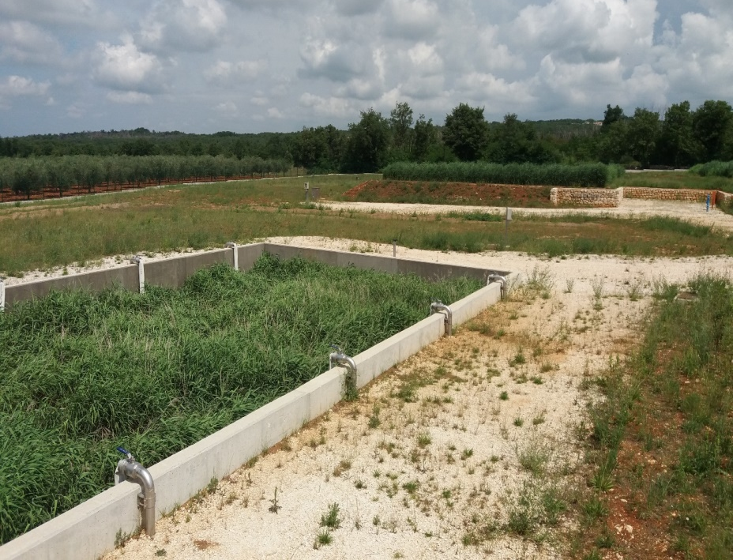
Project data
Contracting authority
European commission, Joint Research Centre
Contractor
Limnos Company for applied ecology Ltd.
Project duration
19.07.2019-30.04.2020
Project value
29.500 €

Slide 3
STUDY AREA
Notes:
What are the wastewater pressures

Slide 4
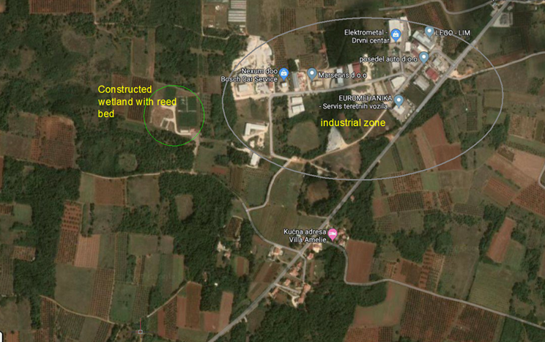
Problem description
Sludge disposal problems (the central WWTP refused to accept sludge, no incineration plant in Croatia) were the key drivers of search for alternative sludge treatment solutions in the Municipality of Kastelir - Labinci
SLUDGE DRYING REED BEDS (RBs)
RBs implemented in 2016, as part of the project for the protection of pollution in the coastal area: sewage network with the establishment of a constructed wetland (CW) for wastewater treatment along with reed beds (RBs) for sludge treatment.

Slide 5
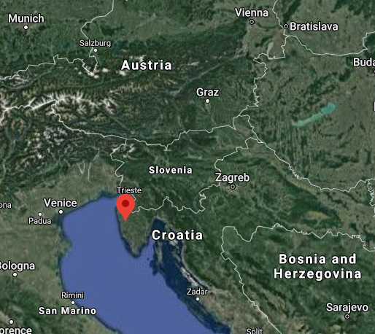
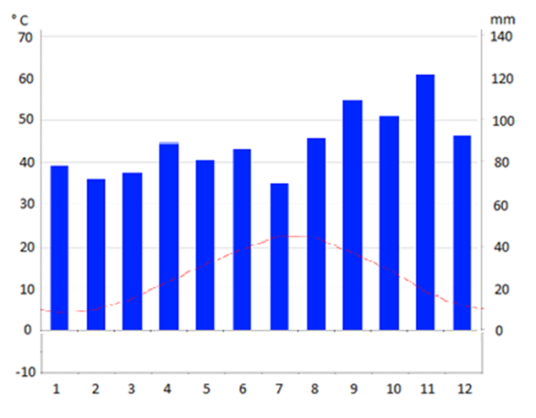
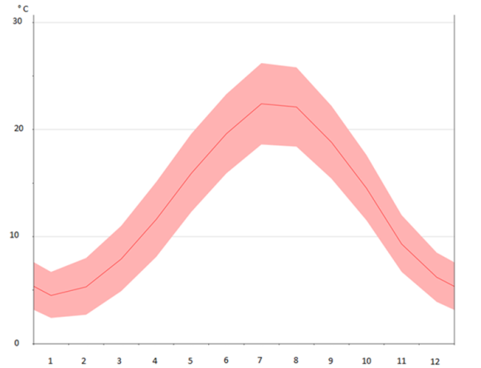
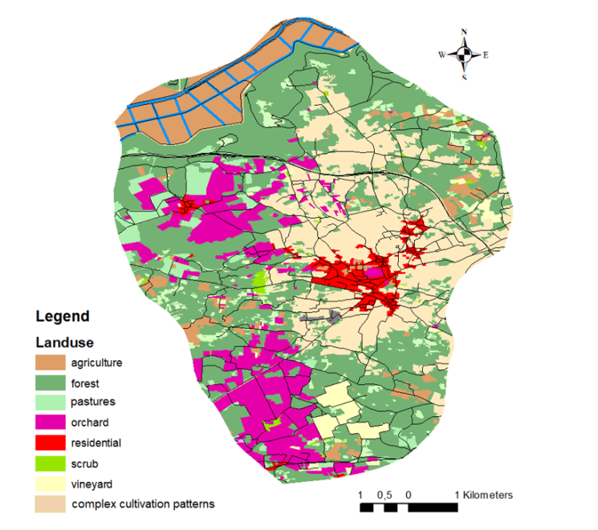
Site location and characteristics
Mediterranean Biogeographical region
Climate and temperature graph of Kastelir during the year
(Source: https://en.climate-data.org/europe/croatia/kastelir/kastelir-228118/
(Source: Google map. Satellite view.)
Land use for Kastelir- Labinci Municipality
Kastelir-Labinci, Croatia
Altitude 220 m
The Istrian peninsula - Mirna River
Average temperature: 13,2 °C
Average precipitation: 1.070 mm
(Source: https://www.kastelir-labinci.hr/hr/dokumenti/sve/sve/Dokumenti%20i%20Akti)

Slide 6
TECHNOLOGY PRESENTATION
Sludge treatment in Kastelir, Croatia
Notes:
What are the wastewater pressures

Slide 7
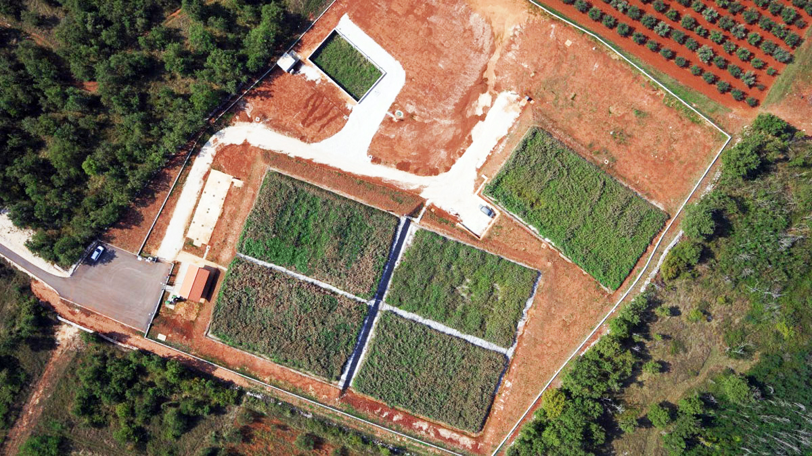
WWTP Kastelir
Groups of units | Units | Process
Primary treatment wastewater | Automatic coarse screens and grit removal, Imhoff tank | Mechanical treatment Anaerobic stabilization of sludge Water/sludge separation
Wastewater treatment | Constructed wetland (5 beds) | Biological nitrification and denitrification
Sludge treatment | Reed bed | Sludge dewatering, mineralization and stabilization
Sludge drying reed bed
Constructed wetland
Aerial shot of WWTP Kastelir
(Source: Limnos Ltd.)

Slide 8
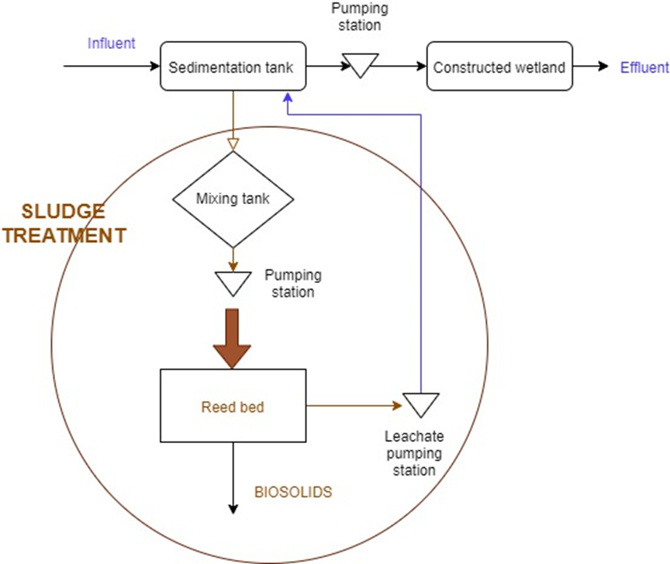
Sludge drying reed beds (RB) Kastelir
Three beds were projected to be built, but only one bed has been constructed so far. The remaining two beds will be built later, once the load of the WWTP increases to the designed load and the first bed fills up.
Dimensions of reed bed system
Reed bed | Width [m] | Length [m] | Area [m²]
RB 1 | 12 | 20 | 240
RB 2 | 12 | 20 | 240
RB 3 | 12 | 20 | 240
The system of RBs comprises:
a sludge mixing tank;
pumping station for sludge distribution onto reed bed;
sludge drying reed bed with a surface area of 240 m2 each;
drained water pumping station to return drained water from RB back to WWTP.
Flowchart diagram of operating sludge treatment in Kastelir
(Source: Limnos Ltd.)

Slide 9
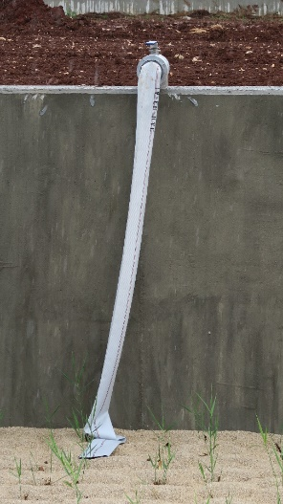
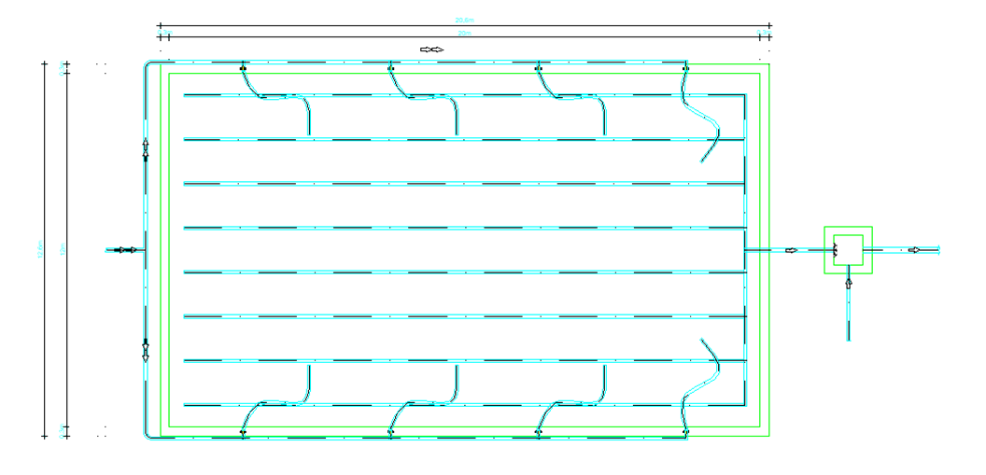
Sludge drying reed beds (RB) Kastelir
Floor plan of RB in Kastelir (Detailed design, 2016)
(Source: Final project design, 2016)
Sludge distribution pipe
(Source: LIMNOS Ltd.)

Slide 10
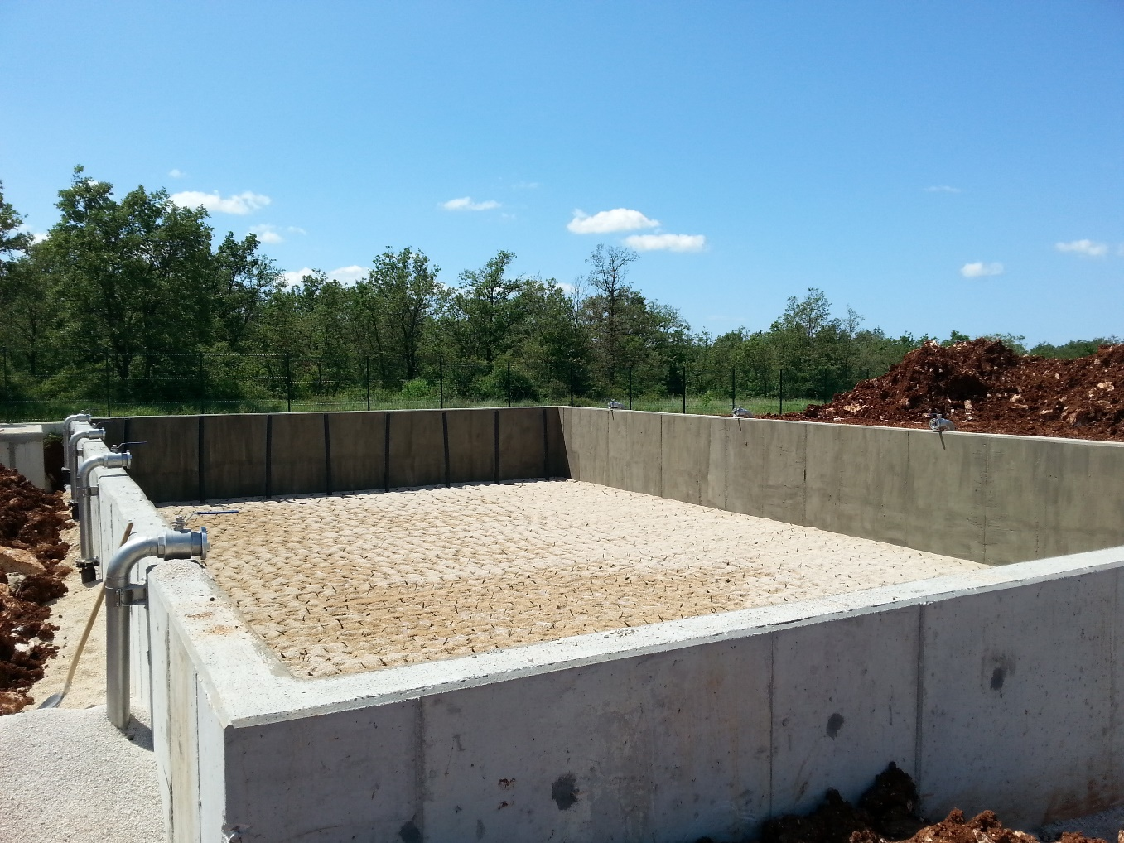
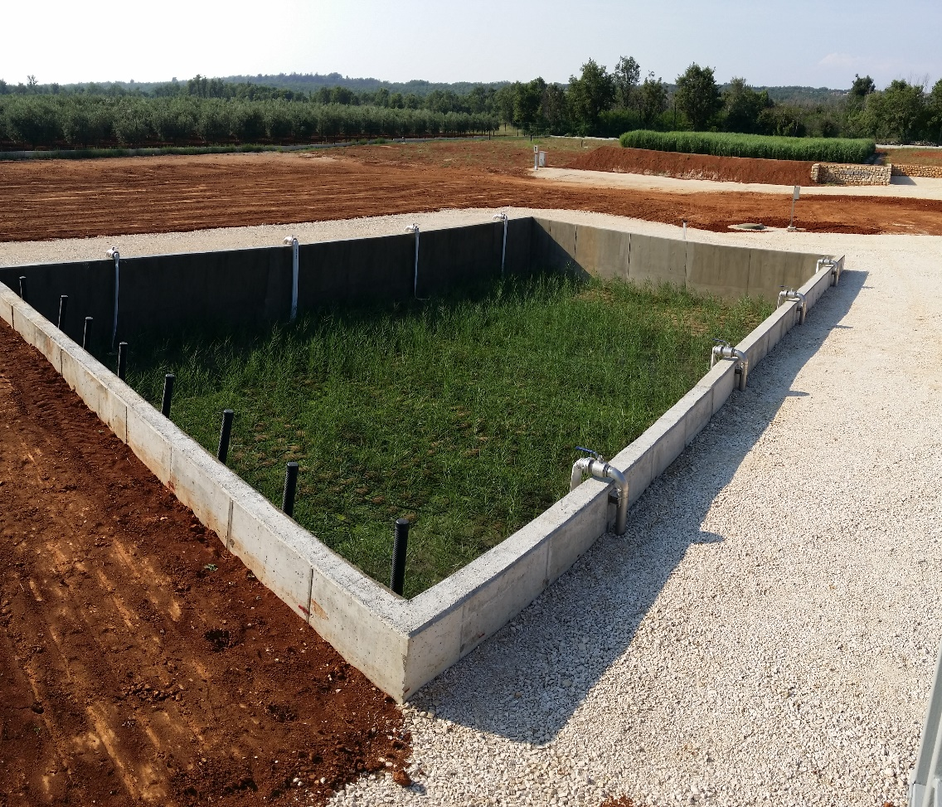
Sludge drying reed beds (RB) Kastelir
Reed bed after planting of common reed in May 2016
(Source: LIMNOS Ltd.)
Reed bed in July 2016
(Source: LIMNOS Ltd.)

Slide 11
Design and process parameters
DESIGN PARAMETRS
RBs capacity: 1.900 PE
Daily flow= 285 m³/day
Wastewater characteristics:
  Urban wastewater
  Typical wastewater
Sludge characteristics before treatment:
  Sludge type: primary sludge from Imhoff tank
  Mostly anaerobic sludge
  Mechanical properties of sludge: fluid sludge
  Dry matter content: 2-5 %
The maximum calculated loading rate is 80 kg TSS/m² y.
Usual loading:
  During summer (touristic season): every two months;
  Rest of the year: every three months.
PROCESS PARAMETRS

Slide 12
Requirments for sludge reuse in Croatia
Limit values for heavy metals
Heavy metals | Allowed heavy metal content in mg/kg of dry matter of representative sludge sample
Zn | 2000
Cu | 600
Cr | 500
Pb | 500
Ni | 80
Cd | 5
Hg | 5
Limit values for heavy metal content of treated sludge used in agriculture
Heavy metals | Allowed heavy metal content in soil in mg/kg of dry matter of representative soil sample
soil pH in 1 M KCl solution | 5,0 | 5,5 | pH>6,5
Zn | 100 | 150 | 200
Cu | 40 | 50 | 100
Cr | 50 | 75 | 100
Pb | 50 | 70 | 100
Ni | 30 | 50 | 70
Cd | 0,5 | 1 | 1,5
Hg | 0,2 | 0,5 | 1
Limit values for heavy metals in soil to which sludge is applied and used in agriculture
(Source: Official Gazette of Croatia, No 38/08)

Slide 13
Requirements for sludge reuse in Kastelir
Limit values for organic compounds in sludge
Organic matters in sludge | Allowed concentrations organic matters in sludge
Polychlorinated biphenyls (PCBs): | In mg/kg of dry matter of sludge
2,4,4’- trichlorobiphenyl | 0,2
2,2’,5,5’- tetrachlorobiphenyl | 0,2
2,2’,4,5,5’- pentachlorobiphenyl | 0,2
2,2’,3,4,5,5’- hexachlorobiphenyl | 0,2
2,2’,3,4,4’,5,5’- heptachlorobiphenyl | 0,2
Polychlorinated dibenzodioxins / dibenzofurans (PCDD/PCDF) | 100 ng TCDD equivalent* per kg of dry matter of sludge
*TCDD equivalent is the sum of the multiplication of the content of individual polychlorinated dibenzodioxins / dibenzofuran expressed in ng / kg and factors.
Limit values for pathogens in sludge
Treated sludge intended for agriculture use needs to be stabilized in such a way that pathogenic organisms, potential causes of diseases, are removed.
Maximum annual load of dry matter in agriculture
A maximum of 1,66 tons of sludge dry matter per hectare of agricultural land is allowed to be used per year.
(Source: Official Gazette of Croatia, No 38/08)

Slide 14
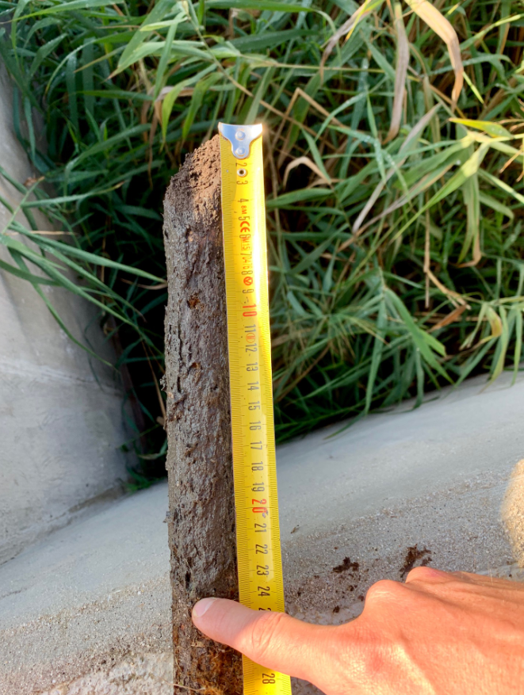
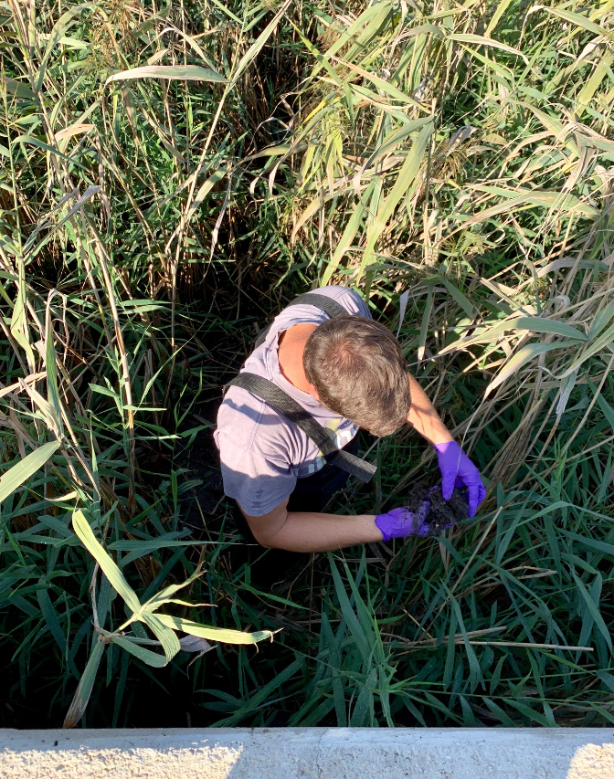
Visual examination (October 2019)
Sludge height
24 cm
Sludge distribution
Uniform, no signs of filter clogging
Sludge height.
Plant growth
(Source:Limnos Ltd.).
Plants in Kastelir are around 2 m high. They are not harvested.
Odor
No odor problems.
Common reed height.
(Source:Limnos Ltd.).

Slide 15
TECHNOLOGY PRESENTATION
Sludge drying reed beds in Sant Boi de Lluçanès, Catalonia, Spain
Notes:
What are the wastewater pressures

Slide 16
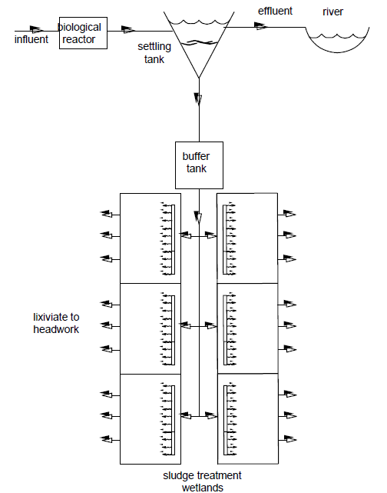
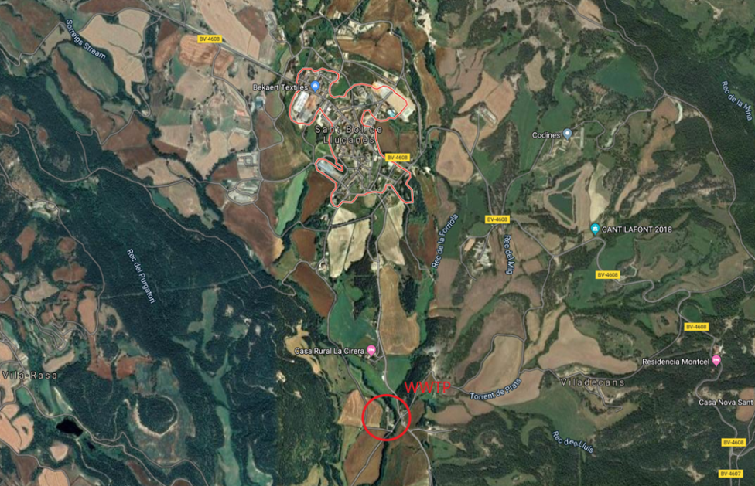
WWTP Sant Boi de Lluçanès, Catalonian, Spain
Primary treatment: screening line;
Biological treatment: two activated sludge aeration tanks, for nitrification and denitrification;
Sludge line and treatment: sludge from the aeration tanks, where the flocks of microorganisms settle down is indistinctly loaded to the reed beds.
WWTP capacity: 1.500 PE
Start of operation: 2006
Location of WWTP Sant Boi de Lluçanès, Catalonian, Spain
Schematic diagram of a sludge treatment for the treatment of activated sludge
(Source:Google map)
(Source: E. Uggetti. Sewage sludge treatment in constructed wetland)

Slide 17
Sludge drying reed beds in Sant Boi de Lluçanès
Implemented six beds
Main characteristics of RBs in Sant Boi de Lluçanès
Number of wetlands | 6
Total surface area (m²) | 324
Bed surface area (m²) | 54
Nominal height for sludge accumulation (m) | 0,65
Total height (m) | 1,5*
Total nominal volume for sludge accumulation (m³) | 210
Sludge loading rate (kg TS/m2·year) | 51
Loading pattern | 2 min every 4 h
* Height of filter layer + height for sludge depositing and freeboard
Operation
Reed beds in Sant Boi de Lluçanès
Sludge loading:
Every two days loading
After loading ten resting days
(Source: E. Uggetti. Sewage sludge treatment in constructed wetland.)
Visual examination
Sludge height
Sludge height (m)
2007 | ¼ of 2008 | ½ of 2008
30 | 30 | 15

Slide 18
EFFICIENCY
In Mediterranean Region
Notes:
What are the wastewater pressures

Slide 19
Efficiency (intermediate results)
HEAVY METALS
Analysis of sludge in Kastelir (Croatia) and Sant Boi de Lluçanès (Spain) showed that heavy metals in sludge are within allowed limits for biosolids use in agriculture. The results are in line with several other studies.
NUTRIENTS
In Kastelir, total nitrogen varies from 3,5 to 3,7% of the mass. Total phosphorous varies from 1,2 and 1,3% of mass. In Sant Boi de Lluçanès total Kjeldahl nitrogen was 3,08 to 3,48% TS on surface and 2,13 to 2,67% TS on the bottom. The total phosphorous was 0,04% on the surface and 0,10 % on the bottom.
The results of nutrients suggest that the final product from the treatment may be used as a fertilizer.
DRY MATTER
In Kastelir, dry matter is 23% while in Sant Boi de Lluçanès is between 20 and 30% at the bottom layer (a maxium content reached on RBs is 40%).
TOTAL VOLATILE SOLIDS
In Kastelir TVS are 63-64% and in Sant Boi de Lluçanès are 36-45% (surface) and 32-39% (bottom).
PATHOGENS
In Kastelir and Sant Boi de Lluçanès Salmonella spp. was present, but in very small numbers. Escherichia coli in Kastelir was 5.500 to 6.200 CFU/g, while in Sant Boi de Lluçanès a much smaller value 1.100 MPN/g (on the surface) and >2400 MPN/g (on bottom) was measured. The pathogen removal is expected during the final resting period (at least log 5 should be achieved).

Slide 20
Efficiency (intermediate results)
MICROPOLLUTANTS
Analysis showed which compunds accumulated or degraded in time;
The number and type of detected compounds are in line with what is found elsewhere in Europe;
There is not much known about the occurrence and fate of organc micropollutants during treatment of sludge with reed beds;
More samples and a complete mass balance would be needed to confirm the exact processes occurring in the sludge drying reed beds for these type of compounds;
The apparent accumulation of few pharmaceuticals (ciprofloxacin, citalopram, oxazepam), one transformation product (BaQD 1-(2-benzoic acid)-(1H,3H)-quinazoline-2,4-dione) and two pesticides (terbutryn, tebuconazole) may be due to resistance of these compounds to treatment coupled with dehydration process. Nevertheles, the application of fresh sludge might also be responsible by this apparent accumulation.
The potential degradation of compounds in time seems to occur to more compounds than the accumulation. Lower content was detected for pharmaceuticals (clarithromycin, clindamycin, sulfamethizole, trimethoprim, atenolol, metoprolol, sotalol, diclofenac, tramadol, venlafaxine, iomeprol, olmesartan, valsartan, irbesartan, eprosartan, losartan, mycophenolic acid, benzotriazole, gabapentin) and pesticides (carbendazim, pirimicarb, 16-BAC). This could be the result of biodegradation on sludge drying reed beds, but cannot be confirmed within the limited scope of the present assessment.
PFAS concentrations were lower than what is normally measured in sludge.
Wang et al. reported that sludge stabilization time and reed are an important factor influencing the removal efficiency of antibiotics in sludge drying reed beds. Plant roots provide growth and reproduction interface for microorganism with antibiotic degradation ability, and indirectly promote the sludge dry reed bed to remove antibiotics. After three years of loading and one year of stabilization period, roxithromycin content reduced for 81%. Roxithromycin was absent in sludge from reed beds in Kastelir, but this can just be due to different usages in different countries.
The compounds measured in high concentrations (>100 ng/g) were cationic surfactant benzalkonium chloride and some pharmaceuticals such as azithromycin, ibuprofen and valsartan.

Slide 21
COST ANALYSIS
Notes:
What are the wastewater pressures

Slide 22
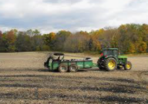
Investment costs
Total construction costs = 262.626 €
CAPEX of RBs:
138 €/PE for construction costs
WWTP Kastelir
(CW + RB)
100% funded by GEF (Global Environment Facility) grant.
Land was free of charge and owned by the Municipality.
It must be emphasized here that investment costs in RB Kastelir were higher because works required mechanical excavation and mining of the hard rock. The cost of investment is higher than costs of comparable investments (two reed beds in Mojkovac (2.500 PE) were 55 €/PE for 900 m²; one reed bed in Kastelir (1.900 PE) was 138 €/PE for 240 m²).
Operation and maintenance (O&M) costs
Cost categories: labor, electricity consumption, monitoring, maintenance and final disposal.
SLUDGE FINAL DISPOSAL
Cost analysis considers biosolids use.
Other options (e.g. incineration) in Istria County are not feasible at the moment.
(Source:Cityofshelby.com)
biosolids reuse
OPEX of RBs:
1,9 €/PE/year without final disposal
2,1 €/PE/year with biosolids reuse.

Slide 23
Water tariff
Required water tariff to cover operation and maintenance of RBs
Option | Water tariff for O&M (€/m³) | % of existing wastewater tariff (1,42 EUR/m³)
Reed beds + biosolids reuse | 0,08 | 6%
Investment = GRANT (100% donation)
Tariff covers NPV (68.897 €/30 years).
Required water tariff rates to cover investment costs through loan and operation costs of RBs
Option | Water tariff for loan and O&M (€/m³) | % of existing wastewater tariff (1,42 EUR/m³)
Reed beds + biosolids reuse | 0,26 | 18%
Investment = LOAN (30 years; fixed intrest rate 0,7%)
Tariff covers NPV (388.807 €/30 years).
The calculated average tariffs take into account future stream of costs and convert them into equivalent values today.
It must be noted that the tariff needed during 1st year of operation is higher as one needed in the last year of operation due to modelled net costs for each of the future years. This is done by discounting costs using an appropriate real discount rate.
Existing wastewater tariff (1,42 €/m3) is affordable The share of expected income spent on water bill is less than 3 % of average disposable household income (7.262 € per year)
However, water is not affordable for people living below the “at-risk-poverty threshold“ The at-risk-of-poverty threshold for a household consisting of two adults and two children younger than 14 was 8.280 € per year

Slide 24
Net present value (NPV)
Different scenarios of accumulated sludge in Imhoff tank (1.900 PE)
% of dry matter content | Accumulate sludge (m³/Y) | Estimated costs (€/Y)
2 | 942 | 9.440
3 | 628 | 6.320
4 | 471 | 4.720
5 | 377 | 3.760
NPV takes into account:
The average economic life is 30 years;
Initial investment costs;
Operational and maintenance costs;
The real discount rate applied is 4%.
Comparison of different sludge handling scenarios
Sludge treatment + disposal | NPV O&M | NPV Investment | NPV Total | Ranking
Reed beds + biosolids use | -68.897 | -262.626 | -388.807 | 2
*Sludge pumping and transport to the central WWTP (3% dry content) |  |  | -109.286 | 1
*The costs don’t include costs of sludge treatment and handling on central WWTP
Sludge transfer to central WWTP was not a feasible option at that time. The quest for a sustainable solution was imminent. Only feasible alternative options should be adequately considered in the feasibility analysis.
Ranking options by NPV showed that sludge transfer to central WWTP would be a cheaper option.

Slide 25
Factors impacting decision-making process
In the decision-making process, the financial criteria impacting selection of reed beds for treatment of sludge from small WWTP (below 2.000 PE) over other options (transport of the sludge to the central WWTP) are:
WWTP capacity – impacting sludge volume;
Technology – affecting sludge volume, sludge characteristics and sludge storage capacity;
Distance (km) and topography from small WWTP to the centralized WWTP - impacting the costs of transport;
Vehicle ownership (does public utility owns vehicles and also use them for other services or has to order a service for sludge pumping);
WWTP ownership – if both small and central WWTP falls under the same public service, the in-house costs are usually cheaper than external costs charged to a client from another municipality.
Costs of transportation and other fees;
CAPEX and OPEX of sludge treatment;
Potential revenues derived from biosolids use.
At the moment O&M costs of public utility for the whole WWTP (not only RB) with sewerage system are much lower (3.600 €/Y) than estimated O&M costs for RB (3.984 €/Y) because this study also takes into the account labor costs, replacement cost and biosolids reuse. Public utility is not having this kind of cost at the moment.

Slide 26
DIRECT AND INDIRECT BENEFITS
Notes:
What are the wastewater pressures

Slide 27
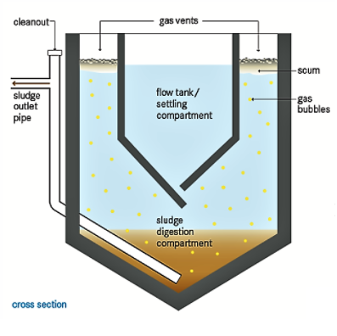
Direct benefits
Reducing sludge volume, pollutants and costs.
Reduced sludge volume
RBs → 18.850 TSS kg/Y → 40 % into CO₂ through microbiological activity,
11.310 TSS kg/Y remains on the reed bed.
Municipality of Kastelir - Labinci reduced sludge volume for more than 90%.
Changes in operation
No longer a need to pump the sludge out of the Imhoff tank and transfer it to the central WWTP for further treatment (at least five times per year)
The avoided costs of sludge transported in slurry tankers = 6.320 €/Y.
Considering how much public utility spends for O&M activities of the whole system consisting of CW and RB (3.600 €/Y), the estimated costs of collection and transfer (6.320 €/Y) to the central WWTP are considered to be significant.
(Source: TILLEY et al. (2014))

Slide 28
Indirect benefits
WWTP Kastelir was needed to protect public health and to prevent contamination of water sources → Protection of coastal sensitive karst area!
Tourism growth → preserved environment is a basis for sustainable tourism development.
Lower O&M costs: low cost technology.
Landscape attractiveness: WWTP Kastelir is aesthetically pleasing – it merges harmoniously with surrounding green areas (vineyards, olive groves).
Green space: biodiversity and ecosystem services.
Avoided sludge transfers to central WWTP reduced local traffic, noise stress, air pollution, and gas emissions.
Pilot case in Kastelir became a well-known example of NBS combining wastewater and sludge treatment: Regionally Important site for education and promotion of NBS!
Possible reuse of biosolids: RB will produce 469 tons of biosolids (40% dry matter) per operating cycle which could be applied to 113 ha of agricultural land (1,6 tons of sludge dry matter per hectare) → RB can supply 25% of vineyards in the municipality with soil amendment every 10 years (low impact).
WWTP enables safe reclamation of treated WW to mitigate water scarcity during the summer months: Reclaimed water could be potentially used for irrigation up to 83 ha of olive trees during vegetation season. Even though the WWTP has been in operation since 2016, the use of reclaimed wastewater has never been practiced by local farmers (controversy around wastewater and biosolids reuse). Even though the costs of freshwater for irrigation (41.000 €) are much higher compared to 0&M costs of WWTP (2.100 €).

Slide 29
IMPLEMENTATION CHALLENGES
Notes:
What are the wastewater pressures

Slide 30
Innovative technology
Challenge: The first-ever constructed NBS for sludge treatment in Croatia.
What action was needed:
Technology presentation by the RB expert.
Organization of the field visit abroad for local and national authorities.
DECISION-MAKERS NEEDED TO BE CONVINCED.
Challenge: NBS technologies require expert knowledge and specialization.
What action was needed?
Inclusion of NBS expert in the project (collaboration with Slovenian experts – a foreign company with experience with the design of RBs);
Collaboration of engineers of various disciplines (civil engineer, RB process design engineer, mechanical engineer, electrical engineer, etc.);
Cooperation between the designer and the construction contractor during final design preparation.
KNOW-HOW TRANSFER
Slovenia
Croatia

Slide 31
Seasonal variation in RB
Challenge: Kastelir is a tourist village characterized by seasonal load.
What action was needed?
Analyses of pollution and hydraulic loadings;
Impact assessment on the RB operation;
Multi-year load proposal and operational plan.
The loading pattern in Kastelir takes into account:
Volume of accumulated sludge in Imhoff tank;
Time required for anaerobic stabilization of sludge;
Seasonal variation;
Weather / climate.
Financing and funding
The project was fully funded through a grant agreement by the Global Environment Facility (GEF).
What action was needed?
Willingness of Municipality to cooperate with project initiator;
Coordination on multiple levels of government;
Perform administrative processes on time.
Kastelir was one of the areas to be addressed among the priority pollution hotspot sites, as identified by UNEP-MAP in 2003 and then confirmed by the World Bank study in 2011.
Top-down approach
Ministry's initiative
Croatian Waters
Municipality

Slide 32
Construction
Challenge: To prevent poor construction
The largest construction company at that time (Viadukt d.d.) led the construction of RBs
Inclusion of technological supervision
RB was constructed well
Commissioning, operation and maintenance
Challenge: To prevent poor maintenance and operation
What action was needed:
Commissioning at the presence of key stakeholders (investor , WWTP owner, WWTP operator) and project consortium team (incl. lead process engineer);
Elaboration and discussion of O&M manual;
Transfer of key messages - poor maintenance and operation can result in poor performance of the system.
Important stakeholders:
Municipality
Operator

Slide 33
Future challenges
Challenge: Biosolids use in agriculture
National legislation allows the use of biosolids in agriculture since 2008
In 2019 Ministry for agriculture accepted another Rulebook that doesn`t allow the use of sludge on food production crops
Rulebook on the management of sludge from wastewater treatment plants when sludge is used in agriculture (Official Gazette of Croatia, No. 38/08)
Both regulations exclude each other.
Rulebook on the protection of agricultural land from pollution (Official Gazette of Croatia, No. 71/2019
What action is needed?
Cross-sectoral discussion on the Regional level;
Elaboration of municipal sludge strategy document or feasibility study based on national strategies but taking into account local conditions;
Elaboration of Guidelines for sewage sludge use.
Challenge: Other final disposals
If the Municipality of Kastelir will not be able to use biosolids in agriculture, other options are very limited by the legislation, permitting processes, existing infrastructure for sludge management, and karst terrain.
For now, the material cannot be incinerated because there is no incineration plant in Istria County or in whole Croatia that would accept dewatered sludge
Revitalization of quarries or other degraded areas, sanitation of erosion, greening, construction, etc.
What action is needed:
Cross-sectoral collaboration on the Regional level;
Environmental and economic assessment of feasible options;
Establishment of pilot cases;
Monitoring.

Slide 34
Lessons learnes
RBs can prolong the lifetime of the CW because of irregular sludge pumping.
RB technology can be designed as modular. Implementation can be planned in a series of phases, according to need. In Kastelir, three reed beds were designed, but so far, only one was constructed.
RB technology can be transferred and adapted to different climate conditions. Our pilot case is a first-ever constructed RB system in Croatia and adapted to the Mediterranean climate. Most of the adaptation is related to the operation, which also impacts design.
RBs work well under seasonal loading variations and are thus appropriate solution for touristic areas
Along the Mediterranean coastline, RBs implementation is limited by the availability and high prices of land. Nevertheless, this case showed that RBs could be implemented in inland regions of coastline where land is cheaper or owned by the Municipality.

Slide 35
BUSINESS MODEL
Notes:
What are the wastewater pressures

Slide 36
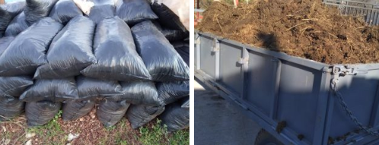
BM1: Contractual partnership (municipality/operator – business entity)
Business entity signs a contractual agreement with the Municipality of Kastelir-Labinci to collect biosolids at the WWTP site and transport them to the storage site from where distribution or sale of biosolids products is permitted.
Provider of biosolids charges a business entity collection fee for biosolids in EUR/ton.
Business can be profitable with revenue earned from the biosolids selling to end-customers.
Key actors:
  Biosolids provider: Municipality or public utility
  Biosolids buyer: Business entity
  End-user: Farmers
Cost recovery price (covers excavation costs) = 10,43 €/ton of biosolids
Potential earnings (collection fee: 20 EUR/ton) = 4.488 EUR/operating cycle
Competitors
Biosolids compete with animal manure and mineral fertilizers. Fertilizer prices in Croatia are:
• 140 €/ton for animal manure (sold by farmers);
• 337 €/ton for mineral fertilizer (sold in stores).
(Source: www. https://www.seljak.me/kategorija/dubrivo/)

Slide 37
BM 2: Local-public partnership (municipality-operator-farmer truck)
Plant operator, public utility MARTINELA Ltd, is contracted by the Municipality of Kastelir-Labinci to implement biosolids use in the Municipality.
This might require the plant operator to enter the strategic partnership with community-based organizations to reach end-costumers.
Community mobilization and campaigns can help to sell and use biosolids.
The biosolids can become the income source for the biosolids provider.
Key actors:
Biosolids provider: Municipality and Public utility
Biosolids buyers are also end-users: Farmers
Cost recovery price = 10,43 €/ton of biosolids
Potential earnings (collection fee: 40 EUR/ton) = 13.872 €/operating cycle
  The forecasting of a price for biosolids is difficult as there is no regional experience with biosolids reuse in terms of what price the farmers are willing to pay. It is reasonable to expect a reduced price.

Slide 38
BM 3: Subsidizing biosolids use
Biosolids use application requires incentives.
A strategy with subsidies payable to consumers for biosolids could be one of the mechanisms to stimulate biosolids use among farmers.
Reasonable subsidies could reduce O&M costs for the final disposal of biosolids.
The model is dependent on government support.
Key actors:
Subsidies provider: Municipality
Subsidy receivers: Farmers
Potential cost savings = 11.261 €/operating cycle
Explanation of potential cost saving:
We used the assumption that final disposal costs for sludge in Kastelir are 14.076 € (30 €/ton), while excavation costs (4.896 €) and subsidizing the use of biosolids at 6 €/ton (2.815 €) would together amount to 7.711 €.
BM 3: Biosolids free of charge
Municipality of Kastelir-Labinci may decide to give biosolids free of charge in compliance with valid conditions, standards, regulations, and legislation.
Biosolids give away would reduce O&M costs for the final disposal of biosolids.

Slide 39
Business model conclusions
Biosolids
create
Revenue
Local-public partnership is the most profitable BM and also the most feasible model to create revenue;
Biosolids free of charge or subsidizing biosolids use does not make revenue, but reduce costs for final disposal;
Farmers from Kastelir are not yet considering wastewater or biosolids use as an option. The biosolids land application initiative would require a long-term effort of multiple levels and allocation of financial resources;
Biosolids can compare in cost with commercial fertilizer under the assumption that municipality bears the cost of biosolids production (CAPEX and OPEX of sludge treatment with RB technology);
All presented business models can reduce O&M costs because biosolids land application is a cheaper option than other final disposal options;
In order to safely apply biosolids to land, BM should be built around the health issues. The monitoring and supervision should support rules governing biosolids use;
The process of establishment of BM in Municipality of Kastelir-Labinci would require the initiative, development and operational team, and involvement of various stakeholders.

