Slide 1
PROJECT PRESENTATION
October 2020
LOT 1 TREATMENT OF WASTEWATER SLUDGE OR MANURE FROM LIVESTOCK (TSM) IN A NORDIC OR ALPINE ENVIRONMENT
Anja Potokar
Alenka Fajs
October 2020

Slide 2
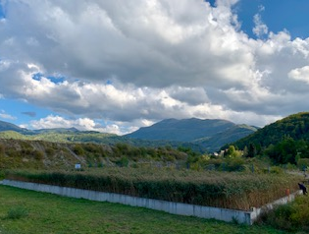
Project data
Contracting authority
European commission, Joint Research Centre
Contractor
Limnos Podjetje za aplikativno ekologijo d.o.o.
Project duration
19.07.2019-19.04.2020
Project value
29.500 €

Slide 3
STUDY AREA
Notes:
What are the wastewater pressures

Slide 4
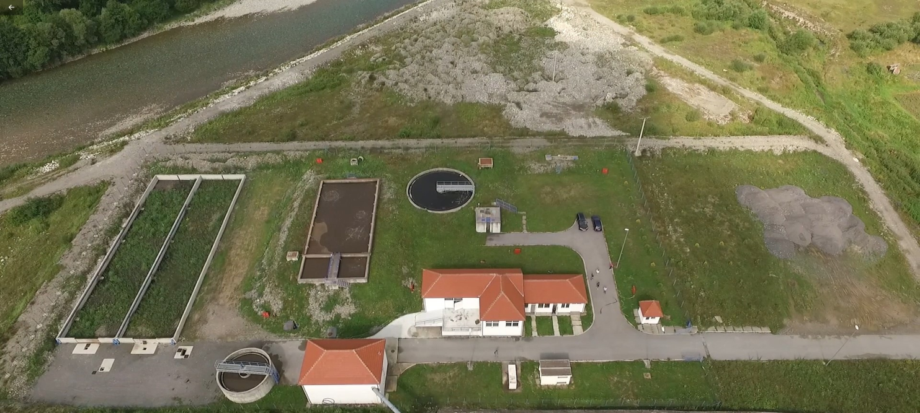
Problem description
High costs of existing sludge treatment (mechanical dewatering) and sludge disposal problems (no incineration plant in Montenegro) were the key drivers of search for alternative sludge treatment solutions in the Municipality of Mojkovac
SLUDGE DRYING REED BEDS
Implemented in 2016 with financial support provided by the Republic of Slovenia to the United Nations Industrial Development Organization (UNIDO).

Slide 5
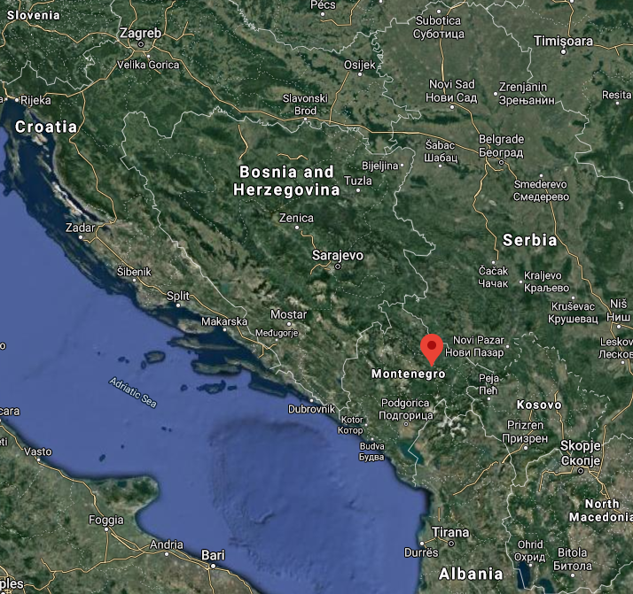
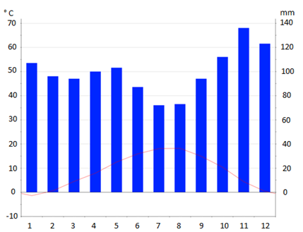
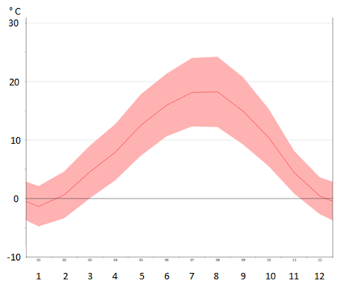
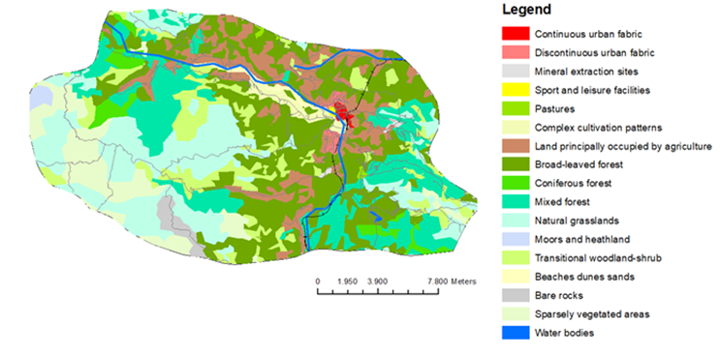
Site location and characteristics
Alpine bio-geographical region
Climate and temperature graph of Mojkovac during the year
(Source: https://en.climate-data.org/europe/montenegro/mojkovac/mojkovac-31454/#temperature-graph
(Source: Google map. Satellite view.)
Mojkovac, Northern Montenegro
Altitude 853 m
Alpine river – Tara River
Average temperature: 8,9 °C
Average precipitation: 1.664 mm
Land use for Mojkovac municipality
(Source: https://land.copernicus.eu/pan-european/corine-land-cover/clc2018)

Slide 6
TECHNOLOGY PRESENTATION
Sludge drying reed beds in Mojkovac, Montenegro
Notes:
What are the wastewater pressures

Slide 7
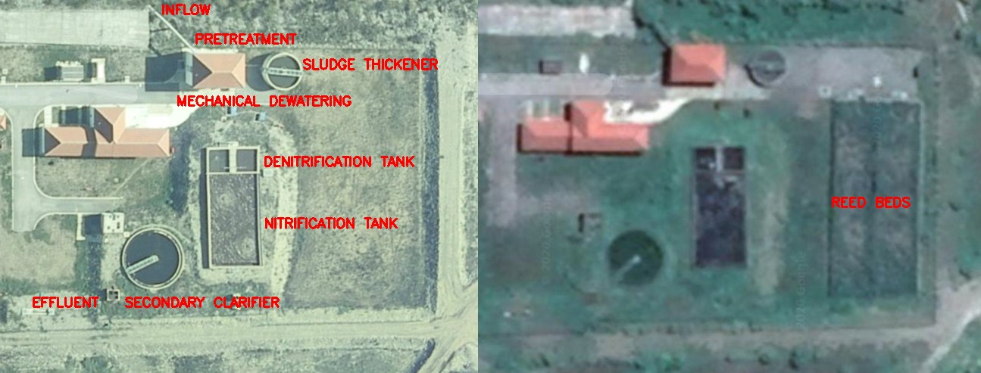
WWTP Mojkovac
Groups of units | Units | Process
Pre-treatment wastewater units | Coarse screens and grit removal | Mechanical treatment
Wastewater treatment units | Anaerobic/Denitrification tank Aeration/Nitrification tank Secondary Clarifier | Denitrification -Nitrification Aerobic stabilization of sludge Water/sludge separation
Sludge treatment units | Thickener (not in use) Filter press (not in use) Reed beds (in use) | Sludge dewatering
Aerial shot of WWTP Mojkovac before (left) and after RBs installation (right)
(Source: Google map. Satellite view.)

Slide 8
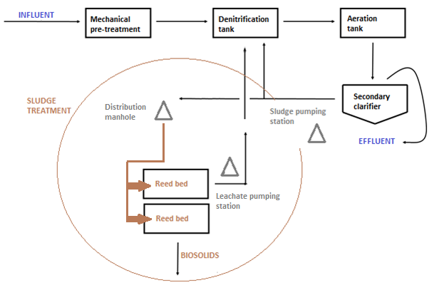
Sludge drying reed beds (RB) Mojkovac
Passive co-natural technology which enables dehydration, mineralisation and stabilisation of sludge from WWTP Mojkovac
Dimensions of reed bed system in Mojkovac
Reed bed | Width [m] | Length [m] | Area [m²]
RB 1 | 10 | 45 | 450
RB 2 | 10 | 45 | 450
The system of RBs comprises:
a sludge pumping station for sludge pumping onto reed beds;
a sludge distribution manhole for sludge distribution on which reed bed;
two sludge drying reed beds with a surface area of 450 m2 each;
a leachate pumping station to return drained water from RBs back to WWTP.
Flowchart diagram of operating sludge treatment in Mojkovac

Slide 9
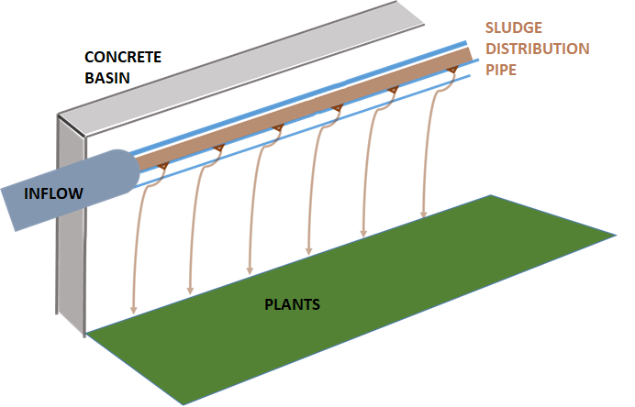
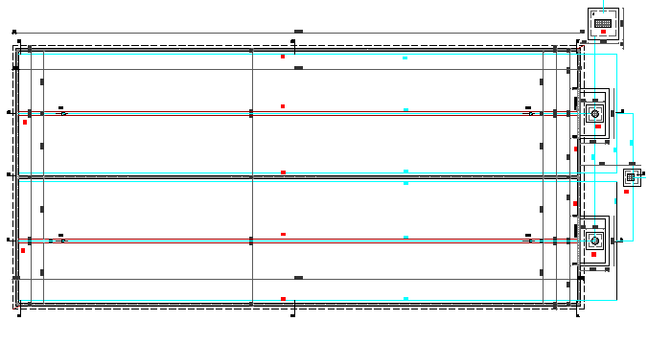
Sludge drying reed beds (RB) Mojkovac
Floor plan of RBs in Mojkovac
(Source: Final project design, 2015)
Sludge distribution pipe
(Source: LIMNOS Ltd.)

Slide 10
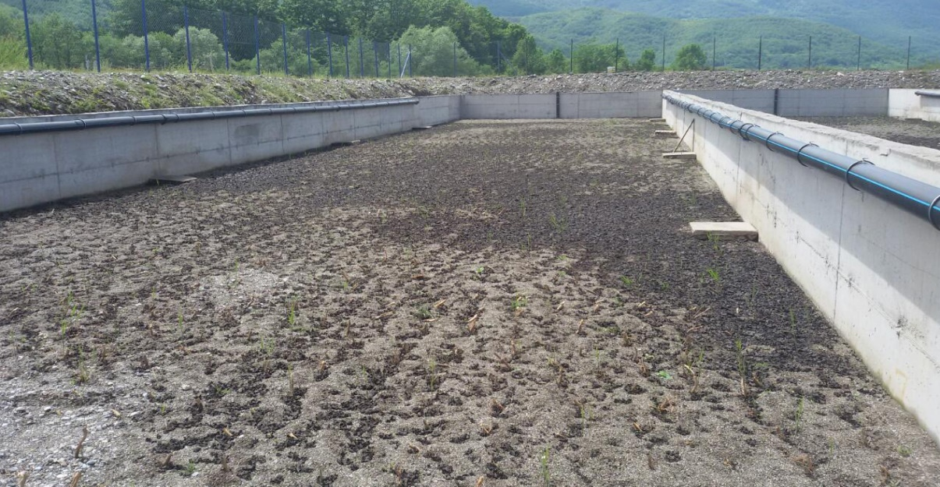
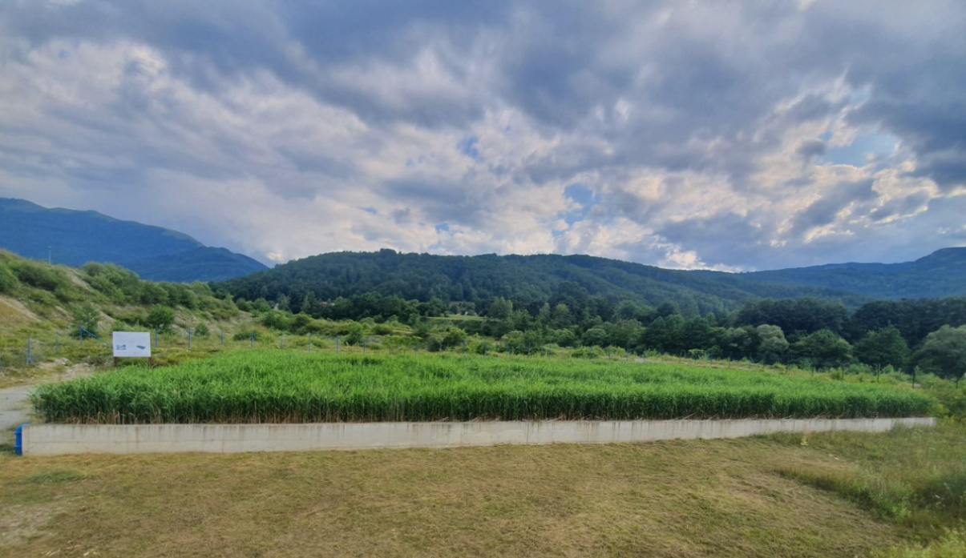
Sludge drying reed beds (RB) Mojkovac
Reed beds after planting
(Source: LIMNOS Ltd.)
Reed beds with fully established vegetation
(Source: LIMNOS Ltd.)

Slide 11
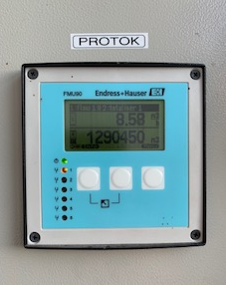
Design and process parameters
DESIGN PARAMETRS
RBs capacity: 2.500 PE
Qaverage= 324 m³/day
Wastewater characteristics:
Urban wastewater
Typical wastewater
Sludge characteristics before treatment:
Sludge type: primary and secondary mixed together
Aerobic biological sludge – stabilized
Mechanical properties of sludge: fluid sludge
Dry matter content: 0,5-2 %
The maximum calculated loading rate is 60 kg TSS/m² y.
Winter preparation loadings (October-November)
Once per day/bed every second day
Period without loading (December-January)
Usual loading (February-September):
Once per week/bed two times per month
Flow on 02.10.2019 afternoon.
(Source: LIMNOS Ltd.)
PROCESS PARAMETRS

Slide 12
Requirments for sludge reuse in Montenegro
Heavy metals | Quality
 | A | B | C
Zn | 600 | 1200 | 2500
Cu | 300 | 600 | 1000
Cr | 100 | 250 | 1000
Pb | 120 | 200 | 750
Ni | 60 | 100 | 300
Cd | 5 | 10 | 20
Hg | 5 | 10 | 16
Limit values for heavy metals in sludge
A and B: use in agriculture
B: use on green areas and parks
C: use for land recultivation on landfills, tailings and mining areas
Heavy metals | Allowed heavy metal content in soil in mg/kg of dry matter of representative soil sample
pH of soil | 5,0 <pH 6,0 | 6,0<pH<7,0 | pH>7,0
Zn | 100 | 150 | 200
Cu | 40 | 50 | 100
Cr | 50 | 75 | 100
Pb | 50 | 70 | 100
Ni | 30 | 50 | 70
Cd | 0,5 | 1 | 1,5
Hg | 0,2 | 0,5 | 1
Limit values for heavy metals in soil to which sludge is applied
Heavy metals | Limit values
Zn | 30
Cu | 12
Cr | -
Pb | 15
Ni | 3
Cd | 0,15
Hg | 0,1
Maximum annual load of heavy metals to land, on a ten years basis
(Source:“Official Gazette of Montenegro, No. 89/09 from 31.12.2009).

Slide 13
Requirments for sludge reuse in Montenegro
Dry matter content
According to the dry matter content, the sludge can be used in agricultural land, green areas, and parks if it contains at least 50 % of dry matter. If the sludge contains at least 35 % of dry matter, it can be used as a covering material on landfills, re-cultivated landfills, degraded soils, and mining fields.
Limit values for organic compounds in sludge
Organic pollutants | Allowed concentrations (mg/kg of dry matter)
PAH (Polycyclic Aromatic Hydrocarbons) | 6
PCBs (polychlorinated biphenyls) | 0,2 – 0,8*
* 0,2 for agriculture; 0,2-0,8 for park greening
Limit values for pathogens in sludge
Treated sewage sludge of A and B quality must not contain pathogen organisms.
The analysis of organic pollutants and pathogens content is performed only when treated municipal sewage sludge is produced at a WWTP with a capacity of more than 100.000 PE.
Maximum annual load of nitrogen in agriculture
Total nitrogen content should not exceed 250 kg/ha/y or 170 kg/ha/y where mineralised sewage sludge is applied to the nitrate-sensitive land that meets the optimal needs of crops.
(Source:“Official Gazette of Montenegro, No. 89/09 from 31.12.2009).

Slide 14
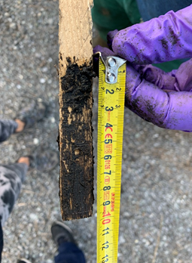
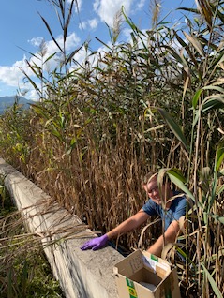
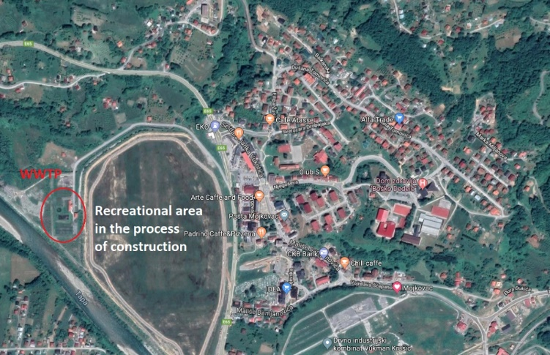
Visual examination (October 2019)
Sludge height
10 cm
Sludge distribution
Uniform, no death zones, no signs of filter clogging
Plant growth
Sludge height.
(Source:Limnos Ltd.).
Plants in Mojkovac are almost 3 m high. They are not harvested.
Odor
No odor problems.
RBs located next to the recreational area.
Common reed height.
(Source:Limnos Ltd.).

Slide 15
TECHNOLOGY PRESENTATION
Sludge drying reed beds in Dellach am Drautal, Austria
Notes:
What are the wastewater pressures

Slide 16
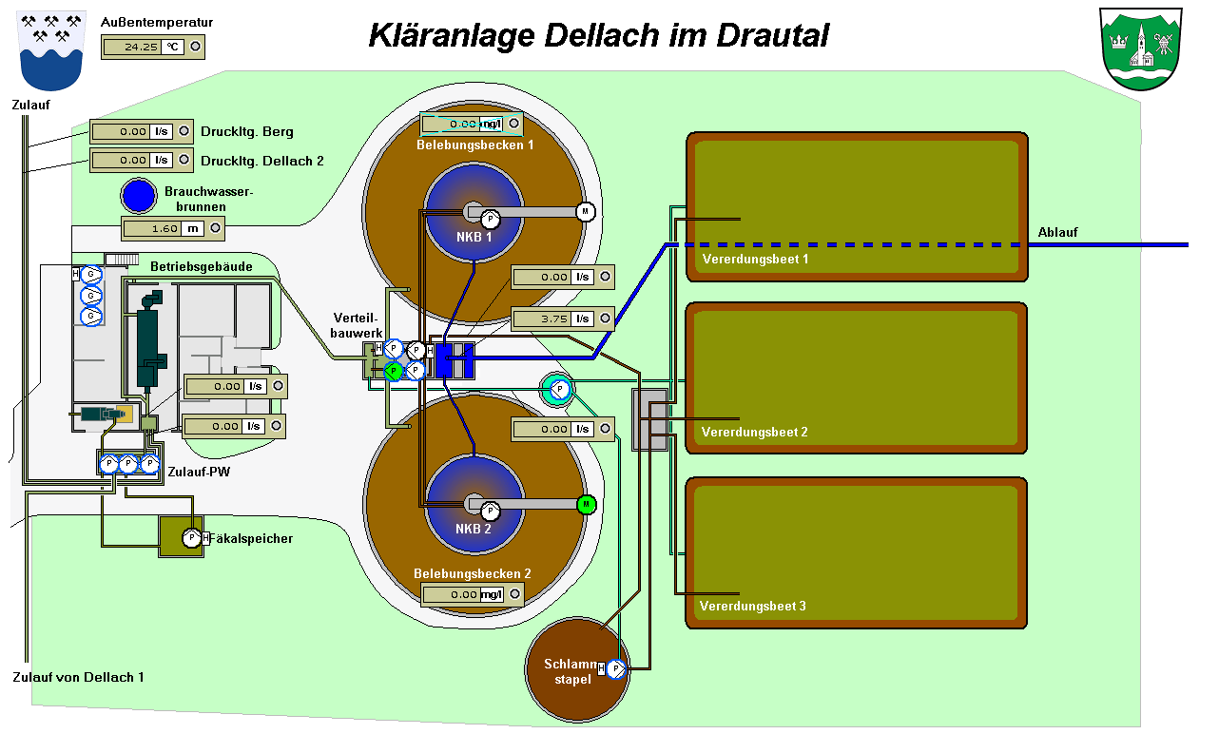
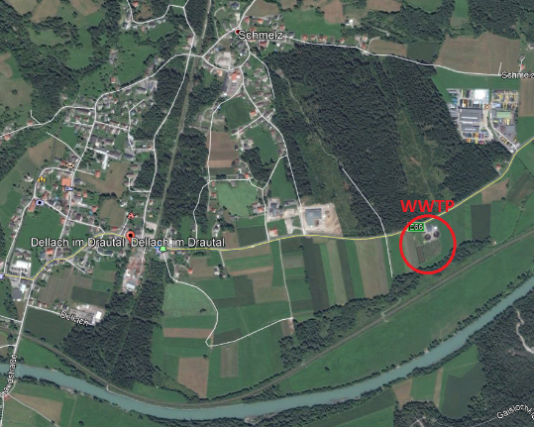
WWTP Dellach am Drautal
Mechanical treatment: sand and grease trap, screening line
Biological treatment: two activated sludge reactors; each of them perform nitrification and denitrification. During high season (summer), both reactors are used, while during low season (winter), only one reactor is in operation.
Phosphate removal: chemical precipitation with ferric chloride.
Sludge line and treatment: sludge from secondary clarifier, where the flocks of microorganisms settle down is pumped directly to reed beds.
WWTP capacity: 7.800 PE
Start of operation: 2007
Location of WWTP Dellach, Austria
WWTP Dellach process scheme
(Source:Google map)
(Source:http://www.wv-oberesdrautal.at/home.html.)

Slide 17
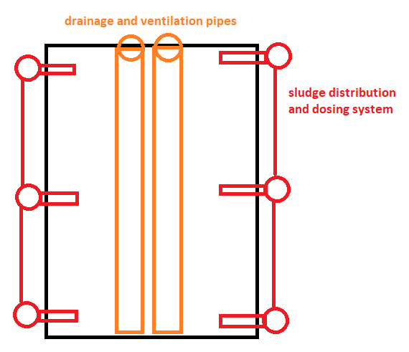
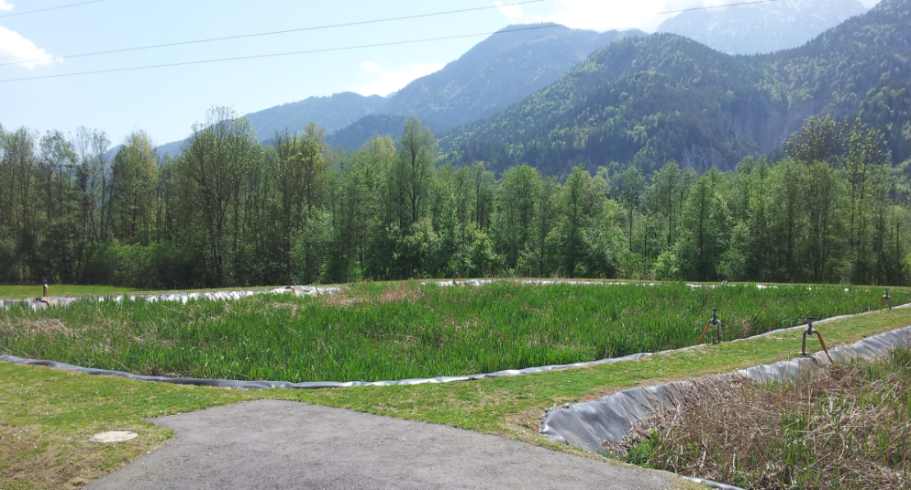
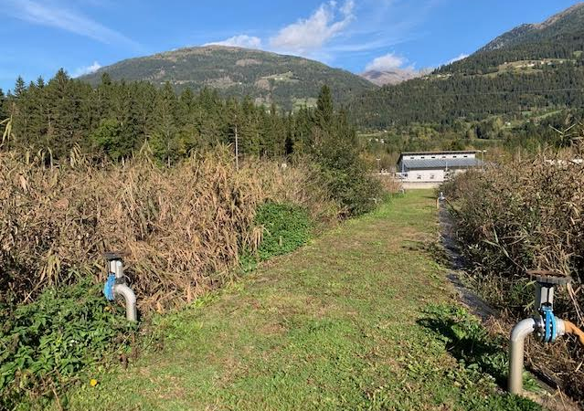
Sludge drying reed beds Dellach am Drautal
Implemented three beds (RB 1, RB2 and RB3)
Dimensions of reed bed system in Dellach am Drautal
Reed bed | Width [m] | Length [m] | Area [m²]
RB 1 | 32 | 65 | 2.080
RB 2 | 32 | 65 | 2.080
RB 2 | 32 | 65 | 2.080
Seasonal fluctuations:
Summer loading: 7.800 PE
Winter loading: 3.-4.000 PE
Sludge dosing system (red) and leachate collection system (orange)
(Source: Limnos Ltd.)
beginning of vegetation season.
End of vegetation season.
(Source: Limnos Ltd.)
(Source: Limnos Ltd.)

Slide 18
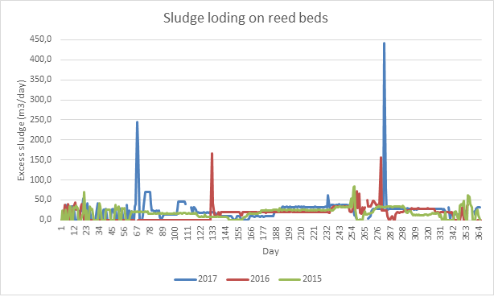
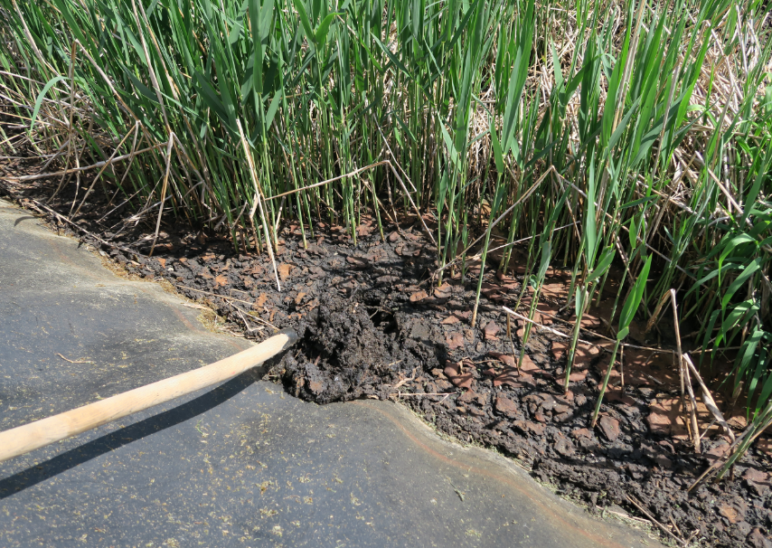
*It is assumed that sludge loading peaks occurred due to maintenance works and yearly emptying of the second tank, which is used only in the main tourist season.
Operation
Sludge log data from Dellach am Drautal
Sludge loading | 2015 | 2016 | 2017
Sludge applied to RBs (m³/y) | 6.612 | 5.494 | 8.253
Sludge loading:
Summer loading
Loading period from – March to October
Daily loading – sludge feeding every hour
The operating cycle per bed lasts three weeks – one bed filled every day for three weeks
Winter loading
Loading period from November to February
Daily loading – sludge feeding once per day or less
The operating cycle per bed lasts three weeks – one bed filled every day for three weeks
Daily sludge loading on reed beds in Dellach
beginning of vegetation season.
Sludge drying.
(Source: Limnos Ltd.)
(Source: Limnos Ltd.)

Slide 19
Visual examination (October 2019)
Sludge height
50-60 cm in 10 years.
Sludge distribution
Uniform, no death zones, no signs of filter clogging.
Plant growth
Plants in Dellach are 2 m high. They are not harvested.
Odor
The system in Dellach has odor problems between winter loading cycles, but only when snow melts on reed beds.
Plants at the beginning of growing season (May 2015, left) and at the end of growing season
(Source:Limnos Ltd.).

Slide 20
OTHER EXPERIENCES WITH RBs
In Alpine Region
Notes:
What are the wastewater pressures

Slide 21
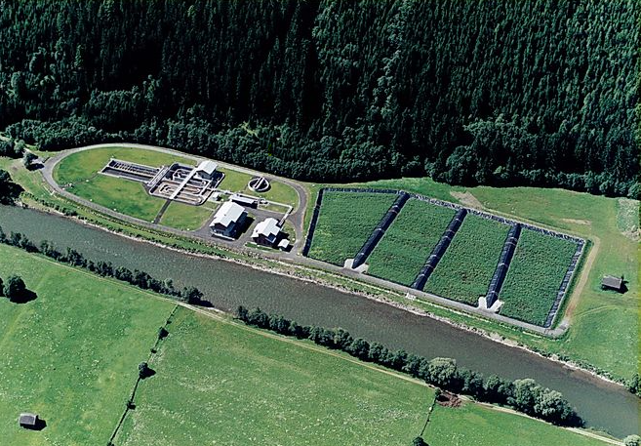
Stallhofen der Möll, Austria
The WWTP was built in 2007 and had a capacity of 15.000 PE.
Sludge treatment consists of 4 beds with a total surface area of 16.000 m2.
The annual amount of fresh sludge is 16.250 m³.
The fresh sludge is aerobic stabilized and contains around 2 % of total suspended solids.
RBs are efficiently reducing sludge volume by 97 %
Annual results of sludge analysis showed that biosolids could be used in agriculture
Filter layer did not clog after ten years of operation
WWTP Stallhofen der Möll.
(Source:https://www.rhv-moelltal.at/schlammbehandlung)

Slide 22
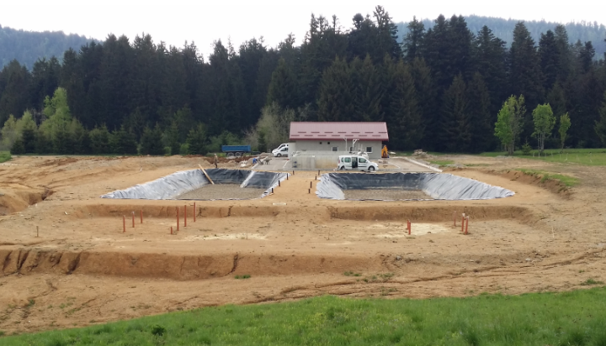
Mrkopalj and Ravna Gora, Croatia
WWTP Mrkopalj (1.400 PE) and WWTP Ravna Gora (2.000)
The two WWTP with reed beds were constructed parallel, and trial operation of one year was launched in September 2019.
The technology applied consists of two reed beds on each location.
During the first year of operation, vegetation established on both locations.
Even though locations are close by and both under the Alpine climate, the precipitation levels differ considerably. Thus, the drainage system on one location had to be adapted to micro conditions during trial operation.
WWTP Mrkopalj.
(Source: Limnos Ltd.)

Slide 23
EFFICIENCY
In Alpine Region
Notes:
What are the wastewater pressures

Slide 24
Efficiency (intermediate results)
HEAVY METALS
Analysis of sludge in Mojkovac (Montenegro) and Dellach (Austria) showed that heavy metals in sludge are within allowed limits for biosolids use in agriculture. The obtained results are in line with several other studies.
NUTRIENTS
In Mojkovac, total nitrogen varies from 4,5 to 4,9% of mass while in Dellach measured value is 3,4%. In Mojkovac, total phosphorus content is 1,4% mass and in Dellach 3,1 % mass.
The results of nutrients suggest that the final product from the treatment may be used as a fertilizer.
DRY MATTER
In Mojkovac, dry matter is 16% while in Dellach is 22% (a maxium content reached on RBs is 40%).
Due to climate conditions, additional solar drying is recommended before biosolids use.
TOTAL VOLATILE SOLIDS
In Mojkovac TVS are 67% and in Dellach are 61 %.
PATHOGENS
Pathogen experiment was set in order to define pathogen removal rate, but failed due to sludge infiltartion into the isolated area.
The results showed 1 log (96,55%) reduction of E. coli, 5 log (99,78%) reduction of Coliform bacteria and 0 log reduction (80,39%) of enterococci.
Based on the results of the pathogen experiment consultant concluded that the pathogen content was not reduced as expected (at least log 5 should be achieved).

Slide 25
COST ANALYSIS
Notes:
What are the wastewater pressures

Slide 26
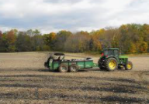
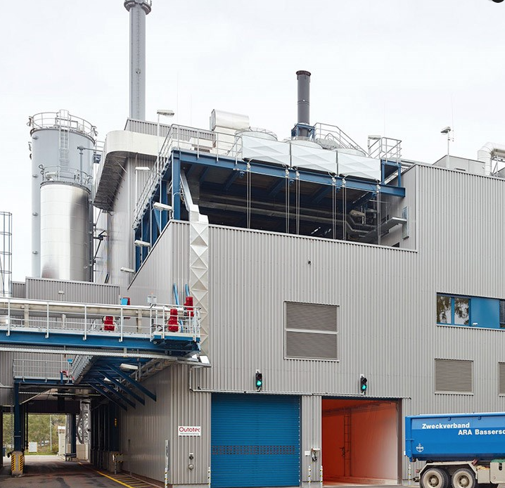
Investment costs
Project investment cost breakdown
Project investment cost | Total cost (€)
Project documentation | 25.000,00
Construction | 138.525,00
Operation staff training | 14.475,00
Dissemination | 15.000,00
TOTAL (EUR): | 193.000,00
CAPEX of RBs:
55 €/PE for only construction costs;
77 €/PE for project documentation, construction, staff training and dissemination.
Covered by the DONATION.
Operation and maintenance (O&M) costs
Cost categories: labor, electricity consumption, monitoring, regular and periodic maintenance and final disposal.
SLUDGE FINAL DISPOSAL
(Source:Cityofshelby.com)
(Source:Outtotec.com)
Option 1: biosolids reuse (15 €/ton)
Option 2: incineration (60 €/ton)
OPEX of RBs:
1,59 €/PE/year without final disposal
2,16 €/PE/year with biosolids reuse,
3,86 €/PE/year with incineration.

Slide 27
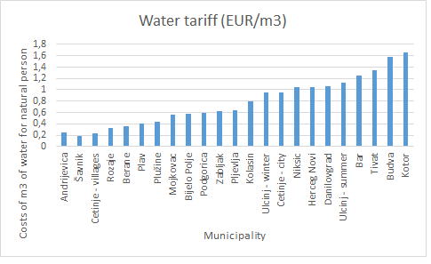
Water tariff
Required water tariff to cover operation and maintenance of RBs
Option | Water tariff for O&M (€/m³) | % of existing water tariff (0,56 EUR/m³)
Reed beds + incineration | 0,13 | 23%
Reed beds + biosolids reuse | 0,07 | 13%
Investment = GRANT (100% donation)
Tariff covers NPV (166.931 €/30 years).
Tariff covers NPV (93.440 €/30 year).
Existing water tariff (0,56 €/m3) is affordable.
Required water tariff rates to cover investment costs through loan and operation costs of RBs
Option | Water tariff for loan and O&M (€/m³) | % of existing water tariff (0,56 EUR/m³)
Reed beds + incineration | 0,30 | 23%
Reed beds + biosolids reuse | 0,24 | 13%
Investment = LOAN (30 years; fixed intrest rate 0,7%)
Tariff covers NPV (380.998 €/30 years).
Tariff covers NPV (307.508 €/30 year).
The calculated average tariffs take into account future stream of costs and convert them into equivalent values today.
It must be noted that the tariff needed during 1st year of operation is higher as one needed in the last year of operation due to modelled net costs for each of the future years. This is done by discounting costs using an appropriate real discount rate.
Cost of water in Montenegro in EUR/m³
(Source: Udruzenjevodovoda.me)

Slide 28
Net present value (NPV)
Net present value of sludge treatment in EUR
Sludge treatment + disposal | NPV O&M | NPV Investment | NPV Total | Ranking
Reed beds + incineration | -166.931 | -193.000 | -359.931 | 2
Reed beds + biosolids reuse | -93.440 | -193.000 | -286.440 | 1
NPV takes into account:
The average economic life is 30 years;
Initial investment costs;
Operational and maintenance costs;
The real discount rate applied is 4%.
Ranking options by NPV showed that biosolids reuse is considered a more financially acceptable option.
Avoided costs with biosolids use
Avoided costs deriving from changed sludge disposal (incineration or biosolids use)
Municipality of Mojkovac could save up 93.440 EUR over 30 years in case if chooses biosolids reuse instead of incineration.
Biosolids reuse or incineration after treatment on RBs?
Potential investment return from changed sludge treatment
Potential cost savings from changed practice (mechanical dewatering changed to reed beds) | €/30 years | *ROI
Potential of cost savings – incineration | 312.507 | 10 years
Potential of cost savings – biosolids reuse | 385.999 | 8 years
RBs instead of mechanical dewatering?
*Municipality of Mojkovac will save up to 385.999 EUR over 30 years by abolishing mechanical dewatering and implementing RBs instead.
The investment in RBs would return in 8 years from potential cost savings.

Slide 29
DIRECT AND INDIRECT BENEFITS
Notes:
What are the wastewater pressures

Slide 30
Direct benefits
Reducing sludge volume, pollutants and costs.
Municipality of Mojkovac avoided capital costs (193.000 EUR)
→ successfully applying for 100% non-refundable donation from UNIDO.
O&M cost savings
→the most affordable type of sludge treatment in WWTP Mojkovac is using RBs aiming at biosolids reuse
→ The O&M cost savings were the main reason to implement RB technology in Mojkovac.
→ O&M cost saving sare: 8,93 €/PE or 22.300 €/year (11,09 EUR/PE for mechanical dewatering with incineration – 2,16 EUR/PE for RBs with biosolids reuse)
Biosolids reuse is the most affordable sludge disposal method
→ method reduces the annual O&M costs for 29% or 2.329 €/year.
RBs could improve energy efficiency of WWTP
→energy consumption to remove 1 kg of BOD/day could be improved by 77%
→energy consumption to remove 1 kg of COD/day could be improved by 46%

Slide 31
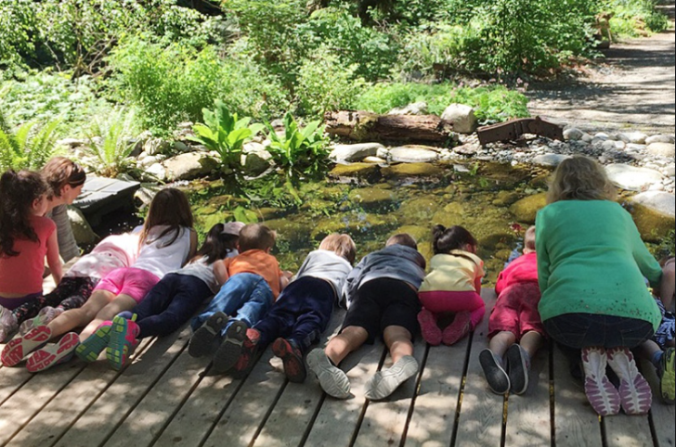
Indirect benefits
SOCIAL
Social cohesion – estimated as low to medium
Even though RBs in Mojkovac could be used as “classroom in nature”, its potential is not exploited.
RBs aestetic value (green area) probably positively affects the sense of well-being of residents.
Project could enhance social inclusion, but the community was not actively involved in the project nor takes care or is connected to O&M of RBs.
Dissemination activities reached inhabitants; thus, their general feeling of safety probably improved due to environmental and health protection.
(Source: www.tricitynews.com)
Cultural values – estimated as high
The solution reduces the risk of untreated sludge being discharged to the Tara River Canyon, which attracts tourists from all around the world.
Compared to mechanical dewatering, RBs require much less transport and thus reduce noise stress, air pollution, and gas emissions, which is better for the development of tourism.
Tara River Canyon is the second-longest in the world after Grand Canyon!
Stakeholder`s engagement – estimated as low
Good collaboration is established among public utility, municipality, and environmental ministry.
Other institutions (research, education, and agriculture), local communities, and farmers were not actively involved in the project, and collaboration is not established.
Circular economy (biosolids use) will require long term collaboration among all stakeholders and especially engagement of the end-users.

Slide 32
Indirect benefits
ENVIRONMENTAL
Habitats – estimated as medium
RBs in Mojkovac support biodiversity. The identified invertebrates are earthworms, frogs, and birds (number and type of species not identified).
GHG emissions – estimated as high
Using reed beds instead of mechanical dewatering seems to be the best alternative to reduce emissions footprint.
RB, with biosolids land application, emit 60% less CO₂ and 84% less N₂0.
Biosolids use – estimated as low for land application on agricultural land, high for local erosion
The amount of biosolids (1000 tons per operating cycle) could be applied on 10% (465ha) of all agricultural land in the municipality every ten years or more.
Sanitation of local forest erosion with biosolids could have a higher local impact.
Enough area and possibilities for biosolids land application!
ECONOMIC
Cost savings for the water community – estimated as high
achieving better energy efficiency, reducing costs for final sludge disposal, reducing overall O&M costs → rising the willingness to pay for WWT service.
Lower demand for commercial fertilizer – estimated as low
Biosolids could complement the use of commercial fertilizer (low quantities, low availability – only every 10 years or more)
The most relevant economic indicator: water tariff – estimated as high
Water tariff stayed the same since RBs were implemented. In the case of mechanical dewatering and disposal, the municipality of Mojkovac would need to increase water tariffs.

Slide 33
Indirect benefits
SOCIAL
Social cohesion – estimated as low to medium): RBs in Mojkovac could foster collaboration across the full spectrum of stakeholders to ensure cross-sectoral buy-in and commitment for nature-based solution policies and planning guidelines, but the stakeholder engagment is not proactive.
Cultural values (high): aesthetic (RBs are green area), tourism (RBs reduce transportations of dewatered sludge and related green gras emissions. RBs removed the risk of untreated sludge being discharged to the Tara River.
Stakeholder`s engagement (medium): stakeholder participation.
ENVIRONMENTAL
Habitats (medium): biodiversity, reducing emissions footprint.
Biosolids use (low: land application, high: local erosion): 4.580 ha of agricultural land, 31.802 ha of pastures, forest, grasslands, shrubs and 71 ha of mineral extraction sites → enough area and possibilities for final biosolids disposal.
ECONOMIC
Cost savings for the water community (high): achieving better energy efficiency by reducing the use of electric equipment, reducing costs for final sludge disposal, reducing overall O&M costs, rising the willingness to pay for WWT service.
Lower demand for commercial fertilizer (high): (limited global resources of mineral phosphate).

Slide 34
IMPLEMENTATION CHALLENGES
Notes:
What are the wastewater pressures

Slide 35
Financing and funding
Challenge: Lack of financial resources for initial investment
Municipality of Mojkovac obtained a grant (100% non-refundable donation from UNIDO).
Ministry of Sustainable Development and Tourism of Montenegro
Tara River Canyon - UNESCO site
Biogradska Gora - National park
Top-down approach
Environmental protection
Touristic development
Municipality of Mojkovac
(black environmental spot on the map of Montenegro for a long time)
Challenge: Lack of financial resources for O&M activities
Water tariff for RBs O&M activities represent from 13 to 23 % of existing water tariff
Existing water tariff (0,56 €/m3) does not cover:
Major repairs of RBs
Biosolids excavation and final disposal
Municipality of Mojkovac should elaborate O&M plan as a mechanism for identifying and addressing specific priority issues in the future → higher water tariff will be probably required

Slide 36
Capacity
Challenge: Innovation (RBs are a a relatively new concept in biosolids management)
The system in Mojkovac is first-ever constructed NBS for sludge treatment in the Western Balkan region.
What action is needed for implementation on a larger scale
(regional/state level)?
Establish a sludge working group of experts, including expert for RBs, to address sludge problems on the national level (creation of knowledge hub) and support policy;
Elaborate a study with baseline scenarios and future scenarios regarding sludge quantities, treatment, and disposal on a national level;
Workshops on sludge - expand knowledge on RBs and biosolids reuse among decision-makers;
Inclusion of RB technology in the school curriculum;
Enrichment of RBs in Mojkovac with teaching materials and learning paths on RBs for various interest group.

Slide 37
Capacity
Challenge: Biosolids use (in agriculture)
National legislation enables biosolids use.
Biosolids use? Yes/no?
Environmental sector
Agricultural sector
Municipality of Mojkovac
Local communities and farmers
Supports biosolids use.
˝Biosolid use is not aligned with strategic agricultural documents and long-term goals“
-Montenegro declared as an ecological state and as such supports ecological and organic farming (high quality soil),
-Sufficient quantities of natural fertilizer.
-Prevails intensive agricultrue (small-scale farmers)
Want to use biosolids for sanitation of forest erosion.
See biosolids use as cost-efficient solution.
Unwilling to use or pay for biosolids.
What action is needed:
Better institutional and cross-sectoral cooperation with regards to biosolids use;
Preparation of national sludge management document emphasizing sludge use as a resource: Such a paper should, at a minimum, discuss agricultural and non-agricultural land uses, sludge sales and giveaways, and the feasibility of technologies;
Municipal sludge strategy document;
Workshops on biosolids use (cross-sectoral).

Slide 38
Capacity
Challenge: Poor construction can result with poor performance of RBs
Construction of RBs:
Simple
Not demanding
Technological supervision required
contractor must fully understand the system
(functionally and structurally)
A critical strength of this system is in its simplicity of operation and transferability of know-how. This also makes technology reliable and affordable.
What action was needed in Mojkovac?
Local contractor was introduced to technology prior construction and critical points of construction were highlighted;
Collaboration between contractor and RB technology expert to ensure proper technical execution of the project was established;
Technological supervisor was included in the construction;
Scheduled supervision meetings during construction.
In addition:
Where possible, give preference to the experienced local contractor.

Slide 39
Capacity
Challenge: Possible poor maintenance and wrong operation
Poor O&M
Poor efficiency
Training
Trial operation
RBs optimization
What action was needed in Mojkovac:
One day training included theoretical and onsite practical training;
Elaboration of O&M manual in local language;
During the first year of operation → the contractor stayed in close contact with operating staff to observe plant growth and optimize operation.

Slide 40
Capacity
Challenge: RBs market uptake (competing technologies)
Reed beds (RBs)
vs.
Mechanical dewatering (MD)
Technology ready since 1990s.
Mainstream adoption not reached.
Technology used worldwide
Mainstream technology.
Much lower O&M costs compared to MD
Rather large footprint requirement
Added value (cost saving and biosolids use)
Technology upscale impacted by the lack of a clear regulatory framework for sludge reuse
Evidented lack of confidence in technology
Low investment costs compared to RBs
Perceived as more established and proven technology.
In engineering culture, traditionally conventional approaches (technical solutions) have been more favored and respected throughout history
Action needed to overcome above listed key challenges:
Land requirements:
RBs are suitable for rural areas and small WWTPs where there may be less competition for land and more demand for biosolids
Attractive solution for areas without appropriate facilities (e.g., incineration plant) → solution reduces the costs of final disposal
Lack of confidence in technology and recognition of benefits:
Promotion of RB technology through educational activities, sludge man. training and RBs regional demonstration projects
Mltiple benefits and avoided costs associated with RBs should be communicated with stakeholders

Slide 41
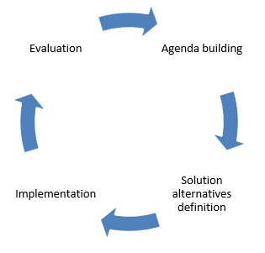
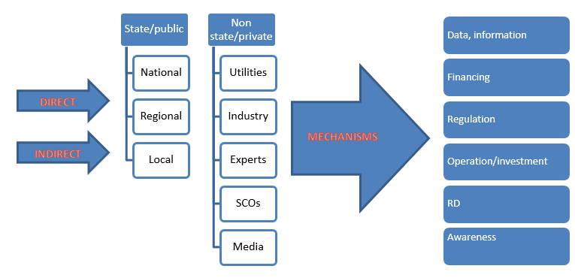
Governance
Challenge: Lack of integrated sludge management
Identified governance gaps include:
lack of coordination of responsible sectoral authorities,
limited technical know-how,
limited financial resources for planning and implementation/evaluation.
What action is needed?
The process of establishment of a holistic sludge management approach.
Actors and mechanisms to provide an efficient and high-quality sewage sludge agenda.

Slide 42
BUSINESS MODEL
Notes:
What are the wastewater pressures

Slide 43
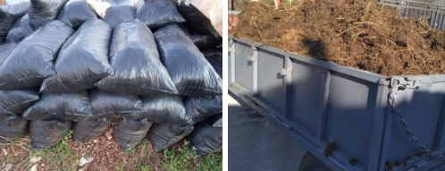
BM1: Contractual partnership (municipality/operator – business entity)
Business entity signs a contractual agreement with the municipality/operators to collect biosolids at the WWTP site and transport them to the storage site from where distribution or sale of biosolids products is permitted.
Municipality/operator charges a business entity collection fee for biosolids in EUR/ton.
Business can be profitable with revenue earned from the biosolids selling to end-customers.
Key partners:
RBs owner – municipality
RBs operator – public utility
Potential customer of biosolids:
Business entity selling to end-users
Cost recovery price (covers excavation costs) = 4,35 €/ton of biosolids
Potential earnings (collection fee: 10 EUR/ton) = 5.850 EUR/operating cycle or 2,34 €/PE
Competitors
Biosolid competitors are farmers selling manure and stores selling artificial/mineral fertilizers. Farmers are selling manure at a price around 50 EUR for a cart ≈ 50 EUR/ton.
(Source: www. https://www.seljak.me/kategorija/dubrivo/)

Slide 44
BM 2: Local-public partnership (municipality-operator-farmer truck)
WWTP operator is contracted by the municipality to apply biosolids reuse in the Municipality.
This might require the plant operator to enter the strategic partnership with partners who can advise on market demand and sales strategies.
Community mobilization and campaigns are necessary to sell biosolids to farmers or local businesses.
The biosolids a can bring the additional income for the municipality/operator.
Key partners:
RBs owner – municipality
RBs operator – public utility
Potential customer of biosolids:
Farmers
Cost recovery price (covers excavation costs and stablishment of on-site storage facility for biosolids ) = 11,72 €/ton of biosolids
Potential earnings (selling price: 40 EUR/ton) = 27.018 €/operating cycle or 10,81 €/PE

Slide 45
BM 3: Subsidizing biosolids use
To overcome the unwillingness of users to use/pay biosolids, one can subsidize their use. It is not unusual that biosolids use application would require incentives.
A strategy with subsidies payable to consumers for biosolids could be one of the mechanisms to distribute biosolids' benefits in the region.
Reasonable subsidies could reduce O&M costs for the final disposal of biosolids.
The model is dependent on government support.
Potential cost savings = 53.820 €/operating cycle or 21,53 €/PE.
Explanation of potential cost saving:
Incineration costs of sludge treated on RBs in Mojkovac are estimated at 62.100 EUR (1.036 tons x 60 €/ton) per operating cycle, while excavation costs and subsidizing the use of biosolids at 8 EUR/ton would amount to 12.780 EUR.
BM 3: Biosolids free of charge
Municipality of Mojkovac may decide to give biosolids free of charge in compliance with valid conditions, standards, regulations, and legislation.
Biosolids give away would reduce O&M costs for the final disposal of biosolids.

Slide 46
Business model conclusins
Biosolids
create
Revenue
The challenge of presented BM lies in the availability of the resource after app. every ten years, so every time all involved parties must be joined together.
Business needs regular and sufficient biosolids quantities, which WWTP Mojkovac alone cannot provide.
Revenue created from biosolids based on the prevailing market price can help to maintain the treatment plant.
Biosolids free of charge or subsidizing biosolids use does not make revenue, but reduce costs for final disposal;
Biosolids can compare in cost with commercial fertilizer under the assumption that municipality bears the cost of biosolids production. What can be cost-effective for one municipality might not be for another.
Biosolids use is a social process involving various actors, so the chances are that unexpected issues will arise during the planning process, regardless of the analysis that supports biosolids use.

