Slide 1
Using the oecd stri for evidence based policy making
Frédéric Gonzales, OECD
13 February 2020
JRC COIN Seminar, Ispra (Italy)

Slide 2
Services are important and tradable
Services are important
Services are tradable
Source: World Bank, WDI
The internet
Lower cost of travel
But what drives trade in services? And what hinders it?

Slide 3
Why the STRI?
Services share of:
To better understand what drives and hinders trade in services
To provide trade negotiators with comparable information on current policy
A tool for trade policy analysis

Slide 4
STRI: two components
1. Regulatory database:
  Database of services trade restrictions
  Standardised set of measures, with links to sources - more than 11000 laws and regulations
2. Composite indices:
  Transforming the qualitative information into quantitative data
  Take values between 0 (open) and 1 (closed)
Coverage: 46 economies and 22 services sectors

Slide 5
STRI sectoral coverage (22)
Digital Network
Computer
Telecoms
Supply Chain
Air transport
Trade and Finance Support
Legal
Physical Infrastructure
Broadcasting
Accounting / auditing
Commercial banking
Architecture
Engineering
Construction
Motion pictures
Sound recording
Maritime transport
Rail transport
Road freight transport
Freight forwarding
Storage & warehousing
Customs brokerage
Insurance
Distribution
Cargo handling
Postal and courier

Slide 6
STRI Regulatory Database

Slide 7
Main elements of the database
Answer
  Mostly just a simple “yes” or “no”
  Numerical answers (e.g., foreign equity)
  “na” for non-applicable – very limited cases
Source
  Official legal instrument or sector regulation
  Common elements
    Title in English; title in original language; details about legal instrument; link to official source
    Comment
  Short, relevant for the measure, if needed to clarify the answer

Slide 8
5 Policy areas of the STRI database
Example of measures
Restrictions on foreign entry |  | Other discriminatory measures
1.1.x. | Equity restrictions | 3.1.x | Taxes
1.2.x | Restrictions on legal form | 3.2.x | Public procurement
1.4.x | Board of directors and managers | 3.3.x | Standards
1.5.x | FDI screening | Barriers to competition
1.7.x - 1.10.x | Other investment barriers | 4.1.x - 4.2.x | Appeal and redress
1.12.x | Performance requirements | 4.5.x | Fee-setting
1.16.x | Commercial/local presence requirement | 4.6.x | Capital requirements
1.20.x | Cross-border data flows | 4.7.x | Advertising
Restrictions to movement of people |  | Regulatory transparency
2.1.x | Quotas | 5.1.x - 5.2.x | Communication of legislative process
2.2.x | Labour market tests | 5.3.x | Business visa restrictions
2.3.x | Duration of stay | 5.4.x - 5.6.x | Doing business
2.4.x - 2.5.x | Nationality/residency for professional license
2.6.x - 2.8.x | Recognition of foreign qualifications

Slide 9
Services regulatory measures
Policy area | Measure | Answer | Source | Comment
Restrictions to foreign entry | Foreign equity limit | 49% | Foreign investment law, Article …
Restrictions to movement of people | Labour market test | Yes | Immigration Act, Article … | Applies to non-EU citizens
Other discriminatory measures | Discrimination in taxes and subsidies | Yes | Decree on R&D | Foreign firms not eligible for R&D subsidies
Barriers to competition | Interconnection is mandated | Yes | Telecoms law, Article … | Applies to dominant operators
Regulatory transparency | Transparent licensing conditions | Yes | Circular by sector regulator | Criteria available on the regulator’s website

Slide 10
STRI - a composite index

Slide 11
The STRI is a composite index
Uses information on de jure regulation only
A snapshot of trade restrictiveness for the countries and sectors included at a particular point in time
Gives the broad picture whereas fine details covered in the database
Changes in the index over time is as useful as capturing restrictiveness levels in the first year

Slide 12
Scoring
Assigning numbers to qualitative information
  Binary scores (0 and 1)
  Refinements:
    Break complex or continuous measures into several thresholds
    Construct nested layers/hierarchies of measures
    Different market structure and regulatory regimes
    Construct regulatory packages when measures are complementary

Slide 13
Example of thresholds:
Foreign equity limits
Thresholds | Score if max is 49% | Score if max is 65%
No foreign equity | 0 | 0
Less than a third | 0 | 0
Less than half | 1 | 0
Less than 100% | 1 | 1

Slide 14
Example of hierarchy
Foreign equity
0%
49%
Board members
Screening
M&A scored 1
100%
All measures scored normally
All measures related to FDI scored 1

Slide 15
Example of different regulatory regimes
Barriers to competition
Dominant supplier
Regulation is good
Competitive markets
Price regulation is bad

Slide 16
Weighting
Equal weighting of all measures within policy categories
Weights of the 5 policy areas assigned by expert judgement
  Online survey – experts asked to allocate 100 points among the five policy areas
  Large number of experts per sector from a diverse set of countries: 380 experts, 50 countries, on average 20 experts per sector (from 15 in transport to 50 in telecom and auditing)

Slide 17
Contribution by measure
𝑤_{𝑗𝑖} = 𝑠𝑐𝑜𝑟𝑒_{𝑗}𝑤_{𝑖} ⁄ ∑_{𝑖} 𝑛_{𝑖}𝑤_{𝑖}
Where:
  score_{j} is a binary score (0,1) of measure j depending on whether the measure is open (0) or restrictive (1)
  𝑛_{𝑖} is the number of measures under category i
  𝑤_{𝑖} is the share of the total number of points allocated to policy area i by the experts

Slide 18
Experts weights by policy area

Slide 19
Sensibility analysis: Digital STRI example (1) – Equal weights
The Spearman rank correlation between expert judgment and equal weights is 0.97

Slide 20
Sensitivity analysis: Digital STRI example (2)
Notes:
All possible values of the STRI drawn from 3 000 random sets of weights (Monte Carlo simulations)

Slide 21
STRI outcomes

Slide 22
Sector profiles

Slide 23
Sector example: computer services (2019)

Slide 24
Top performers in 2019

Slide 25
Country profile: Thailand (2019)

Slide 26
Changes in scores (2018-2019)

Slide 27
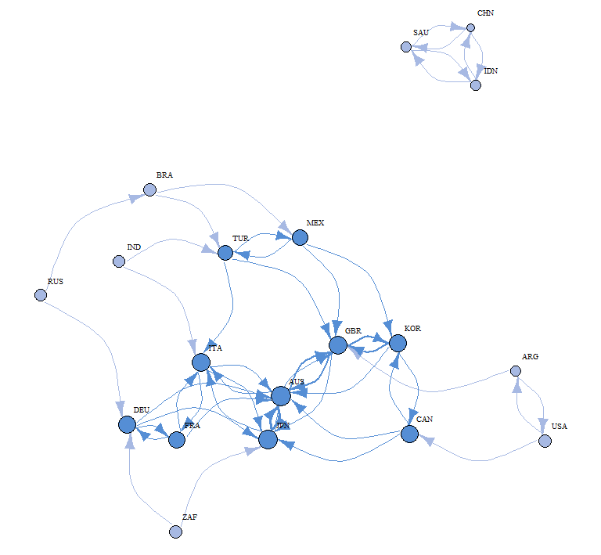
Regulatory heterogeneity for digitally-enabled services in G20 countries (2018)

Slide 28
2019 Services policy trends
Barriers to services trade are rising: New OECD data demonstrates an accelerated shift towards increasing trade restrictive measures across most services sectors.
New restrictions have economy-wide implications ; affecting foreign investment, conditions related to commercial establishment, and the temporary movement of services providers.
Digital trade is confronted by growing restrictions: New analysis reveals an increasing level of restrictiveness affecting trade in digitally enabled services in 2019.
The European Economic Area (EEA) market for services continues to liberalise: Liberalisation through EU/EEA and domestic reforms of EU Member States affected the logistics of cargo-handling services, and commercial banking and insurance services.

Slide 29
What can it be used for?
  Identify domestic reforms
  Identify regulatory bottlenecks and regulatory spillovers across sectors and policies
  Analyse how regulation shapes global value chains e.g. which activities are located in which economies
  Estimate ex ante the likely impact of reforms on industrial structure, employment, relative wages and welfare
  Support regulatory cooperation across economies

Slide 30
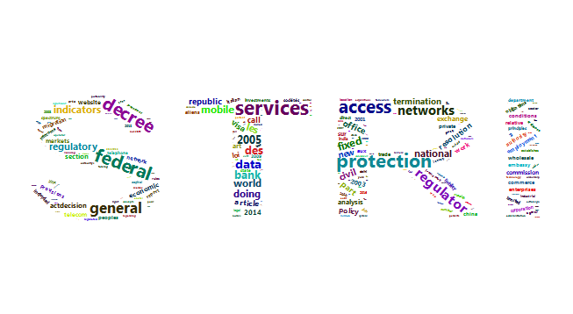

Thank you !!
Contact us
We look forward to your comments!
Access all of the information from the Trade & Agriculture Directorate at:
www.oecd.org/tad
You can reach us via
e-mail by sending your message to the following address:
tad.contact@oecd.org
We invite you to connect with us on Twitter by following:
@OECDtrade

