Slide 1
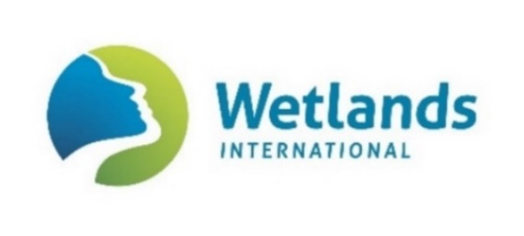
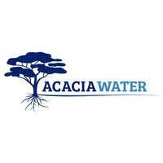
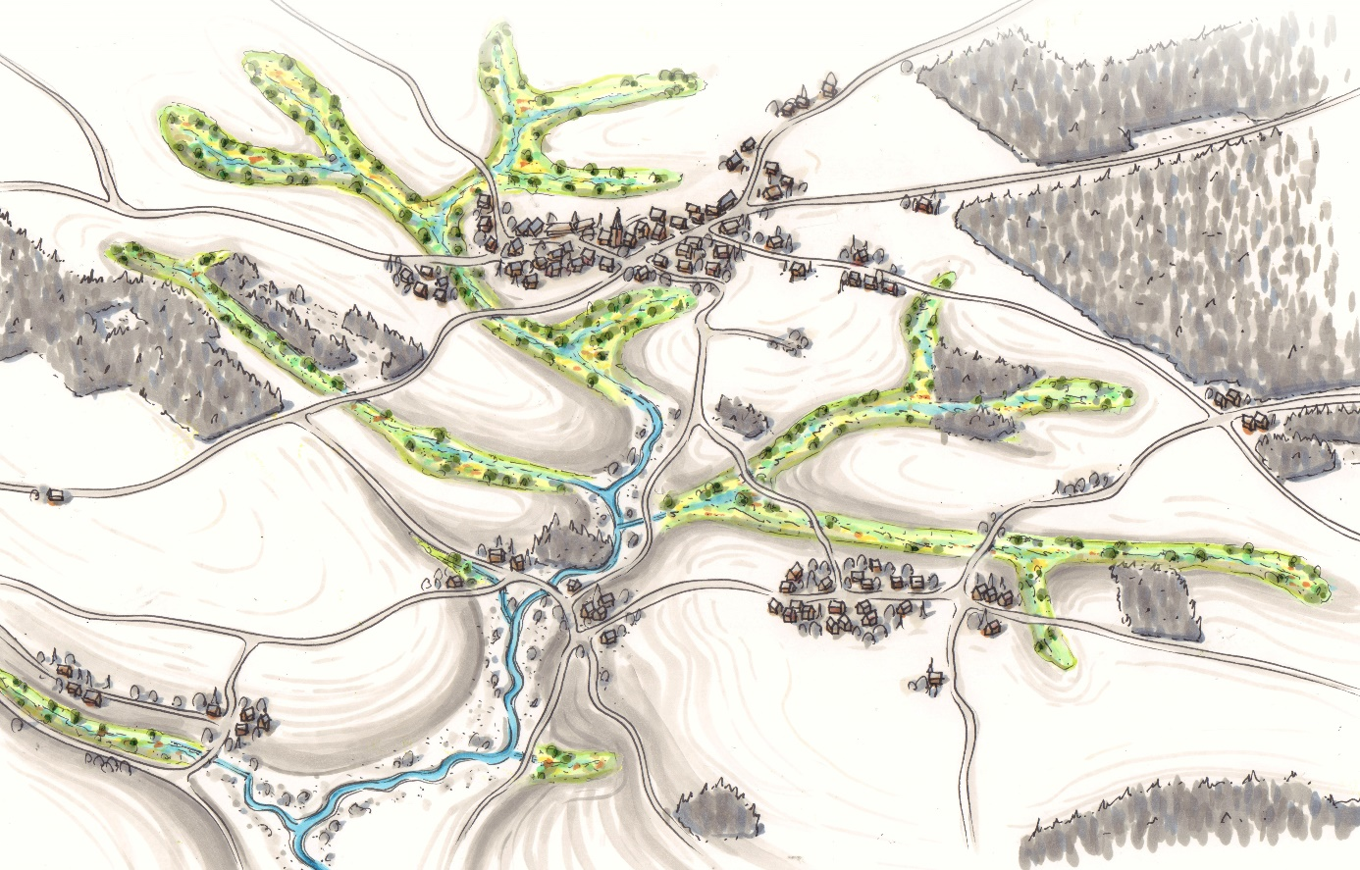
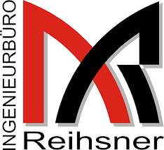
Micro Catchments, Macro Effects Natural retention in the Rhine catchment as a nature-based solution for flood risks, drought control, biodiversity restoration and climate challenges.
Micro Catchments, Macro Effects
JRC – European Commission
Contractor: Wetland International
NUMBER – 939651-IPR-2020
30th June 2021

Slide 2
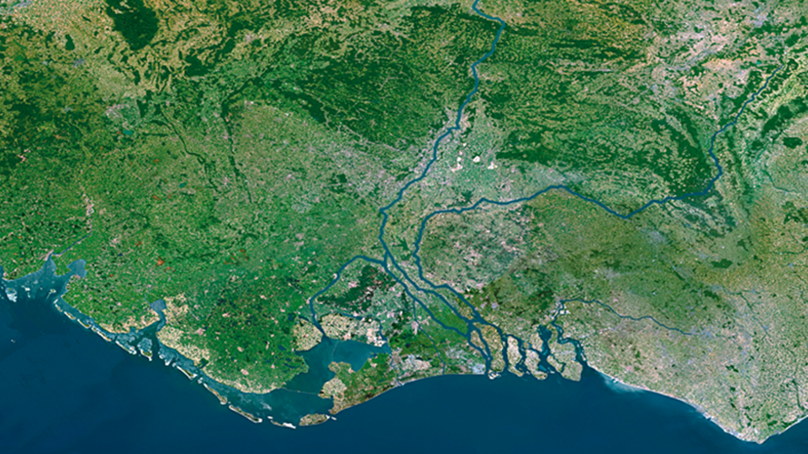
How can natural retention in the Rhine Catchment help us in decreasing flood risk while creating valuable environmental functions?
Rhine: from the Alps to the lowlands
Wetland loss and climate change
The loss of the water buffering capacity of floodplains along the Rhine and its tributaries diminishes the water storage capacity of the whole basin.
In addition, large scale drainage took place at the sloping hills and valleys which discharge their water into (the tributaries of) the Rhine.
As a consequence water travels faster downstream than ever before, causing higher flood peaks and longer periods of drought.
Ecosystem degradation
On top of this, modifications of natural river conditions, cultivation practices, grazing by livestock, fertilization and pesticides are the most frequently mentioned pressures and threats causing ecosystem degradation and loss of biodiversity.
Wetlands International, World Wide Fund for Nature – Netherlands and Stroming BV have initiated a project to assess the effectiveness and feasibility of enhancing the natural sponge effect of wetlands in the German Middle Mountains by restoring wetlands in the upper reaches of the tributaries of the Rhine River. Underlying goal is to explore the possibilities to combine positive effect on water quality, river ecology and river hydrology.

Slide 3
Introduction – Problem setting
Loss of water buffering capacity of floodplains along the Rhine and its tributaries diminishes the water storage capacity of its basin
In addition, large scale drainage took place at the sloping hills and valleys which discharge their water into (the tributaries of) the Rhine.
Therefore, water is leaving the upstream catchments quicker than ever before, causing higher flood peaks and longer periods of drought.
Modifications of natural river conditions, fertilization, pesticides are the most frequently mentioned pressures causing river ecosystem degradation

Slide 4
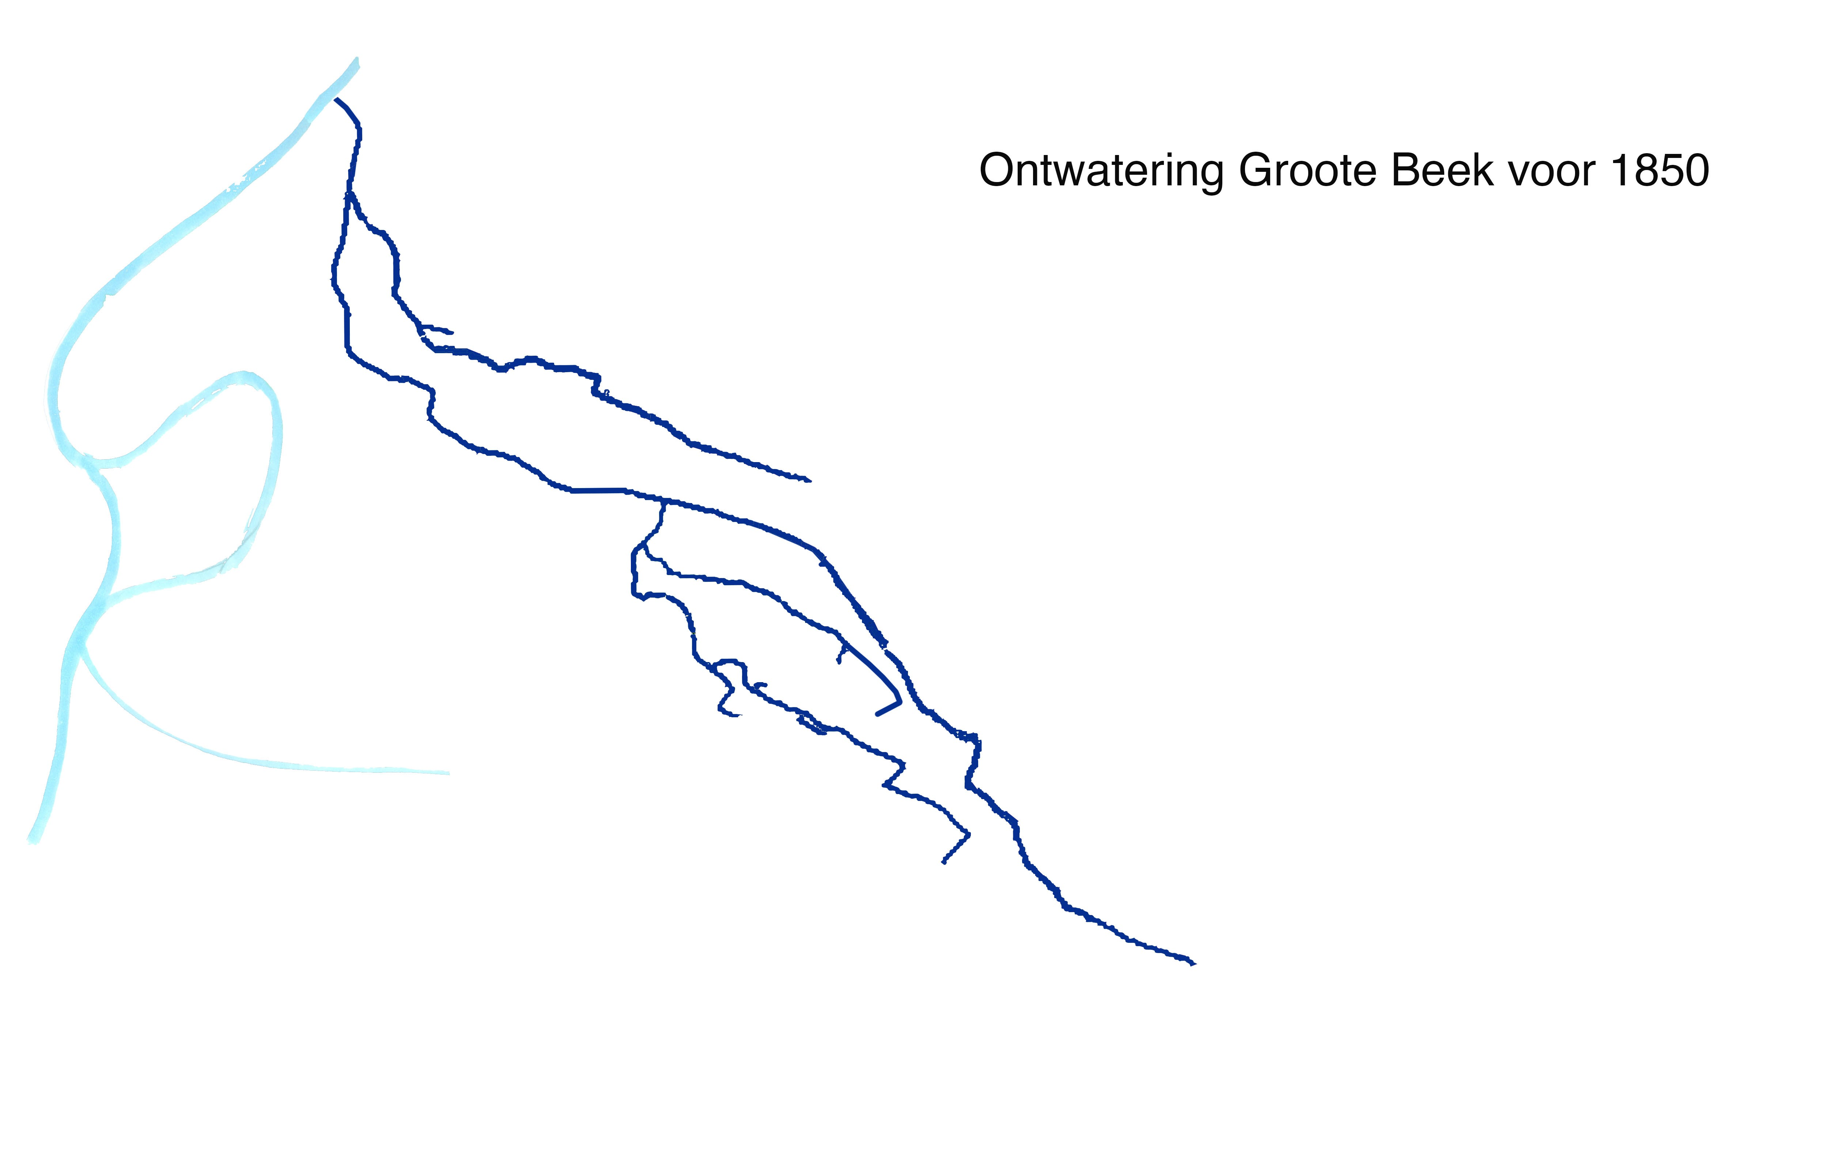
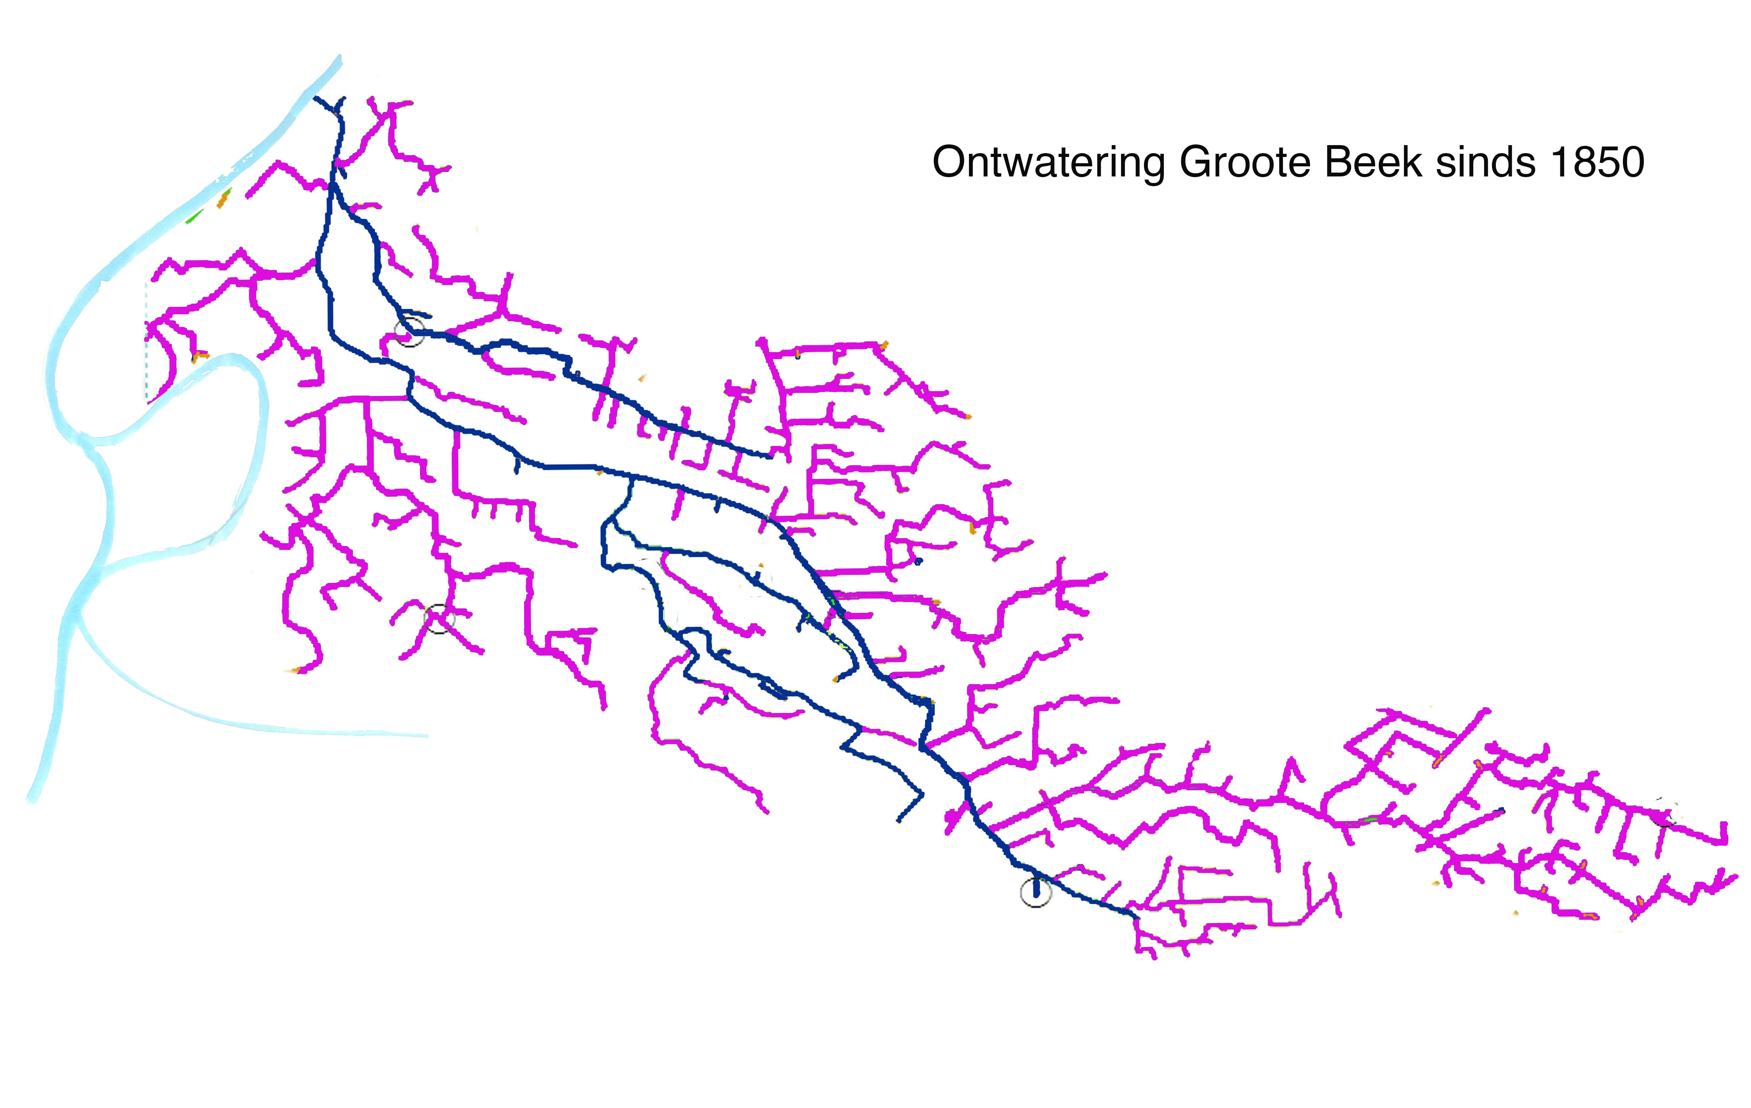
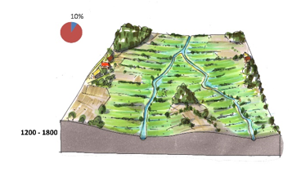
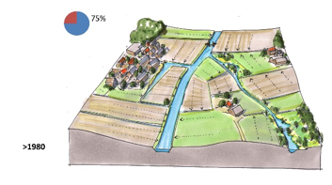
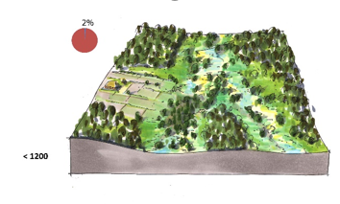
Driven by agriculture: Enlargement of upstream river catchments and drainage channels in small upstream catchments
Small tributary of the Rhine in the Netherlands in 1850
The same Rhine tributary in 2020

Slide 5
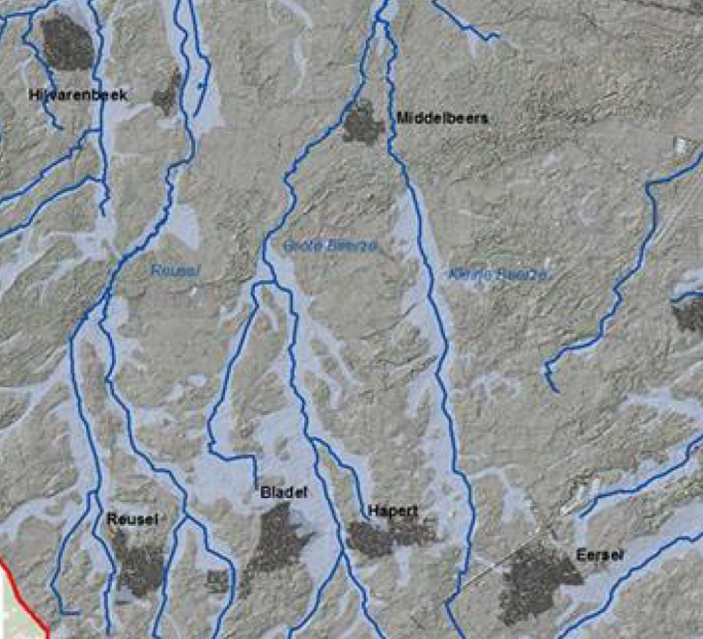
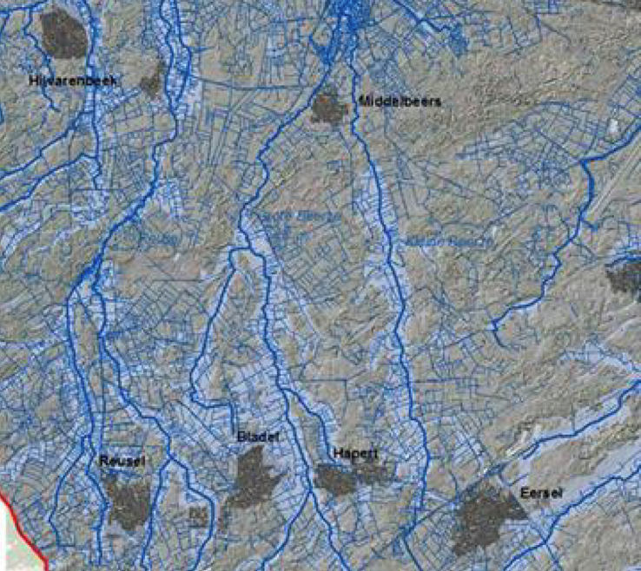
Driven by agriculture: Enlargement of upstream river catchments and drainage channels in small upstream catchments
Small tributaries of the Meuse in the Netherlands in 1850
Small tributaries of the Meuse in the Netherlands in 2020

Slide 6
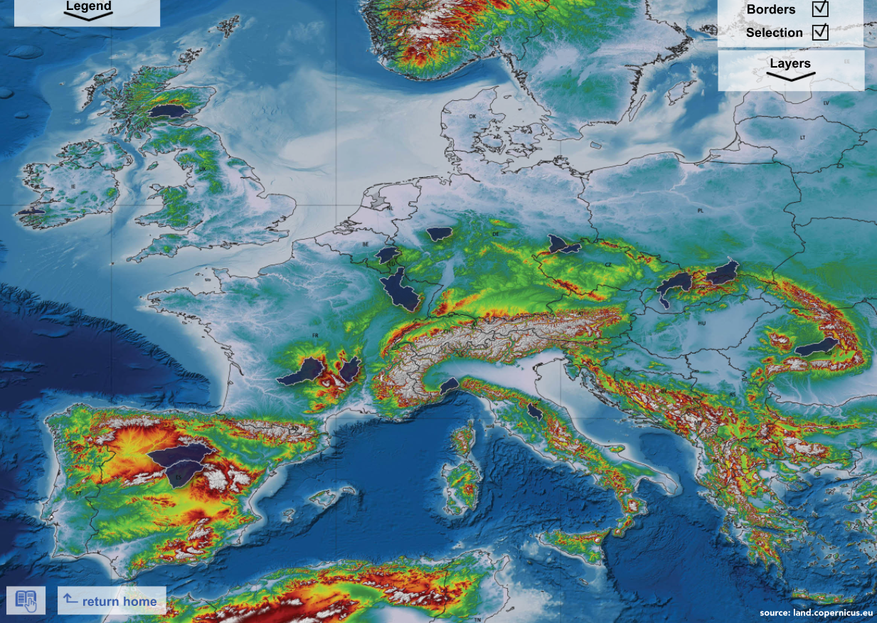
Extended river catchments common in European Rivers
https://media.stroming.nl/sponges/

Slide 7
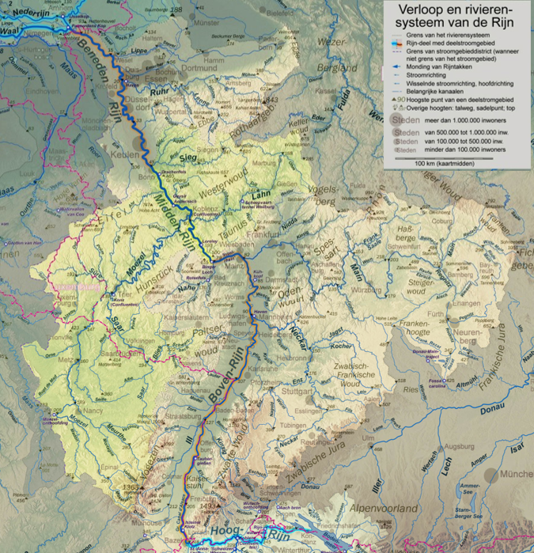
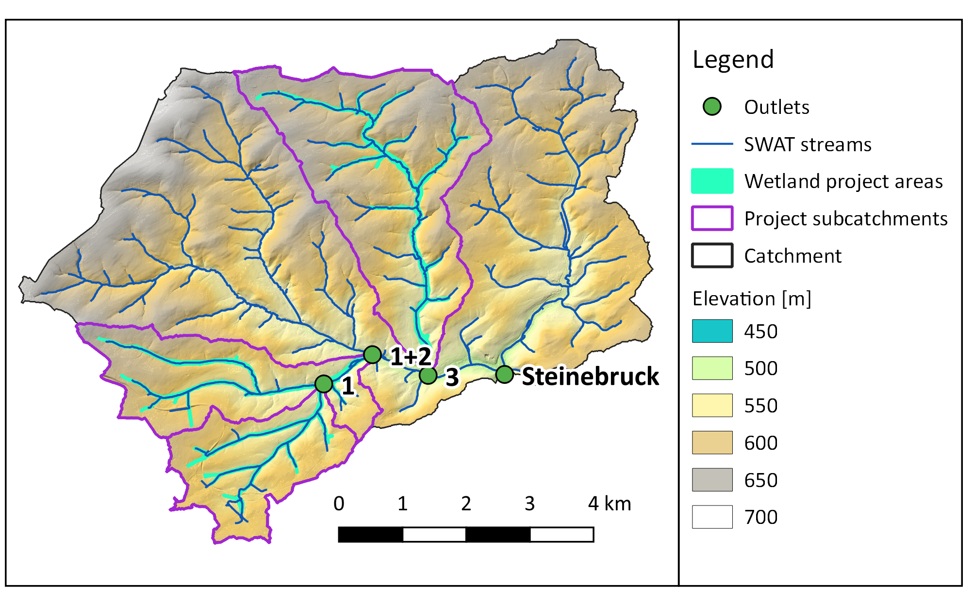
Natural Water Retention in the Capillaries of the river Rhine
Where a natural riverbed is formed by the power of flowing water

Slide 8
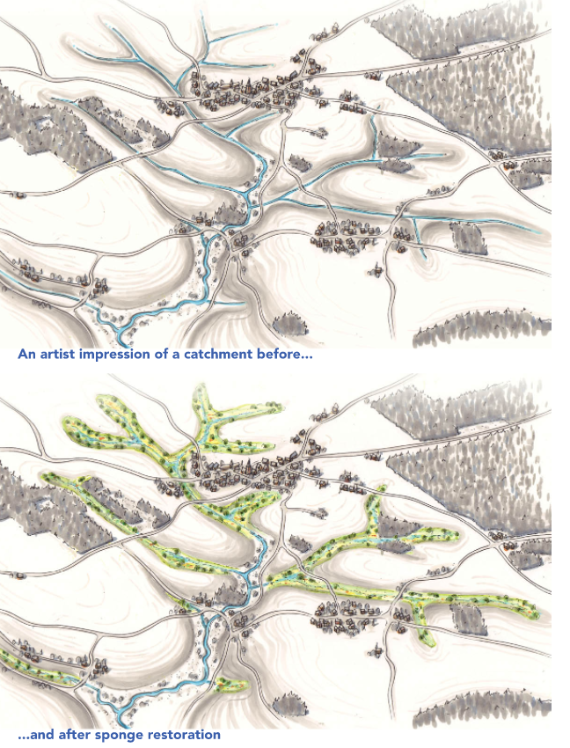
Sponge restoration in upstream catchments

Slide 9
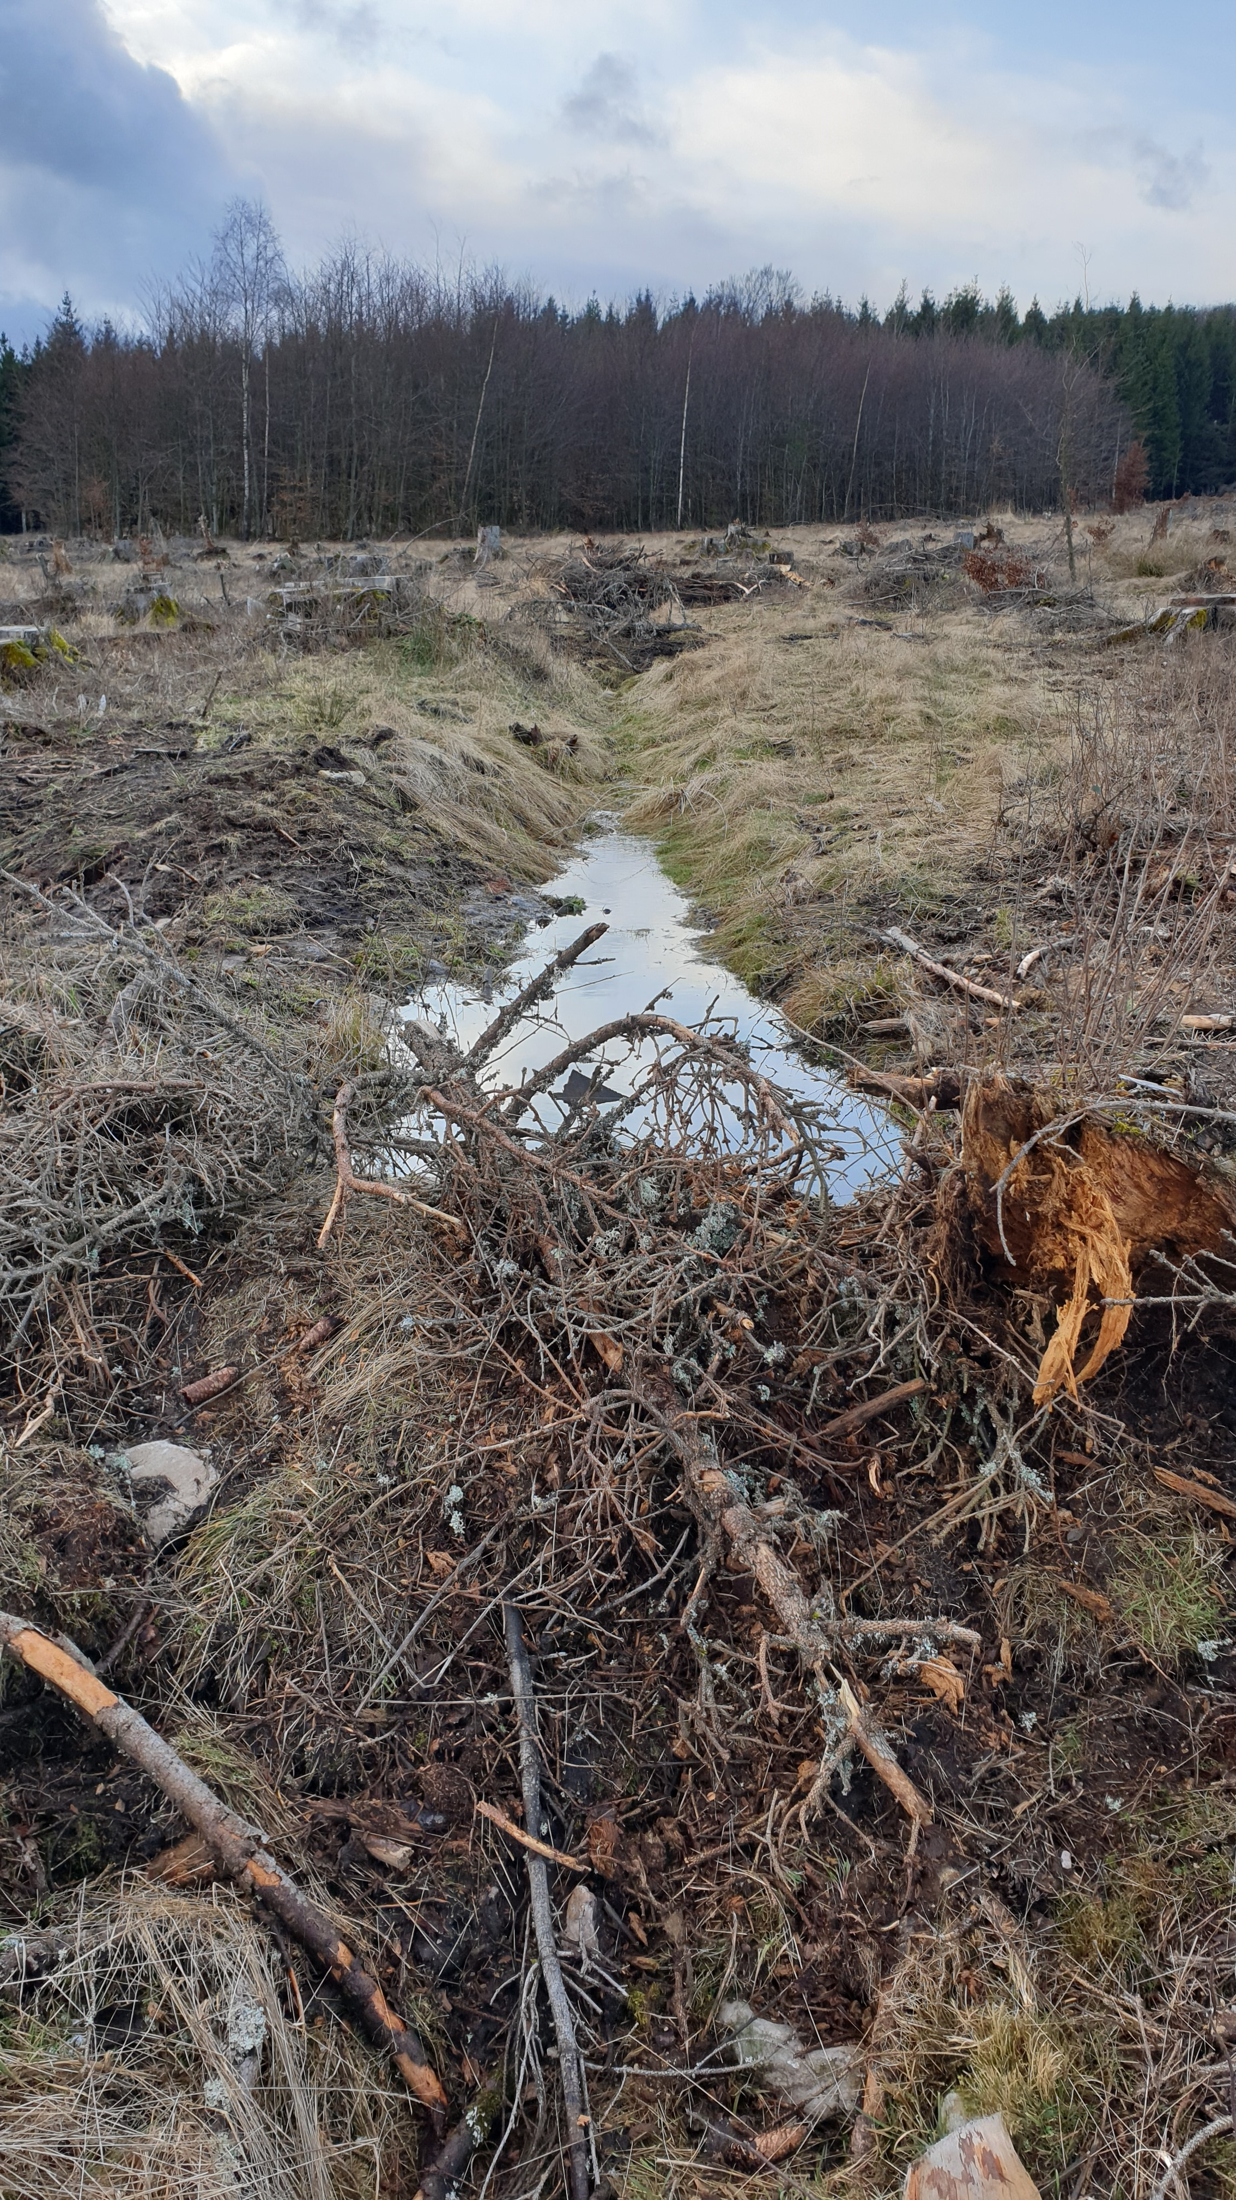
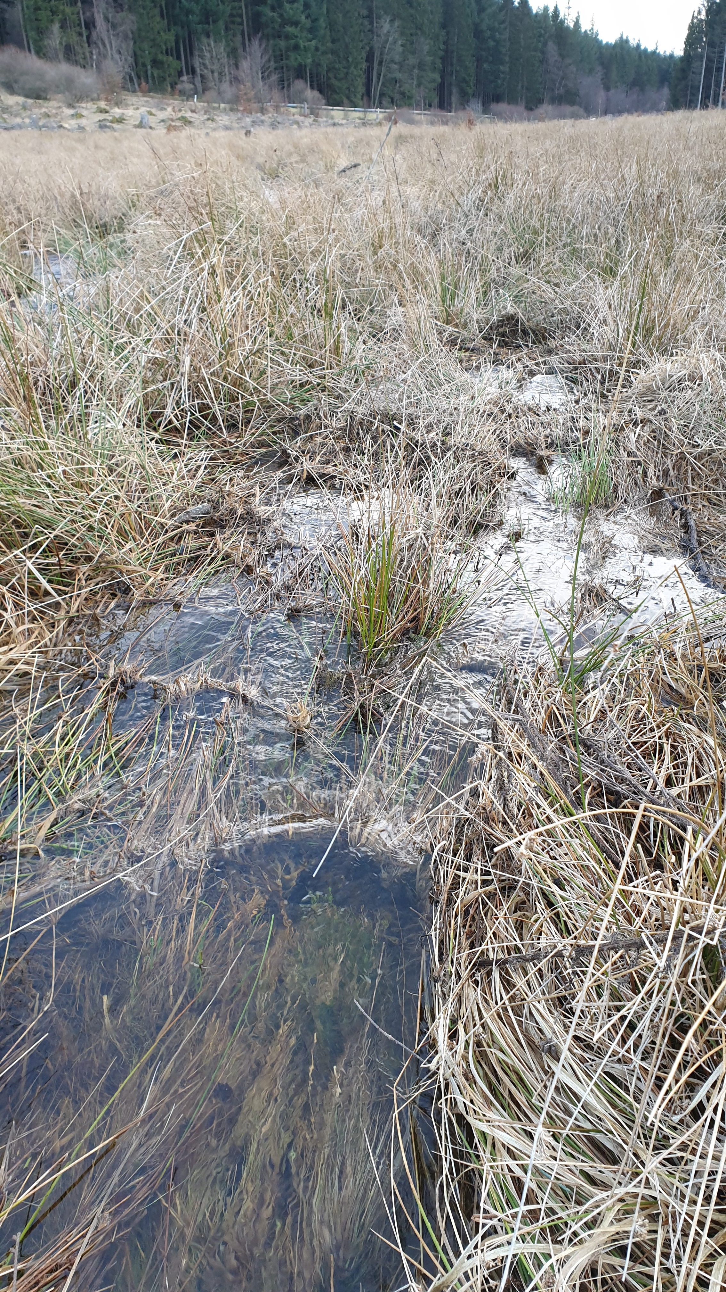

Slide 10
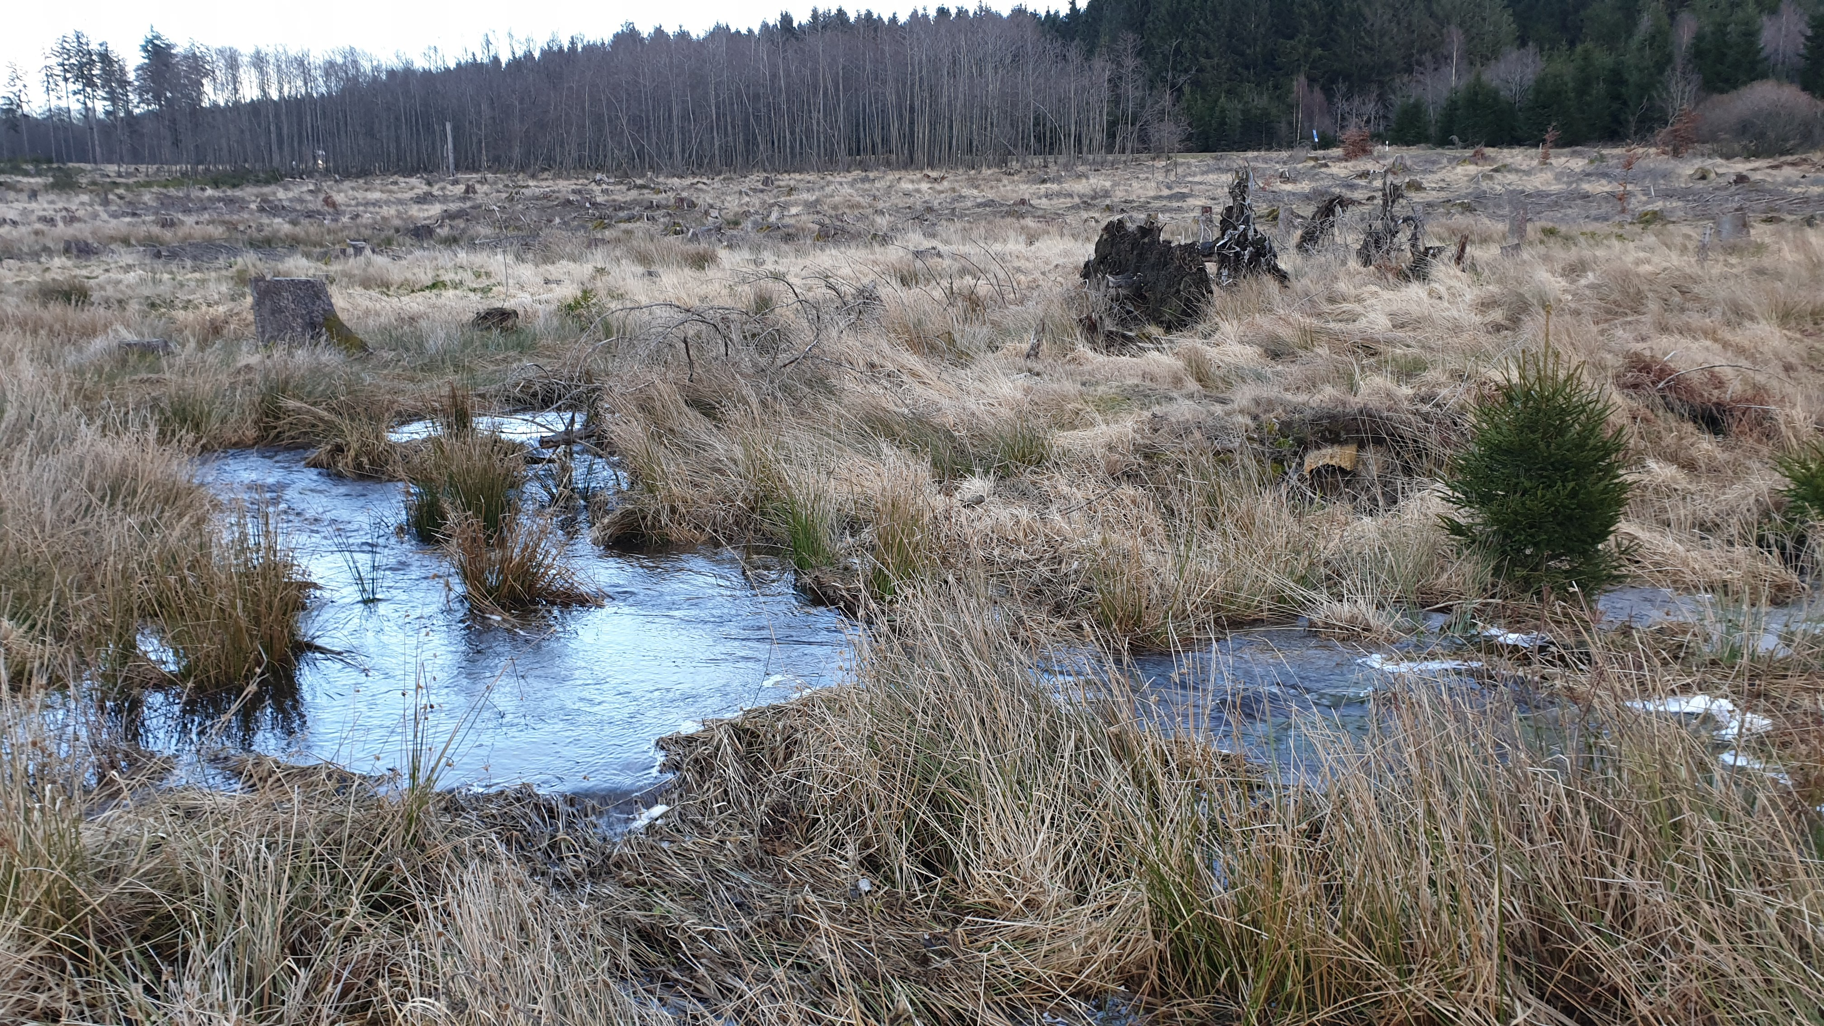

Slide 11
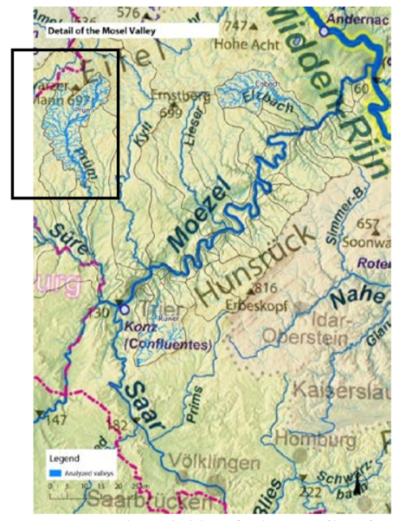
Effectiveness sponges: high precipitation in middle mountain areas
Notes:
In Duitse Middengebergte valt meeste regen. Dus aan voet van de helling verhoogt efficientie maar ook door in de rode cirkels te gaan zitten want dan vang je met een zelfde oppervlakte meer neeslag in.

Slide 12
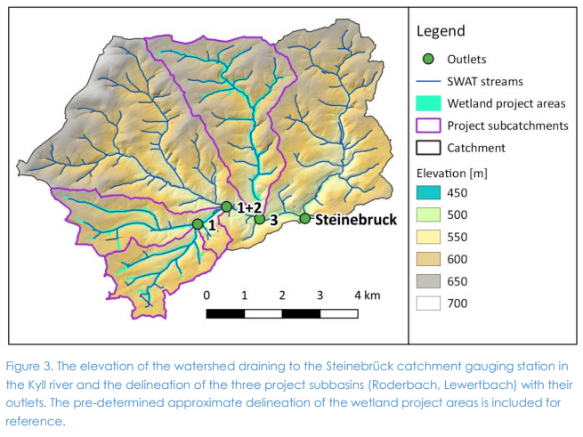
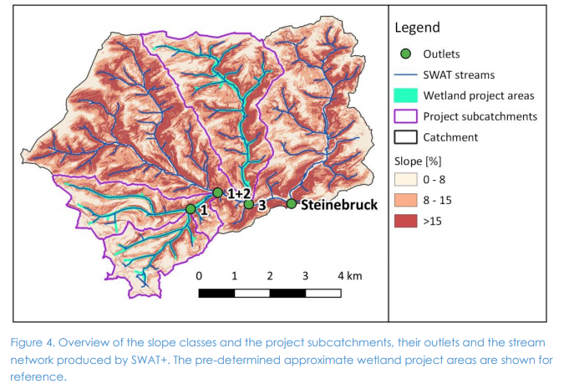
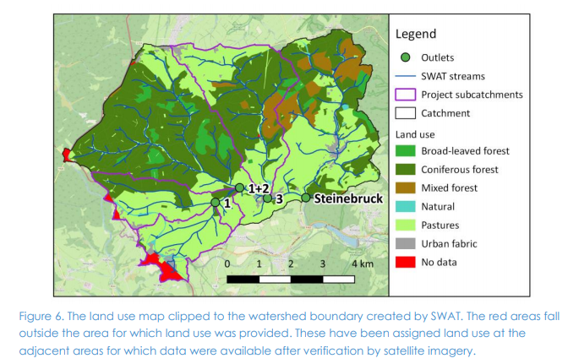
Upstream Kyll River

Slide 13
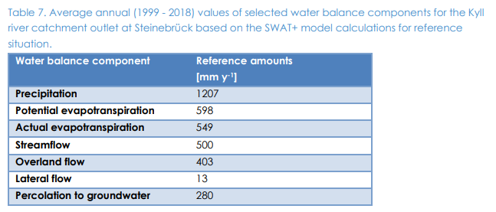
Water balance Kyll catchment

Slide 14
Modelling approach
Wetlands areas are small (25-100 m length scale) in headwater catchments
Rhine River Basin size about 160,000 km²
Scale differences requires use of hydrological models to bridge different scales:
Microscale SWAT+ model
Translation step
Macroscale WFLOW_sbm model

Slide 15
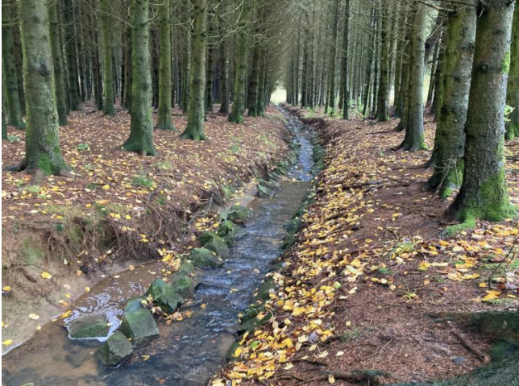
Microscale peak flow assesment
Presently flow from pasture is channeled through dug ditches and waterways
Filling up of dug channels and return of wetland vegetation creates shallow flow regime with obstructing vegetation and ponds in valley
Increase of roughness (friction) and storage delays and attenuates the flow out of these wetlands
SWAT+ model used on Kylldal Steinebrück catchment (48 km²) with restoration in three subcatchments (38% of catchment, 4-10 km²)

Slide 16
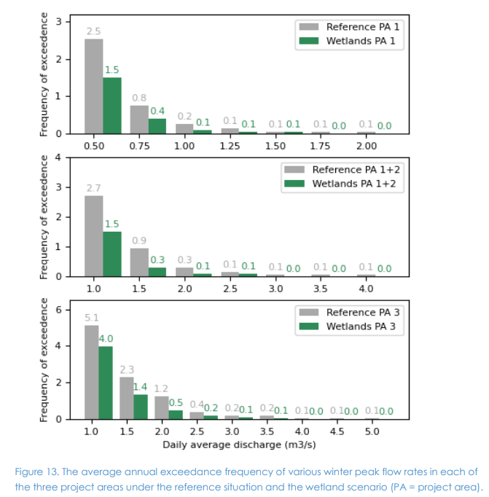
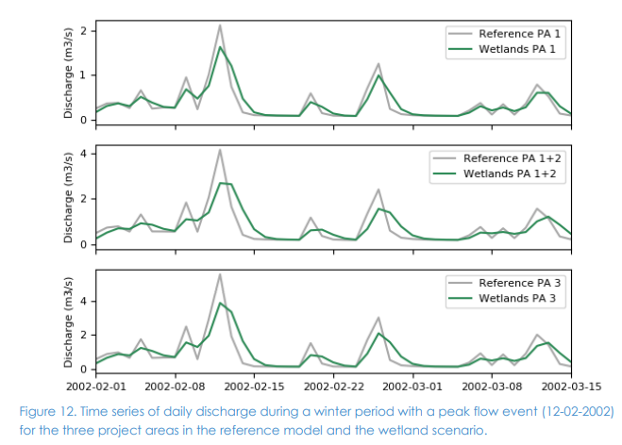
Microscale modelling results
Decreased peak flows and shorter baseflow periods after restoration

Slide 17
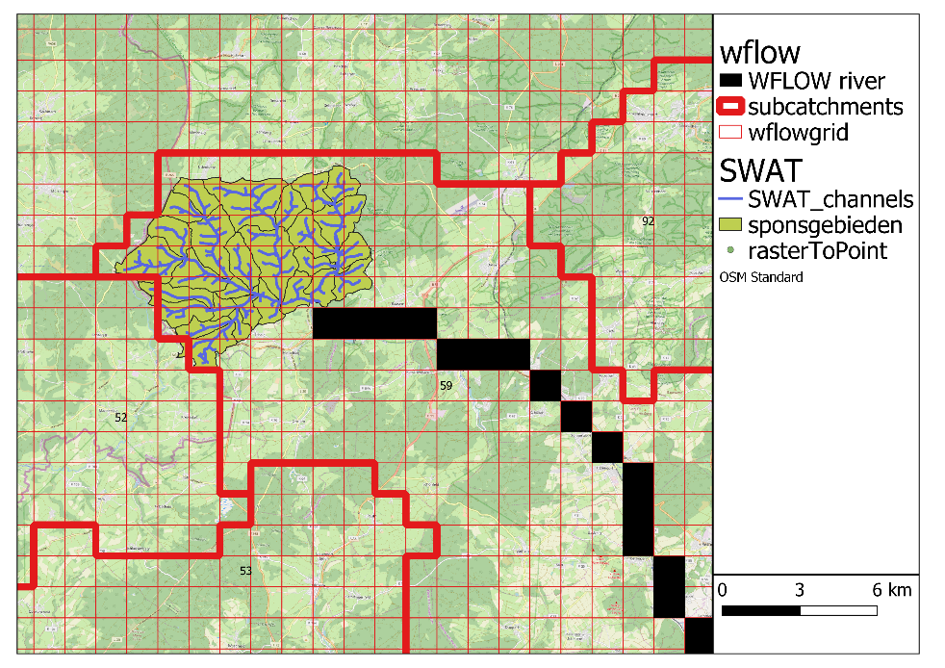
Macroscale assessment
Extrapolation of microscale assessment to Mosel and Rhine River Basins
Translation step: Changes to river friction values in wetland restoration grid cells made to simulate microscale model results
Simulations made for different wetland restoration intensities (5, 25 and 50%)

Slide 18
Conclusion hydrology natural wetland retention
Wetland restoration in headwater catchments of the Mosel and Rhine River Basins lead to reduced peak flows
Strongest reductions at microscale
Wetland restoration in Germany can decrease annual peak discharges in The Netherlands by 2 % at a restoration intensity of 38%.
10 – 30 % higher baseflow in dry periods in Steinebrück catchment
 | Steinebrück | Mosel | Rhine
Wetland restoration intensity | 38 % | 4 % 19 % 38% | 4 % 19% 38%
Annual maximum Peak discharge change | -13% | -0.4% -2.2% -4.1% | -0.5% -1.3% -1.8%

Slide 19
Field Survey Steinebrück catchment land use practices for pasture areas
1) No manure or fertilizer with N > 1.5% can be applied between 1 November until 31 January;
2) Solid manure containing more than 1.5% N or 0.5% P2O5 in dry matter cannot be applied from 1 December until 15 January;
3) On grassland, if sown before 1 May, the maximum amount of N that can be applied as liquid organic manure or mineral fertilizer is 80 kg ha-1 . However, if harvesting occurs, the amount can be increased on average up to 170 kg N ha-1 to reflect the removal in harvested matter;
4) If more than 30 kg ha-1 P2O5 are fertilized in a year, soil analysis is mandatory. If soil P2O5 levels exceed 20 mg per 100 g soil, P fertilization is limited to equal Premoval in harvested crop;
5) For extensively used pasture, with 24 h d-1 grazing, total P2O5 application is limited to 58 kg ha-1 , with 28 kg ha-1 P2O5 removed in the harvested crop;
6) On flat surfaces it is not allowed to apply manure or fertilizer within 4 m distance of the bank edge to a stream. For sloped areas these distances increase by 3 m, 5 m and 10 m for slopes exceeding 5%, 10% and 15%, respectively;
7) Hay is harvested 2-4 times a year;
8) Cattle grazing occurs only in summer

Slide 20
Water quality nitrogen balance Steinebrück

Slide 21
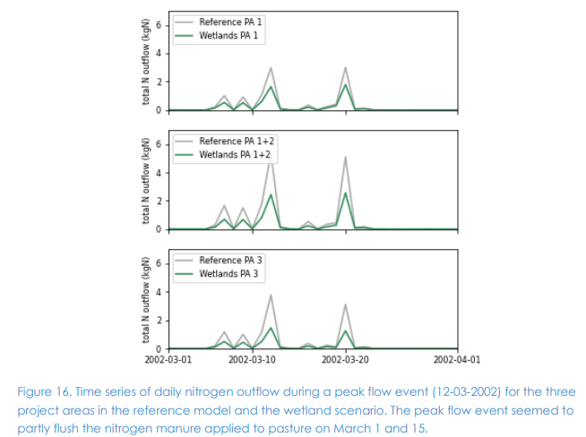
Water quality modelling results SWAT+ (1)
Fertilizer and manure were applied in the model from March to the end of April and flushing occurred after rain events in these months but decreased in summer under baseflow conditions. For example, nutrients were applied on March 1st and March 15th in the model, with elevated nutrient exports simulated after rainfall between 12 and 20 March (Figure 16)

Slide 22
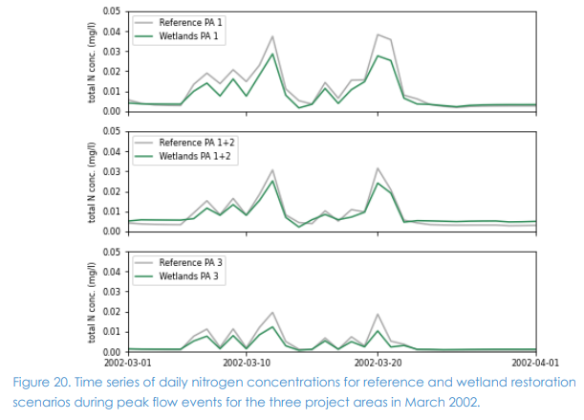
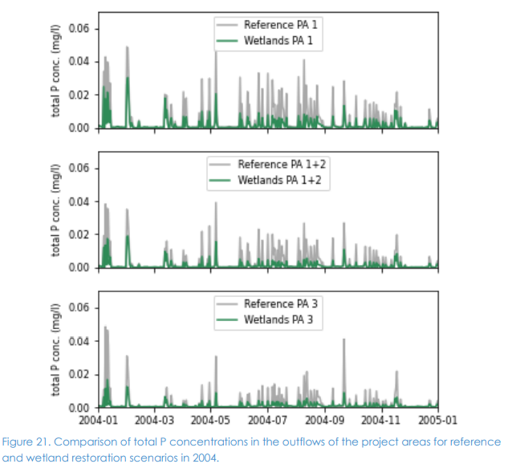
Water quality modelling results SWAT+ (2)
In the wetland scenario, peaks in nutrient concentrations were lower than in the reference scenario (Figure 20 and Figure 21). At catchment level, peak nitrogen and phosphorous concentrations were reduced by 10-30% and by 2-27%, respectively, depending on the month.

Slide 23
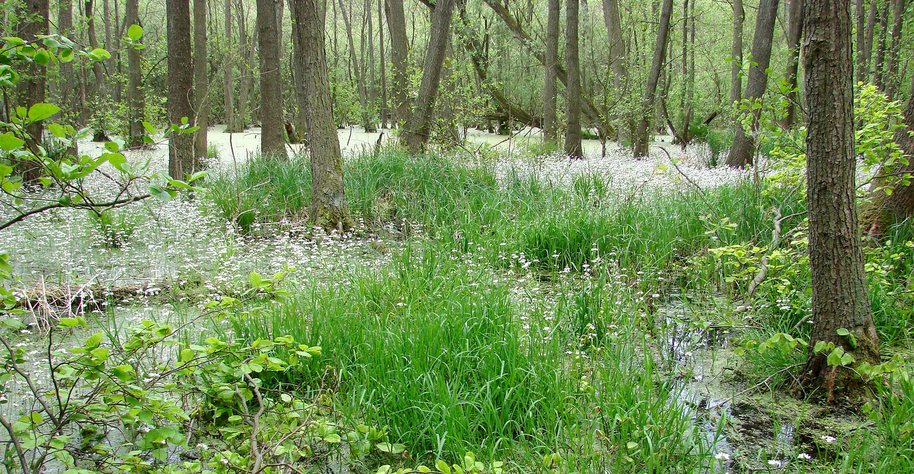
Benefits from natural sponges
Ecosystem restoration => Increasing upstream wetland habitat
Peak flow reduction: 2% on large scale, 35% on local scale
Base flow increasement: preventing droughts on a local scale
Water quality improvement: Retention of nutrients in upstream areas
Carbon storage => Farmland to Wetland 20ton CO2 reduction per acre per year

Slide 24
Social Cost Benefit analyses Natural Water Retention

Slide 25
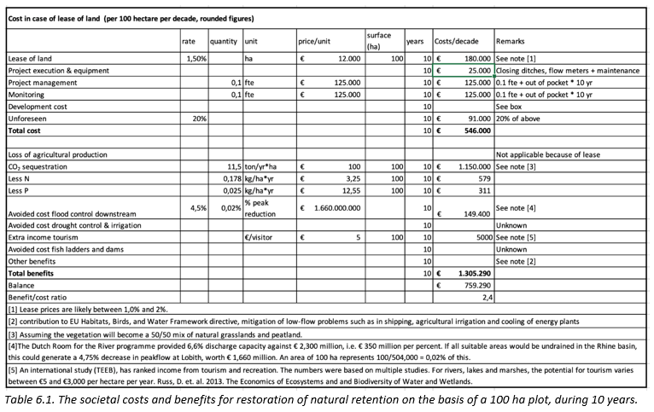
Social Cost Benefit analyses Natural Water Retention

Slide 26
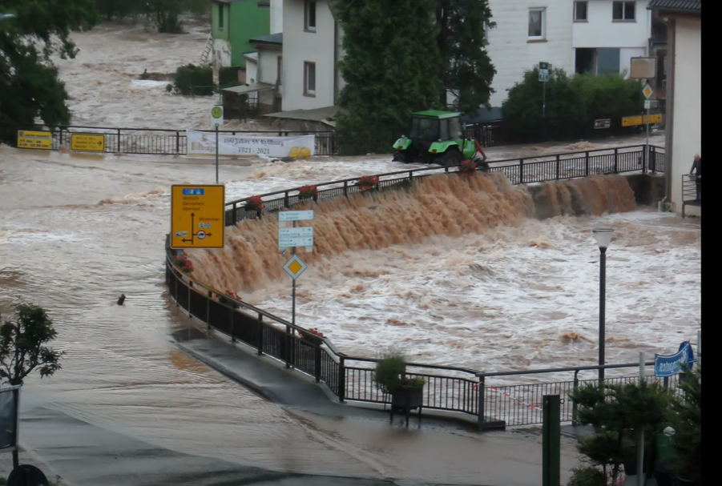
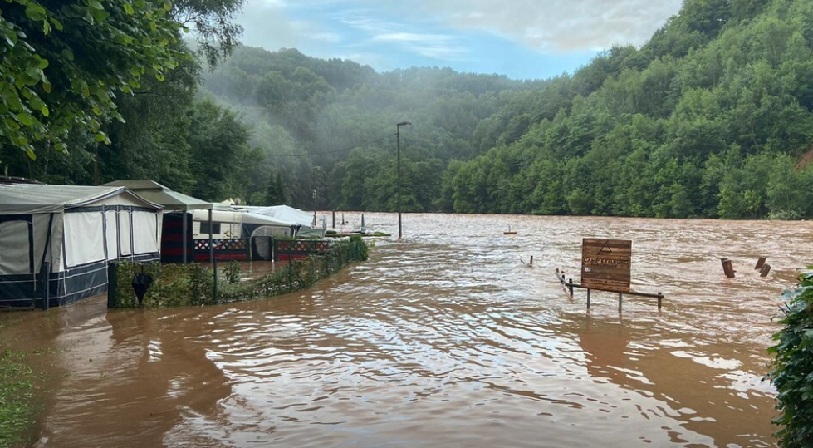
Social costs flood event July 2021
Devastating flood event in July 2021 in the Kyll river (pictures are from Kyllburg) and other middle mountain areas in Germany and Belgium
Social and Financial costs are not yet estimated but are enormous
First analyses show that upstream catchments contributed more to the peak flow downstream then one would expect given their catchment size.

Slide 27
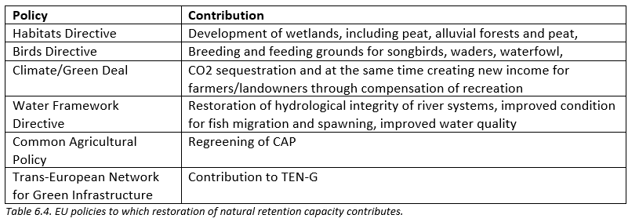
Policy contributions, a crucial part of the business case

Slide 28
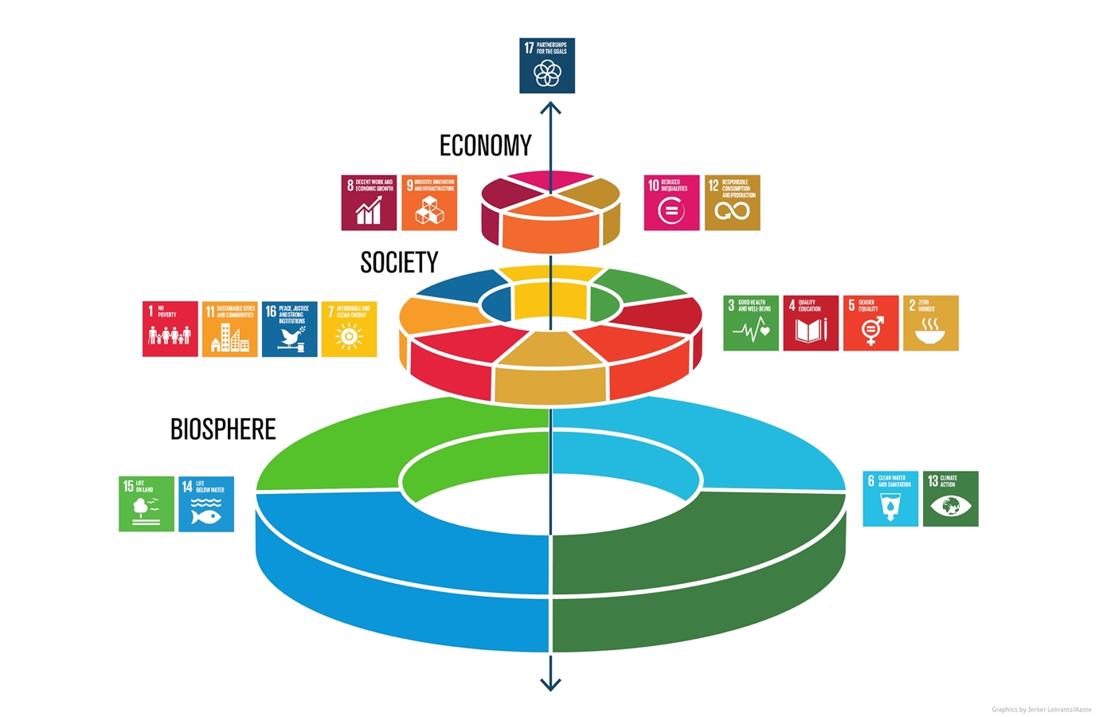
From governmental to private financing
Step 1: EU/Government funding will enable the further development of the funding needed in this step could either come from JRC of the European Green Deal Investment Plan (EGDIP), also referred to as Sustainable Europe Investment Plan (SEIP).
Step 2: EU/Government and/or the European Investment Bank funding will enable certification of the CO₂ sequestration potential for natural retention. Inclusion of certificates in either a voluntary or mandatory (Government/ETS) system need to be explored..
Step 3: European Investment Bank and/or EGDIP/SEIP funding will buy pre-financing of financing CO₂ certificates linked to natural retention as a sign of confidence.
Step 4. Businesses and institutions moneys will become a main source of funding for natural retention.

Slide 29
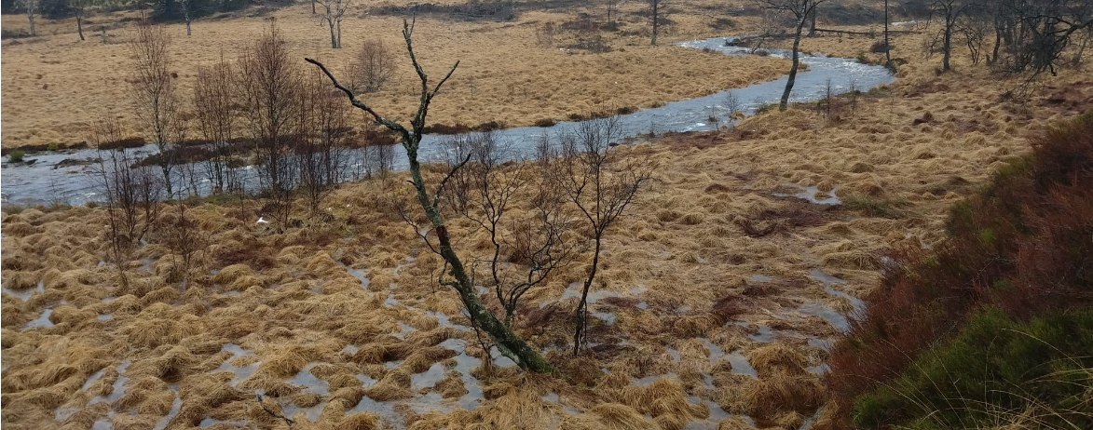
Conclusions
Restoration of natural retention (wetlands) in the German Middle Mountains is a viable ecosystem-based solution to improve the hydrological services of catchments.
It reduces flood risks and droughts in the Rhine basin, with local effects being strong, favouring the chances for local cooperation needed.
Similar effects can be seen on regional and international level, less strong but still pronounced.
The more pronounced if other benefits are taken into account as well: the decrease of CO₂ emissions, improved water quality, the increase in biodiversity, strengthening of Europe’s green infrastructure and a step towards a greener economy. As such restoring natural retention contributes to multiple EU policies as well as national goals.

Slide 30
Thank You!

