Slide 2
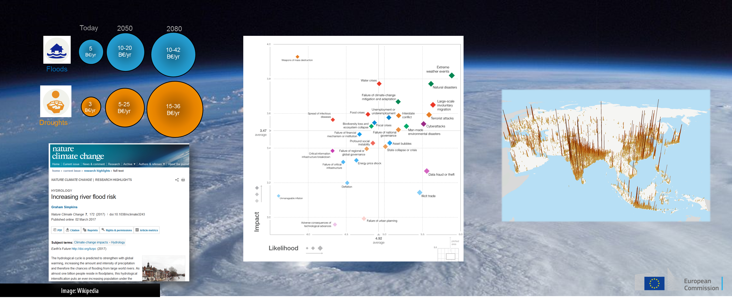

Slide 3
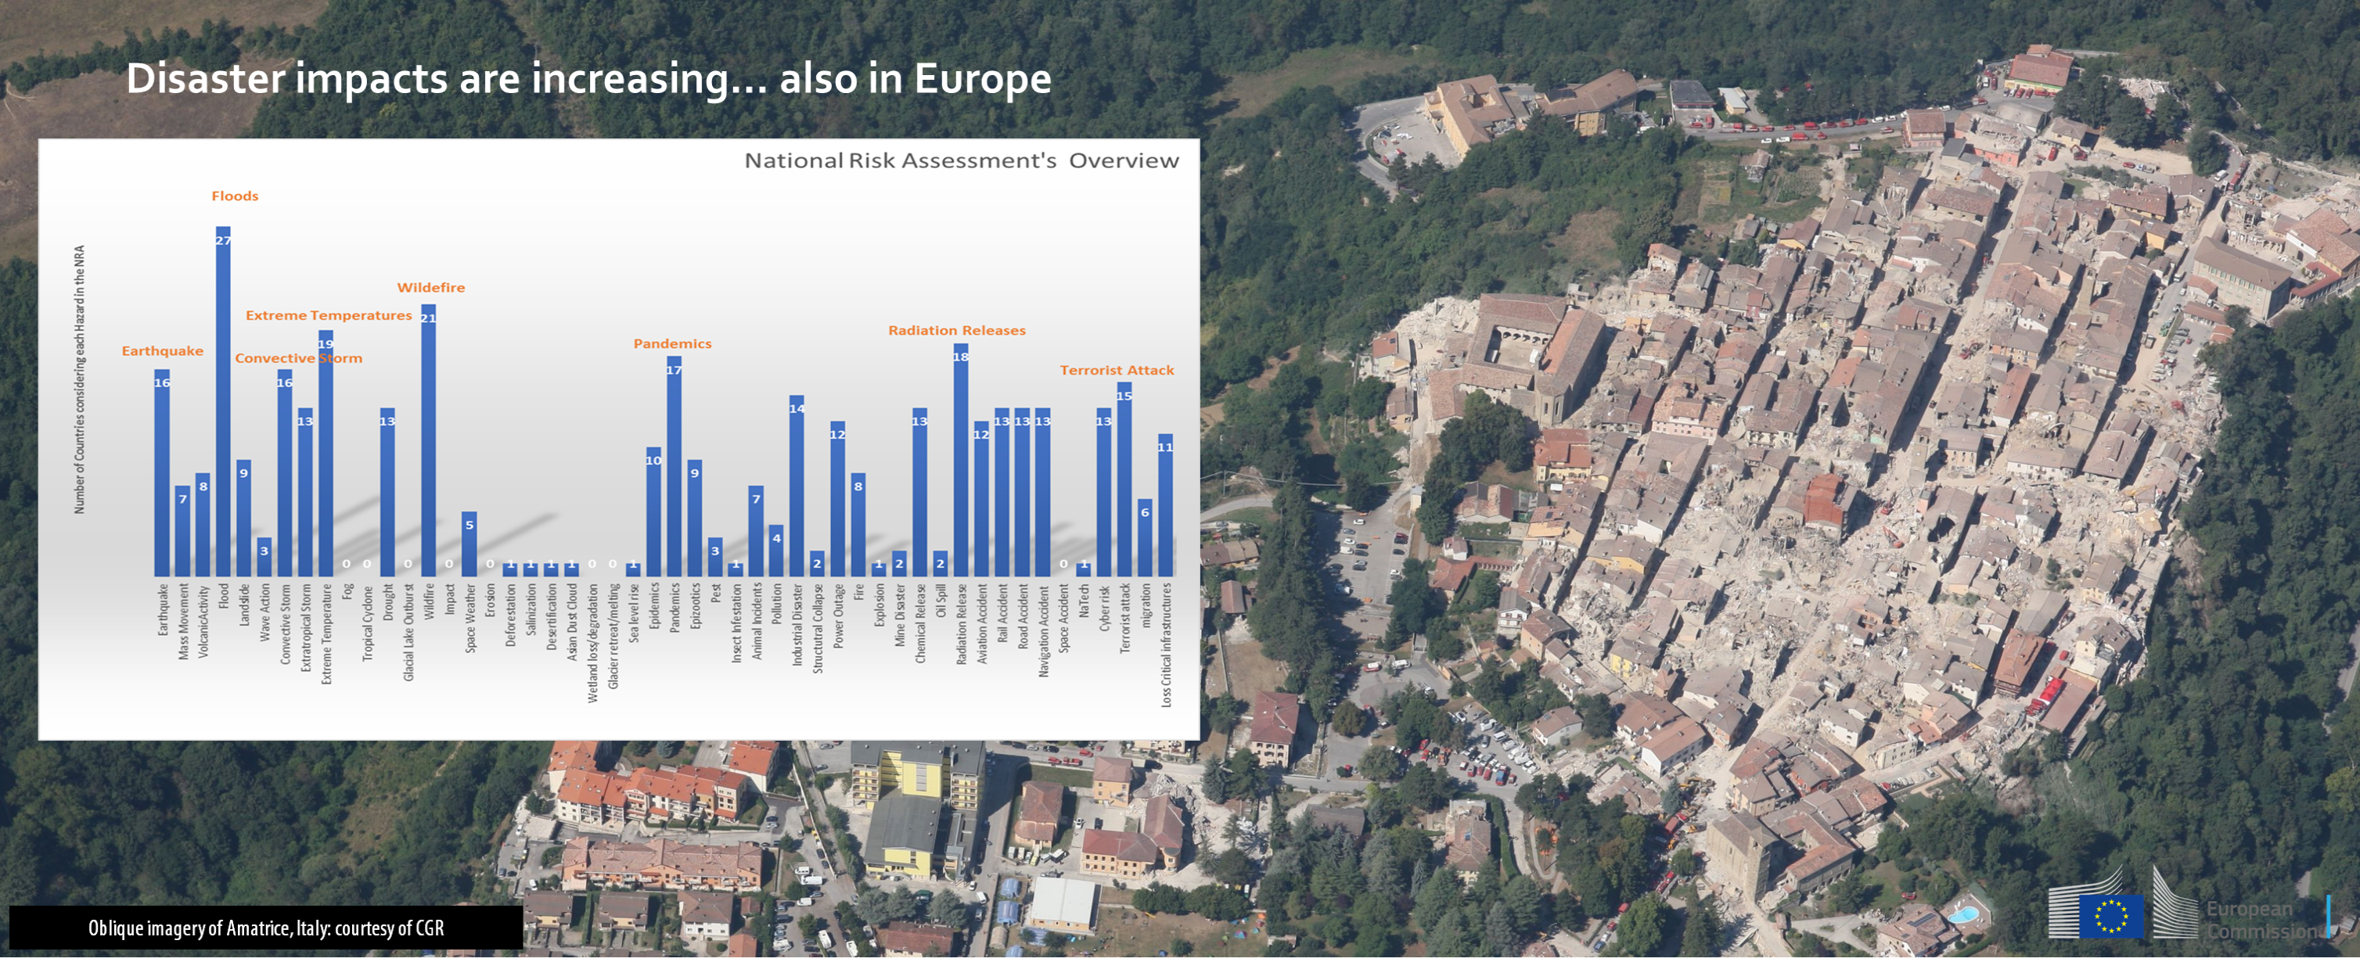

Slide 4
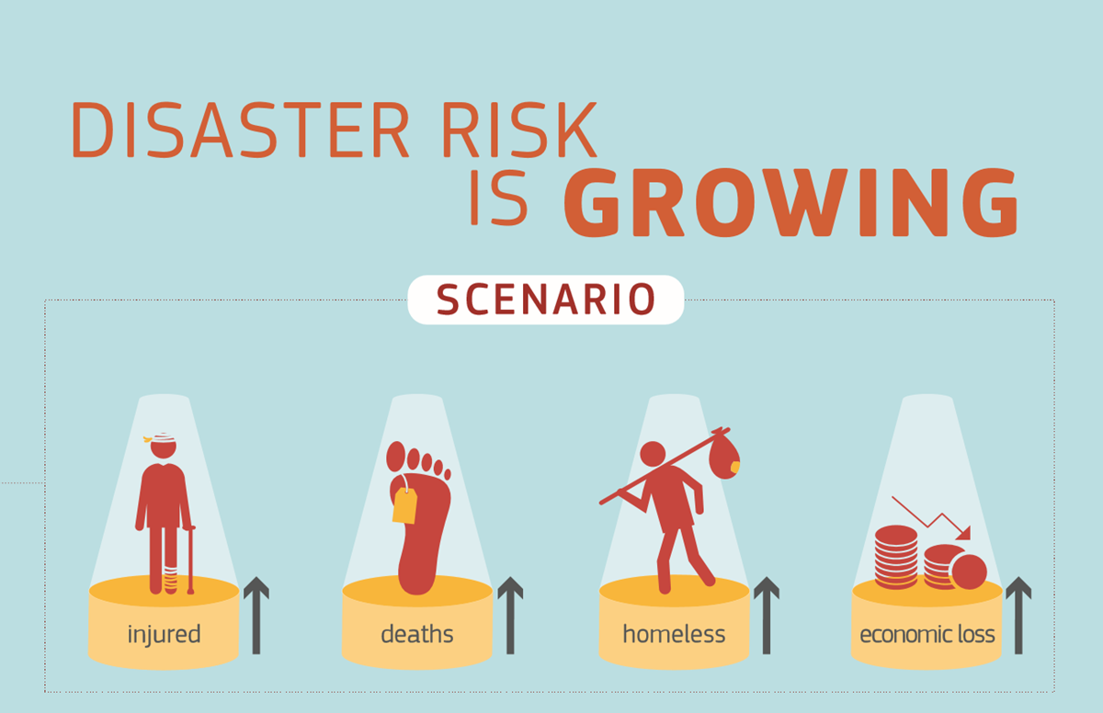
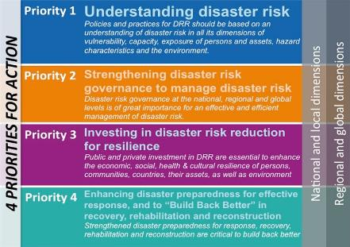
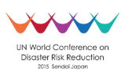


Enhancing Science-Policy interface for DRM
  Disaster risk knowledge: policy context
  New Union Civil Protection Mechanism
    Nov. 2017
  “Strengthening the effectiveness of prevention action as part of the DRM cycle, as well as reinforcing links with other key EU policies acting in the field of disaster prevention and disaster response”
  Sendai Framework for Disaster Risk Reduction
    2015-2030
    Call for stronger role of science and building risk knowledge

Slide 5
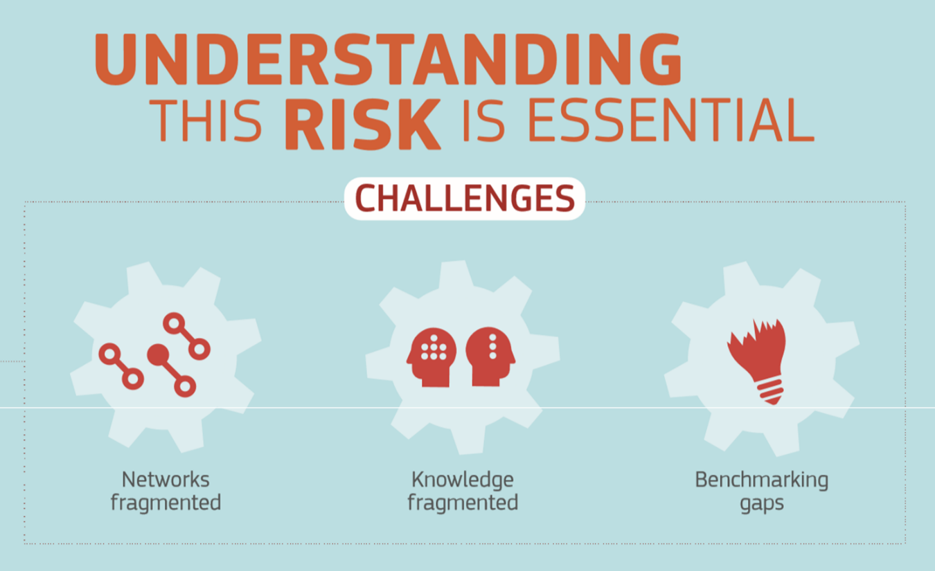
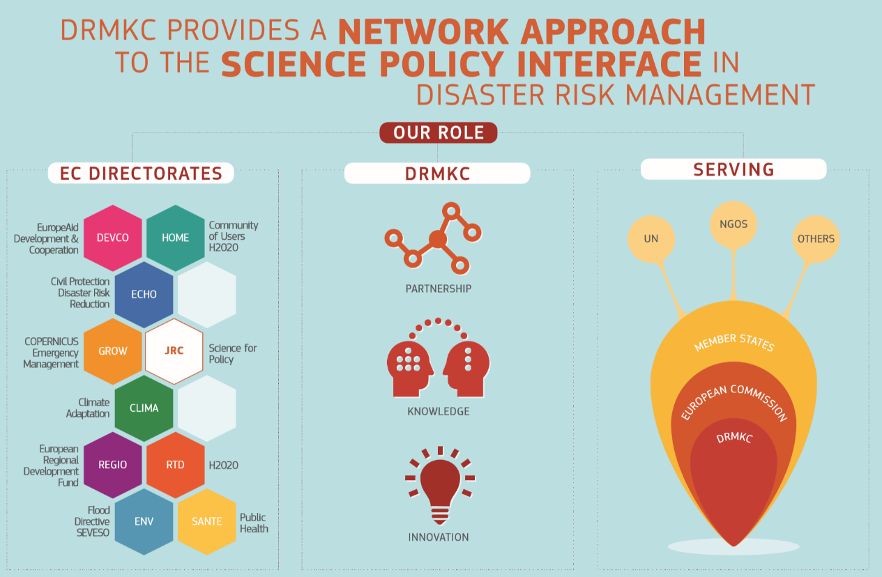
Network approach to Science-Policy

Slide 6
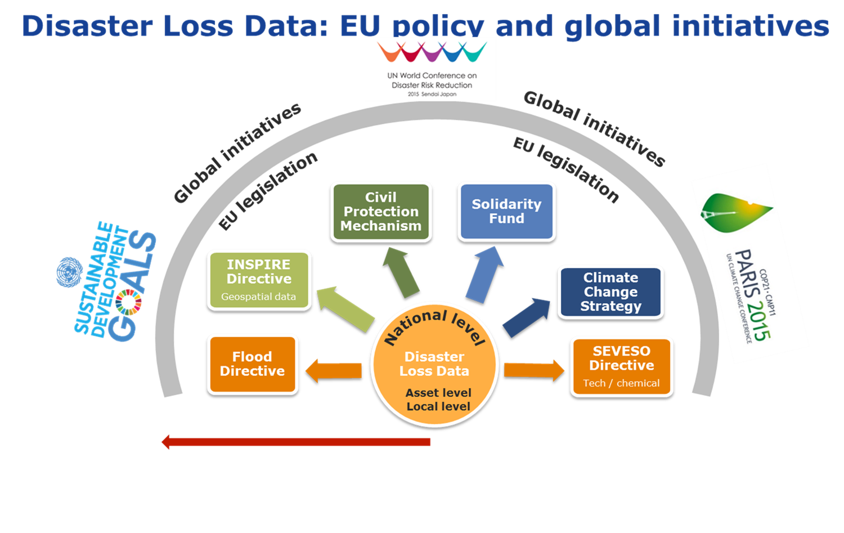
Data 4 Policy

Slide 7
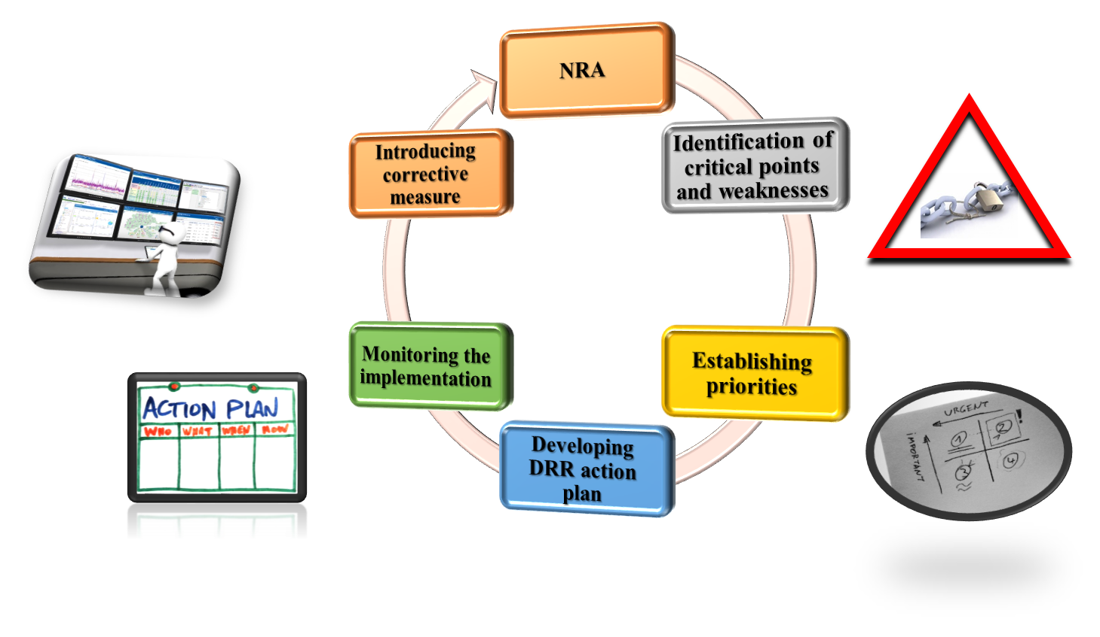
Data 4 Enhanced Resilience

Slide 8
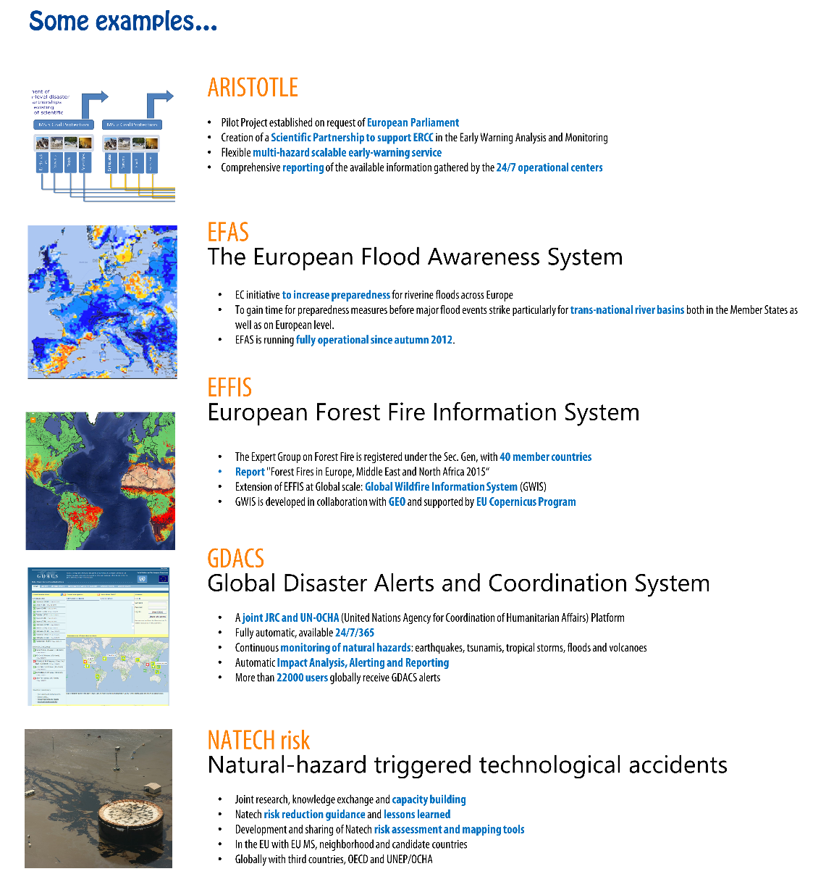
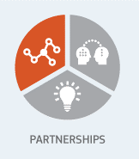
How?
21 March 2018
1. Hazard Scientific Partnerships
Sharing Science
  Fostering EU wide scientific networks
  From MS to MS and EU
  Sharing of competences and resources
  Promoting EU science at global level
  Developing EWS and RA methodologies, tools and models
Where knowledge begins

Slide 9
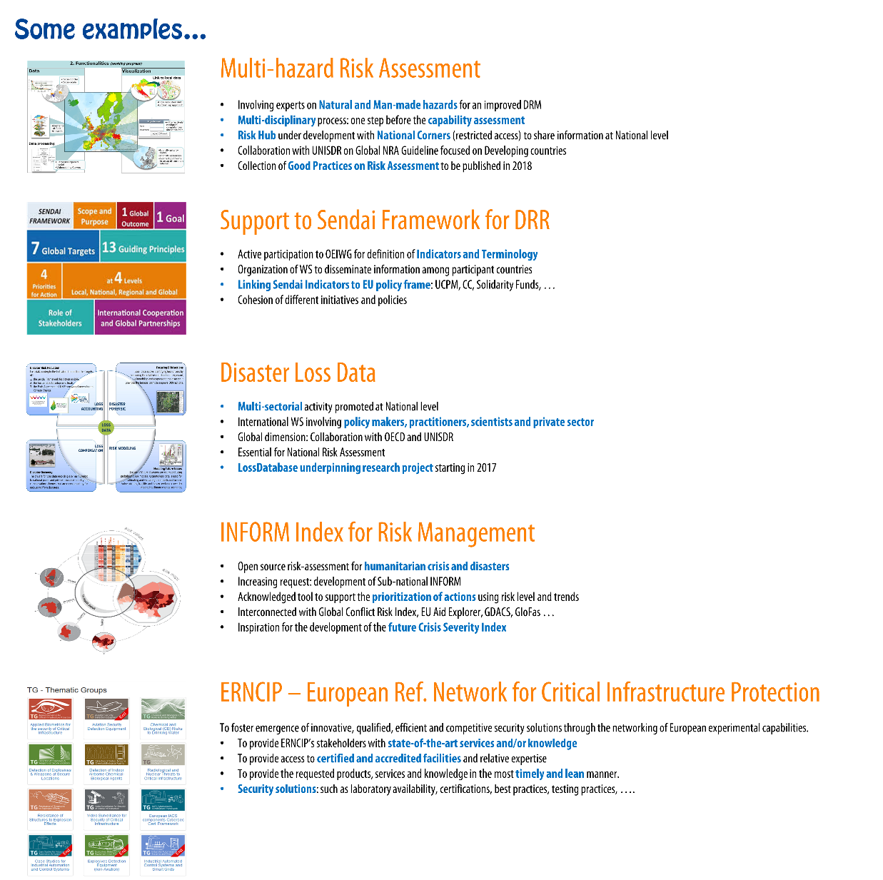
How?
21 March 2018
2. Science-policy Partnership
  Networks of networks
  Coherent science-based advice for policy
  Disaster Risk Reduction and Risk Management
  EU (UCPM) and Global (Sendai) dimensions
  Multi-sectorial, across policies (climate change, flood directive, solidarity fund, INSPIRE, SEVESO…)
Where knowledge applies

Slide 10
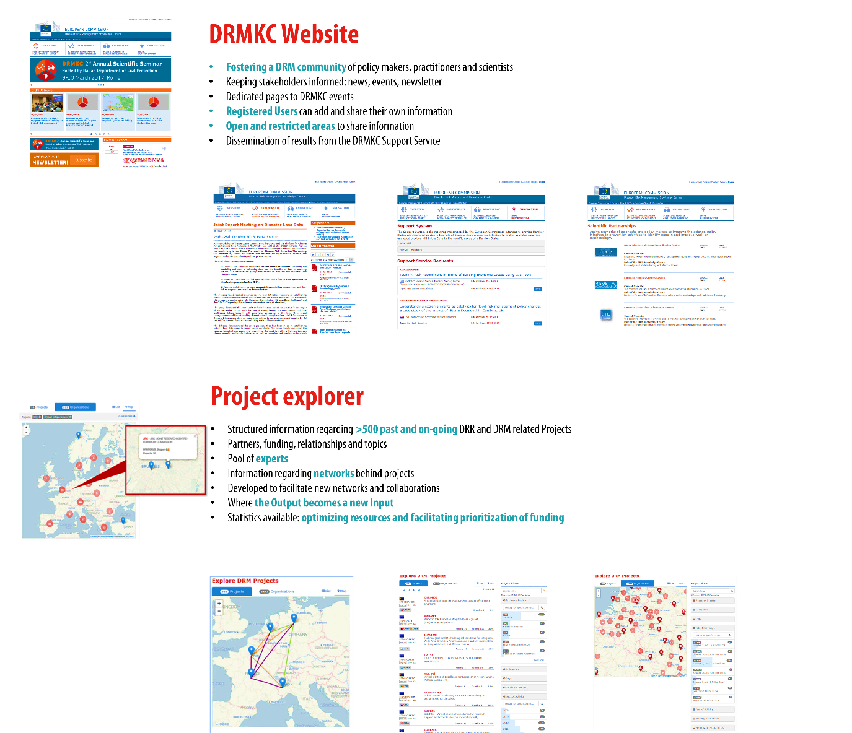
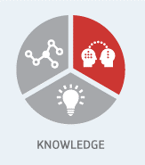
How?
21 March 2018
3. Pooling of research results
  Collection and dissemination of information
  Increased pooling and accessibility of research results
  Developed to ensure a thorough transfer of research outputs to end-users.
  Centralized access point to DRM related information
  Where knowledge meets

Slide 11
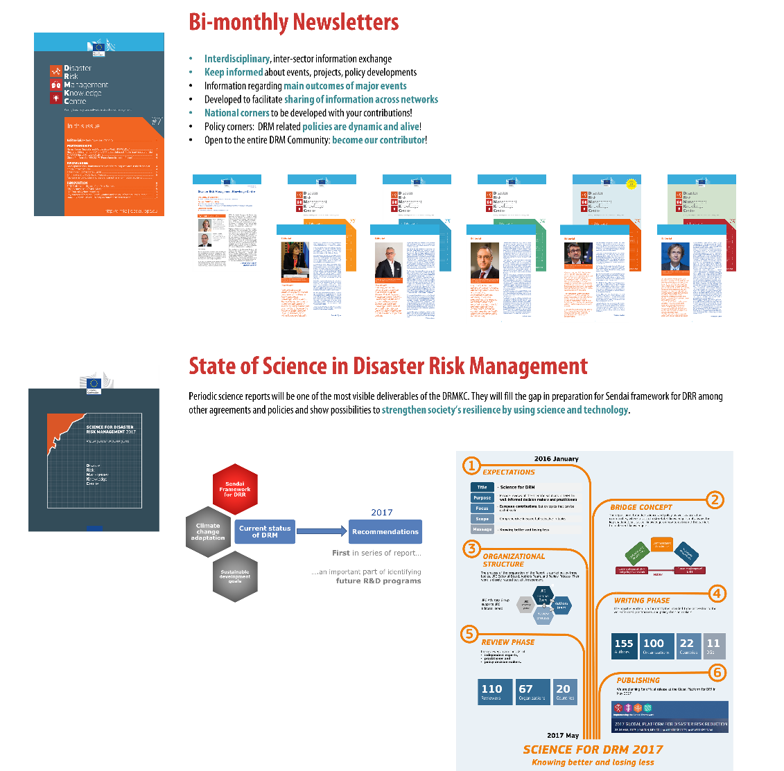
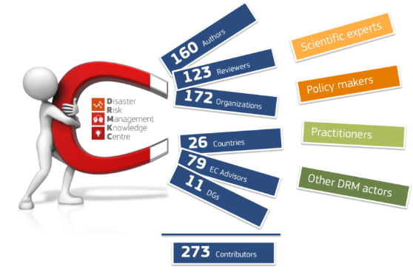
How?
21 March 2018
4. Identification of research needs
  Research opportunities
  Dissemination of research results and information
  Identification of research needs and gaps in disaster risk and crisis management
  Where needs are identified

Slide 12
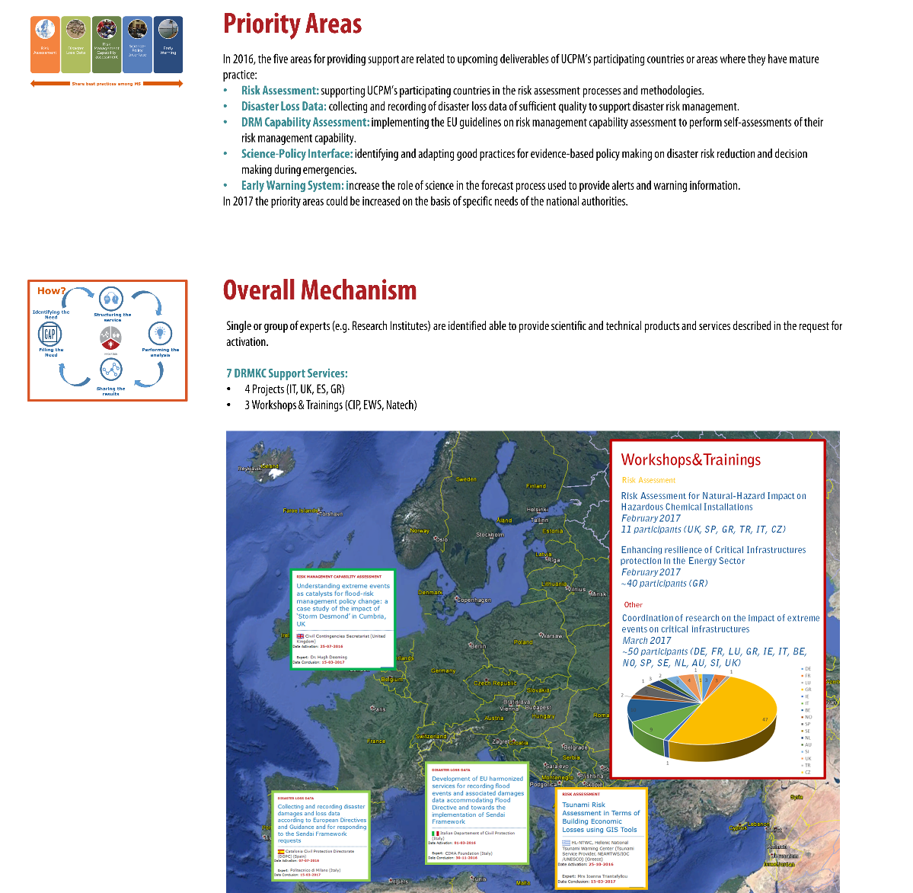
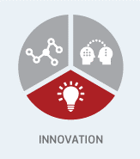
How?
21 March 2018
5. DRMKC Support System
  Support Service
  Facilitate the use of existing expertise for science-based policies
  Providing scientific and technical advices to end-users
  Reinforcing the link with global and EU frameworks
Taylor-made projects
2017 – 10 New projects under discussion
  Where gaps are filled

Slide 13
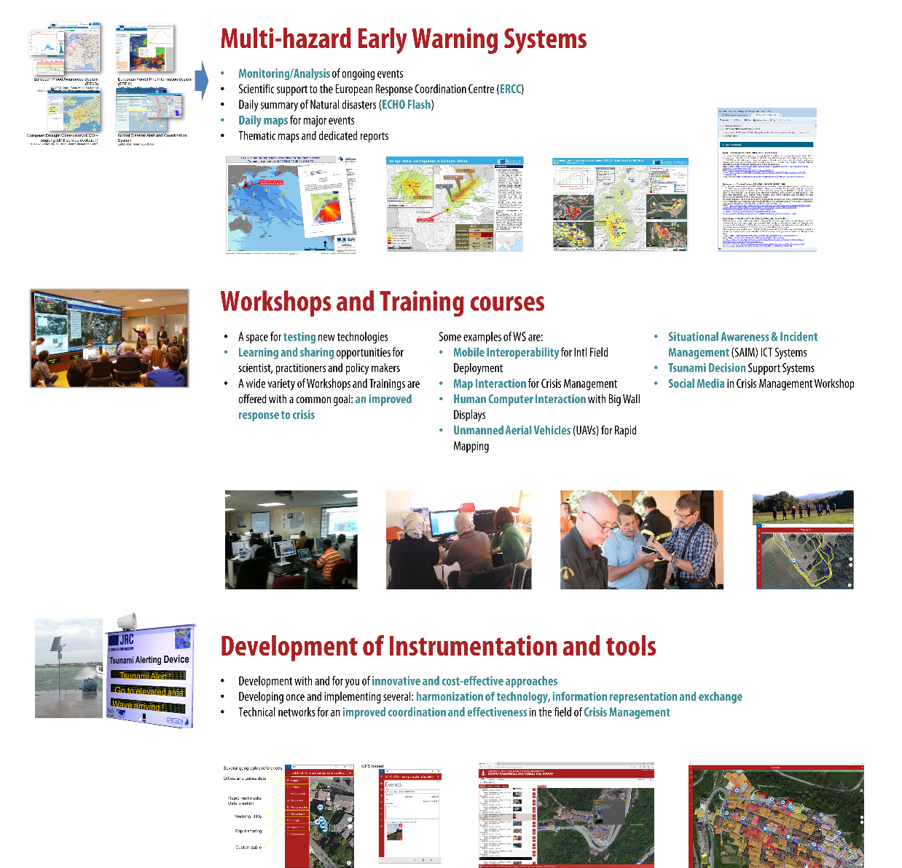
How?
21 March 2018
6. European Crisis Management Lab
  ECML
  Developing dedicated technologies and capabilities
  Scientific and technological at the service of emergency response
  Reinforcing emergency management operations and supporting disaster recovery processes
  Where innovation is tested

Slide 14
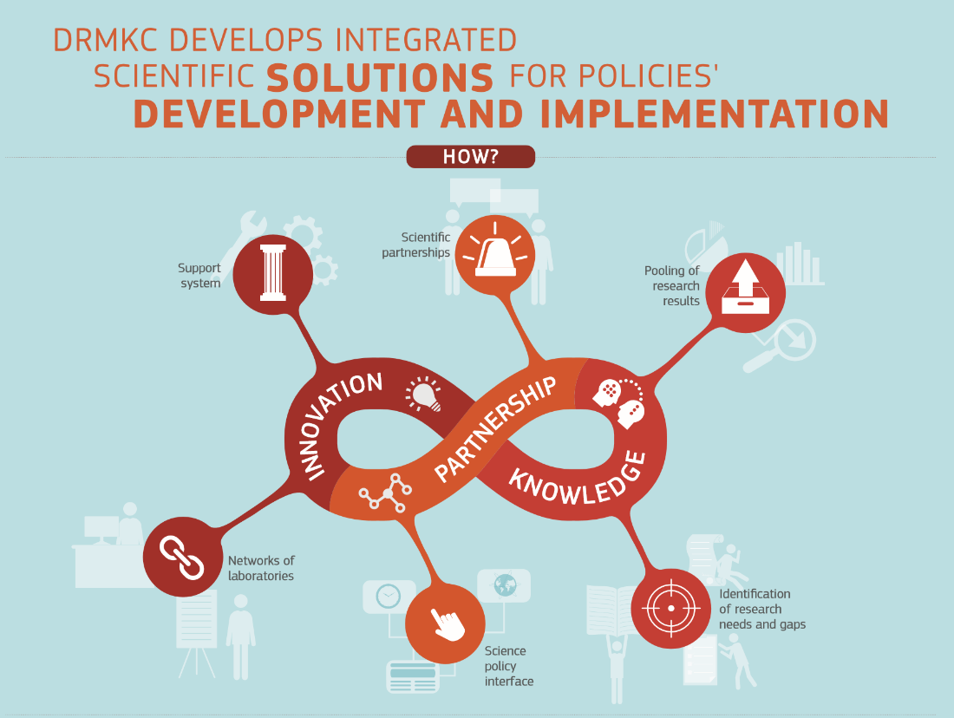
DRMKC: Aligning Research Solutions & Needs

Slide 15
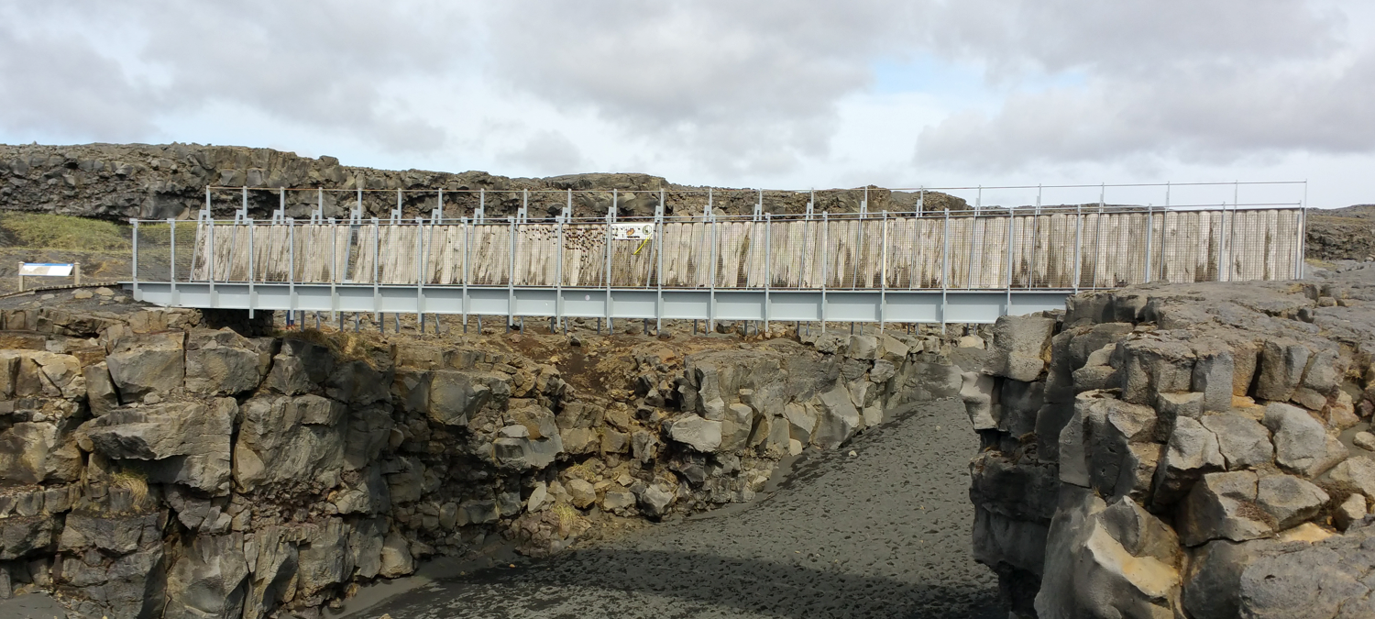
Scientists
Science trends
  Complexity
  Acceleration
Challenges
  Usable and used science
  Distill relevant results
Practitioners
Implementation trends
  New technological developments
  Impact of events is growing
Challenges
  Providing feedback
  Benchmarking/exercises
Policy-makers
Policy trends
  Interconnected
  Global
Challenges
  Holistic approach
  Evidence-based policy making

Slide 16
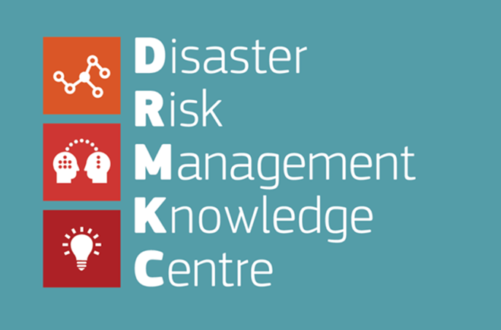
Any questions?

