Slide 1
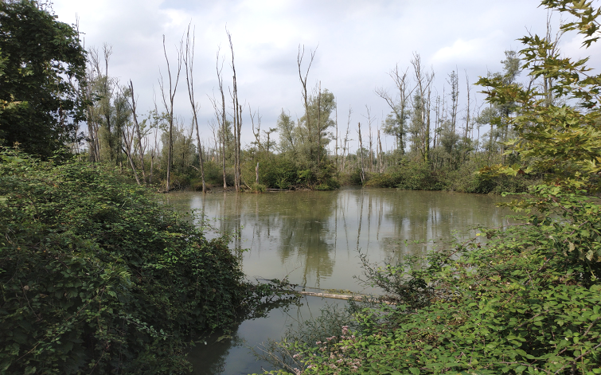


NATURE-BASED SOLUTIONS
FOR CLIMATE CHANGE ADAPTATION
AND WATER POLLUTION IN AGRICULTURAL REGIONS
Lot 5
LDP in a Continental Environment Feasibility Study
Dr. Fabio Masi 05th May 2020
www.iridra.com
info@iridra.com

Slide 2

Objectives
The present study aims to contribute to the reduction of agricultural water pollution by Nature-Based Solutions (NBS) while delivering, at the same time, other benefits beyond water pollution control, such as shelters for biodiversity, amenity and recreational opportunities.
More specifically the present study will provide evidence to address the following questions:
How can NBS contribute to mitigate agricultural water pollution (nutrients, pesticides, sediments, and other contaminants)?
What are the costs and cost drivers of NBS?
What are the benefits they deploy?
What are the technical, capacity, governance, management and financial constraints hampering their take-up?

Slide 3
Study Area
Venice Lagoon is easily subject to eutrophication thus national and regional laws have been set up to create a special regulatory framework to deal with the problem in the area
The most recent Regional Director Plan, approved in the year 2000, sets quantitative objectives of pollutants removal that includes nutrients (nitrogen and phosphorus) from point and diffuse sources.
The removal targets set for the whole region by the Director Plan are :
    3000 tons per year for nitrogen.
    300 tons per year for phosphorus.

Slide 4
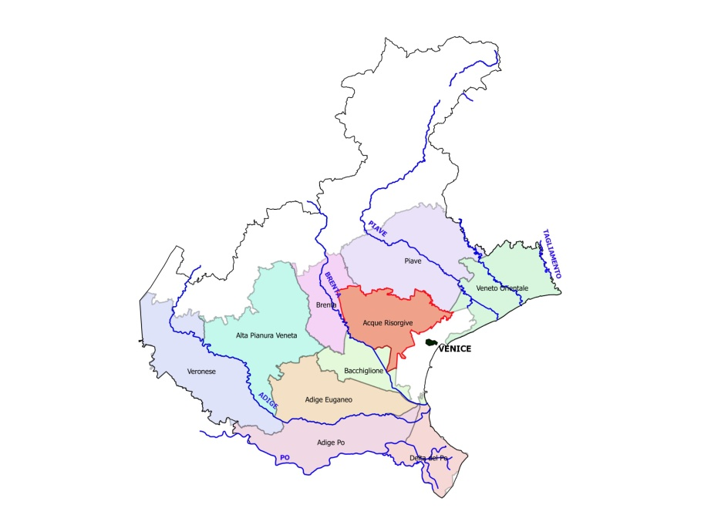
Study Area
The drainage basin of the Venice lagoon is composed by several basins, each of them managed by a different Drainage Authority
Acque Risorgive drainage authority operating on several basins located in the Northeaster part of the region and managing an area of around 100.000 hectares.
To organise its management activities the Acque Risorgive drainage authority identified six sub-basins with similar characteristics (UTO – Unità Territoriali Omogenee).
Figure 1. The Consorzio di Bonifica “Acque Risorgive” and the other Drainage Authorities of the Veneto Region.

Slide 5
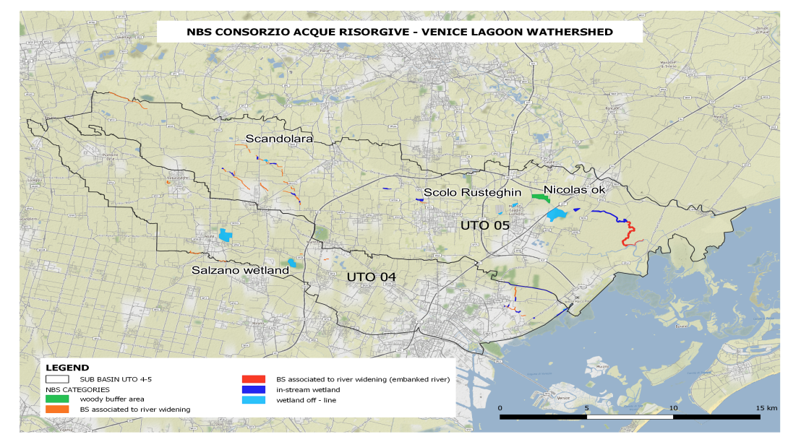
Study Area
The present study is focused on two units, UTO 4 and UTO 5 (Marzenego and Dese-Zero) , where most of the NBS to reduce pollution have been implemented in the last 25 years.
2 wetlands and 2 buffer strips have been identified taking into account the amount of monitoring data available.
Able to provide detailed parametric data to estimate NBS direct and indirect benefits and develop the business model for the UTO 4 and UTO 5.
Figure 2. Map of the two sub-basins under study

Slide 6
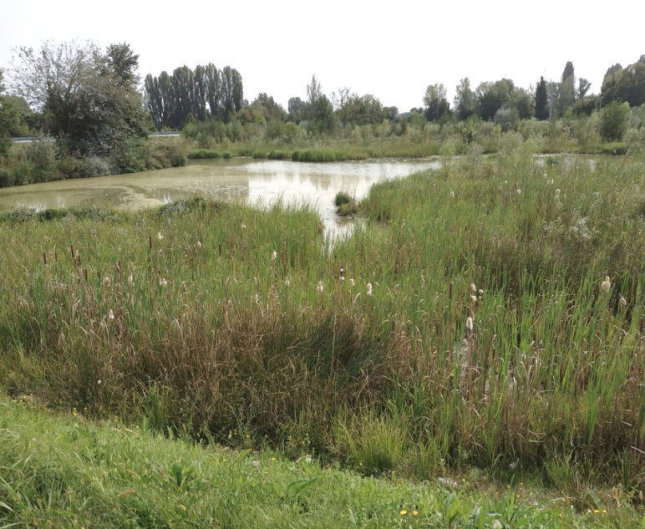
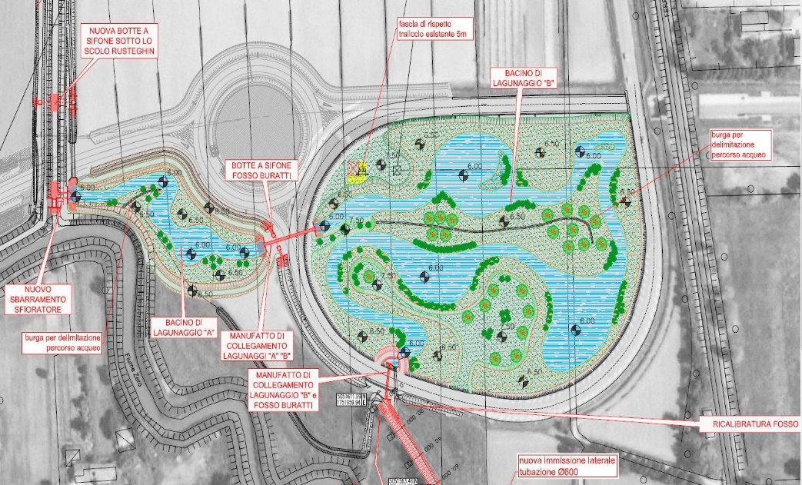
Wetlands
SCOLO RUSTEGHIN (3.5 ha):
It is an in-line wetland receiving the water from the canal Rusteghin.
Designed to create a tortuous flux inside the wetland to increase the residence time and improve the effects of the natural processes on the nutrient removal.
The wetland can also be used to store rainwater contributing to flooding risk reduction.
Figure 3. Pictures of the Rusteghin wetland from the site visit held the 17th September 2019
Figure 4. Planimetry of the Rusteghin wetland

Slide 7
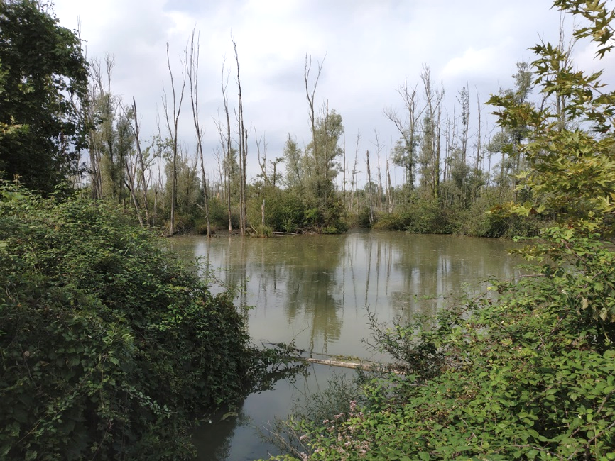
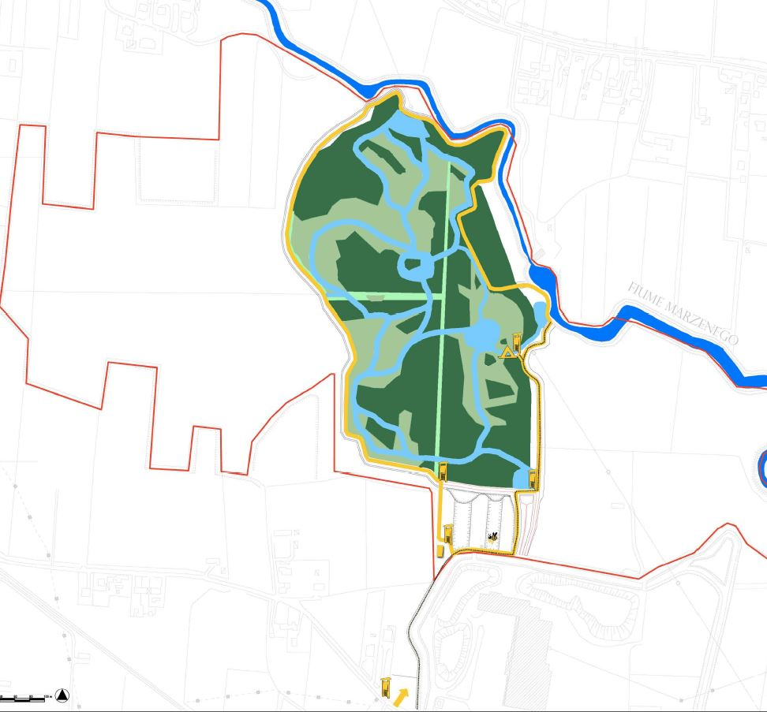
Wetlands
SALZANO (21.6 ha):
This wetland is limited between two water bodies: the Marzenego river and the Rio Roviego.
Part of the flow of the Marzenego river is withdrawn to feed the wetland and then flows into the Rio Roviego.
Water flows through the wetland without the use of pumps since the water moves by gravity thanks to the presence of different water level height.
Figure 6. Pictures of the Salzano wetland from the site visit held the 17th September 2019.
Figure 7. Planimetry of naturalistic and recreational infrastructure

Slide 8
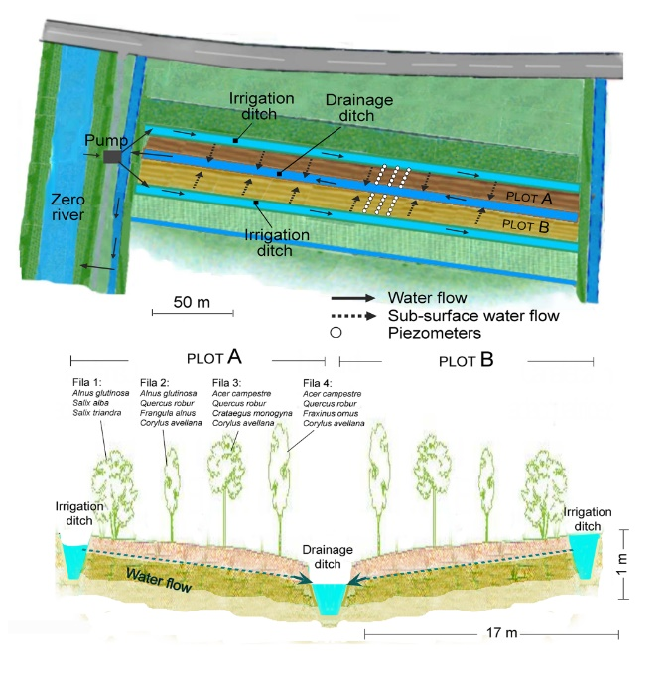
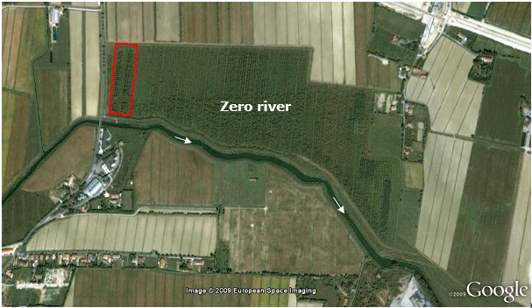
Buffer Strips
NICOLAS site (0.86 ha):
It is a 30 ha wide sub-irrigated and afforested riparian buffer area near the village of Mogliano Veneto.
Five pumps distribute the water from the Zero river to 30 drainage channels, where water is accumulated and then allowed to flow through the soil.
Finally, water reaches the main drainage channel and then goes back to the Zero river.
Figure 8. Aerial view of the whole (30 ha) afforested riparian buffer area, located in the left bank of the Zero river. The red area includes the NICOLAS experimental site (0.85 ha).
Figure 9. Plan (above) and section (below) of the 30 m wide experimental site. (modified by Gumiero et al., 2009).

Slide 9
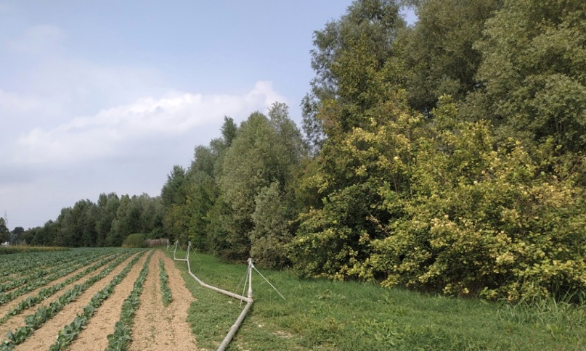
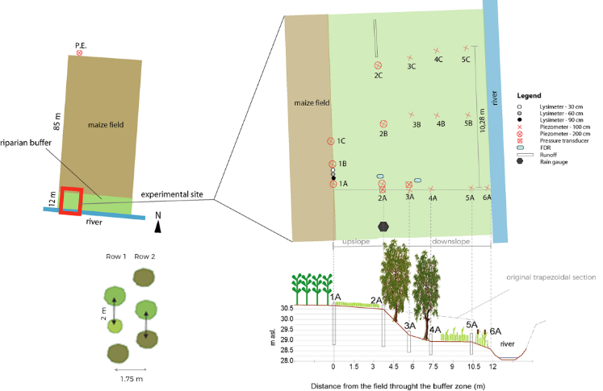
Buffer Strips
SCANDOLARA (0.95 ha):
11 meters wide buffer strip realized in 2007 along the left bank of the Piovega di Scandolara stream .
A 4 m wide herbaceous strip, between farmland and the restored river section, was created at the same level of the adjacent cultivated field.
The section of this stream was reshaped to create a 7 m wide riparian strip that would become flooded during moderate water level rise.
Two rows of trees were planted within the higher portion of the bank, while the resting downslope part was covered by spontaneous helophytic vegetation.
Figure 10. Pictures of the buffer strip from the site visit held the 17th September 2019.
Figure 11. Illustrative design of the Scandolara buffer strip and the experimental scheme (modified by Gumiero & Boz, 2017)

Slide 10
Results
Each NBS is described in terms of its design (layout, illustrative design drawings such as cross sections or sketches)
Several monitoring campaigns on the 4 NBS have provided data on their removal effectiveness, however not all the same data were available for the 4 sites.
Data on TP, TSS and glyphosate were missing for Buffer strips while only glyphosate was missing for the wetlands.
Where lacking, the removal effectiveness were estimated by using the data from the literature.
Basing on the removal capacity of the 4 studied NBS an estimation of the performances of all the 23 NBS existing on the two sub-basins has been provided

Slide 11
Results
 | Areal removal capacity of NBS [g m⁻² y⁻¹] or percentage removal
 | TN | TP | SS | Glyphosate
Scolo Rusteghin | 93 | 7.8 | 644 | 0.81
Salzano | 21 | 1.1 | 197 | 0.28
Scandolara | 25 | 3.0 | 6608 | 0.026
Nicolas site | 7.5 | 1.2 | 168 | 0.053
Other NBS on the studied sub-basins (Average)
CW for agricultural runoff | 57.8 | 4.3 | 450 | 0.57
Buffer strips | 10.2 | 2.9 | 6608 | 0.026
Wooden buffer area | 10.2 | 1.2 | 168 | 0.053
Table 1. The table shows the removal capacities of the NBS given in g m⁻² y⁻¹

Slide 12
COST ANALYSIS
The investment costs of the NBS have been estimated on the basis of the financial framework of the detailed design delivered for their construction year
O&M have been detailed with interviews to the staff of the management Authority
 | Working costs | Investment costs | O&M costs
 | € m⁻² | € m⁻² | € m⁻² y⁻¹
Scolo Rusteghin | 19 | 39.1 | 0.06
Salzano | 7 | 11.4 | 0.02
Scandolara | 22 | 38 | 0.17
Nicolas site | 2.7 | 3.1 | 0.26
Other NBS on the studied sub-basins (Average)
CW for agricultural runoff |  | 25.2 | 0.04
Buffer strips |  | 38 | 0.17
Table 2. The table shows the investment costs and O&M costs of wetlands and buffer strips and their estimations for the whole sub-basins.
* Higher values correspond to CWs waterproofed with plastic liner, as in Rizzo et al. (2018)

Slide 13
Social Analysis
General Objective
Specific Objectives
Explore the main issues affecting social sustainability of the study area
Identify and evaluate the capacity of the case as local development success model
Study the main relations among relevant stakeholders and their perceptions about NBS
Collecting and analysing the issues affecting the social sustainability of the application of a NBS in Venice Lagoon watershed.

Slide 14
Quantification of Direct and Indirect Benefits
Costs and benefits identified have been quantified using specific indicators
Estimation of the performance of each NBS of the 23 ones to compare different NBS.
Valuation of non-monetary benefits through appropriate value transfer methods
for a general assessment of the benefits provided to the study area.
BENEFITS
Improved water quality
Recreation and health
Education
Flooding Risk
Biodiversity
NBS contribute to flood risk reduction
Wetlands aquatic Habitat provide higher biodiversity compared to buffer strips
Natural areas appreciated by schools
NBS provide a recreational service for the local population

Slide 15
Quantification of Direct and Indirect Benefits
Objectives/criteria | Indicators and units of measure to compare each NBS performance | Range of monetary values by value transfer [€/year]
Reduce flood risk | Peak flow reduction (retention volume) m³ | 46,000 – 53,000
Use for recreation | Accessibility: no. of people leaving in a range of 1 Km from the NBS (potential recreation users) | 960,000 – 1,070,000
Use for education | Expert judgement based on 3 classes: NBS not used for educational purposes NBS used for educational purposes by the Drainage Authority NBS used for educational purposes by the Drainage Authority and by NGOs Dimensionless, ranging from 0 to 2 | 30,000 – 70,000
Contribute to water quality | Nitrogen removal: t_{N}/year | 450,000 – 1,450,000
 | Phosphorus removal: t_{P}/year
 | Sediment removal: t_{TSS}/year
 | Pesticide removal: t_{glyphosate}/year
Support biodiversity | Expert judgment, based on the size of the NBS Dimensionless, ranging from 0 to 1 | 80,000 – 90,000
CAPEX | € | 45,968,183
OPEX | €/year | 147,281
Loss of farmland income | €/year | 378,489.00
Table 3. The table sum up the benefits and the related monetary values quantified in the present study.

Slide 16
Business Model Analysis
The main conditions that allow the Venice Lagoon watershed business model being effective in the realization and maintenance of NBS for diffuse water pollution control are:
  Regulatory Framework
The availability of public funds to cover 100% of the realization costs
Drainage Authority “Consorzio di Bonifica delle Acque Risorgive”: highly qualified and innovative in its technical approach.
  Social acceptation
Flood risk prevention of NBS facilitates their acceptability by the local farmers community.
Urban population: their interest concerns mainly the recreation opportunities in easily accessible NBS

Slide 17
Conclusions
In conclusion, the experience of the Consorzio Acque Risorgive appears to be successful:
Pollutant removal capacity in line with the scientific data
Reasonable construction and O&M costs
Several benefits provided
High value provided by the NBS every year for the community
Positive and effective business model based on the “centralised governance”

Slide 18
NATURE-BASED SOLUTIONS
FOR CLIMATE CHANGE ADAPTATION
AND WATER POLLUTION IN AGRICULTURAL REGIONS
Lot 5 : LDP in a Continental Environment Feasibility Study
Thank you for your attention!
www.iridra.com
info@iridra.com
Dr. PhD FABIO MASI

