Slide 1
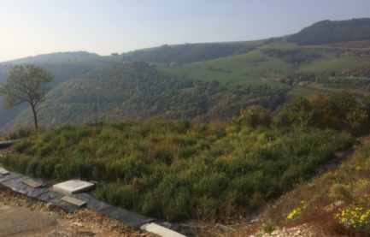
NATURE-BASED SOLUTIONS
FOR CLIMATE CHANGE ADAPTATION
AND WATER POLLUTION IN AGRICULTURAL REGIONS
Lot 2
TSM in a Continental Environment Feasibility Study
Dr. Fabio Masi 25th June 2021
www.iridra.com
info@iridra.com

Slide 2
Objectives
The present study analyses how Nature-based solutions (NBS) may contribute to reduce water pollution by treating pollutant loads generated by farm manure (Nitrogen, Phosphorus), investigating also the potential interest in the so-called side-benefits, i.e., the capability of NBS to also provide additional benefits such as biodiversity.
More specifically the present study will provide evidence to address the following questions:
How can NBS contribute to mitigate farm water pollution (nutrients)?
What are the costs and cost drivers of NBS?
What are the benefits they deploy?
What are the technical, capacity, governance, management and financial constraints hampering their take-up?

Slide 3
Study Area
Sasa Snc is a company dedicated to intensive breeding for fattening pigs. The facility is located in San Rocco di Piegara, in the hearth of the Lessinia region, an area characterized by a strong agricultural vocation linked to traditional products such as chestnuts, cherries, strawberries, wine, and honey. Itineraries and nature trails favour the development of tourism with the presence of hotels, restaurants and agritourisms
During the renewal of the authorisation to discharge the regional Environmental Authority (ARPAV) requested to change the authorisation terms, requiring more stringent water quality standards to discharge on soil.
The limits for nitrogen load that can be spread on landset by the Italian law 152/2006:
170 kgN/ha/y for areas sensitive to nitrate pollution
340 kgN/ha/y for areas not sensitive to nitrate pollution

Slide 4
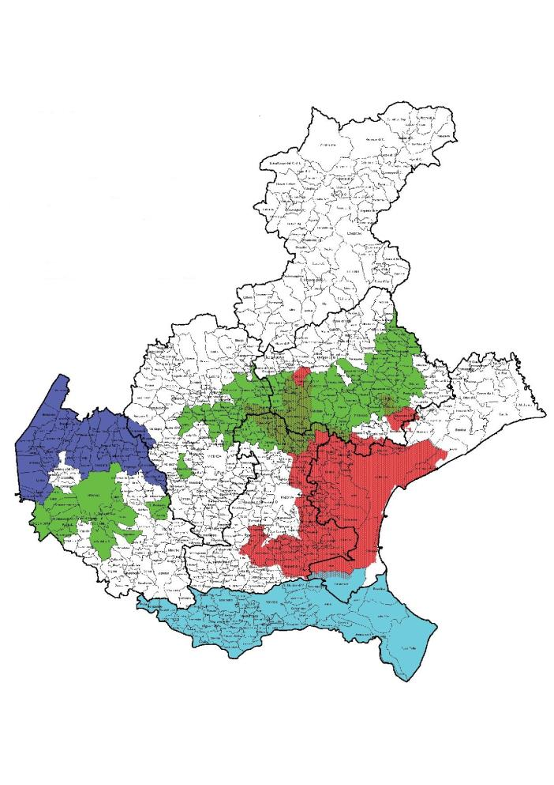
Study Area
The SASA pig farm is located in a quite isolated and barely visible hilly position, about 3 km away from the town and about 600 m from the first house. The facility has a maximum capacity of 7848 animals, but it currently hosts 3145.
Roverè Veronese is located, according to the National and Regional law in an area sensitive to nitrate pollution, therefore the possibility of spreading the manure generated by the SASA farm on land is limited.
Roverè Veronese
Figure 1. Map of the areas defined as vulnerable to nitrates for the Veneto Region (www.regione.veneto.it – Access 17/04/2020). Hatched areas are nitrate vulnerable zones.

Slide 5
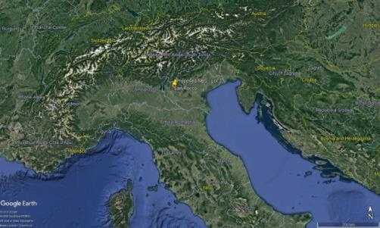
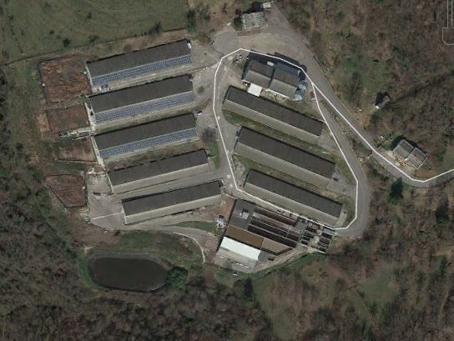
Study Area
The farm owner decided to install a “Nature Based” treatment system which, thanks to lower operational and maintenance costs, was expected to make the re-opening of the farm financially sustainable. Due to limited available space, the chosen solution was a “hybrid” solution (NB and technological): an aerated constructed wetland (CW) plus a reverse osmosis (RO) final polishing stage. The new system was sized to treat the liquid fraction of the manure produced by half of the farm capability, i.e. 3000 pigs, maintaining the possibility of an upgrade to 6000 pigs
Figure 2. Geographical localization of the proposed NBS case study.

Slide 6
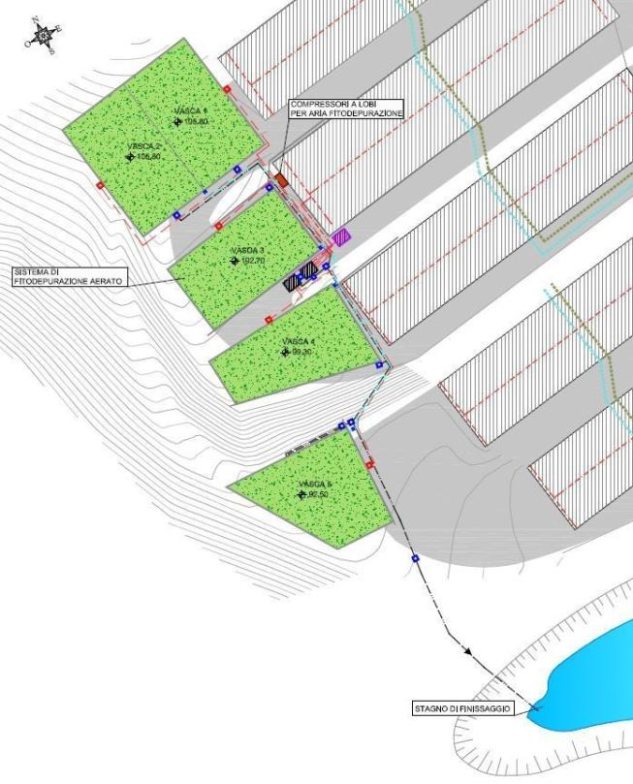
Wetlands
AERATED CONSTRUCTED WETLAND (2240 m² ):
5 beds, each one of 448 m².
Designed to treat the swine wastewater produced by up to 3000 pigs (up to 38 m³ /d).
Three stages: primary treatment for solid fraction separation; aerated CW for swine wastewater treatment; reverse osmosis (RO)
Figure 3. View of the realized NBS in spring
Figure 4. Planimetry of the aerated CW treatment plant of SASA Srl.

Slide 7
Results
Monitored data was gathered during two sampling campaigns, one at the start-up of the WWTP and a second after 1 year of functioning
Data on wastewater quantity and quality was gathered, as well as TP, TSS, COD, N-NH₄⁺, N-NO₃⁻, TN and Cl⁻
Literature data was used to estimate wastewater quantity and to test the proper functioning of NBS in terms of oxygen transfer rate (OTR)
A pig farm could be interested in realizing a treatment system if fields to spread the pig manure are not available nearby, NBS would highly benefit from a public financial support and a legislative framework aimed at promoting the circular economy
The analyzed case study shows that NBS could be a solution for the treatment of swine manure

Slide 8
Results
Areal removal capacity of NBS (percentage removal)
 | TSS | COD | N-NH4+ | TKN | TN | TP
Areated CW | 87 | 88 | 90 | 87 | 73 | 80
Mass Balance for the CW WWTP system (concentration, mg/L)
C IN Centrifuge | 9467 | 25600 | 2380 | 2327 | 2327 | 332
C IN AEW | 1131 | 8355 | 1936 | 1787 | 1502 | 49
C OUT AEW | 158 | 814 | 217 | 258 | 458 | 11
C OUT RO | 25 | 100 |  |  | 15 | 2
Water quality standards (concentration, mg/L)
Discharge to surface water | 80 | 160 | 15 |  | 35.6 | 10
Discharge on soil | 25 | 100 |  |  | 15 | 2
Table 1. Removal capacity of the NBS (%), mass balance (mg/L) and water quality standards (mg/L)

Slide 9
COST ANALYSIS
A cost analysis was carried out considering four alternatives for the full farm capacity (6000 pigs, 50 m³/d) considering both the scenarios of soil discharge and surface water discharge:
Previous technological membrane bioreactor (MBR)
Upgrade of the existing AEW with an additional AEW stage to reach the full original farm capacity
Upgrade of the existing AEW with an additional stripping stage to reach the full original farm capacity as well as to recover nitrogen
A passive CW system for the original farm capacity

Slide 10
COST ANALYSIS
Soil discharge scenario
 | Unit | A1 MBR | A2 Upgrade AEW | A3 Upgrade AEW + stripping | A4 Passive NBS
Investment | € | 1,576,000 | 1,256,000 | 1,247,000 | 2,715,200
OPEX | €/yr | 383,800 | 211,100 | 217,600 | 88,700
Lifetime | yr | 20 | 20 | 20 | 20
Discounted Costs (T= 20 y; i= 5%) | € | 6,358,996 | 3,806,773 | 3,878,777 | 3,111,398
Table 2. The table shows the investment costs and O&M costs of the four alternatives considering a lifetime of 20 years

Slide 11
COST ANALYSIS
Surface water discharge scenario
 | Unit | A1 MBR | A2 Upgrade AEW | A3 Upgrade AEW + stripping | A4 Passive NBS
Investment | € | 1,456,000 | 1,438,200 | 1,320,800 | 2,554,200
OPEX | €/yr | 319,800 | 172,600 | 154,600 | 87,100
Lifetime | yr | 20 | 20 | 20 | 20
Discounted Costs (T= 20 y; i= 5%) | € | 5,441.415 | 3,589,178 | 3,247,458 | 3,639,659
Table 3. The table shows the investment costs and O&M costs of the four alternatives considering a lifetime of 20 years

Slide 12
Social Analysis
General Objective
Specific Objectives
Explore the main issues affecting social sustainability of the study area
Identify and evaluate the capacity of the case as local development success model
Study the main relations among relevant stakeholders and their perceptions about NBS
Collecting and analysing the issues affecting the social sustainability of the application of a NBS in the treatment of manure from the SASA pig livestock

Slide 13
Quantification of Direct and Indirect Benefits
Costs and benefits identified have been quantified using specific indicators
To assess the direct and indirect benefits of the different possible solutions a Multi Criteria Analysis (MCA) was applied
The side benefits of the different alternatives in both scenarios were compared
BENEFITS
Climate change mitigation
Nuisance
Simple maintenance
Landscape integration
Biodiversity
Visual impact in terms of landscape integration
reed beds could contribute to the landscape diversification
key role of simple O&M of the manure treatment plant
odors caused by the spreading of manure on fields

Slide 14
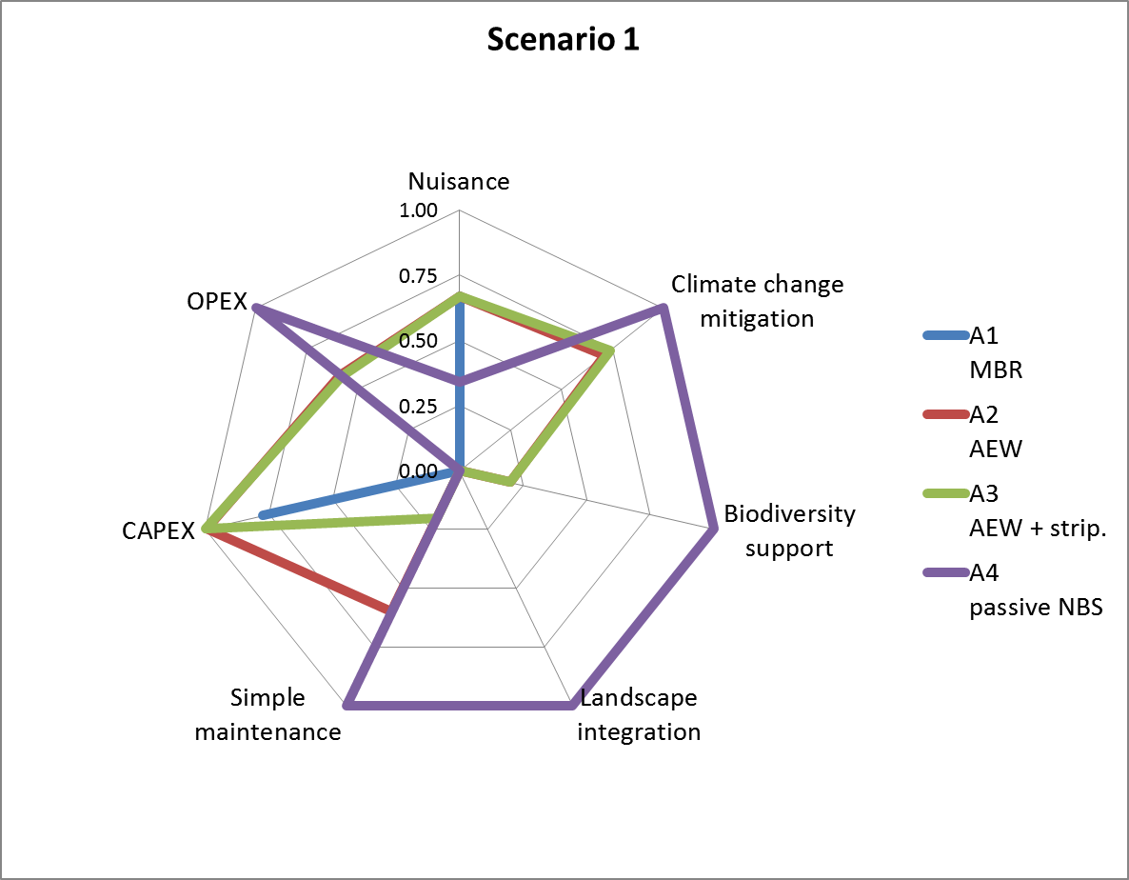
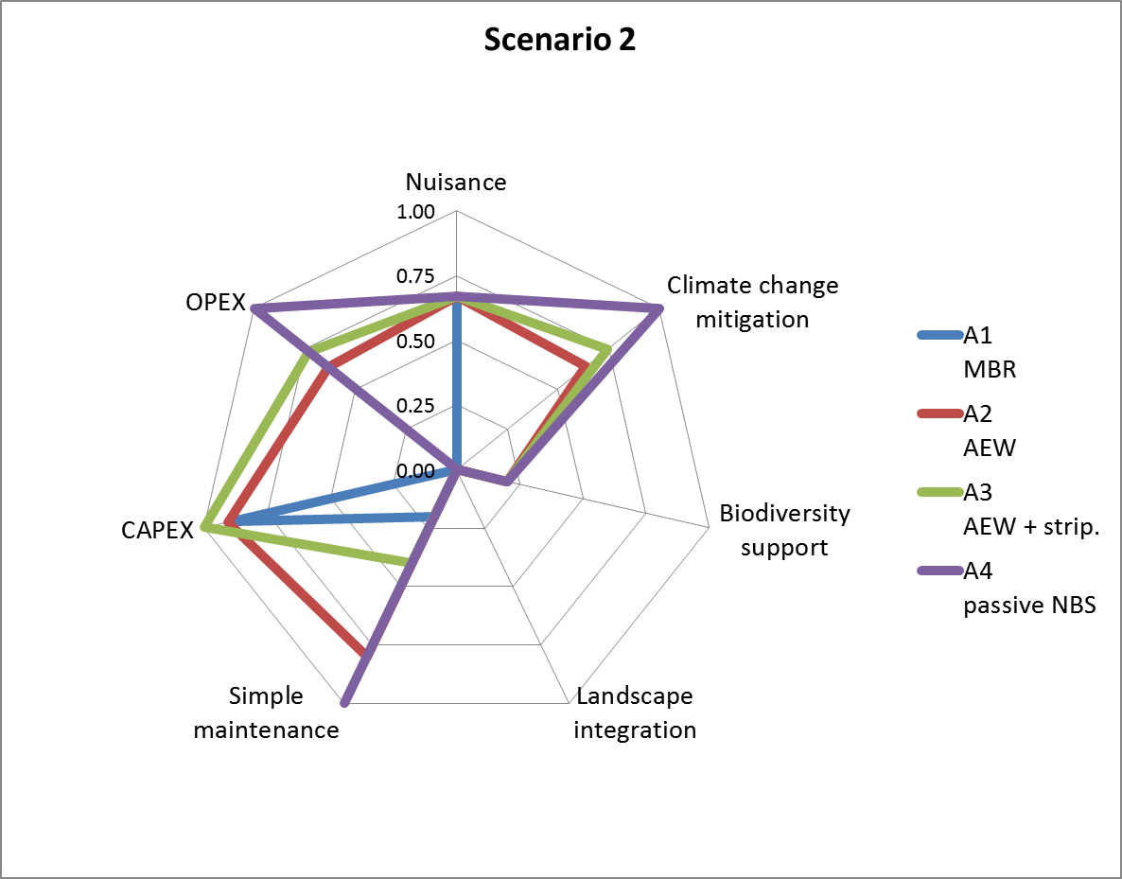
Quantification of Direct and Indirect Benefits
 | Scenario | A1 MBR | A2 AEW | A3 AEW + strip. | A4 passive NBS
Final rank of the 4 alternatives under the 2 scenarios (S1, S2) | S1 (discharge on soil) | 0.29 | 0.67 | 0.60 | 0.66
 | S2 (discharge in water) | 0.35 | 0.68 | 0.67 | 0.63
Table 4. The table shows the comparison among the 4 treatment alternatives in both scenarios
Figure 5. Graphical representation of the criteria performances for all the alternatives and the two considered scenarios

Slide 15
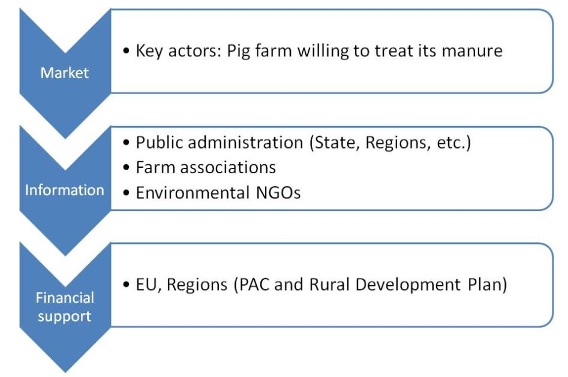
Business Model Analysis
The business model of the analyzed case study is mainly based on the market, since the hybrid NBS requires lower maintenance costs compared to the MBR system. In Italy very few pig farms treat their manure, as most of them spread the manure on the fields since it is the most cost-effective solution.
The main conditions that would allow the SASA pig farm business model being effective in the realization and maintenance of NBS for pig manure treatment are:

Slide 16
Conclusions
In conclusion, the analyzed case study shows that NBS could be a solution for the treatment of swine manure:
The NBS shows to be effective in removing the most important pollutants of a pig farm
A pig farm may only be interested in setting up a treatment system when fields to spread the pig manure are not available nearby
Reasonable construction and O&M costs
Several benefits provided
NBS would highly benefit from a public financial support and from a legislative framework aimed at promoting the circular economy

Slide 17
NATURE-BASED SOLUTIONS
FOR CLIMATE CHANGE ADAPTATION
AND WATER POLLUTION IN AGRICULTURAL REGIONS
Lot 2 : TSM in a Continental Environment Feasibility Study
Thank you for your attention!
www.iridra.com
info@iridra.com
Dr. PhD FABIO MASI

