Slide 1

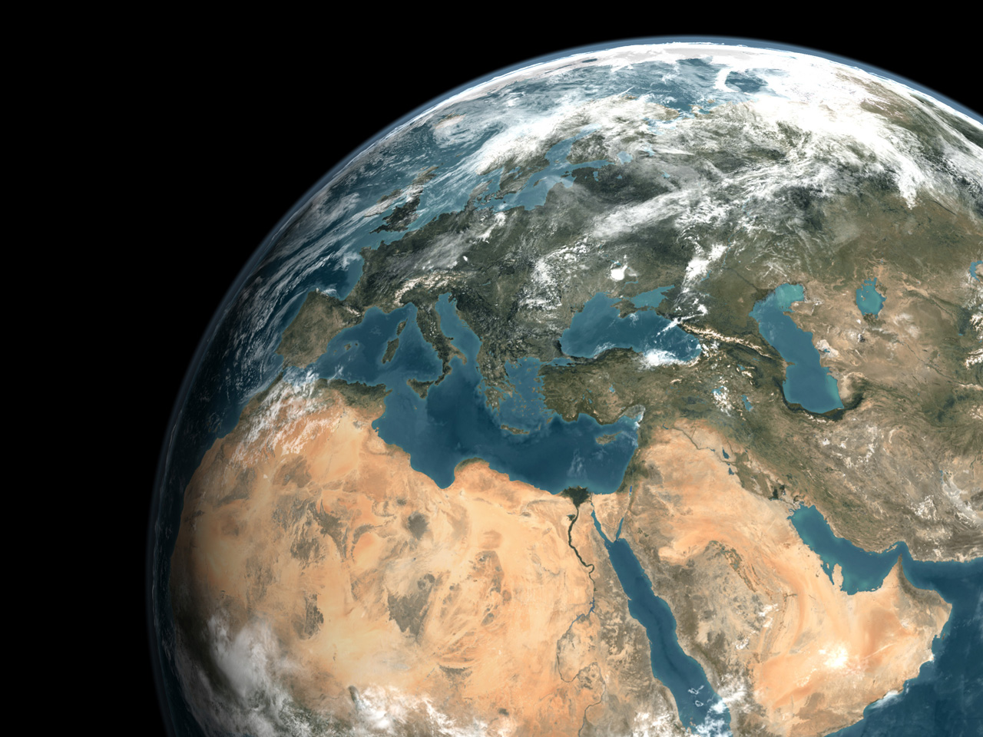
Twinning and Global
Environment Monitoring:
The Example of Water
A Pathway of Opportunity Bridging from Data to
Actionable Forecasting on Relevant Scales
Georg Teutsch, UFZ, Hartwig Kremer, UN Environment Programme
22/11/2021

Slide 2
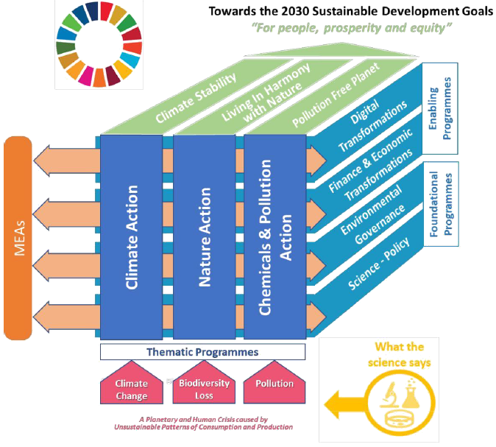
Framing the Environmental Dimension of SDGs
UNEP’s Medium-Term Strategy (MTS) 2022-2025
Notes:
UNEP is considering an innovative Global Environment Monitoring System for oceans and coasts as a critical complement to its portfolio of observatories. By drawing on available information from the variety of existing monitoring initiatives on national, regional and global scale and working closely across the UN and with the Earth Observation and global observing system communities the GEMS/Ocean shall in future also inform and enable action at scale. By focusing on climate action, nature and pollution action as stipulated in the UNEP MTS 2022-2025 substantial expertise can be accessed through existing programmes and activities within UNEP, including to build partnership to embrace the notion of maintaining and building natural coastal and ocean capital.

Slide 3
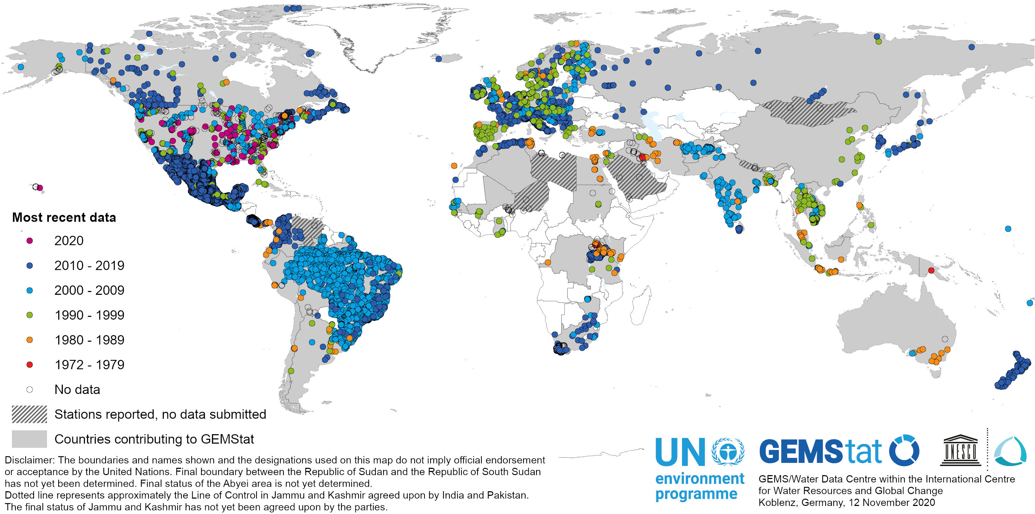
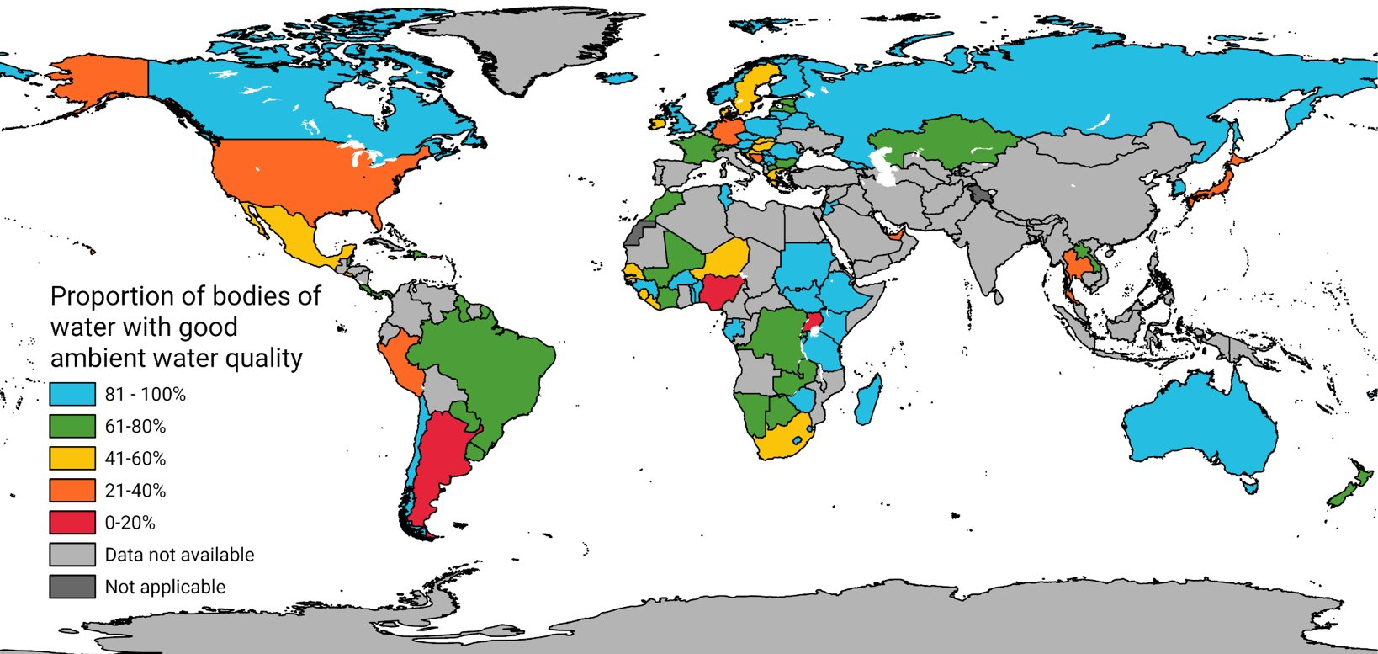
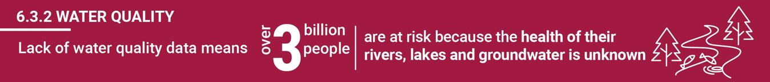
Bridging from Data to Prediction and Services
Reality Check: Global Water Quality In- Situ Data Collection & SDG Indicator 6.3.2 - 2020 data drive results
GEMStat In-Situ Data Collection
Good and Poor Water Quality Reported in 2020

Slide 4



Bridging from Data to Prediction and Services
Towards Data & Modelling Driven near Realtime High-Resolution Services on Water
ʺUnlimitedʺ parameters
Long time series
Ground truthing
Basis for model calibration
In-situ data
Near realtime information
Spatially unconstrained
Limited parameters
BASELINE STATUS QUO SCENARIOS
SECTORAL HOTSPOTS
Predictions and scenarios
Spatially and temporally continuous information
Sectoral forecast
Remote sensing data
Modeling data
Twinning

Slide 5
How can Digital Twins support Earth System Politics?
Urgent need to link our general policies (e.g. EU Green Deal) for sustainable development to concrete measures of action …all that in a highly hetrerogeneous world with respect to available data, level of information, available knowledge, prevailing governance, existing infrastructure etc.
Digital Twins (DTs) promise:
  to connect heterogeneous data sources and multiple models in a consistent way at meaningful scales
  to provide the means to generate ‚pictures of the future‘ (e.g. with climate change), forecasts and projections which can be exploited to identify optimal (sustainable) solutions together with socio-economic impacts
  to be people centred rather than technology driven only - the user requirements and design will be informed by co-design with sectoral stakeholders across society

Slide 6
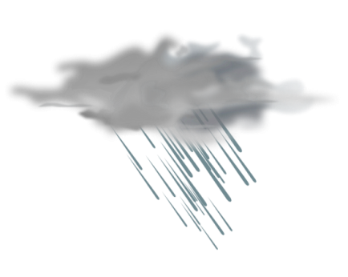
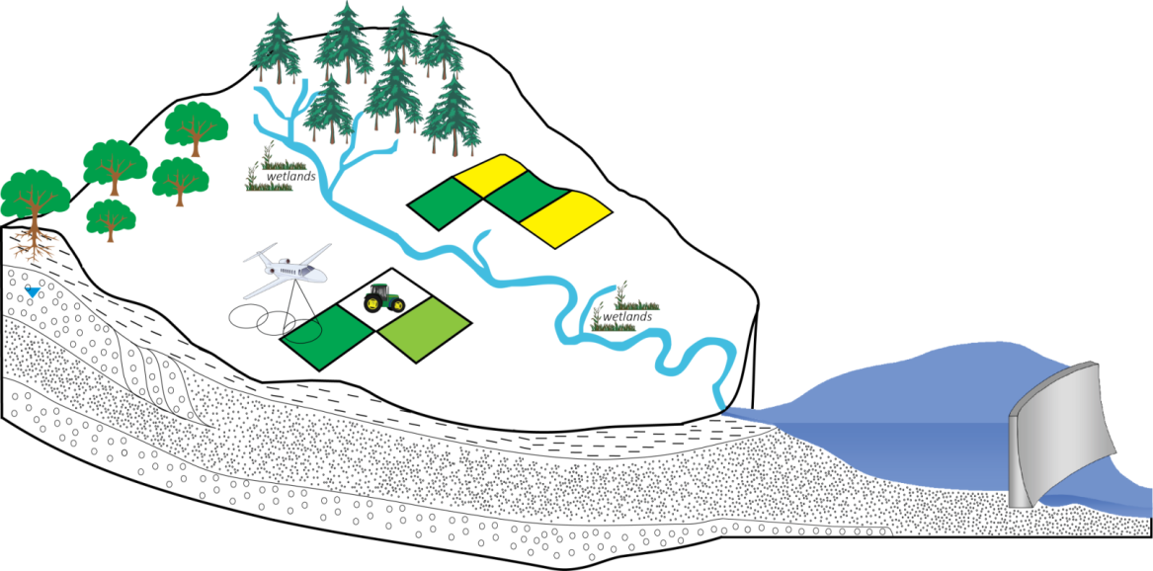
Key Elements of a Water-DT
dynamics
dynamics
(Q, C_{N,P,C….})
structure
Discharge
Concentration
structure
function
function
(UFZ, 2018)
→ The conceptualisation of a Water DT requires a co-design concept

Slide 7
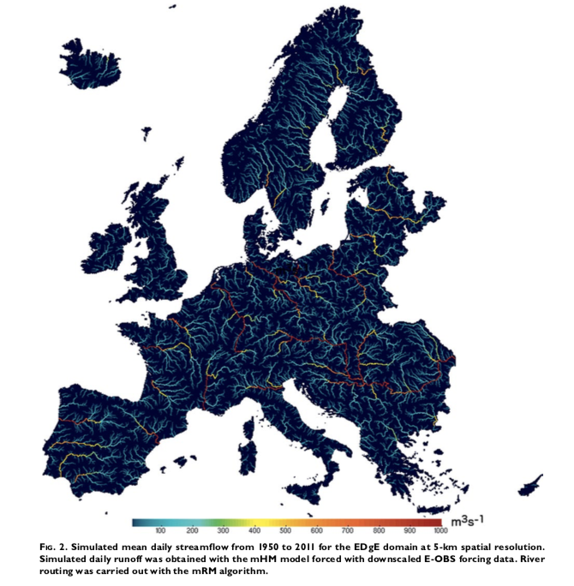
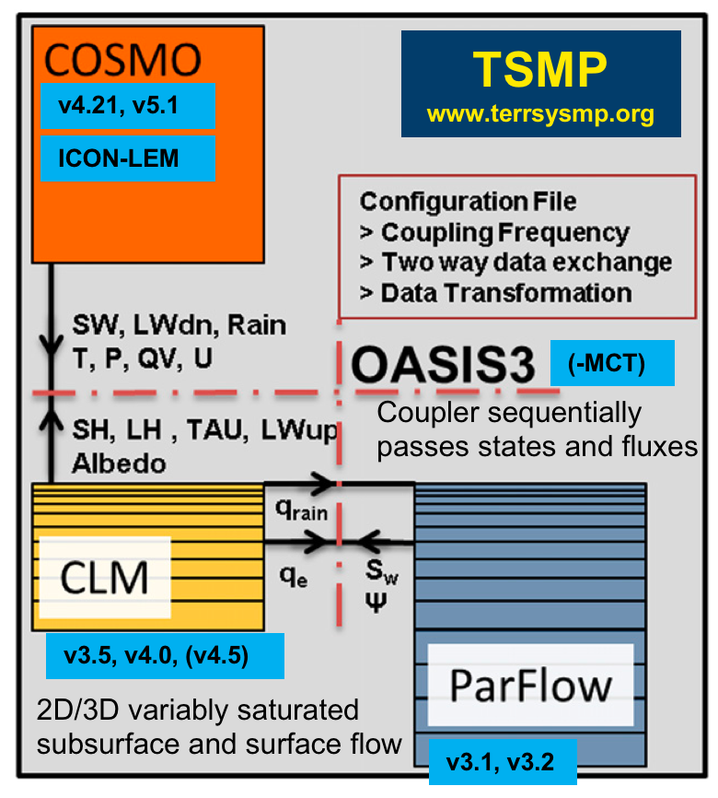
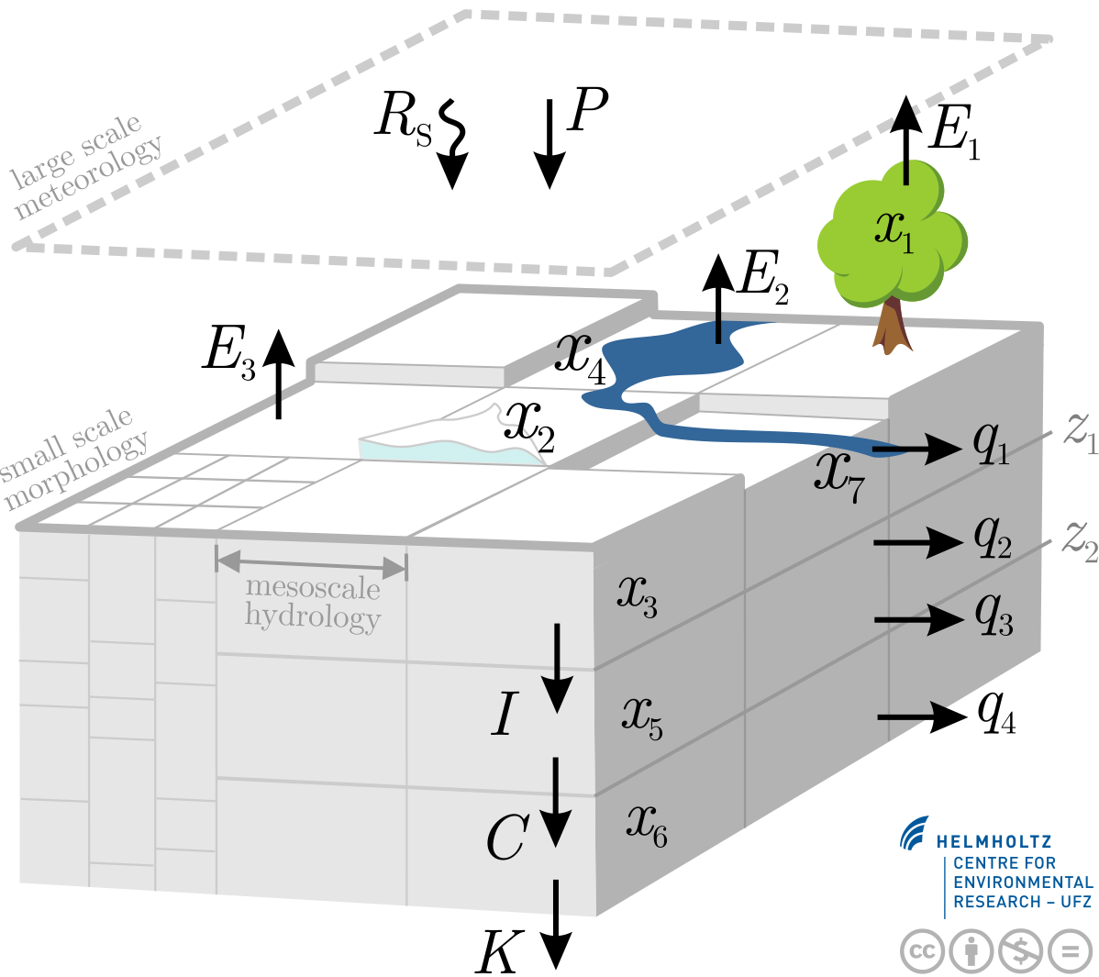
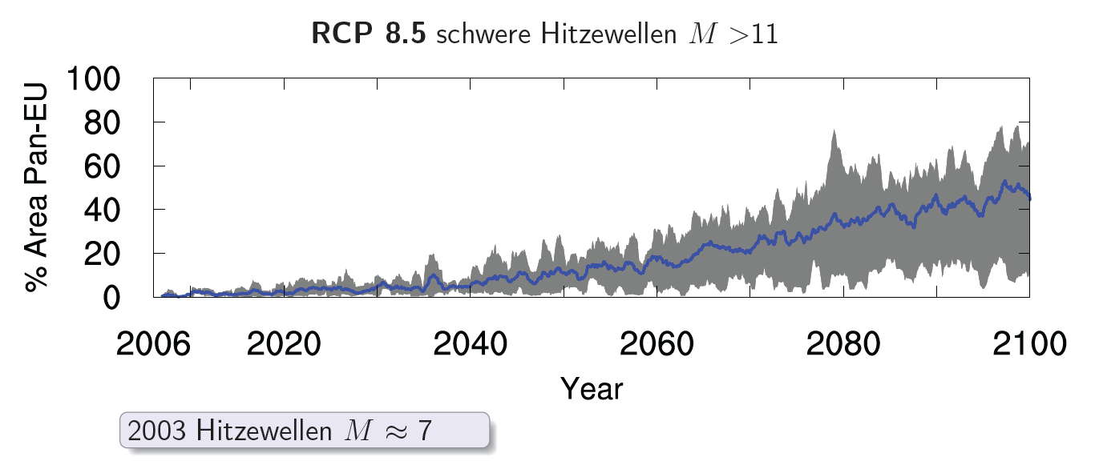
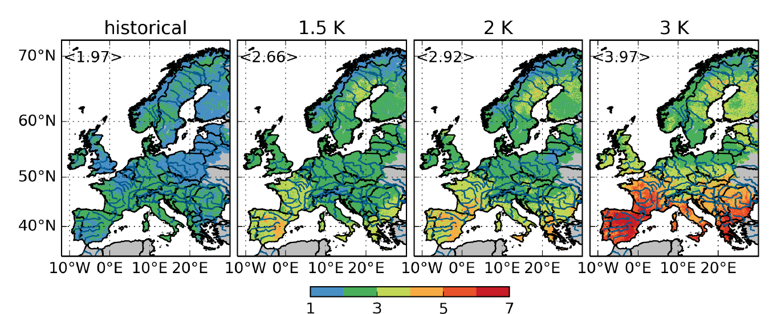
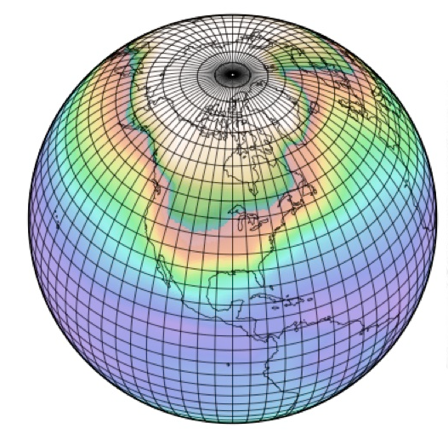
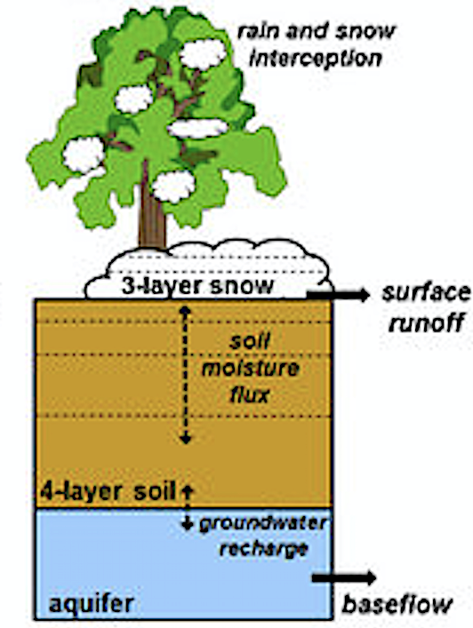
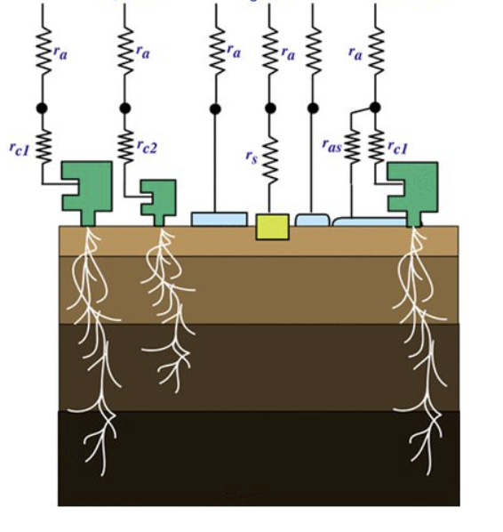
The Water Dynamics: Consistent from Global to Regional to Local
Weather & Climate GCMs
Hydrological system
Multiscale terrestrial environmental variables and indicators
Impacts
GCM/RCMs
HAPPI-DE
EURO-CORDEX
…
Severe Heat Waves
CLM/ParFlow
mHM
2003 Heat Waves M ≈ 7
Noah-MP
HTESSEL
→ Co-design: define time- and spatial-slices & resolutions needed for the DT?

Slide 8
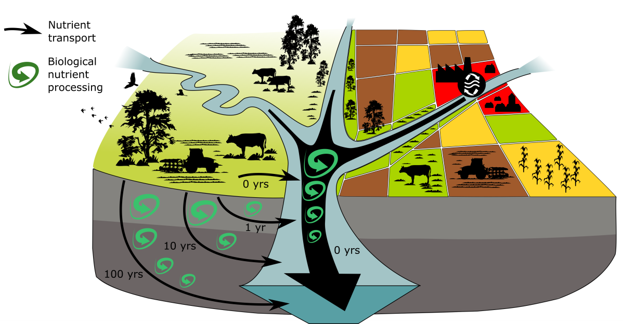
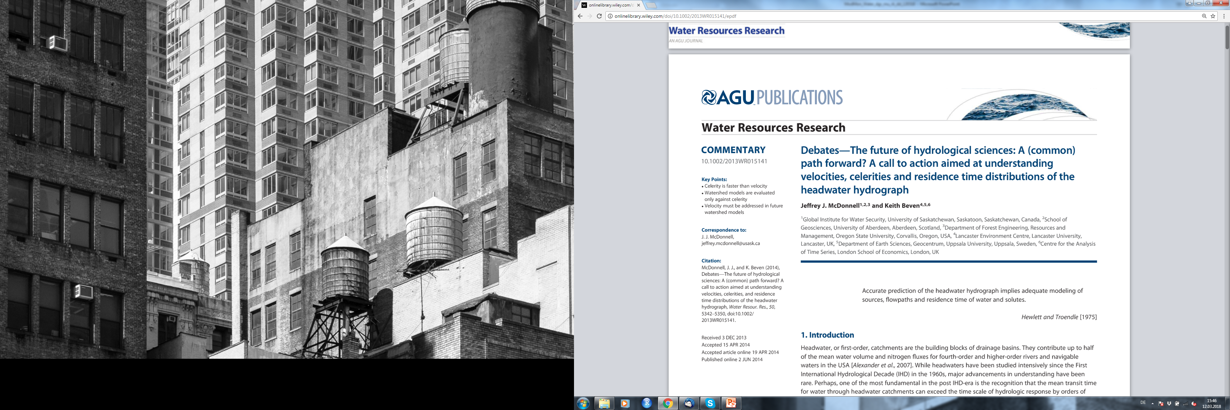
Water Quality at Catchment Scale
Data challenges
Point sources (WWTP, industry)
Non-point sources (landcover/ fertilizer)
Process representation challenges
Legacy effects
In-stream processes
Interactions of nutrient cycles
Modelling challenges
Seamless parameterization
Spatial scaling/transferability
Uncertainty
application
mobilization
(reactive) transport
integration and processing
→ The functional elements we need to represent in the DT need to defined by co-design
Rode et al. (2010) HP
Wellen et al. (2015) ES&T

Slide 9
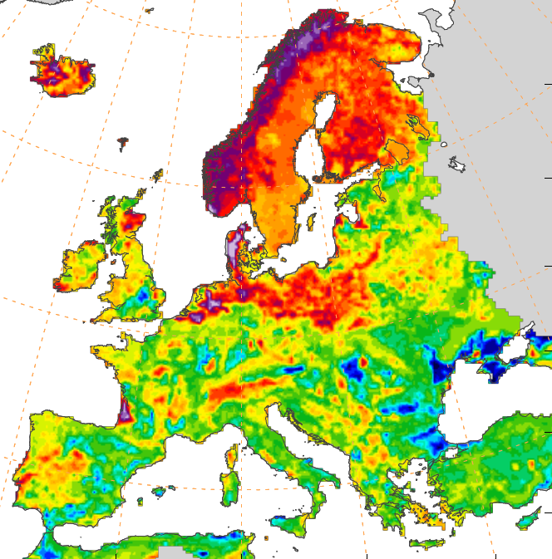
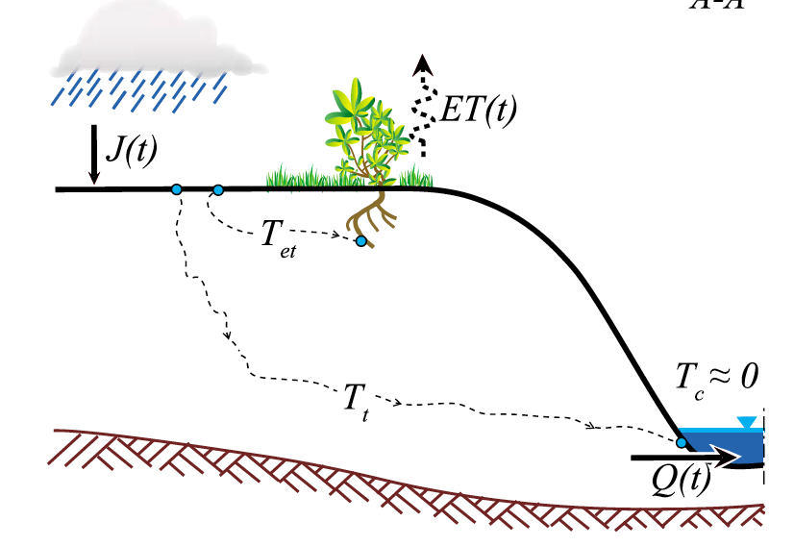
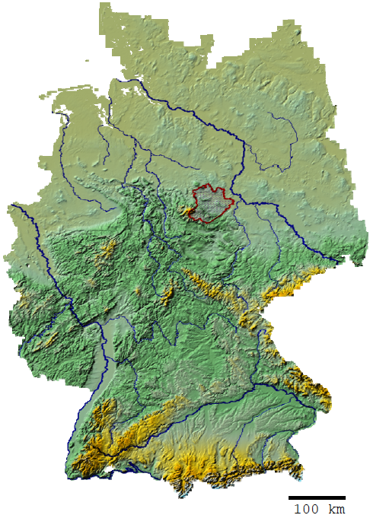
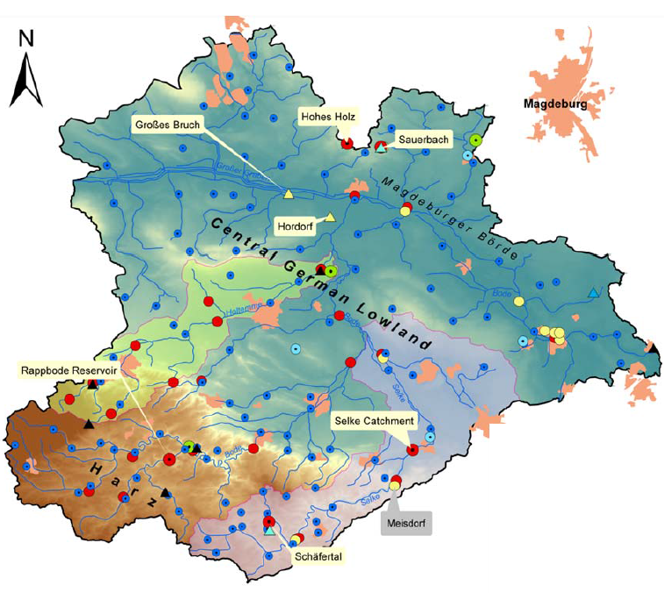
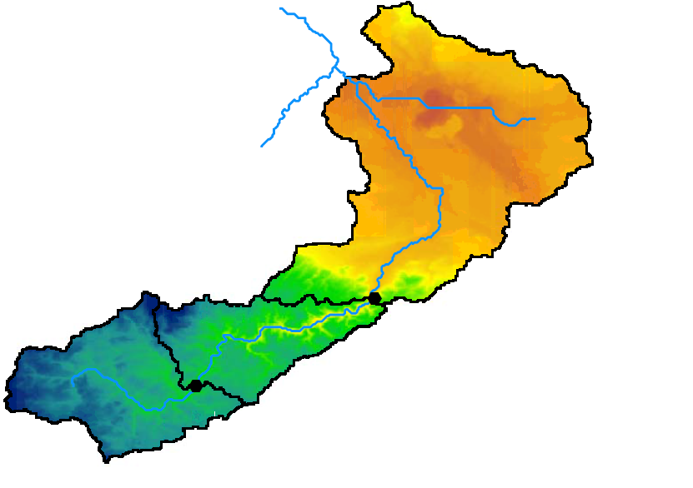
Water-DT: Integration of Quantity and Quality Modeling across scales
Travel Time Distributions (TTDs)
(Kumar et al, Nature Comm. 2018)
Vadose zone
Groundwater zone
Hillslope representation of TTs (Botter, et. al., 2010)
Catchment
Regional
National
Continental
The challenge is to account for local scale variabilities of geophysical attributes (e.g. travel-times, reactive parameters) in regional scale predictive models
Page 9

Slide 10
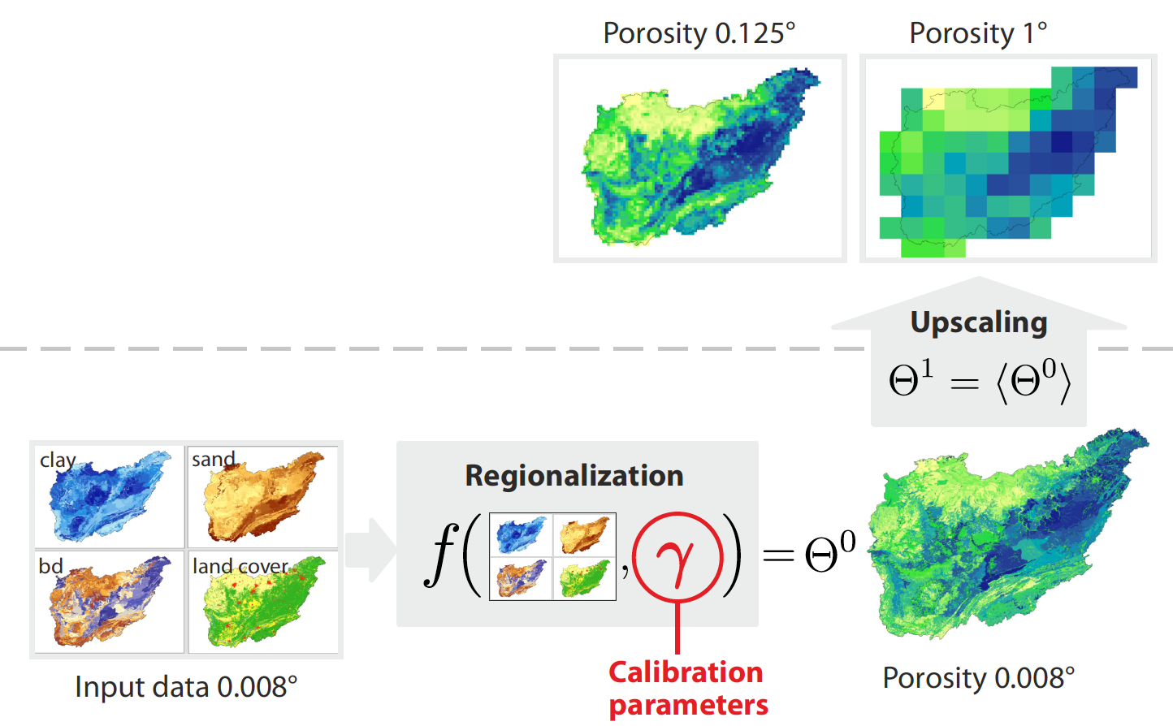
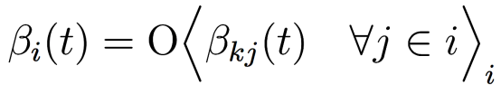
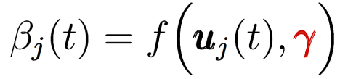
Modeling
Multiscale Parameter Regionalization (MPR)
Upscaling operator
mass conservation of fluxes/states across scales
Modeling scale
Regionalization
observational analyses
process understanding
Geophysical
data scale
Reliable estimation of water fluxes across a range of spatial scales and diverse locations
Samaniego et al. (2010) WRR
Kumar et al. (2013) WRR

Slide 11
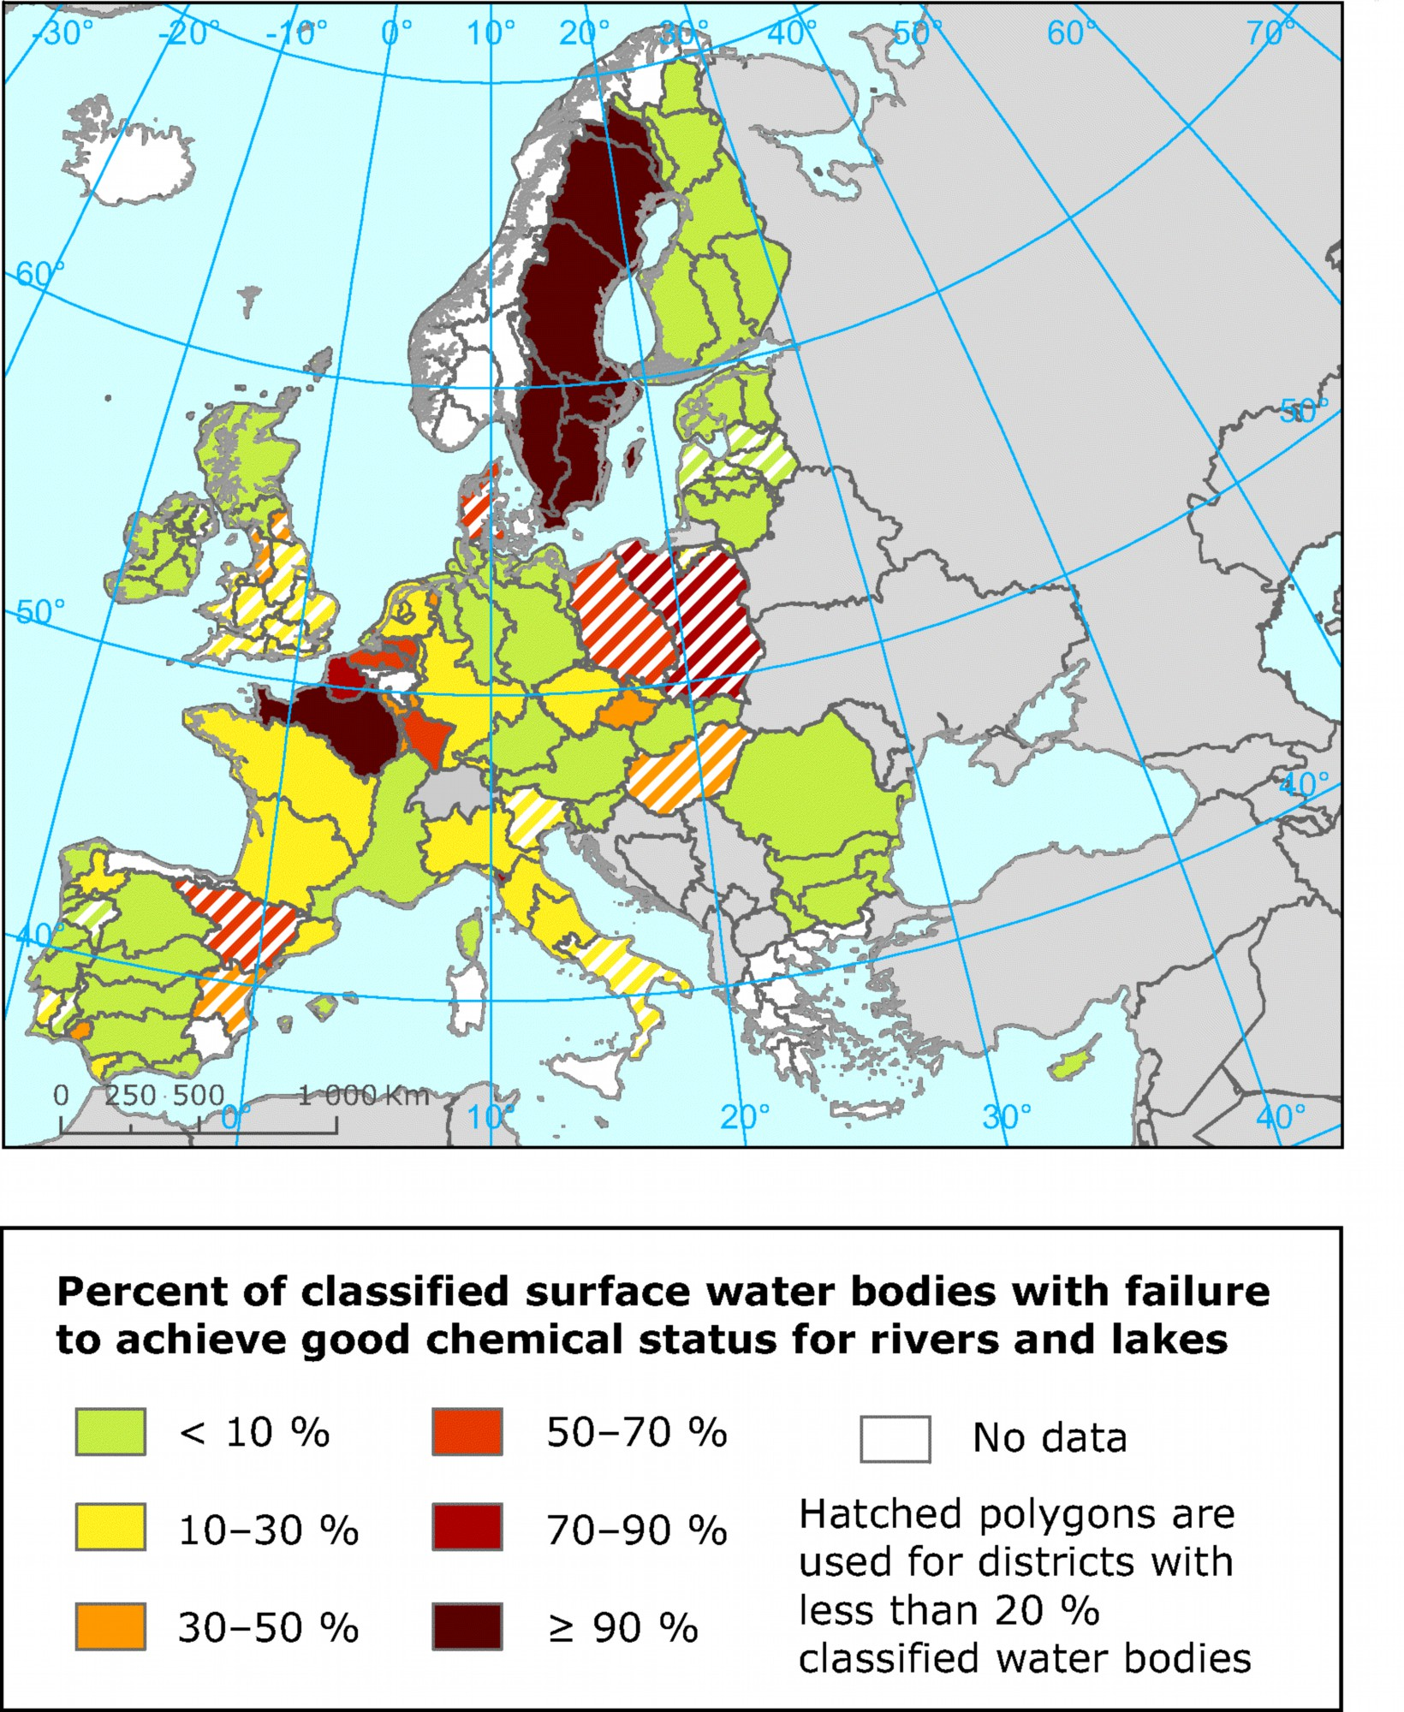
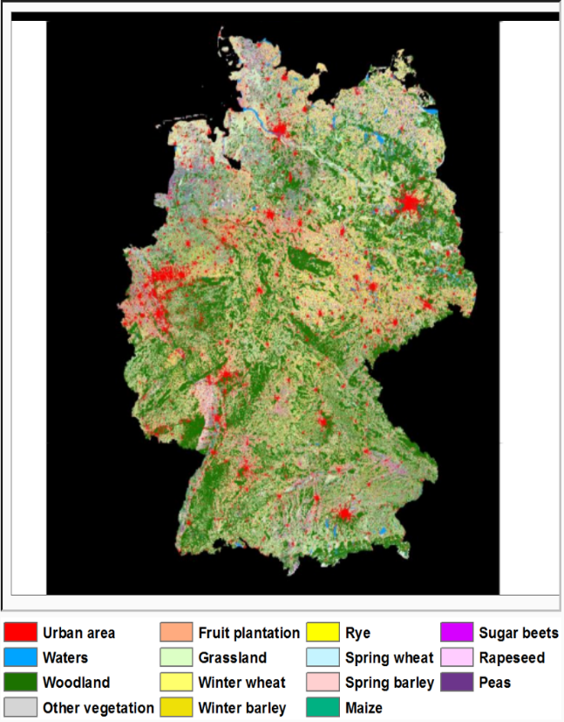
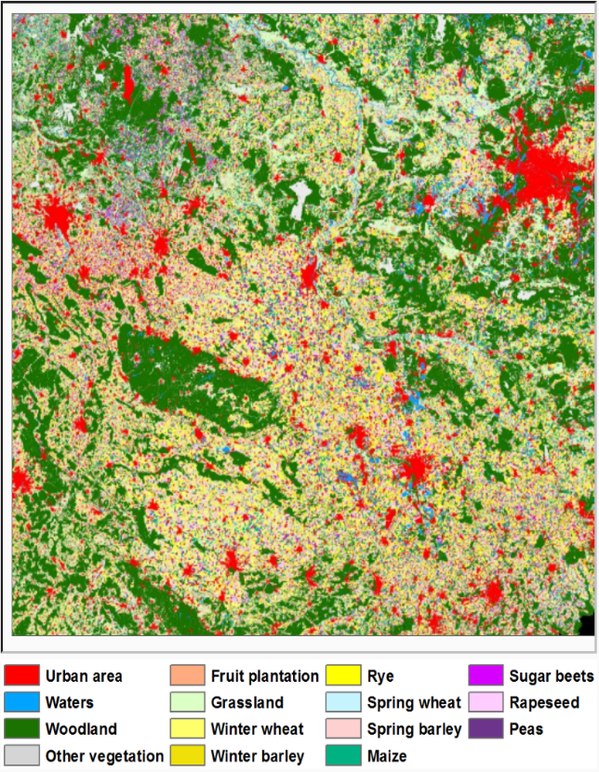
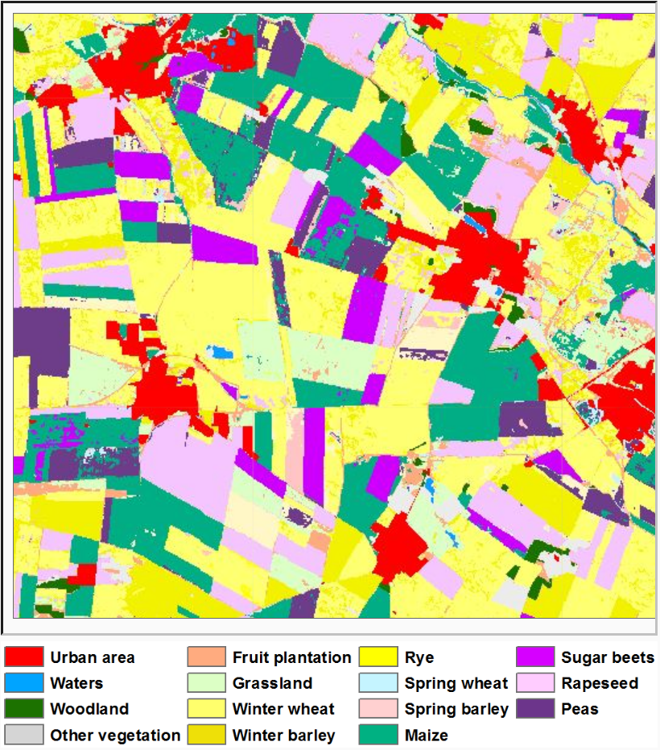
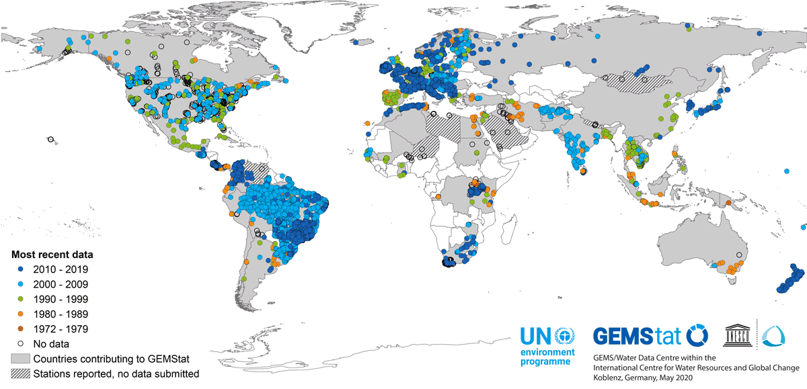
100 km
25 km
0.8 km

Slide 12
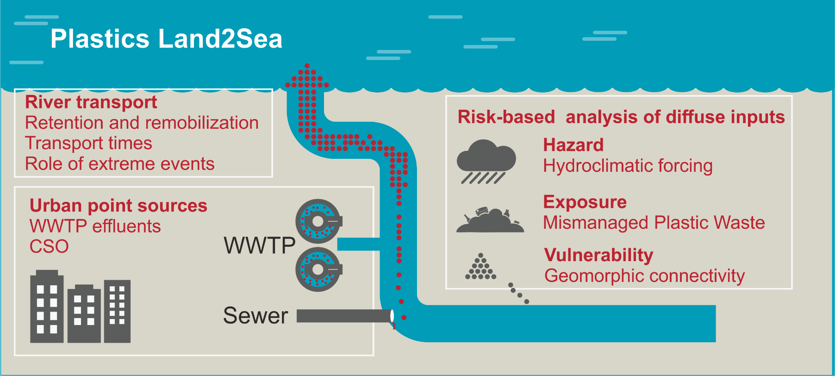
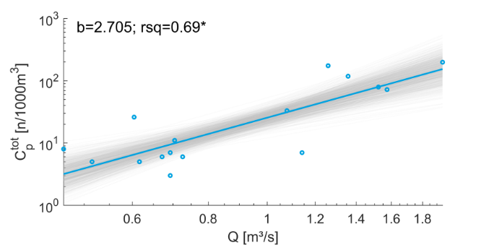
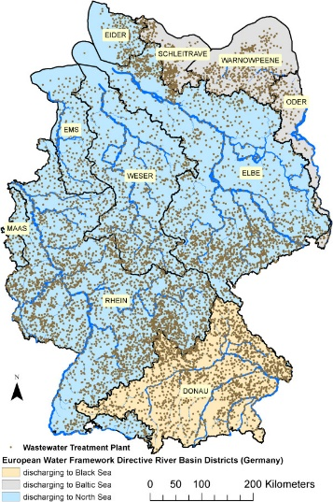
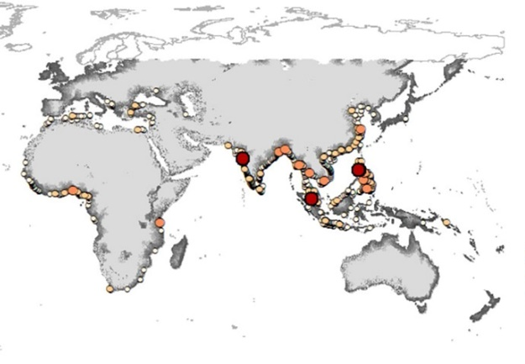
Land & Ocean: Plastics – from Inland to Sea
Proxies and C-Q relationships of plastic debris in rivers
Continental upscaling
Mismanaged plastic waste and WWTPs as dominant source for plastics at national scales
Wagner et al. 2020, ES&T
Global riverine plastic loads
1,000 rivers are accountable for 80% of global annual emissions
Meijer et. 2021, Sci.Adv,
Schmidt et al. 2017, ES&T
Schmidt et al. 2020, STOTEN

Slide 13

Summary & Conclusion
DTs are the driver for data & model integration from global to local scale
The complexity and nature of a Water-DT needs a co-design strategy upfront
In Europe, a Water(-quality)-DT can tap multiple data sources (e.g. WWTP, time series of water-quality data) → robust predictions and projections expected
At global scale, available water-quality monitoring data is sparse. Model optimised monitoring concepts (e.g. at relevant discharge points) employing standardized procedures are urgently needed.
A global Water(-quality)-DT needs to combine densly monitored as well as sparsly monitored areas and should use proxis (e.g. population distribution, remote sensing, statistics).
A global Water(-quality)-DT needs to connect terrestrial effluent data with ocean water quality data
Gespräch mit Dr. Siegfried Dais (Fa. BOSCH)
→ The detailed and final design/focus of the DT will rely on stakeholders representing the sectors involved

Slide 14
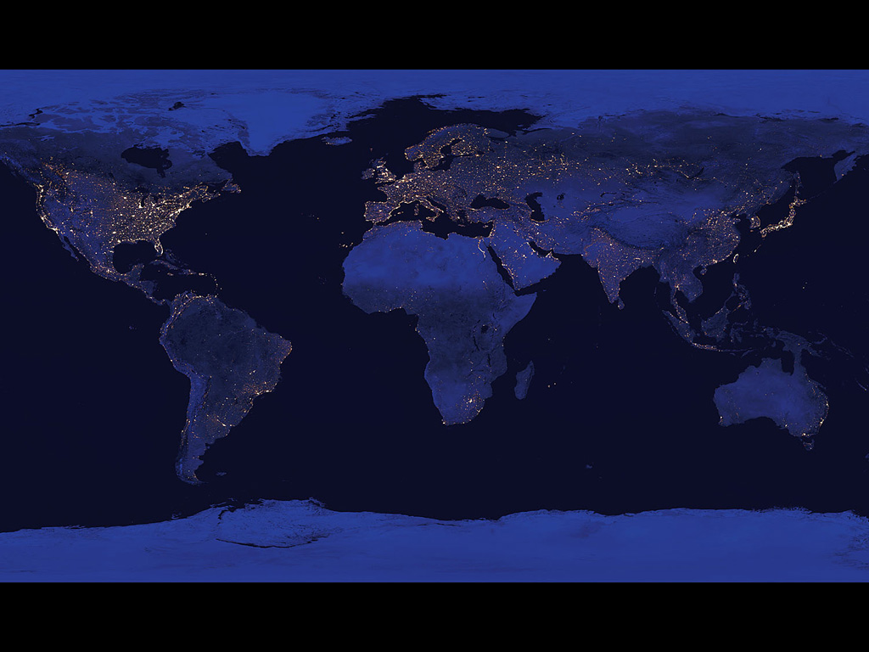
Thank you for your attention!
hartwig.kremer@un.org georg.teutsch@ufz.de
Acknowledgements: Dietrich Borchardt, Sabine Attinger, Andreas Musolff et al.

