Slide 1
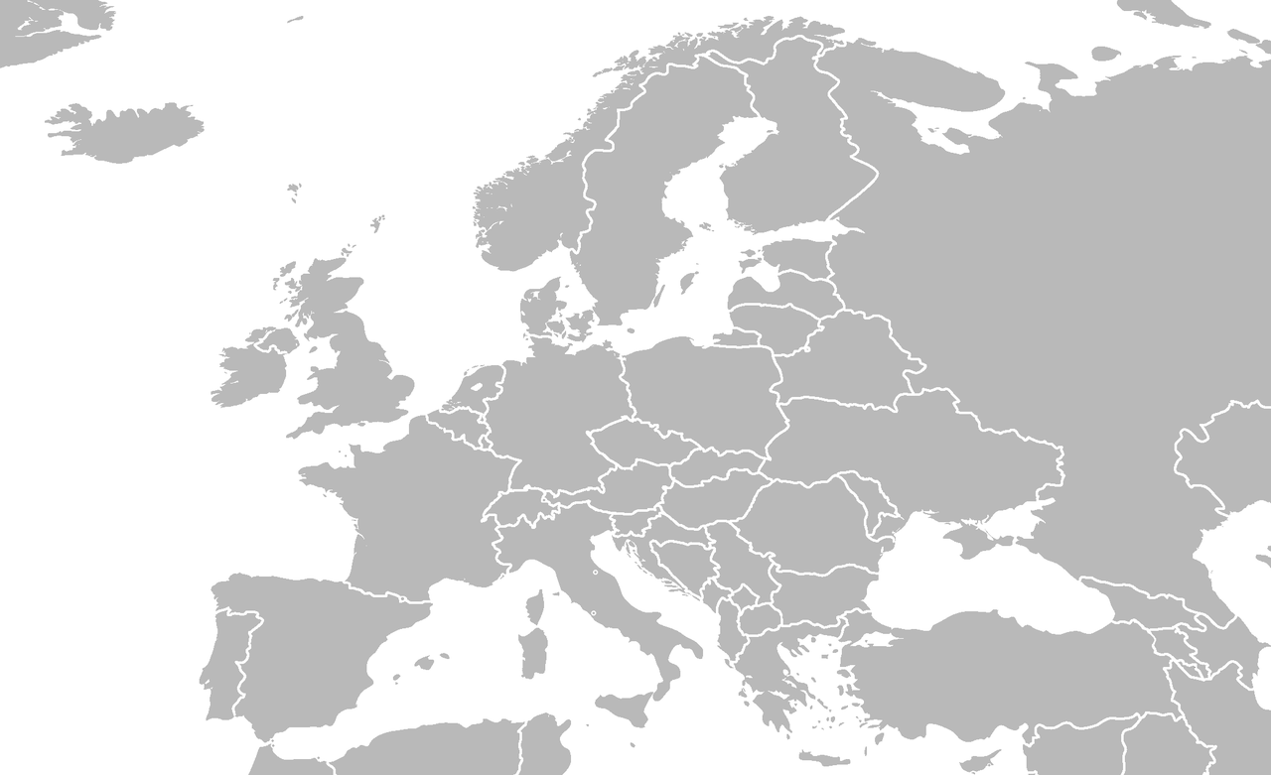
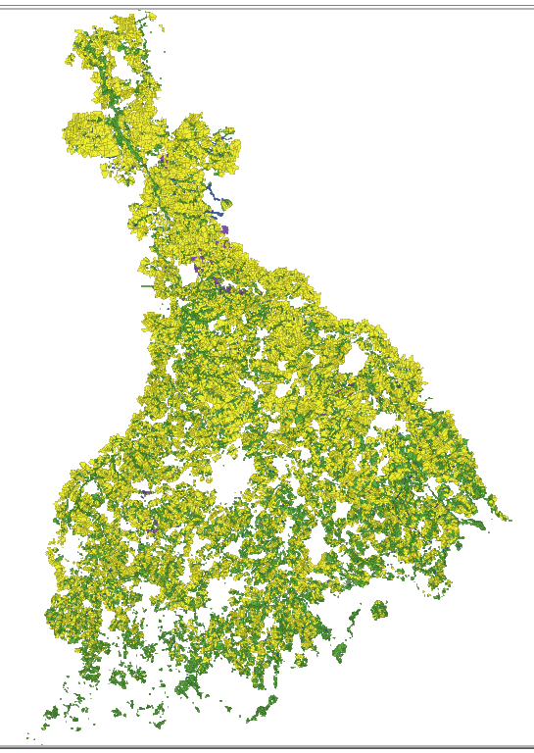
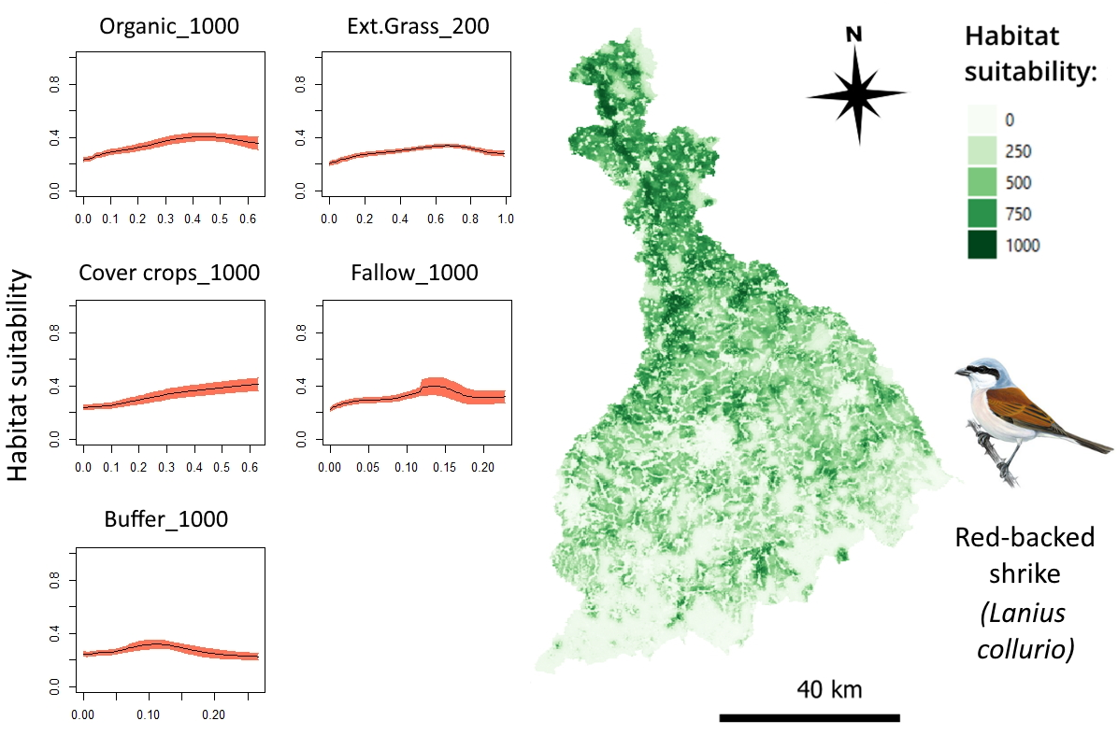
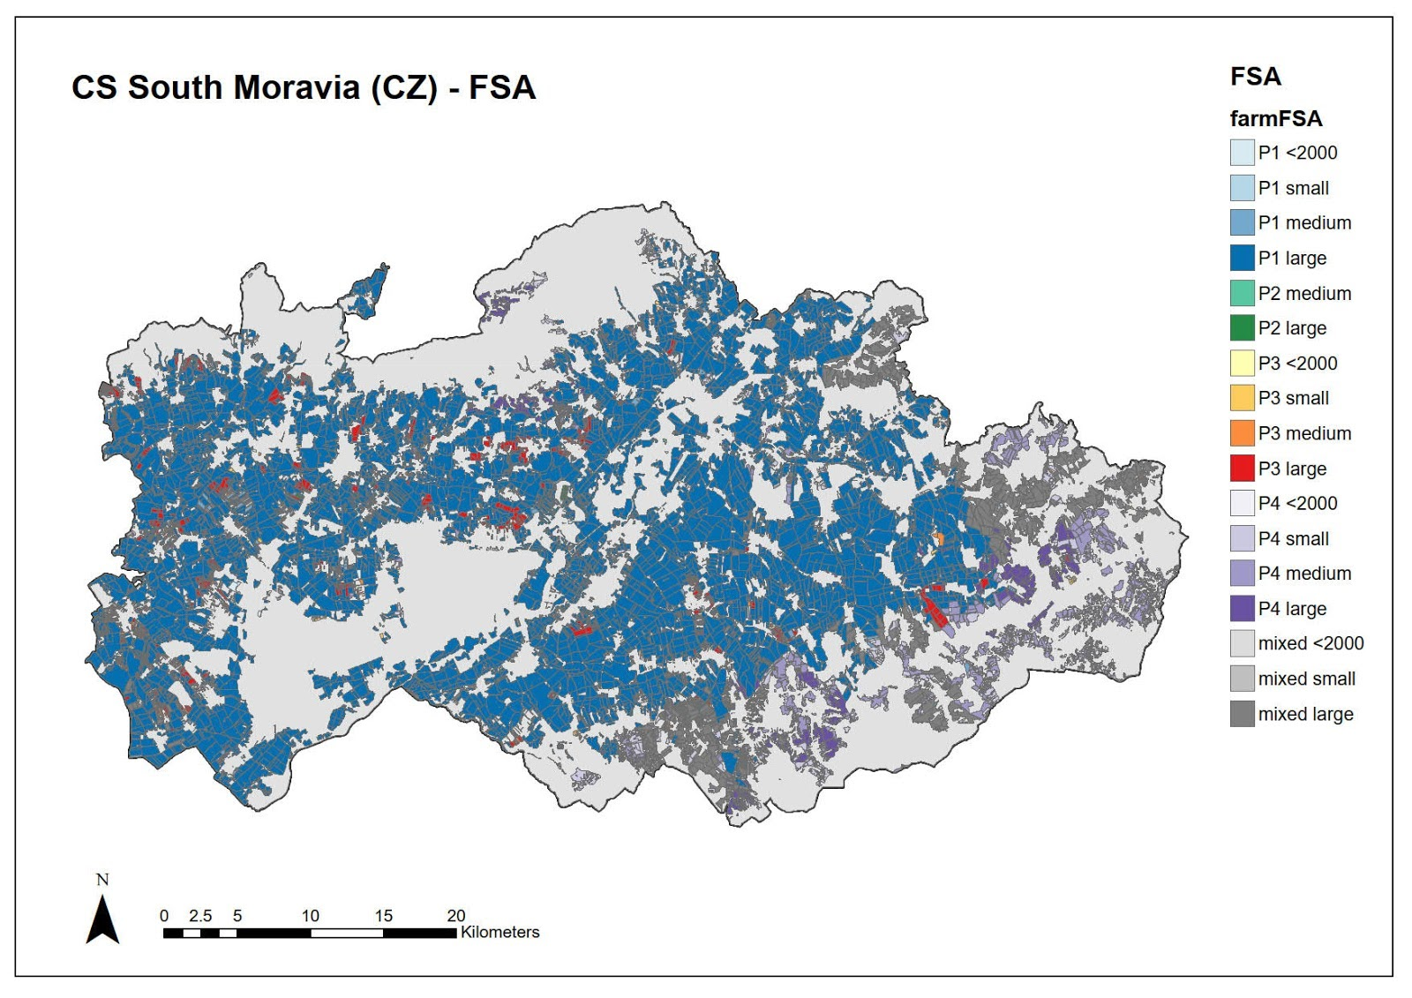
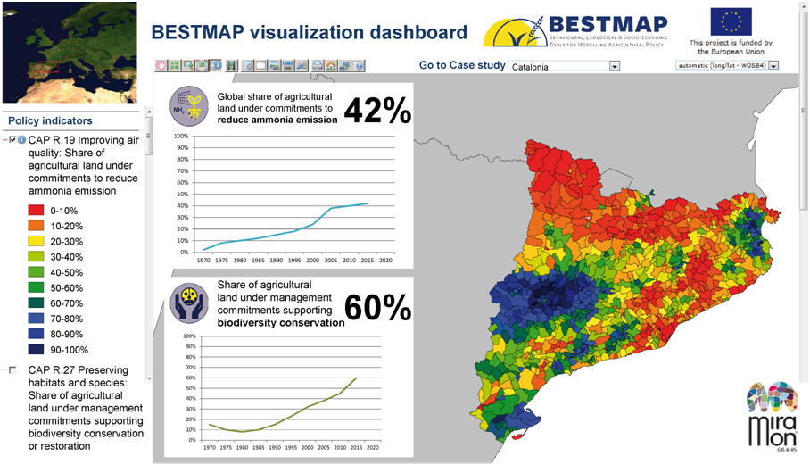
BESTMAP Impact Assessment Modelling framework
4
FADN + preprocessing
1
Transferability analysis
Typical field size mapping; Allocation using FMU to get environmental covariates
Representative FADN regions
Farm System Archetypes
Farm specialization; economic size
2
Catalonia
Agent-Based Model
Policy-indicators
Humber
Mulde
Moravia
Biophysical impacts
Socio-economic impact
European Dashboard
LPIS/IACS Base data
Crops, EFA, AES
Backa
ABMs
Alternative-now co-designed w/ EC/JRC; policy scenarios;
Story-maps
Biophysical Models
3
Calibrated w/ Case Study specific DCE surveys
Farm System Archetypes
Species distributions; N retention; Food; Carbon
(Regression) Meta-models
5
Farm specialization; economic size
FSA farm-level, FADN + European base data as predictors
Agent-Based Model
Socio-economic Models
Case-study Dashboard
Low input grass; field margins; cover crops; covert to grass
%income from AES
Policy-indicators
Alternative-now CS co-designed; policy scenarios;
Story-maps
Post-2020 CAP; SDGs; National indicator frameworks
BESTMAP General Assembly November 2021

Slide 2
BESTMAP Impact Assessment Modelling framework
Access to LPIS/IACS, especially for international consortia
Harmonization challenging between LPIS/IACS and FADN
Linking social science models (ABMs) and biophysical models is challenging, e.g., because stylized ABMs representing a set of selected simplified AES and data-driven biophysical models based on observations of (complex) existing AES must be aligned
Difficulties in access to micro-data from FADN (started May 2020, just got it…)
Re-usability of models will be limited if underpinned by FADN microdata
No clear ‘go-to’ website to find modelling tools. ERIC not ideal. MIDAS only for official models

