Slide 1
Environmental, economic and distributional implications of gradual energy tax reform in the EU
2021 EU Conference on Modelling for Policy Support
Toon Vandyck
25-11-2021
Notes:
JRC
EMF36

Slide 2
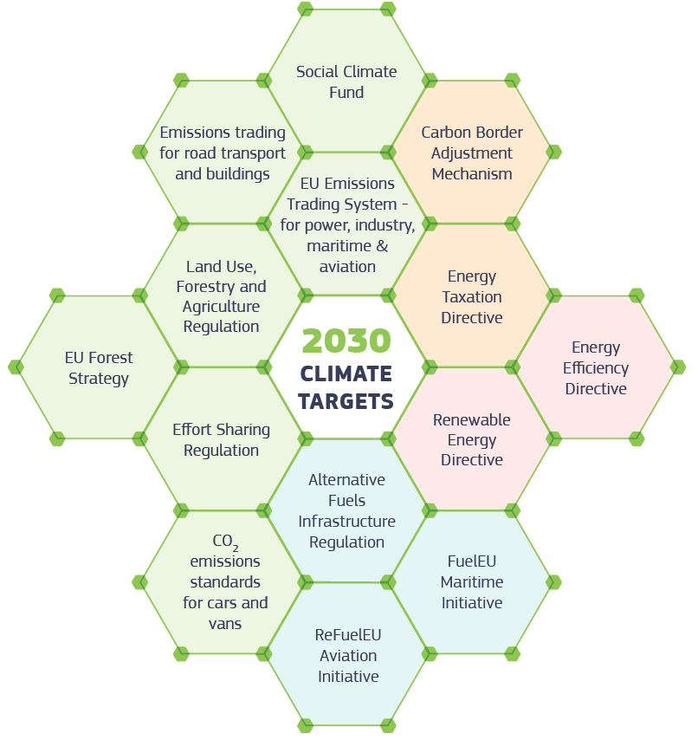

Slide 3
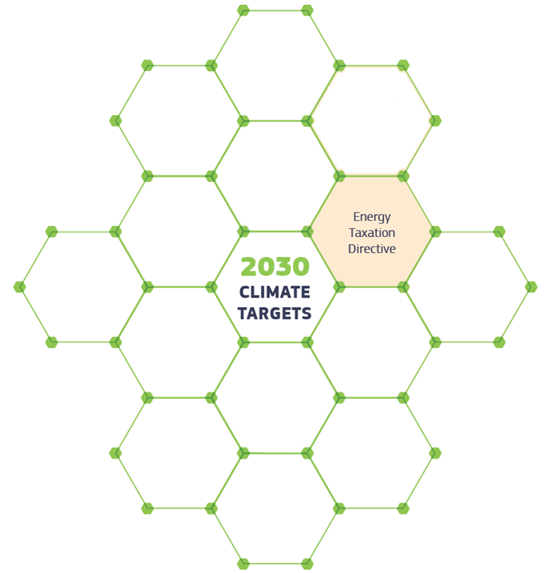

Slide 4
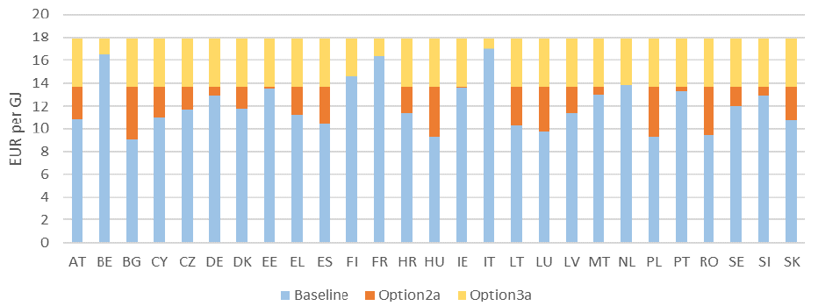
ETD revision: Policy proposals
Tax rates, 2035, Households, Heating, Natural Gas
Tax rates, 2035, Households, Motor, Gasoil

Slide 5
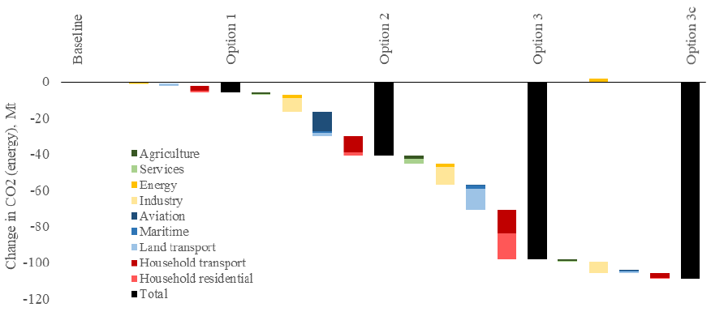
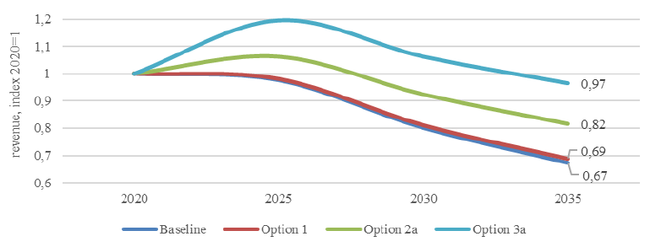
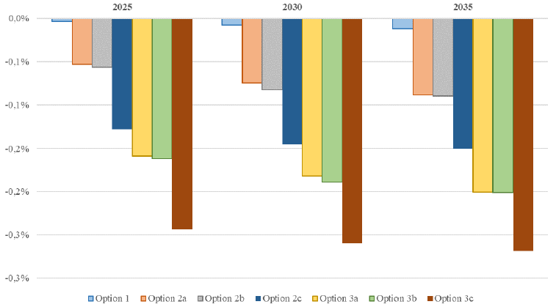
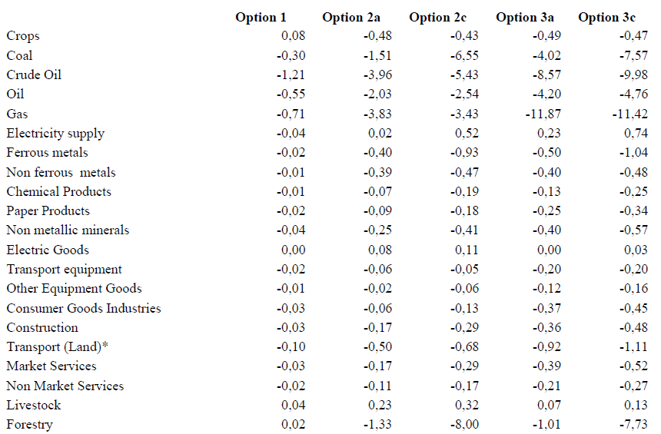
Impact Assessment
Environmental
Fiscal
Economic
Employment

Slide 6
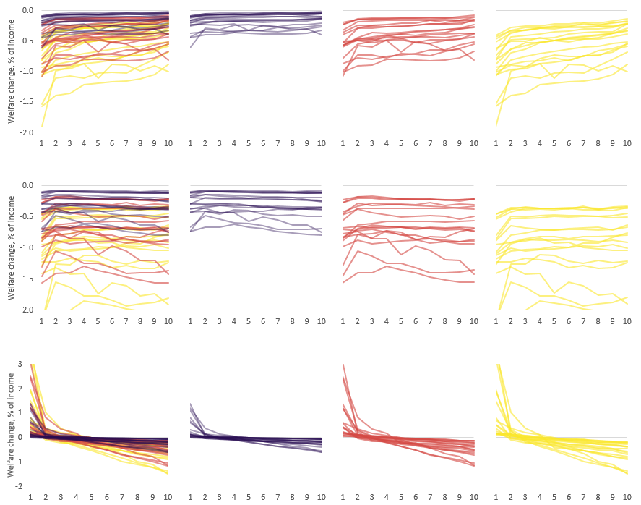
Distributional impacts
All 3 scenarios
2a: Energy content
3a: Carbon content
2a: Carbon + air
Price effect
Price + income
Price + income + recycling

Slide 7
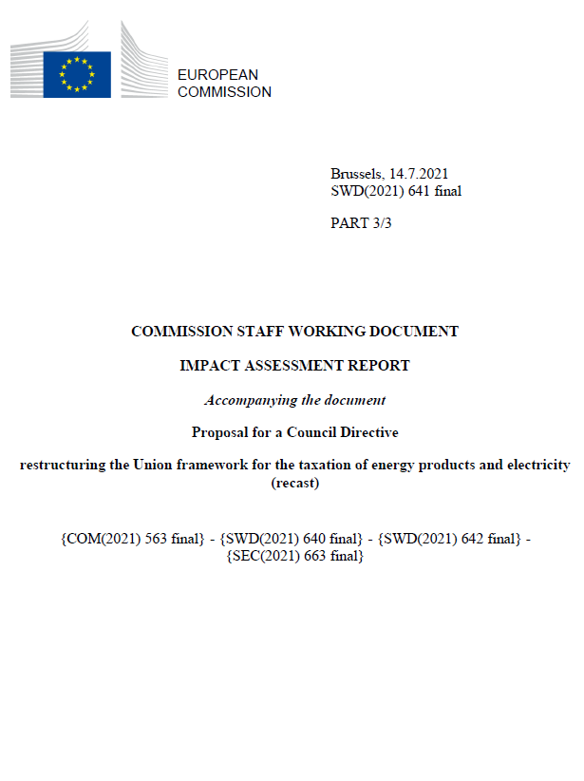
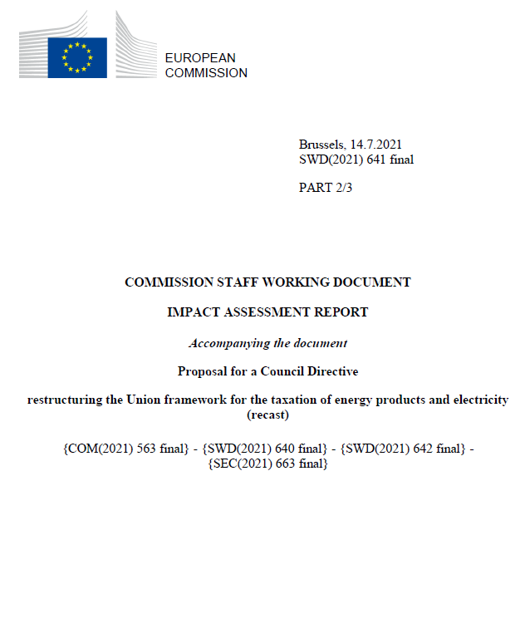
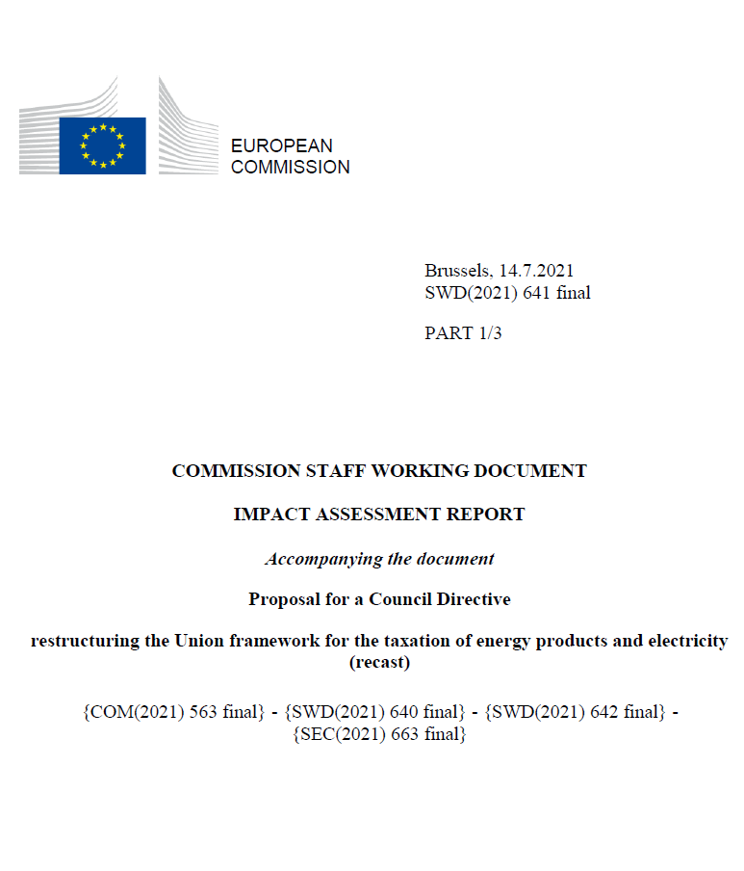
Thank you
Toon.Vandyck@ec.europa.eu
@Toon_V
© European Union 2021

