Slide 1
Policy modelling for scoping alternative pathways for sustainable and profitable agriculture for Europe
Hedwig van Delden, Luuk Fleskens, Roel Vanhout, Melanie Muro, Tugce Tugran, Jantiene Baartman, João Pedro Nunes, Simone Verzandvoort, Jane Mills, Julie Ingram, Charlotte Chivers, Lilian O'Sullivan, Iris Vanermen, Guna Salputra, Lingtong Gai, Jan Peter Lesschen, and Rudi Hessel
Notes:
Feel free to add your name

Slide 2
Aim: policy support under uncertainty
1. How can policies support sustainable and profitable farming practices under different future pathways?
2. Are some policy actions more robust under a range of future pathways?
Develop exploratory scenarios at European scale to enhance the understanding of future uncertainties
Use the developed scenarios to assess:
Policy actions tailored to specific socio-economic conditions
Robust policy actions valid across several socio-economic conditions

Slide 3
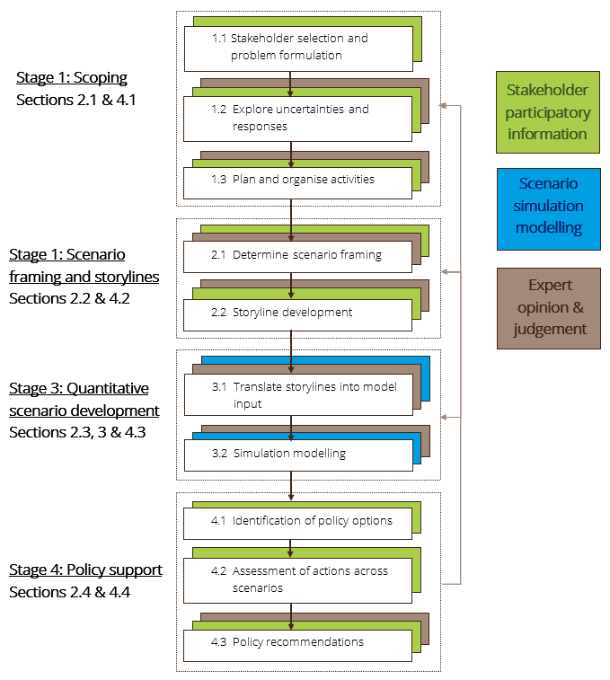
Scenario, simulation and policy support approach
Combination of participation (interviews, workshops, webinar), expert opinion, and modelling
Inclusion of qualitative and quantitative aspects
Narratives: creative and rich exploration of how the future might unfold
Modelling: enhance the consistency and coherence of the narratives, visual and spatially explicit understanding
Policy action assessment: use of scenarios to better understand how different future pathways impact on the likelihood of success of policy actions
2

Slide 4
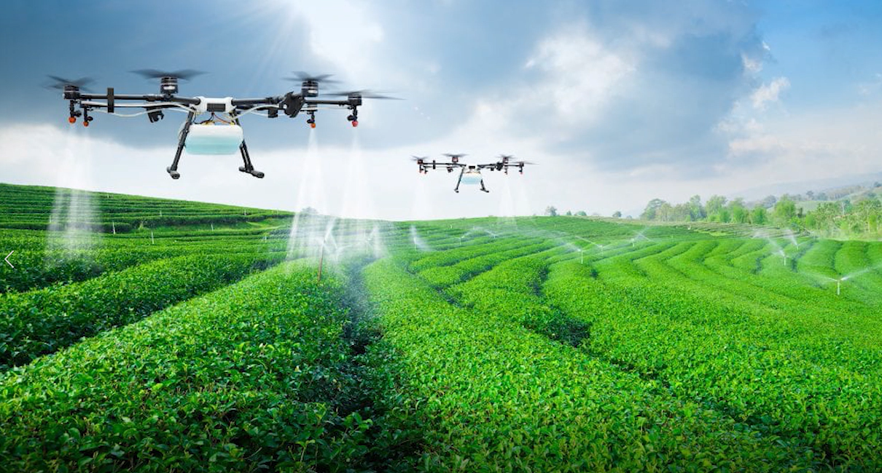
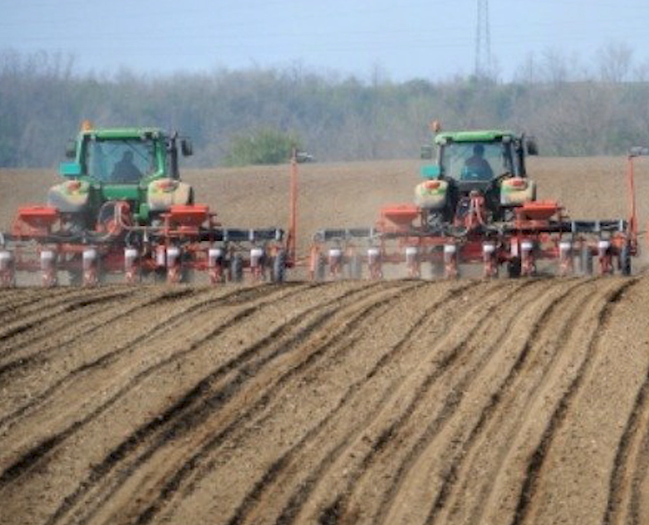
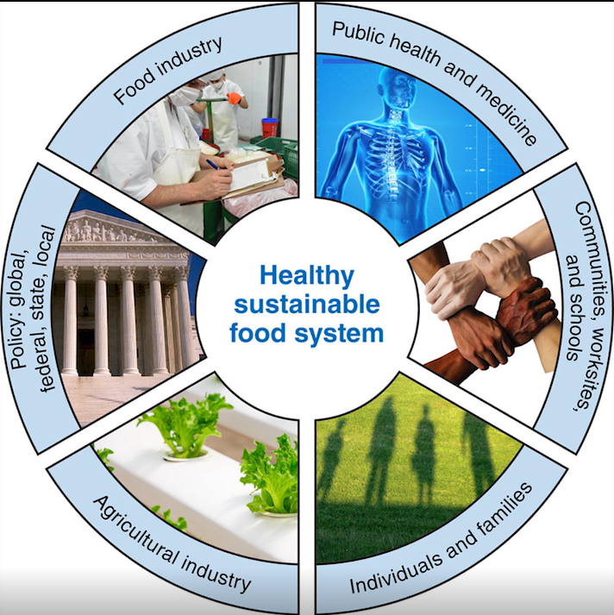
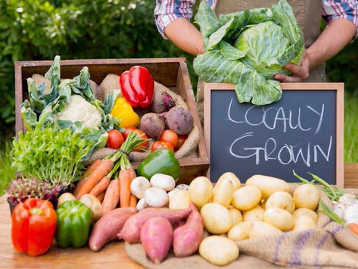
Motivating factors driving scenarios
Under pressure
Societal pressure for government action
Race to the bottom
Societal demand for
low food prices
Under pressure
Race to the bottom
Significant
S. 2
S. 4
Future challenges to voluntary instruments
Caring and sharing
Broadly supported
resilience approach
Local and sustainable
for those who can afford it
Individual drive for healthy and sustainable food
Few
S. 1
S. 3
Caring and sharing
Slow and local or quick and global
Few
Significant
Future challenges to mandatory instruments

Slide 5
Motivating factors driving scenarios
Under pressure
Societal pressure for government action
Race to the bottom
Societal demand for
low food prices
Under pressure
Race to the bottom
Significant
S. 2
S. 4
Future challenges to voluntary instruments
Caring and sharing
Broadly supported
resilience approach
Local and sustainable
for those who can afford it
Individual drive for healthy and sustainable food
Few
S. 1
S. 3
Caring and sharing
Slow and local or quick and global
Few
Significant
Future challenges to mandatory instruments

Slide 6
SoilCare IAM
Scenario drivers
(climate, population, GDP, diet changes, trade, spatial planning, farming practices)
Characteristics
Modular framework
Temporal resolution: months, years
Temporal horizon: 2050
Spatial scale: Europe (EEA space+)
Spatial resolution: 100-500 m grid
Dynamic approach with interactions between important model components
Agricultural economics (AGMEMOD)
Land use (Metronamica)
Land suitability
(Metronamica)
Farmer decisions
(Metronamica)
Hydrology, vegetation, soil, emissions (PESERA/QUEFTS/MITERRA)
Integrated model
Model outputs
(domestic use, production, net exports, land use, yield, erosion, SOC contents, etc.)

Slide 7
Main findings
The cost-benefit analysis of farming practices shows a mixed spatial pattern of the profitability of those practices across scenarios
the combination of drivers plays out differently in different parts of Europe, indicating the complexity of the issue and the importance of understanding local dynamics
No actions were identified that are robust across all scenarios
understanding the socio-economic conditions and their likely evolution is critical for policy design
Including not just one temporal dimension but alternative future pathways, the spatial dimension, and the range of agricultural practices makes the exercise complex
but does provide the context under which decisions on policy actions should be considered

Slide 8
Use of policy tools - Lessons learnt
Question, understand and improve model results, iterative process
Important to disentangle the complexity in communicating model results. E.g. why is change in yield different in different regions?

Slide 9
Use of policy tools - Lessons learnt
Tools for thinking!
Better understand the range of plausible future pathways scoping uncertainty
‘Future-proof’ policy actions by assessing them under plausible future pathways and ensure they
address specific issues within a pathway
are robust across different pathways
Mapping and modelling helps to understand spatial differences and related potential for sustainable and profitable agricultural practices across Europe
Project deliverables available on www.soilcare-project.eu

Slide 10
Questions?
www.soilcare-project.eu
Hedwig van Delden: hvdelden@riks.nl

