Slide 1
Global land-use impacts of EU’s future bioeconomy
An econometric input-output approach
2021 EU Conference on modelling for policy support, Nov 23, 2021
Dr. Johannes Többen, Saskia Reuschel, Dr. Britta Stöver, Lara Ahmann, Martin Distelkamp, Dr. Christian Lutz

Slide 2
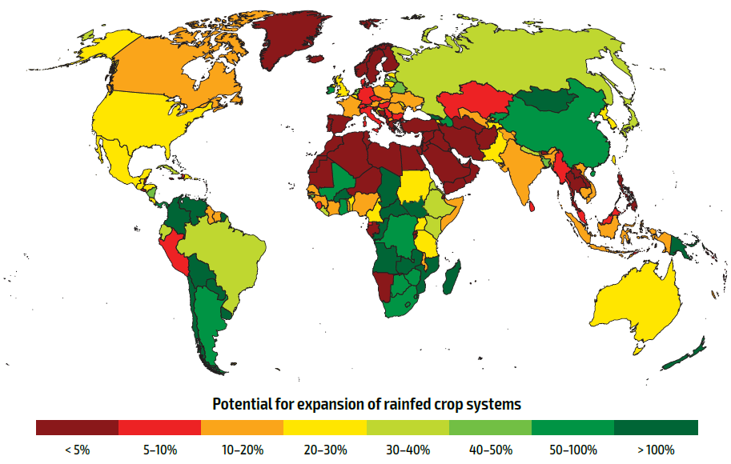
Background: EU‘s Bioeconomy and Global Sustainable Development
Objectives EU Bioeconomy Strategy:
  Contribution to climate goals
  reducing import dependency
  Jobs and economic competitiveness
4 components of the Bioeconomy:
  More efficient biomass production (Agriculture/Forestry/Fishery)
  Increased use of bioenergy (Transportation, Buildings, Industry)
  Increased use of biomaterials in traditional applications (Construction)
  New bio-based materials (bio-plastics, platform chemicals)
Available versus required additional agriculture land in FAO Scenarios (a) and distribution of available land across countries (b)
Bottleneck: Availability of arable land
  Food vs. Fuel
  Risk of future losses of arable land due to climate changes
  Future demand for food and global population growth
Assessment of the economic, climate and land use impacts of the EU’s bioeconomy

Slide 3
GINFORS-E
Macroeconometric model of the world economy, combining consistently production, international trade, energy use and emissions: https://web.jrc.ec.europa.eu/policy-model-inventory/explore/models/model-ginfors-e
Economic Core
  Macroeconometric country-models project GDP components and labor markets
  Input-Output country-models: Harmonized OECD input-output tables for 64 countries, 36 industries
  Econometric World Trade model: Links country models via price dependent bilateral trade shares (Mönnig/Wolter 2020)
Modules provide detail on sectors insufficiently covered in IO
  Energy module: Econometric model of generation and consumption based on IEA energy balances taking carbon prices (ETS and non-ETS) into account
  Emissions: non-combustion emissions from EDGAR

Slide 4
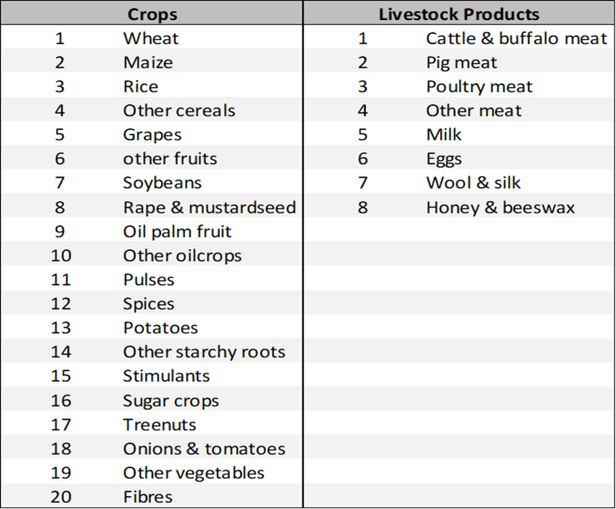
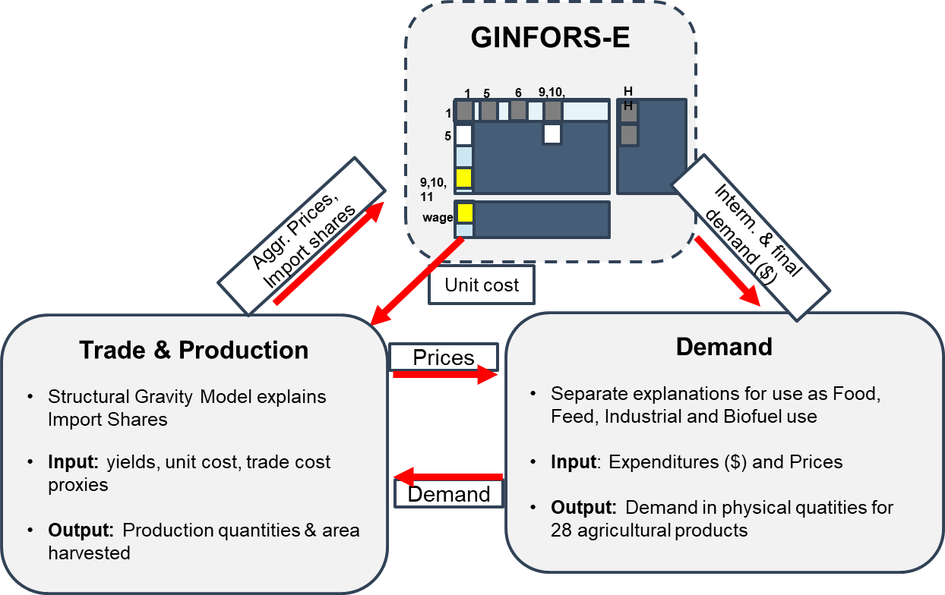
Concept: Modelling the Bioeconomy in GINFORS-E
GINFORS-E: well suited for modelling structural change related to bioeconomy in industrial sectors
  Energy module: Explains demand for biofuels by travel demand, EV-shares, blending mandates etc.
  Increased use of biomaterials in traditional applications: mineral products vs. agriculture & forestry products in construction
  New bio-based materials: biomass vs. oil inputs in chemical industry
New Agriculture Module: models consumption, production, land use and trade
  Based on FAOSTAT Commodity Balance Sheets, Bilateral Trade Data & Production Accounts
  Inputs from GINFORS-E:
    Expenditures for food, feed and other industrial use
    Biofuel demand
    Unit cost agricultural products
  Feedbacks to GINFORS:
    Domestic consumer and export prices
    Import shares

Slide 5
Modelling Approach
Follows setup of GINFORS-E: Country models linked via a world trade model
Agriculture Trade
Structural Gravity Model Components:
EXP-FE: Measures exporters competitiveness and
depends on relative yields and unit costs
IMP-FE: Measures importers market attractiveness
and depends on relative yields and unit costs
Trade Cost: Proxies for monetary and non-monetary
trade barriers
Hierarchical Demand Estimation
Demand
GINFORS-E: Expenditures for agricultural products by
Households: Expenditure-, Own- and Cross-price Elasticities
Industry: Scenarios for biofuel and feedstock in chemical industry
Prices
Demand quantities for aggregate crop and livestock groups
Econometric demand equations with for aggregate product (e.g
cereals, meat) and uses (food, feed & industrial use)
Inputs for Biofuel driven by energy module
Import shares
Demand
Production and Land-use
Produktion volumes depend on other country‘s
demand and trade shares
Yields & animal productivity (technology shifter)
times production deliver harvested area & herd size
Cropping intensity delivers physical area required
Substitution within aggregate crop and livestock groups
Econometric substitution elasticities between individual products
E.g. palm- versus soybean oil

Slide 6
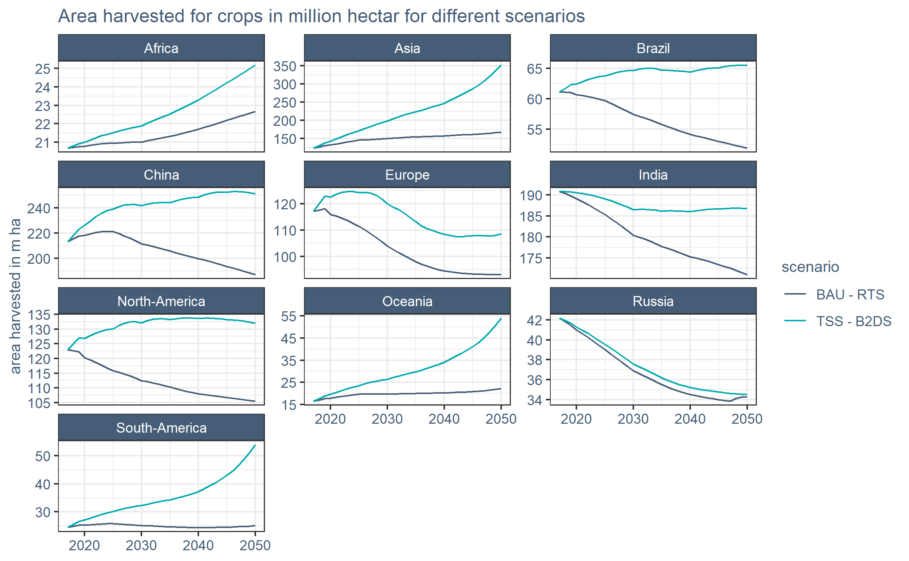
Main Scenario Parameters & First Results
Scenarios
BAU – 2DS: FAO-BAU + IEA - 2 Degree Scenario
TSS – B2DS: FAO – Towards Sustainability Scenario + IEA – Beyond 2 Degree Scenario + Increased sustitution of biomass feedstocks for oil

Slide 7
Outlook
Link to SDGs: assessment of wider economic, societal and environmental impacts
  Zero hunger: Food prices
  Biodiversity impacts of agriculture: Links to habitat loss, water use overnutrition…
Extension to further biomass producing sector:
  Forestry: Important domestic biomass source in EU
  Fisheries and Aquaculture:
Additional feedbacks: Agriculture Module and GINFORS-E
  Land prices and land availability
  Pesticide and fertilizer use
  Construction materials and paper industry

Slide 8
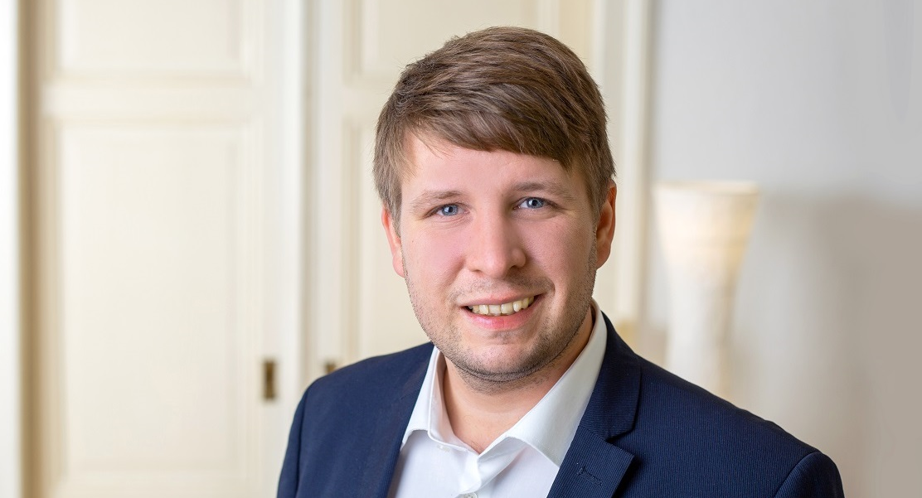
Contact person
Johannes Többen
T: +49 (0) 541 40933 - 284
E: toebben@gws-os.com
Division of Energy & Climate

