Slide 1
Territorial Impact Assessment – modelling evidence for better EU legislation
EU Conference on Modelling for Policy support: collaborating across disciplines to tackle key policy challenges
Nov. 26th, 2021 | Roland Gaugitsch, Bernd Schuh

Slide 2
Content
Modelling and TIA – the happy marriage
The ESPON TIA QUICK CHECK Tool – the modelling elements
A flavour of how it works

Slide 3
Policy and decision making – looking into the cristal ball
Political decision making ex-ante – problems of uncertainty, multiple criteria, various intertwined effects and unclear cause-effect relations
Any decision support tool should not substitute policy-makers through a mathematical model but improve their understanding of the main features of the problem at hand
Any modelling approach should therefore create knowledge about key assumptions, degree of uncertainty, robustness of results and overall technical and social defensibility of options chosen
IA is supposed to serve this purpose (see EU Better Regulation Guidelines)

Slide 4
What makes a TIA a TIA?
Some common elements regardless of everything:
Territory – i.e. unlike thematic IA (environmental, economic,…) focal point is a territory (regardless of its granulation – NUTS, region, MS) bundling all thematic impacts in all their complexity
Assessment – i.e. measuring/ capturing something & comparing
Impact – i.e. a causal consequence of a trigger – combination of an outside influence and a „situation as it is“
Source of the impact – i.e. any „external“ influence – e.g. policy, bundle of policies/ strategies, shocks (Covid, Brexit etc.)
A TIA method will have to deal with all that!

Slide 5
The Basis - vulnerability concept
Different for
each policy proposal
Independant
of policy proposal
Policies
Regions
Exposure
Territorial sensitivity
Workshop ESPON Data
Territorial impact

Slide 6
The Basis - Process
Workshop procedure:
Identification of causal chains across 4 relevant dimensions – pinpointing of main effects
Selection of indicators suitable to depict effects
Voting on strength and direction of impacts (“majority opinion”)
Model calculations
Intersecting for each region territorial sensitivity (i.e. normalised indicator value) with exposure (i.e. factor depending on strength and direction of impacts)
Calculation of impact class for each region
Mapping and interpretation
Mapping of impact classes
Group discussion and interpretation

Slide 7
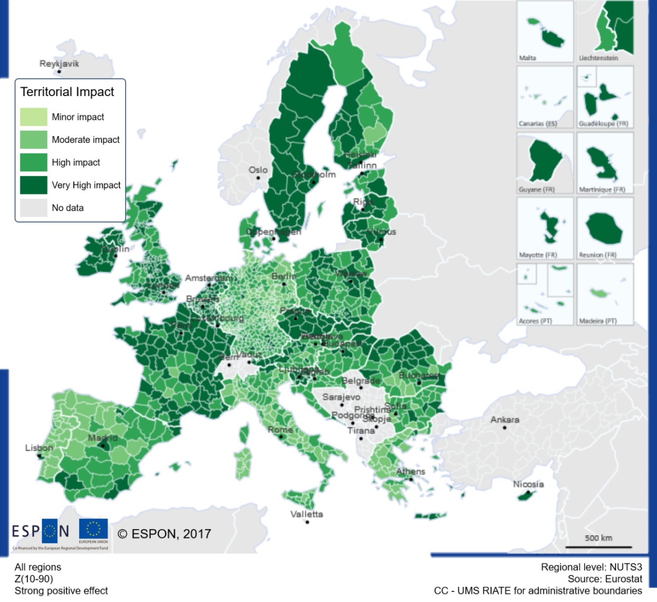
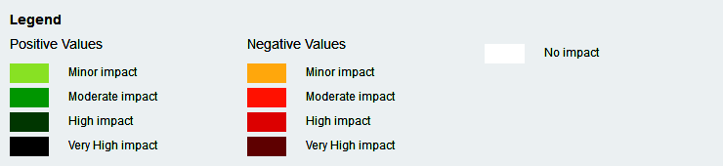
Impact map
Source: Committee of the Regions,
TIA Workshop “Work-life balance directive”,
11th October 2017, Brussels

Slide 8
Challenges and solutions
Data quality/lack of data
  Impacts are calculated relative to other regions, thus completeness of regional data is required
  Broad range of data sources and gap mitigation techniques are applied
“Exactness” of results
  “complete” datasets are rare, mitigation techniques or missing values are necessary and influence results
  Relative impacts in broad impact classes are not distorted by single missing values -> overall results remain robust even with missing data or estimations
Balancing effort necessary and robustness
  Policymakers are less likely to use non-mandatory assessment methodologies
  The model is easy to apply, easy to understand and produces quick yet policy relevant results which do not require excessive interpretation, thus incentivise their use

Slide 9
A flavour on how it worked so far…
The method has been endorsed in the Better Regulation Guideline Toolbox as recommended TIA method for legislative proposals
It has been applied in 5 legislative proposals (ranging from EU Ports facility Directive, over Directive on Re-Use of Water to Clean Vehicle Directive) and passed in all cases the EU Scrutiny Board and all of these proposals have entered into force
It has been applied in more than 40 cases for assessing territorial impacts for political decision making by DG Regio, the CoR and other EU institutions (e.g. INTERACT)

Slide 10
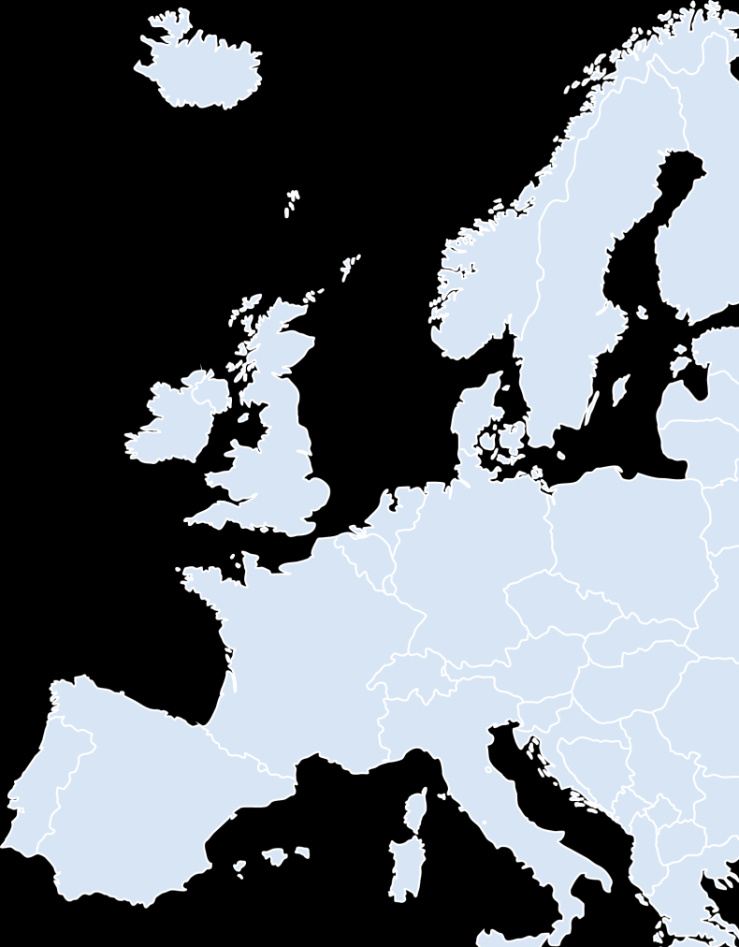
Additional information
ÖIR GmbH
Bernd Schuh, Roland Gaugitsch
schuh@oir.at | +43 1 533 87 47
1010 Wien, Franz-Josefs-Kai 27
Subscribe to our e-letter: www.oir.at/e-letter

