Slide 1
Taxing income or consumption: macroeconomic and distributional effects for Italy
Diego d’Andria, Jason DeBacker, Richard W. Evans, Jonathan Pycroft and Magdalena Zachłod-Jelec
2021 EU Conference on Modelling for
Policy Support, 26th of November 2021

Slide 2
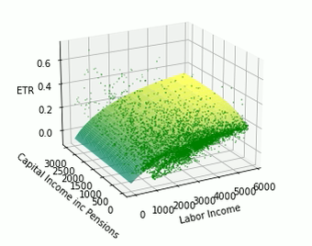
Taxing income or consumption:
Macroeconomic and distributional effects for Italy
Linking models
Microsimulation
➔ Macroeconomic
Diego d’Andria
Jason DeBacker
Richard W. Evans
Jonathan Pycroft
Magdalena Zachłod-Jelec
2021 EU Conference on Modelling for
Policy Support, 26th November
Disclaimer: The views expressed are those of the authors and may not in any circumstances be regarded as stating an official position of the European Commission or any of the authors’ affiliated institutions.

Slide 3

Thank you!
© European Union 2021
Unless otherwise noted the reuse of this presentation is authorised under the CC BY 4.0 license. For any use or reproduction of elements that are not owned by the EU, permission may need to be sought directly from the respective right holders.

