Slide 1
Climate services for better
informed adaptation choices
Case application, performance and outlooks
2021 EU Conference on modelling for policy support
Jaroslav Mysiak, Euro-Mediterranean Centre on Climate Change, CMCC
with contributions by Larosa F, CMCC and University College London, Bagli S and Mazzoli P, Gecosistema Srl; Villani G, ARAPE; Barbato G, CMCC; and

Slide 2
Climate services
born out of the recognition that climate information & knowledge is not or not sufficiently used for and relied on in tactic and operative decision making,
many divergent but useful definitions but little recognition as a common trademark, hence difficult to convey,
a type of (science-based) knowledge intensive business services KIBS - with all the challenges and risks this involves,
not Decision Support Systems (DSS) - although similar in some respects,
a specific, if not unique, area of model-based decision aid - which has implications for this session - how models are responsibly used for policy and decision making.
EU Research & Innovation roadmap on CS:
Climate services entail ‘transformation of climate-related data - together with other relevant information - into customised products such as projections, forecasts, information, trends, economic analysis, assessments (including technology assessment), counselling on best practices, development and evaluation of solutions and any other service in relation to climate that may be of use for the society at large’
Global Framework for Climate Services (GFCS) and its evolution – Hewitt et al. 2020. 10.1175/BAMS-D-18-0211.A Harjanne. 2017. GEC 10.1016/j.gloenvcha.2017.06.008
Mapping of climate services - Larosa & Mysiak ERL 2019, 14(9).10.1088/1748-9326/ab304d
Business model innovation. Larosa & Mysiak CLIMS 2020 10.1016/j.cliser.2019.100111
Climate services for DRR. Street et al (2018) IJDRR 10.1016/j.ijdrr.2018.12.001

Slide 3
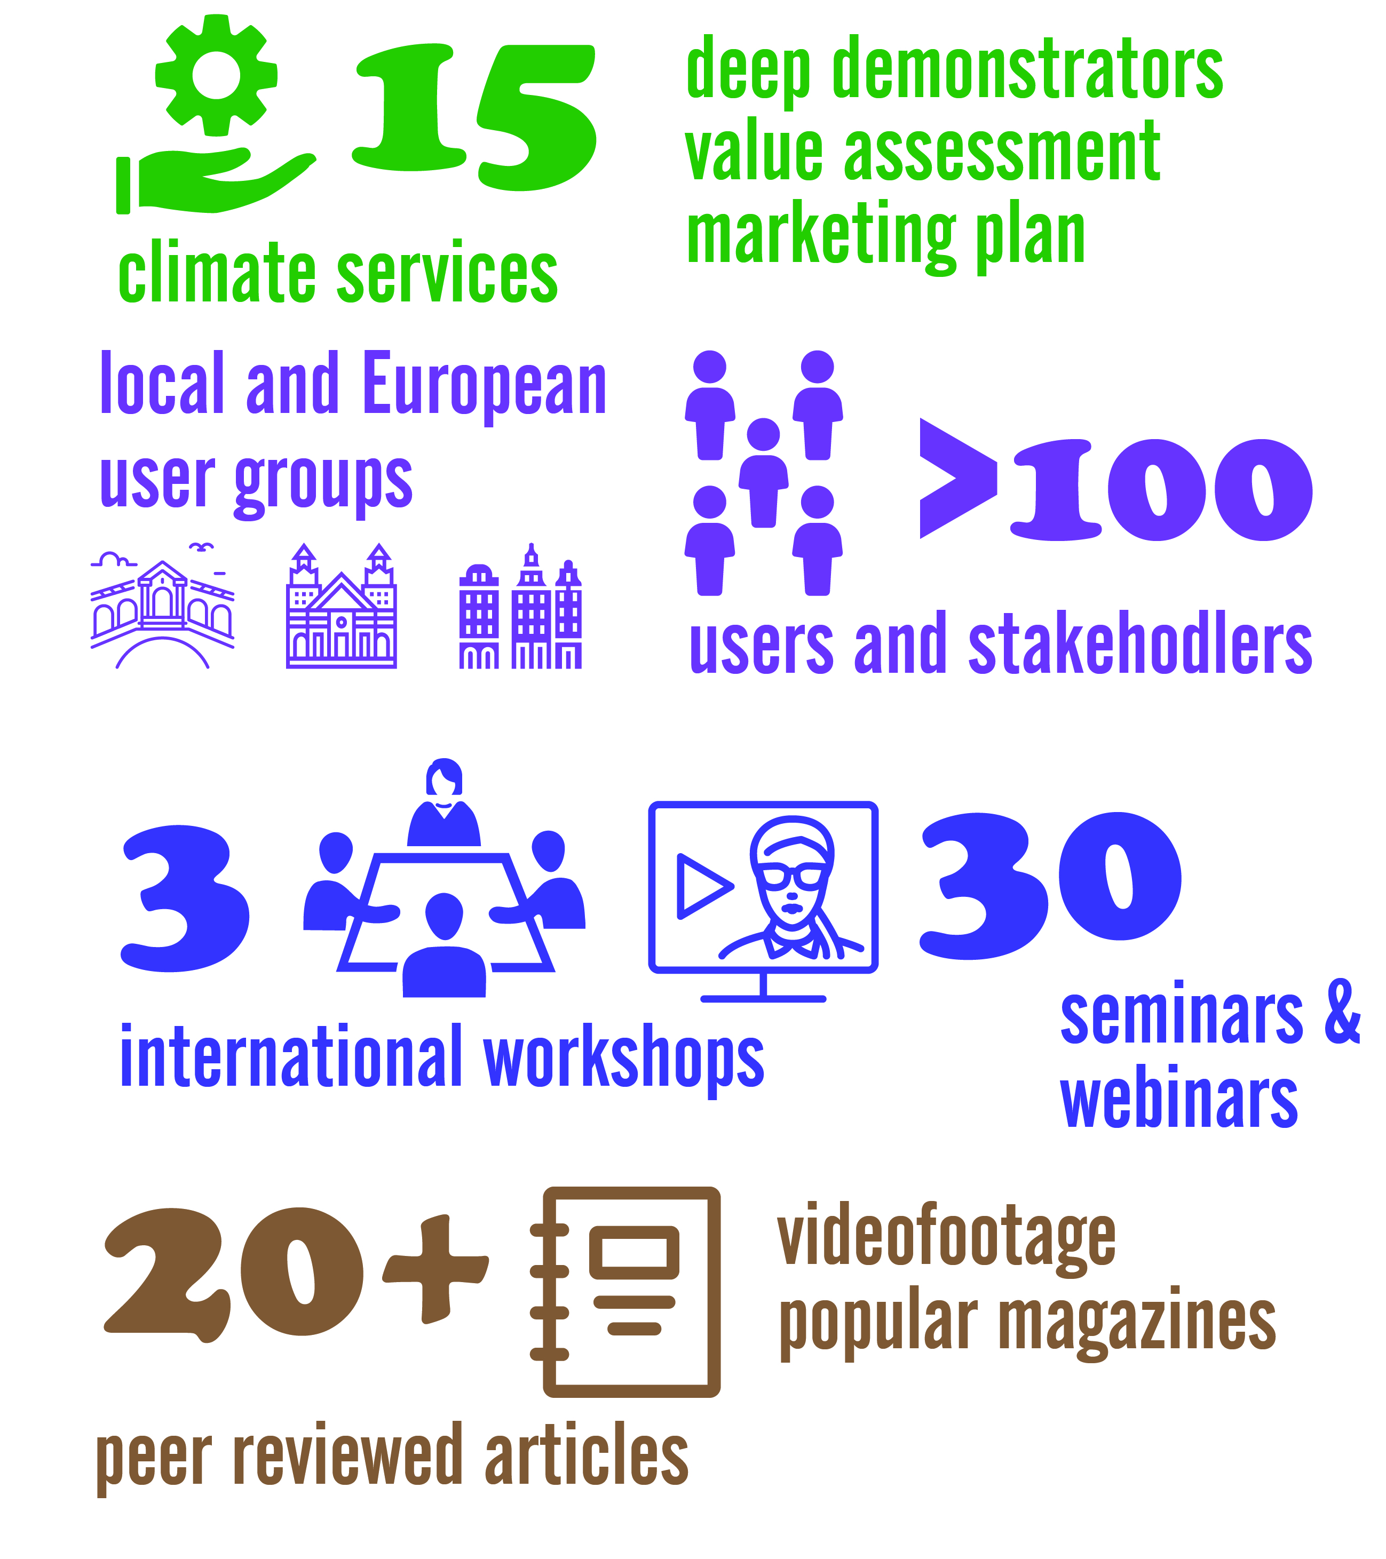
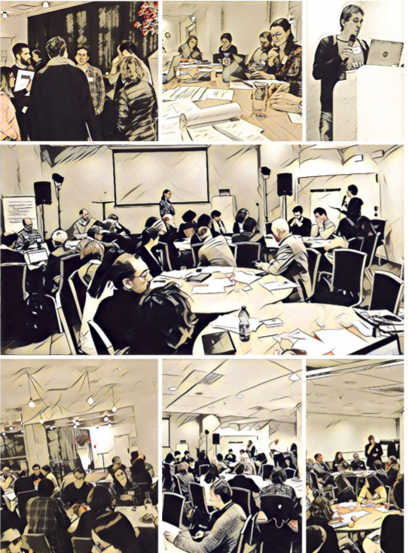
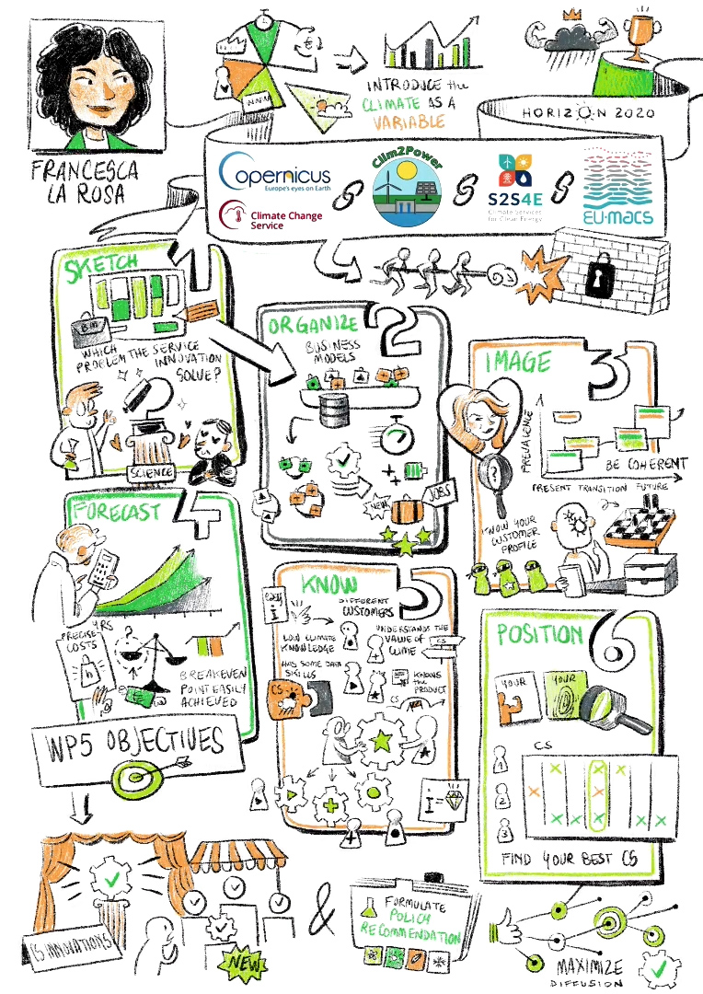
CLARA – a learning journey
Climate forecasts enabled knowledge services, H2020, https://www.clara-project.eu/, ZENODO
Notes:
CLARA – Climate forecasts-enabled knowledge services
one (of many) Horizon 2020, JPI-Climate, Copernicus and Climate KIC-funded innovation projects
developed new or enhanced 15,

Slide 4
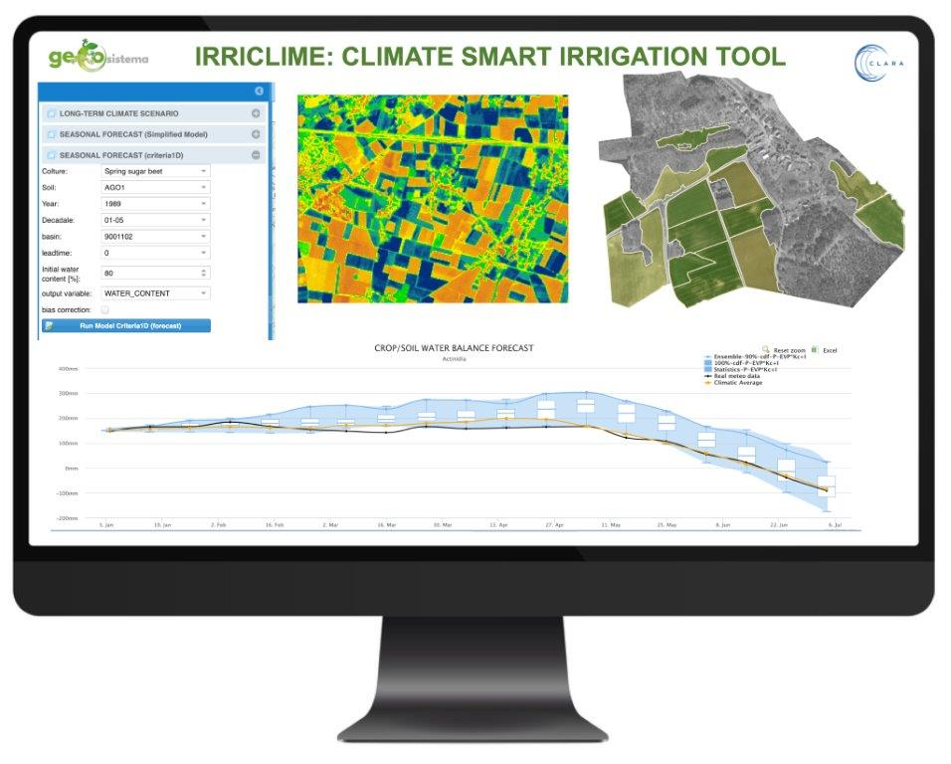
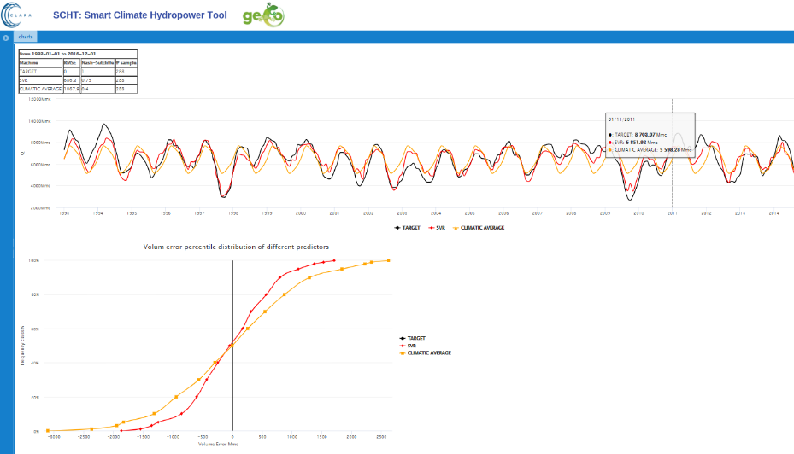
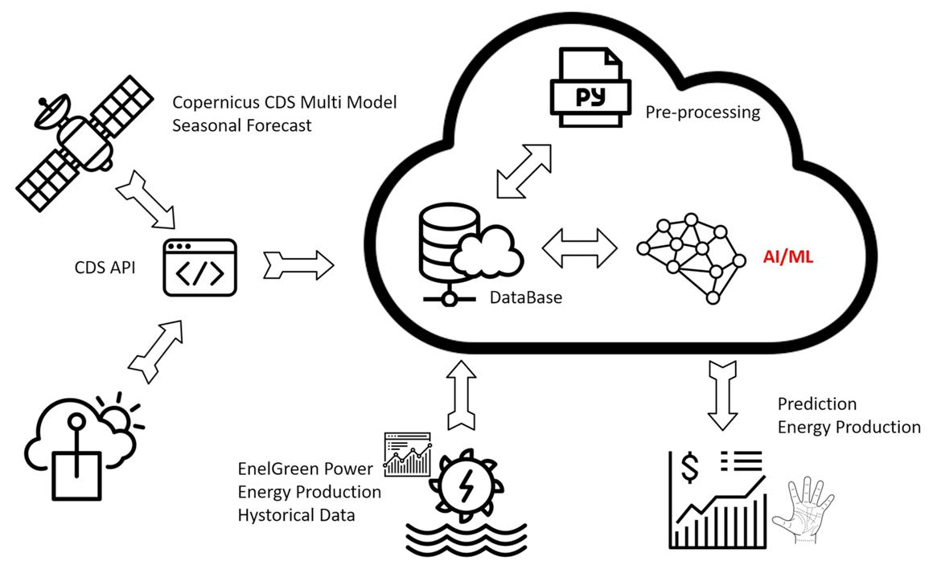
Application 1 – Water resource management
SCH – Smart river (web, leaflet)
Value proposition
Hydropower forecast - predict the accumulated seasonal river discharge into the reservoir and estimates the difference between the scheduled and achievable hydropower production to choose corrective sales or purchase of energy. Web-cloud-based service base don data-driven methods relying on ML.
Essenfelder et al (2020) Atmosphere doi.org/10.3390/atmos11121305

Slide 5
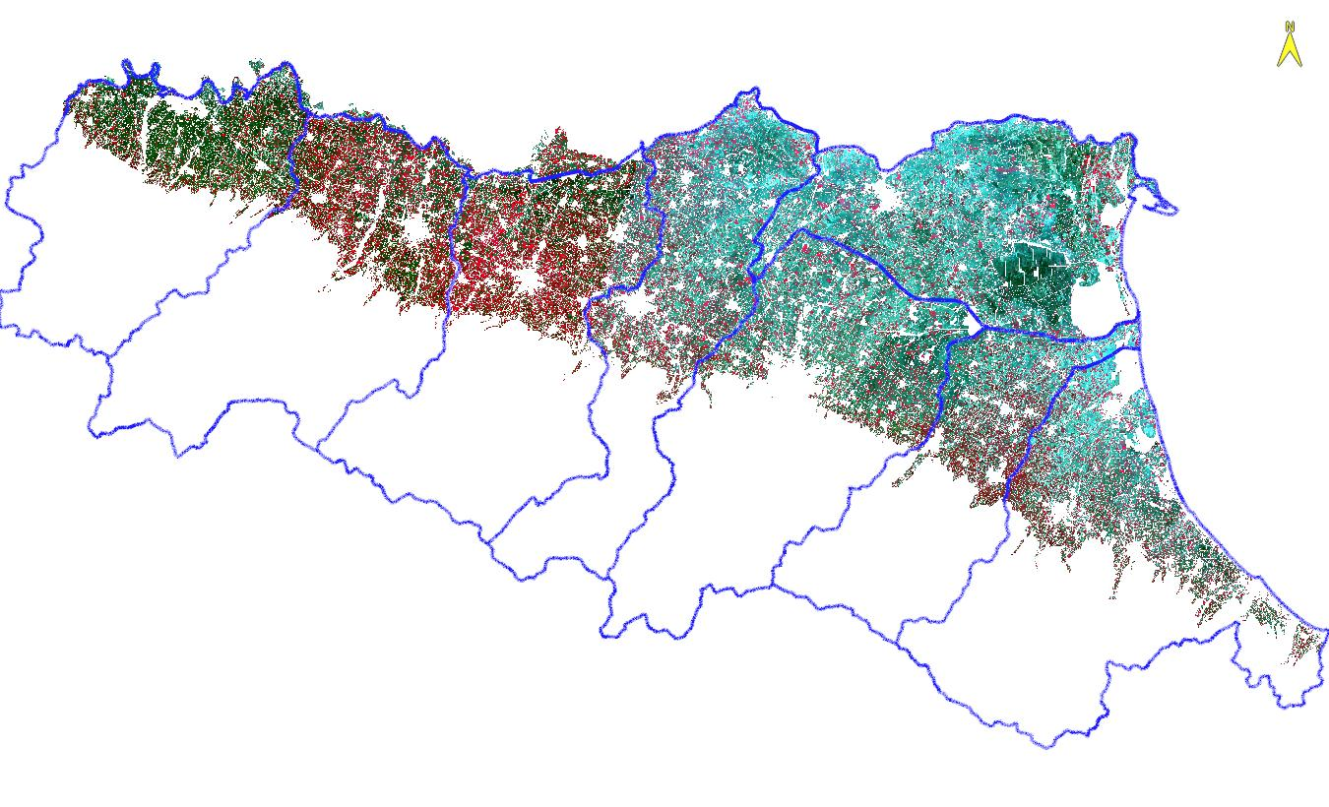
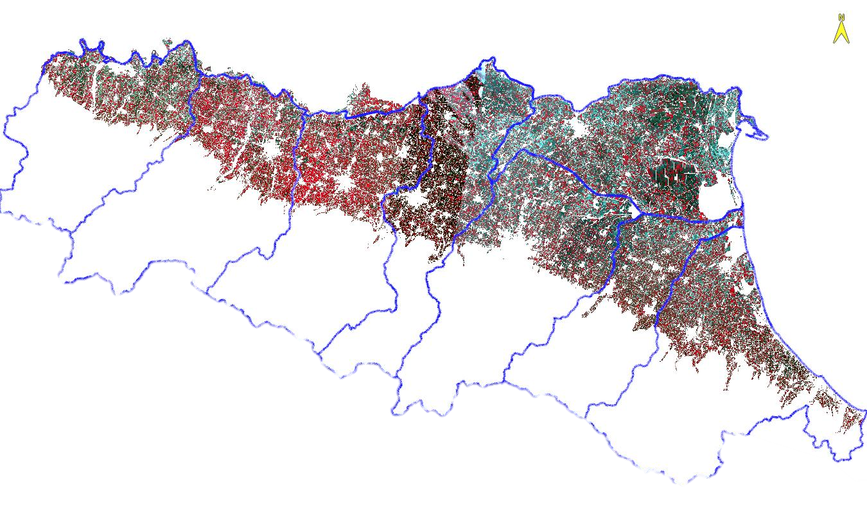
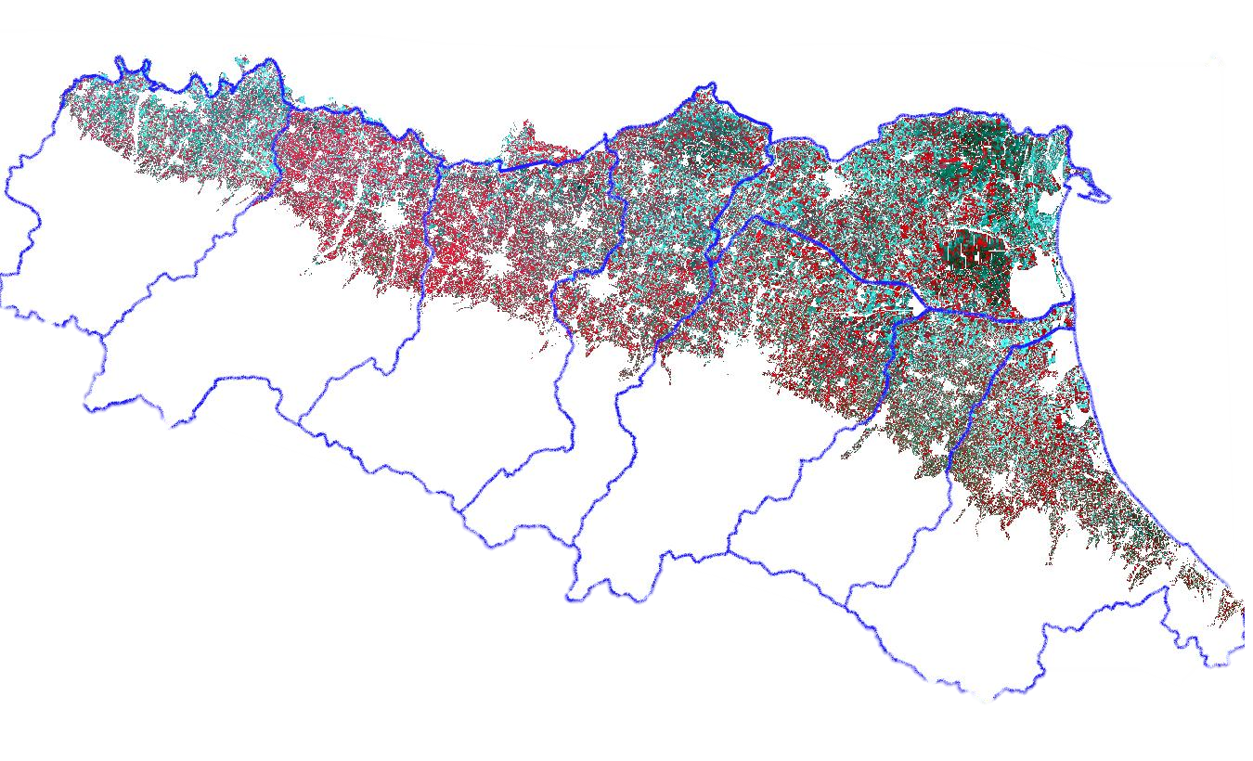
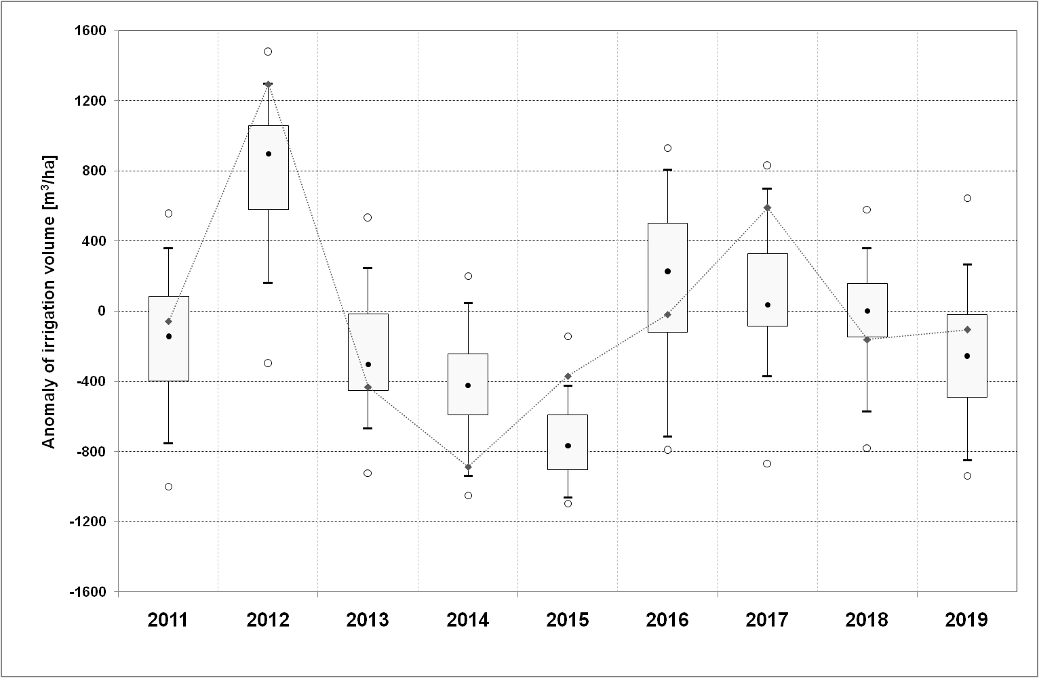
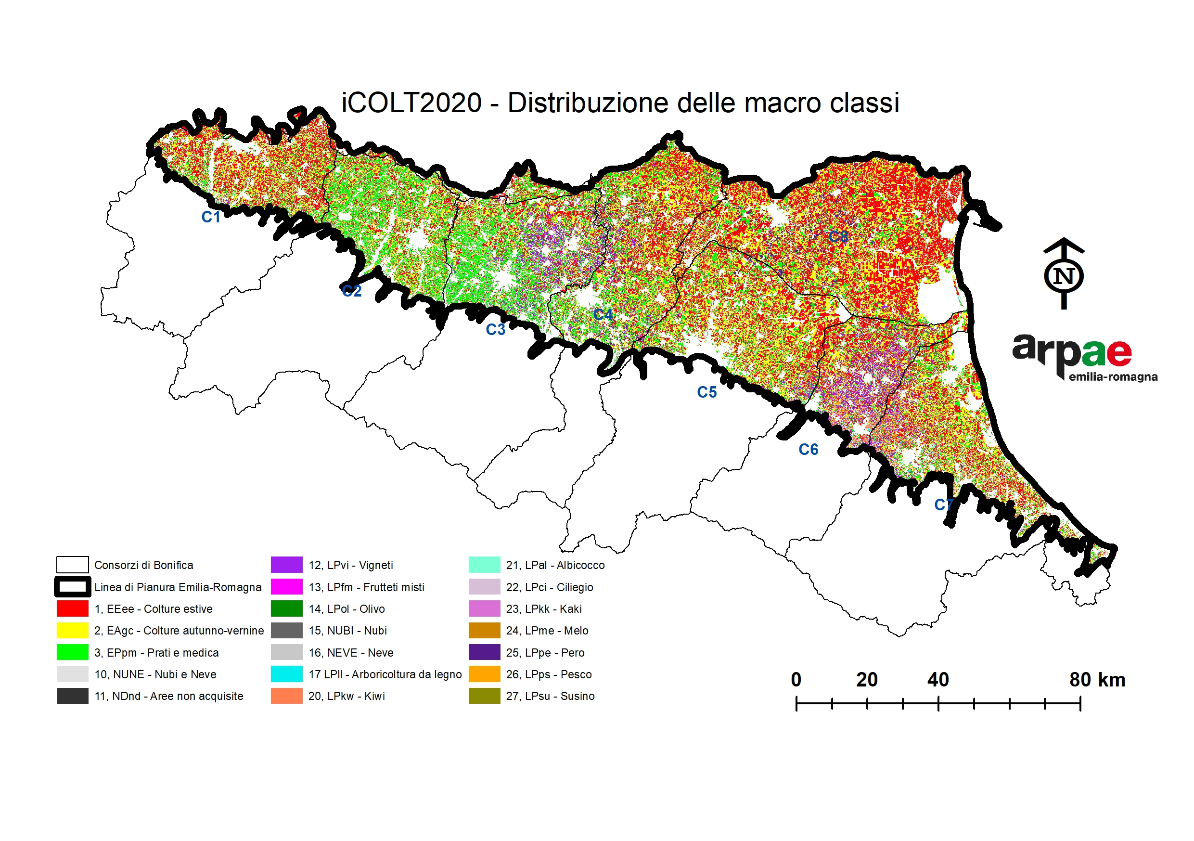
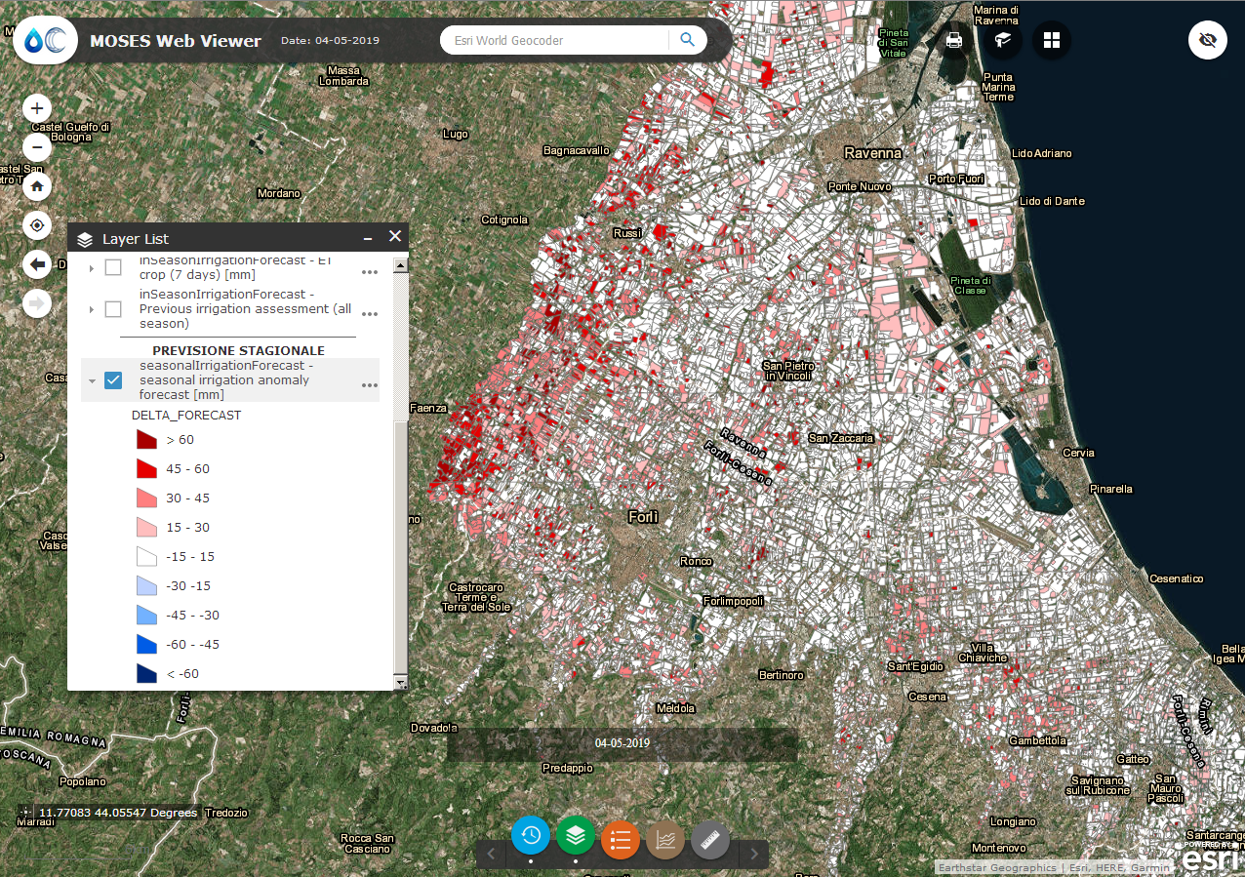
Application 2 – Agriculture
Downscaled, bias-corrected seasonal forecasts
Validation of irrigation
forecast
WRI (web, leaflet)
Value proposition
Water availability and irrigation demand over irrigation season
Water irrigation demand during the irrigation season from April to September.
Forecasts provide anomalies of crop water needs with respect to reference climate.
Seasonal forecasts (+3 months) are produced every month, and weekly forecasts (+7 days) are provided daily.
1st Window
2nd Window
3rd Window
Multitemporal satellite data analysis
Sep-Oct-Nov
Feb
Mar/Apr
Early crop classification map
Villani et al https://doi.org/10.1002/met.2007

Slide 6
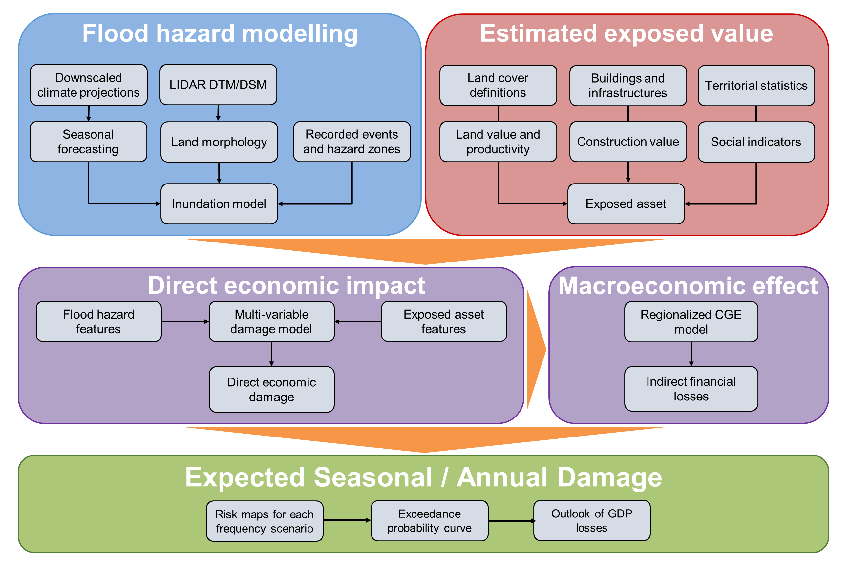
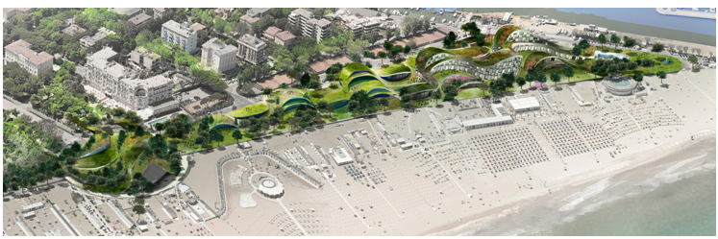
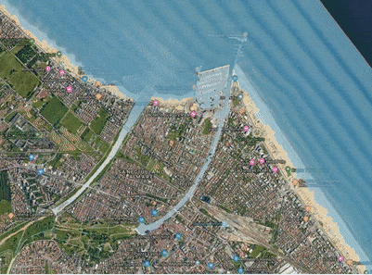
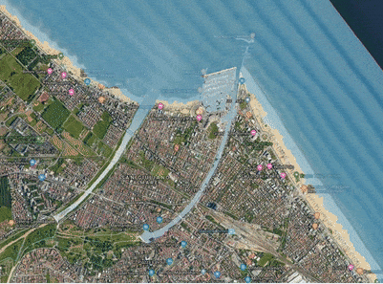
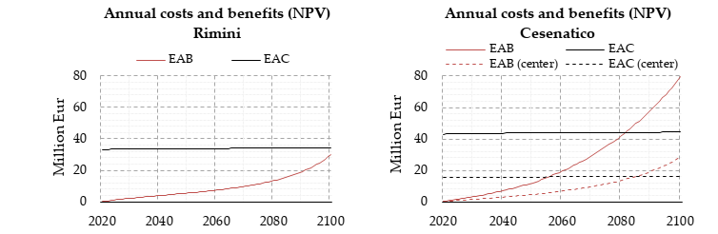
Application 3 – Disaster risk reduction
FLOODMAGE (web, leaflet)
Value proposition
From forensic analysis of the drivers of risks to economic and social benefits of improved climate risk assessments.
From in-depth asset-level to community & regional to national risk assessments.
Examples of applications:
- Cost benefit assessment of restored natural dunes to protect coastal residential areas,
- Pluvial urban hazard and risk assessment and management through urban green

Slide 7
Application 3 – Disaster risk reduction
FLOODMAGE (web, leaflet)
Value proposition
From forensic analysis of the drivers of risks to economic and social benefits of improved climate risk assessments.
From in-depth asset-level to community & regional to national risk assessments.
Examples of applications:
- Cost benefit assessment of restored natural dunes to protect coastal residential areas,
- Pluvial urban hazard and risk assessment and management through urban green

Slide 8
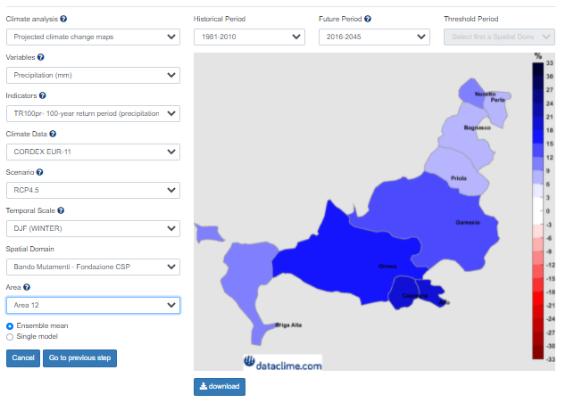
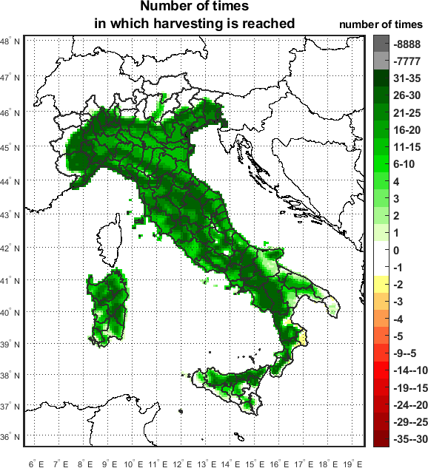
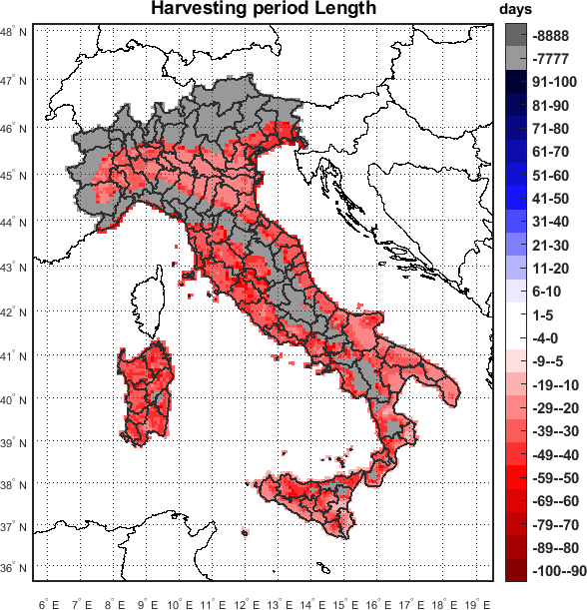
Application 4 – Data processing
DATACLIMA (web, leaflet)
Value proposition
Easy-access, processing and analysis of climate data from heterogeneous, quality assured and high-quality sources; users’ history
Flagship applications
- Local authorities – local action plans
- Insurance (Actuaries Climate Index) and prudential regulation (EIOPA & RMS & CMCC exercise for sensitivity risks)
- Infrastructure - climate proofing in investments and spatial planning
- Agriculture - extreme growth-sensitive indices
User-guided queries specify step-by-step the requests for data analysis and format of
outputs

Slide 9
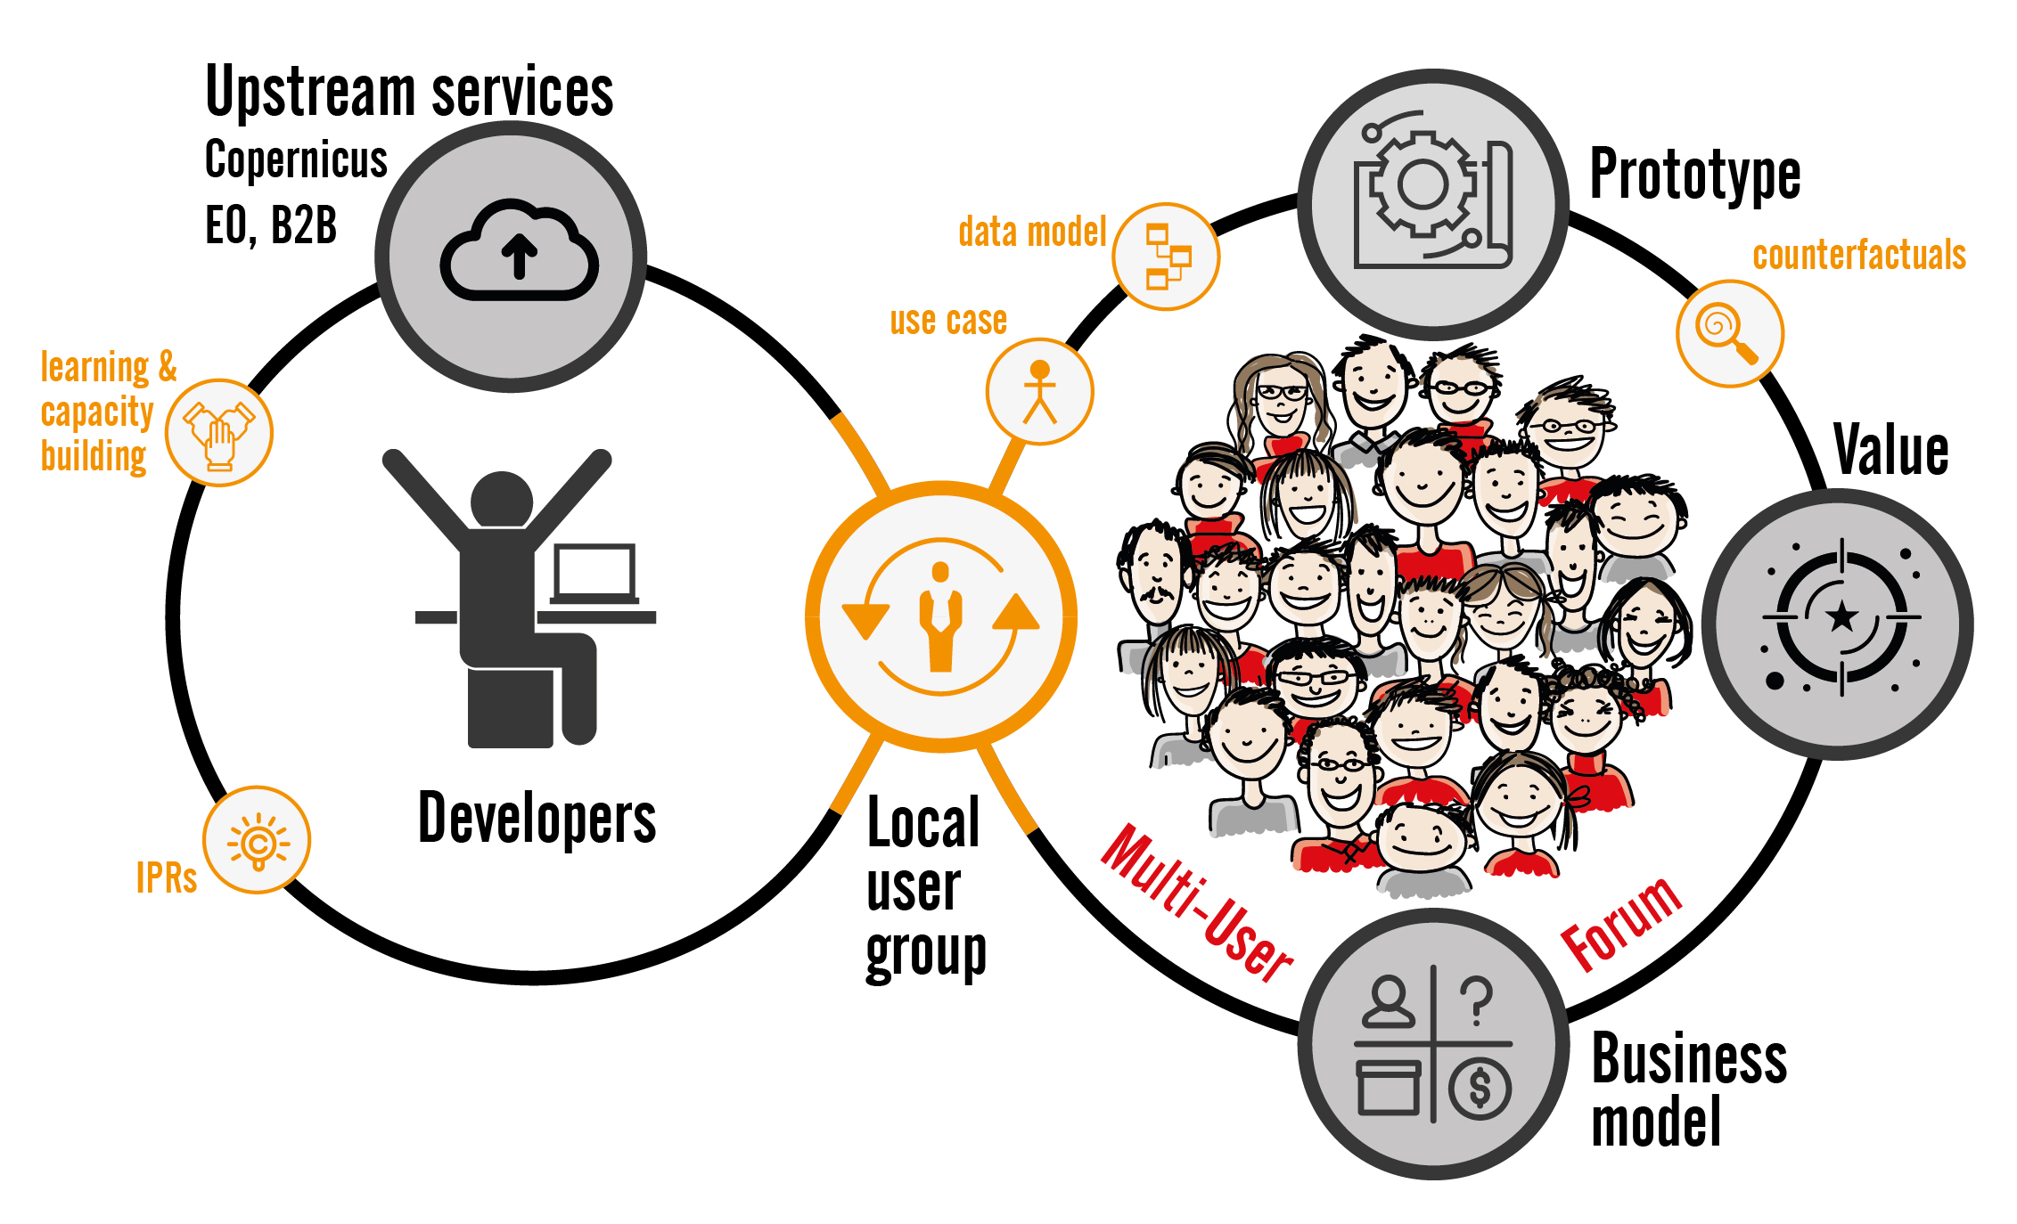
Co-generation, what it means for the users
Co-generation means looking for solutions to ill-defined, messy operational problems or challenges. It starts with a recognition that an establish practices are either suboptimal or no longer suitable.
Users’ needs are a tacit knowledge yet to be surfaced. Co-generation entail mutual learning: users learn about climate data & information that are readily available and explore how
Monitoring
& observation
Forecasting
Perception
& interpretation
Modelling
& simulation
Communication
Decision
making
Opportunity costs
Value of
Information
amount a decision maker would be willing to pay for information prior to making a decision
Private benefits: cost reduction, increased yields and incomes, better-informed planning and protection against unforeseen events, and potential of new entrepreneurial ventures.
Collective benefits - greater water, energy and food security; enhanced resilience, adaptive capacity, and innovation-prone policy and business environments

Slide 10
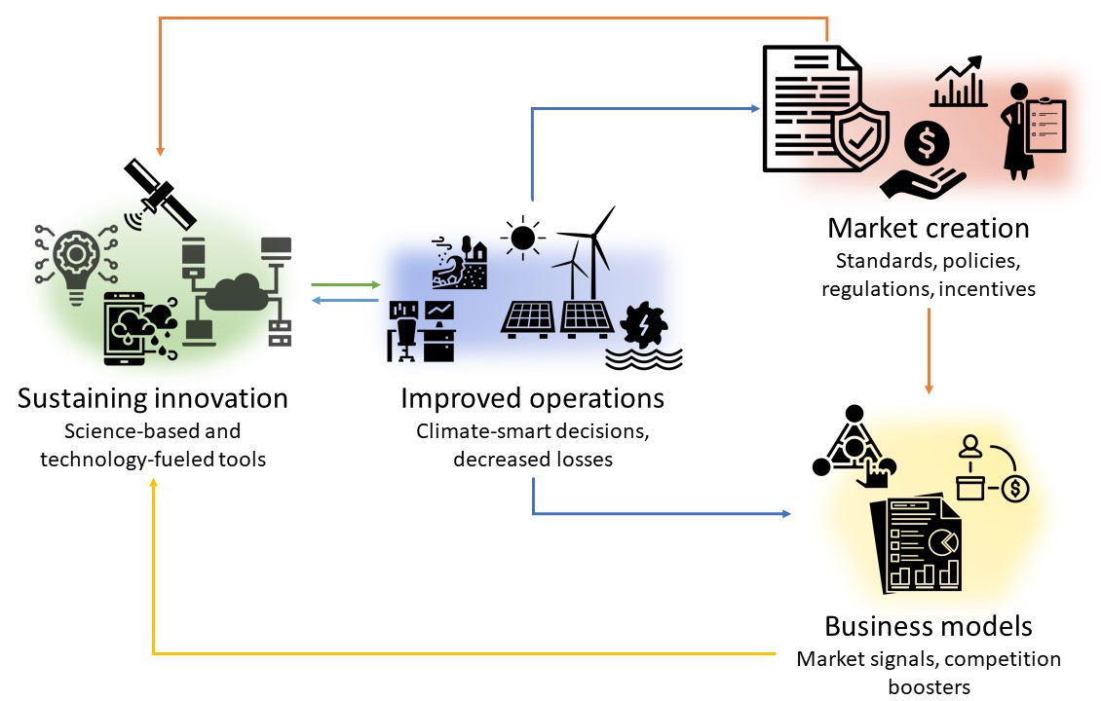
Co-generation – what it means for service purveyors
Co-generation for purveyors means to design business model that captures value(s) that a better use of climate knowledge creates for users. It includes strategy, value network, creation & detainment of value.
Business models are used to co-produce innovation, launch original ideas in unexplored markets, define company’s position along the value chain. This is above and beyond the product/service itself.
capture main feature of the service, which serve in the value creation process
an in-depth market insights and previous experiences
information on costs, capital requirements and potential revenues
present and future of the service, based on plausible and credible assumptions
target user and the best entry points in the reference market
Larosa & Mysiak Clim Serv. Doi:10.1016/j.cliser.2019.100111

Slide 11
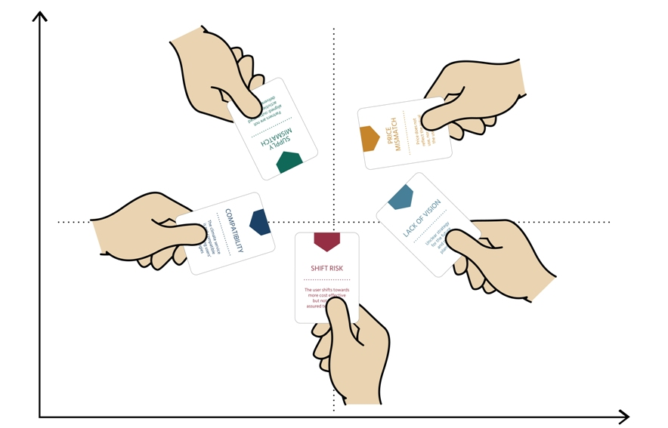
Climate services as experimental devices
Call For Water game
Business game
trains users on forecast-based decision-making. It familiarizes players to the use of seasonal forecasts and forecast quality information for decision-making
The Climate Devil’s Advocate is a card game that guides the climate services development teams along the business model creation process
The Water game can be accessed from here
The Business game can be downloaded from Clara website

Slide 12
Future of climate and co. services
Adaptation services - supporting assessment of vulnerability in a wider perspective and include the design and appraisal of adaptation strategies in a multi-stakeholder setting (Gooden et al.).
Active brokerage and mediated transfer of knowledge, face-to-face collaboration between providers and clients, and integration of social, economic and non-climate environmental challenges with climate risks (Swart et al)
Resilience services – focus on determinates of vulnerability, role of citizens and organisations as agents of individual and social change, forging new commitments and knowledge, and innovative mechanisms of engaging people throughout the process. Shared vision and pathways to realize that vision.
Resilience has become a new 'compass' for EU policies (Strategic foresight report, 2020).
Resilience dashboards aim to provide a holistic assessment of resilience in the EU and Member States in relation to ongoing societal transformations and challenges ahead
Union Civil Protection Mechanism (UCPM) introduced resilience goals. European Climate Adaptation Strategy (‘Forging a climate-resilient Europe’) and the European Climate Law that promotes resilience, as a part and target of climate adaptation efforts in line with the Paris Agreement on Climate Change. Horizon Europe Mission on climate adaptation and societal transformation laid out an ambitious goals of least 150 European regions and communities to become climate resilient by 2030.

Slide 13
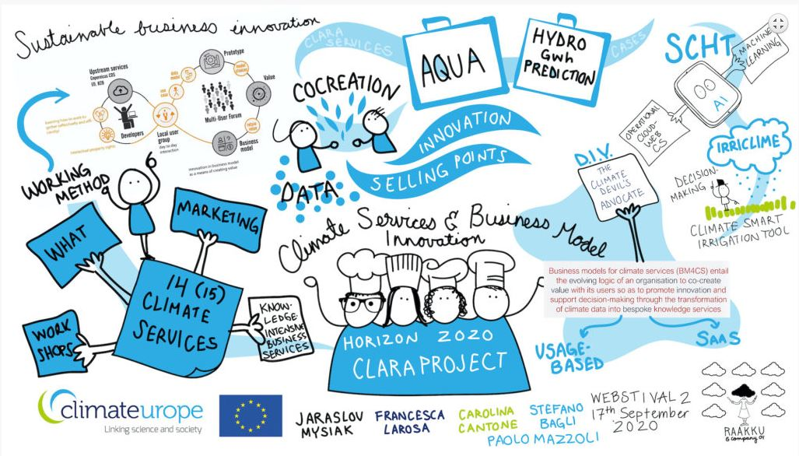
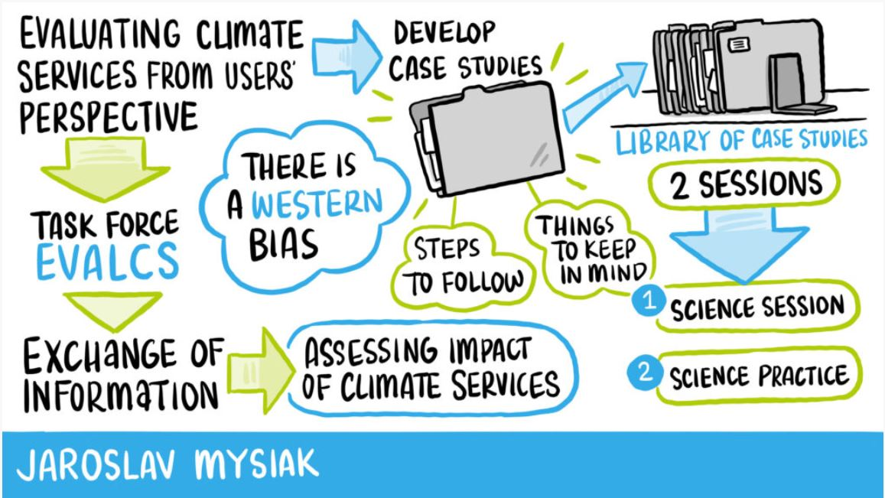
Take home messages
Climate innovation and piloted climate (adaptation and resilience) services produce action-oriented knowledge that rally transformational change
Climate & co. services are knowledge-intensive business services for which both users and purve-yors play a vital role in developing solutions.
Climate services generate private and collective benefits - after a critical mass of uptake/use of services was reached.
Costs of user-deployed climate services is not limited to the price paid for their provision.
Sustainable business innovation has prompted a diversity of mechanisms to capture and detain value generated by climate services

Slide 14
CLARA services
^{Thank you for your attention}
^{jaroslav.mysiak@cmcc.it}
https://www.clara-project.eu/

