Slide 1
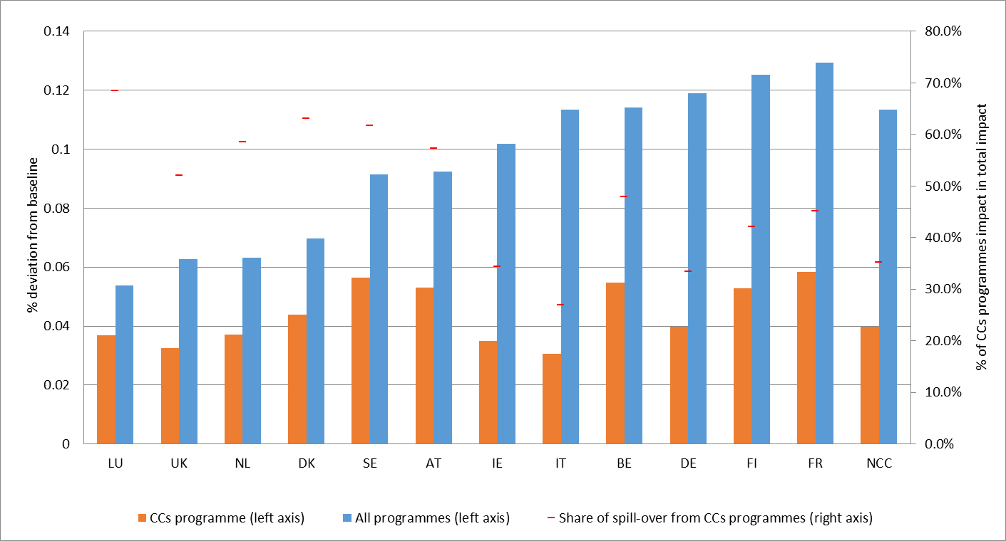
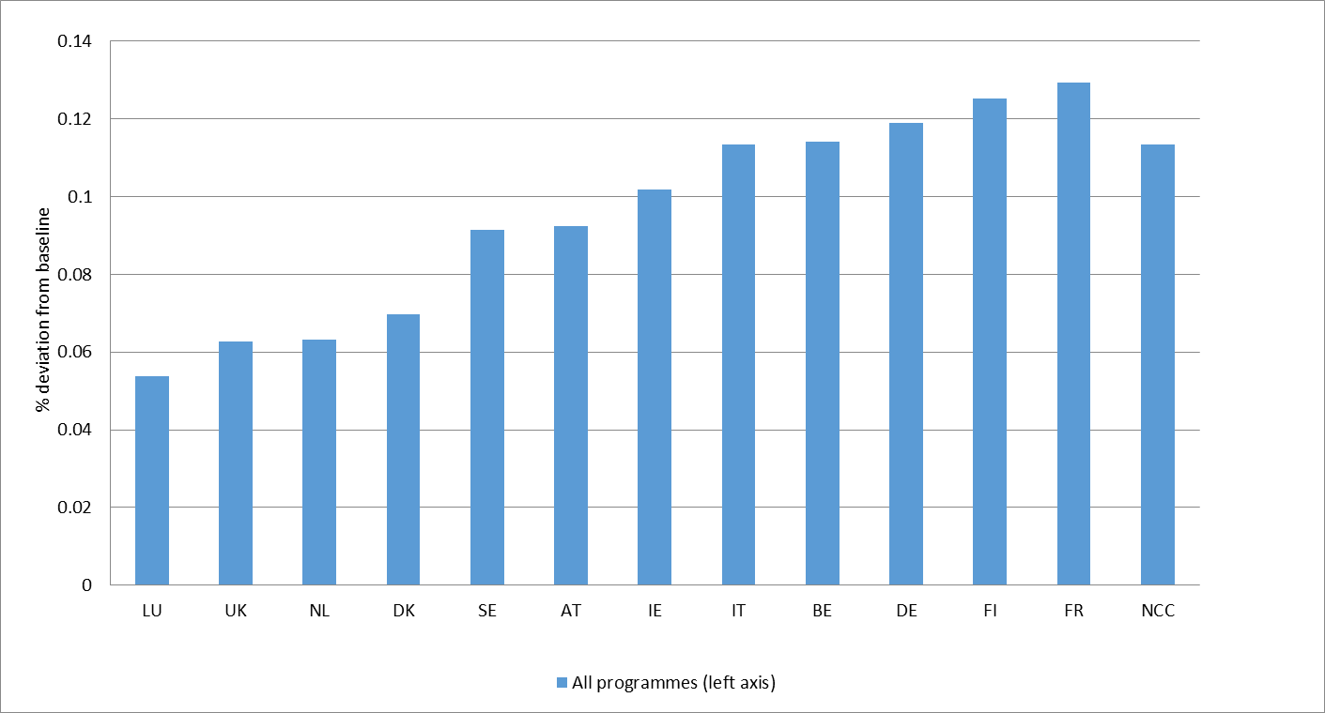
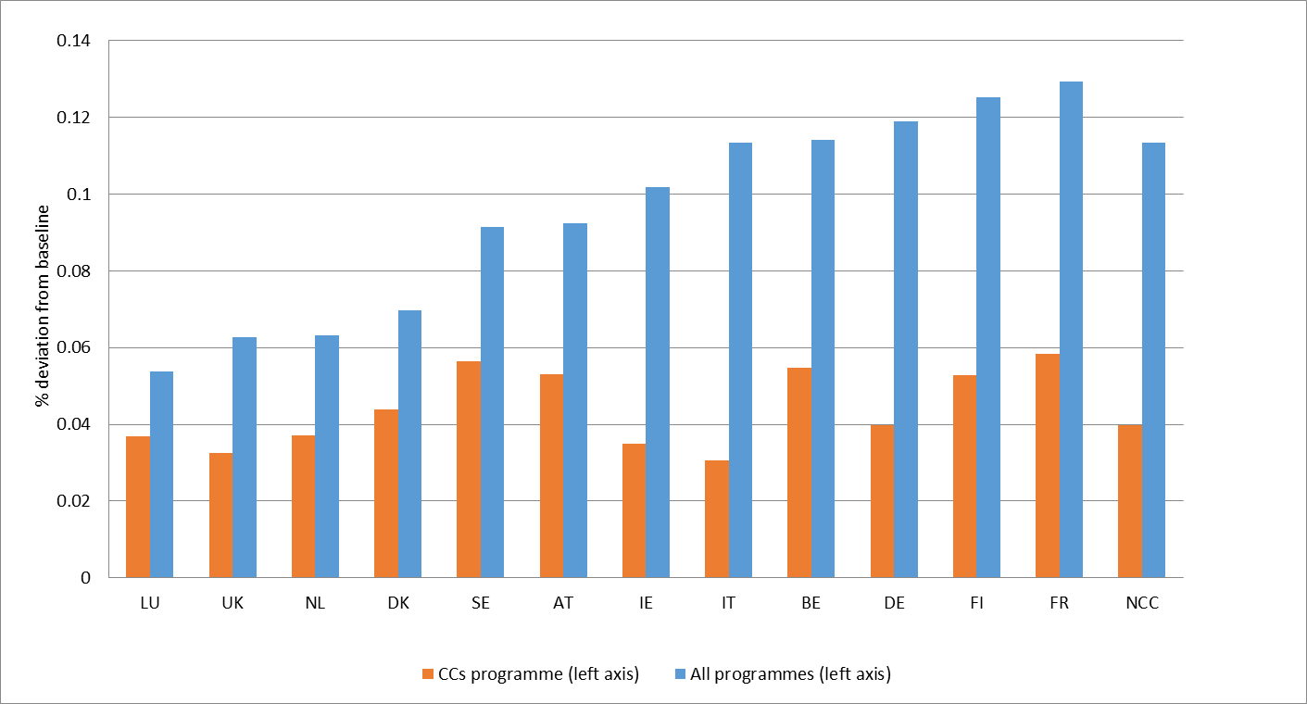
Where does the EU Cohesion Policy produce its impact?
REGIO Working Paper Series – WP 02/21
In the long run, around 45% of the impact of the policy in the NCCs correspond to spillovers originated in the CCs.
To what extent net contributors to cohesion policy benefit from the interventions implemented in the net beneficiaries?
57%
69%
RHOMOLO simulations

