Slide 1
Enhancing the European Adaptation Platform Climate-ADAPT to support Digital Twin on Climate Change Adaptation
Blaz Kurnik & Christiana Photiadou
Climate Change Impacts, vulnerability and Adaptation

Slide 2
Adaptation will be vital (despite mitigation efforts) whatever happens
Monthly surface air temperature variation relative to 1981-2010 average
1980 1990 2000 2010 2020
Source: Copernicus Climate Change Service
Notes:
Climate change is ongoing.
The prospects are dire.
Even with the fulfilment of the NDCs of all countries, we are on the course for 2.7 degrees global warming by the end of the century.
The European Green Deal is a step in the right direction on mitigation, but we have to adapt for Europe to remain liveable and prosperous.

Slide 3
Having information on adaptation is key: Climate-ADAPT
Notes:
Climate ADAPT and the Climate & Health Observatory are information hubs with a wealth of data on the interface between climate adaptation/mitigation and human health, wellbeing and social vulnerabilities, and the policies that underpin current European approaches.
As you can see here, high water use coincides with existing water stress in the case of southern Europe where water scarcity is already the highest.

Slide 4
From climate data to actionable knowledge on adaptation
The platform is developed according to users and providers’ needs
User and Policy driven
New EU Adaptation Strategy
EEA Member countries’ needs
Regional, Local, Urban
Policy
&
implementation
Policy information
Regular reporting under the EU Governance Regulation
EU Policies
Science & Development
EU Digital Agenda, DestinE & Digital Twin, EU Green Deal Agenda
EU R&I projects
Copernicus services
(e.g., C3S, CLMS, CMEMS)
Regular update
of data, indicators, policy information
Evidence base/ Knowledges
Cause-Effect-chains Adaptation Interventions
Notes:
- Policy & implementation ->What do we need
Regular data indicators, policy information ->What is the progress?

Slide 5
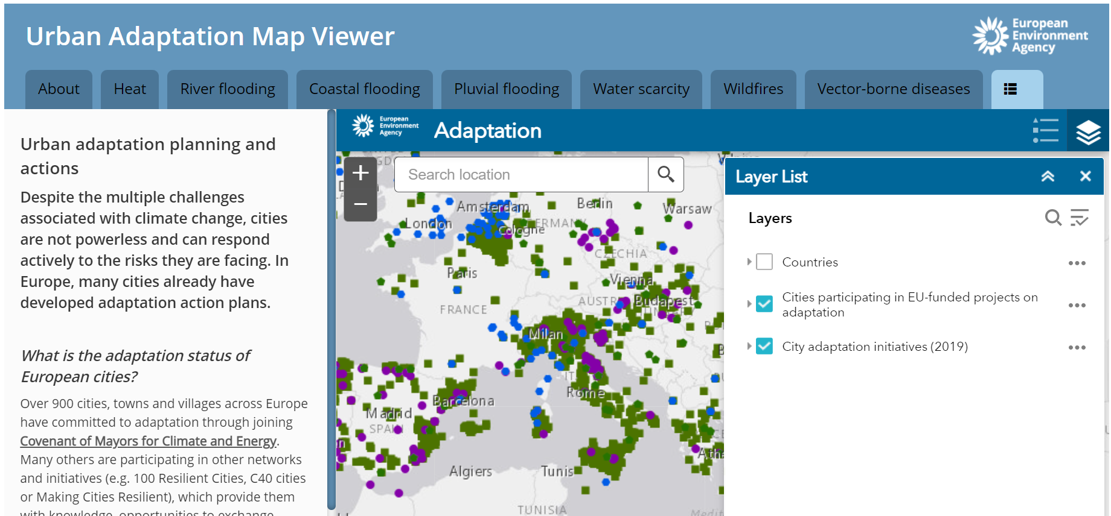
Climate-ADAPT key tools: health observatory, climate data explorer, urban tools
2

Slide 6
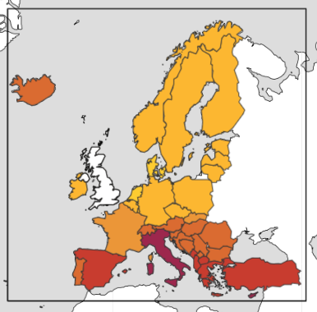
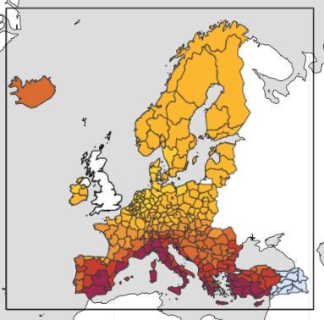
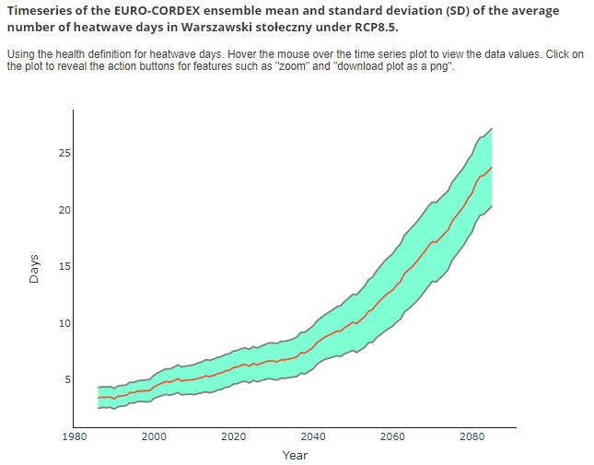
Enabling access to relevant climate data: climate and health
Number of health-related heatwave days (2070-2099)
National level
Regional level
https://climate-adapt.eea.europa.eu/observatory/++aq++metadata/indicators/health-heatwave-high-temperature-and-humidity-1971-2099?bs=0#details

Slide 7
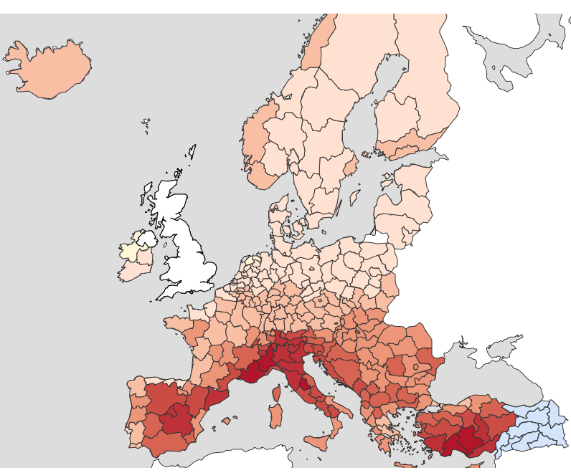
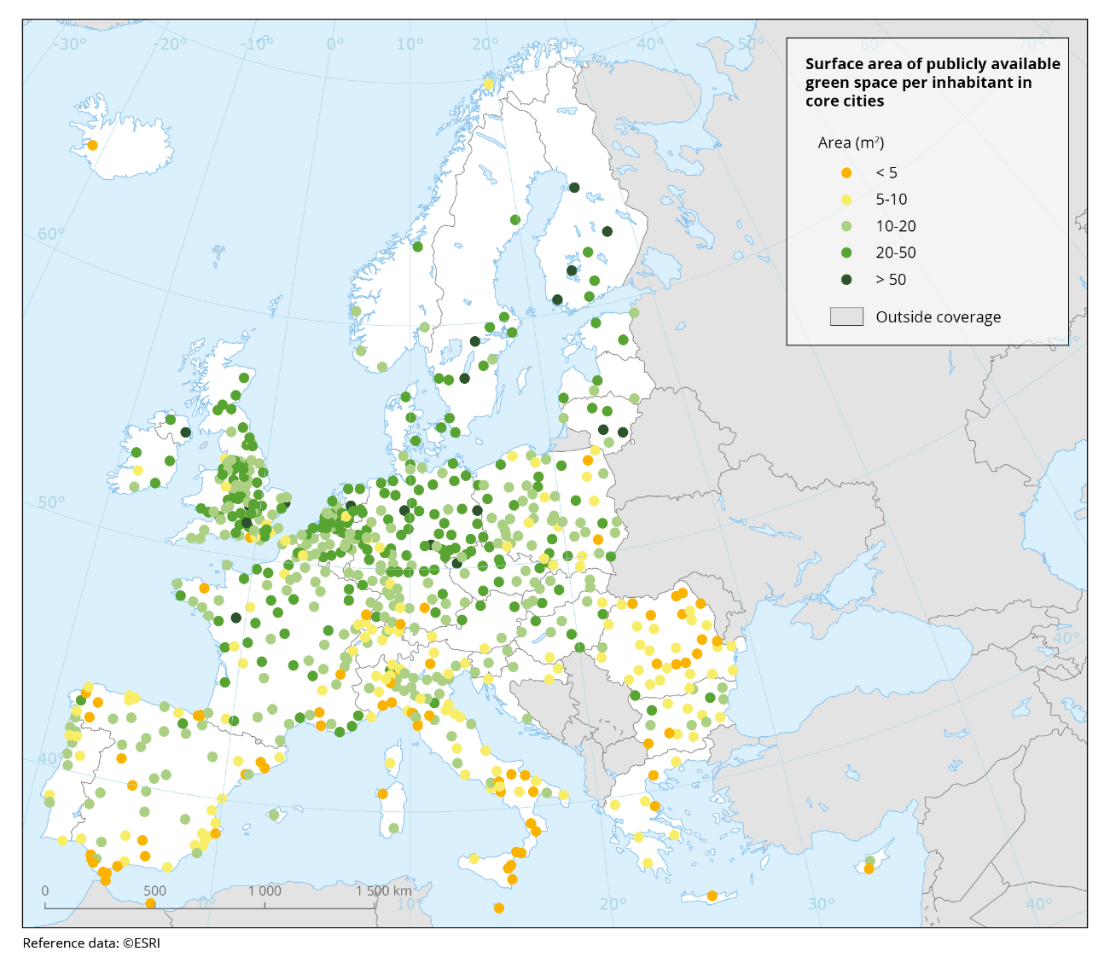
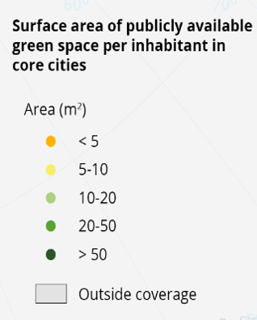
Supporting implementation: changing the way we build our cities
Projected heat waves (2070-2099)
0 5 10 15 20 25 30 35 40 60 80 number of days
Source: Maes et al. (2019)
Source: https://climate-adapt.eea.europa.eu/knowledge/european-climate-data-explorer/
Notes:
We need to switch to climate resilience and actions. For example, the hottest areas in Europe – in the South - are projected to get even hotter in the future. This is where there is the lowest availability of green space .
Similarly, floodplains are being still built upon and urban sprawl into wildfire prone areas continues.
We need 1) concrete measures to adjust the already existing areas and 2) spatial planning and urban design taking into account climate change to ensure that

Slide 8
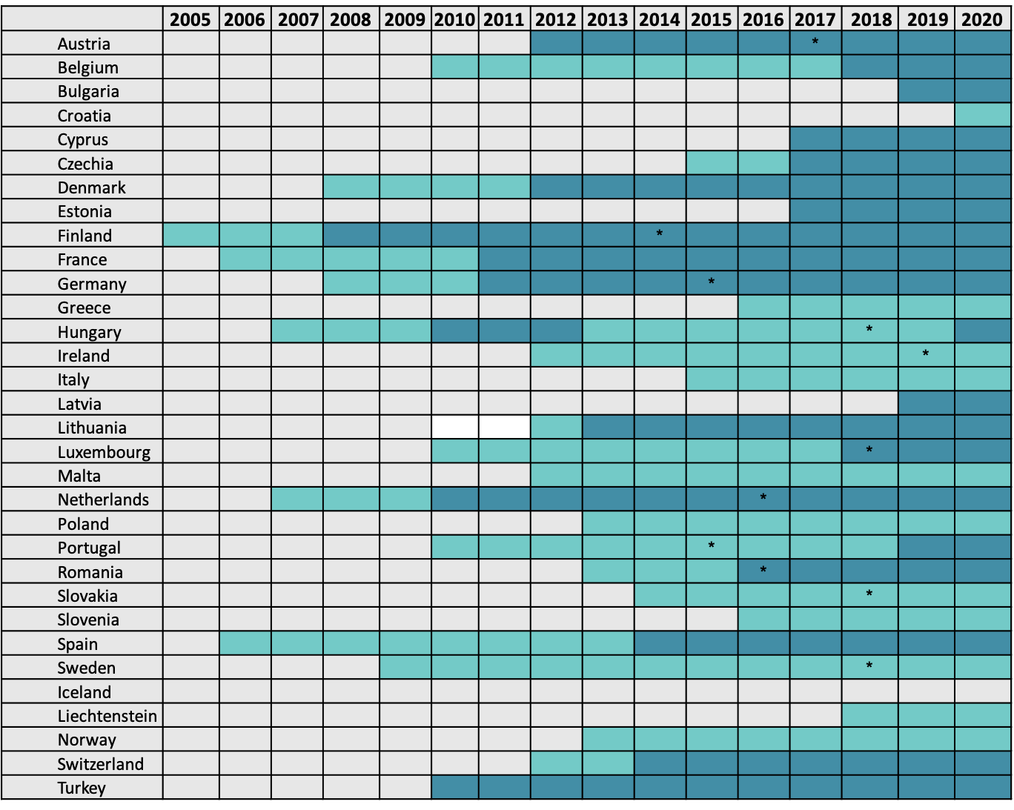
Supporting progress in national policies
All EU Member States (MSs) have a dedicated adaptation policy in place
All EU MSs have prepared climate impact assessment
Some MSs have started evaluation of the strategies and identifying adaptation measures
Source: https://www.eea.europa.eu/publications/national-adaptation-policies
Notes:
What is a NAS and NAP is diverse, and there are even no clear and well agreed definitions
EEA’s report has working definitions that can help further improving NAS and NAP when revised
no universal unit of measurement for adaptation and perceptions of effectiveness and even success vary
This is the case for strategies, plans, actions and (programmes of measures)
measuring the change in overall vulnerability may leave open the questions: 'vulnerability of whom?', 'to what?' and 'who decides?’
None of the adaptation policies and frameworks fully answers the question

Slide 9
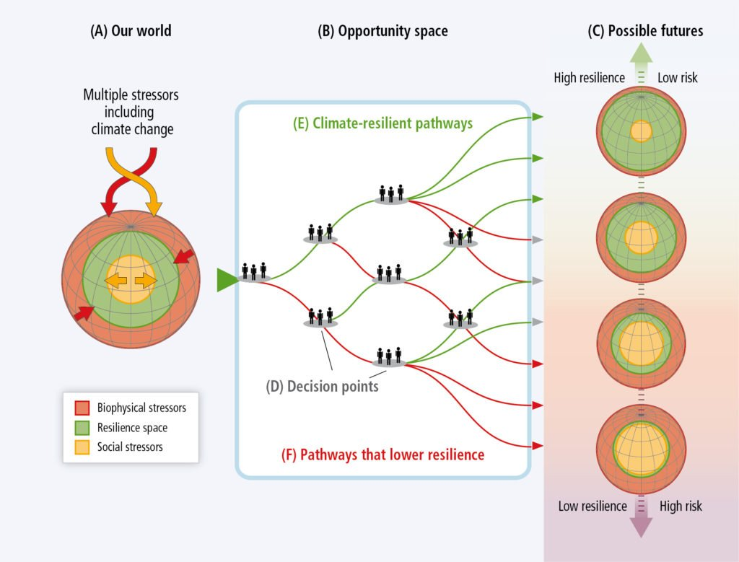
How to connect Climate-ADAPT with DestinE?
Climate Resilient development pathways:
Develop trajectories that combine adaptation and mitigation to realize sustainable development & green deal agenda
Include strategies, choices and actions that reduce CC impacts
Purpose is to limit tradeoffs and promote synergies
IPCC AR5 WGII: Climate-resilient pathways relationship between adaptation, mitigation and sustainable development
Notes:
So now let’s see how to connect Climate-ADAPT with Destination Earth.
- We use here for insipration the Climate-resilient development pathways, described in IPCC AR5. We focus on what is called an ’Opportunity space’.
- Ideally in an adaptation modeling framework we would like to create trajectiories....
- This will allow us to include strategies, choices, limitations and actions that will lead to decision/action to reduce CC impacts. Make a point on how Climate-ADAPT is the ideal source of infomration for european scale.
-The puprose here is to limit tradeoff....
-In this process we need to remember that by increasing resilinece we can reduce the risk from CC impacts.

Slide 10
Why investing in resilience is important?
What we can achieve:
Analyzing hazards, impacts, risks (quality assured)
Exploring adaptation options (harmonizing approach and method)
Integrating approaches
Identifying actions and selection
Which pathways we could consider:
Cost of inaction
Natural based solutions/Human health
Economy
Copernicus services & Others
Adaptation metrics, evaluating policy options,
visualisation,
informing on integrated approaches and actions
Notes:
The Digital Twin, under the proper construction, can provide a integrated perspective or it can be a holistic tool grunded in an extensive multidimensional set that would provide a knowledge/information base for analysisng risks and options for adaptation solutions (options, needs, limits ), better linking approaches (adaptation & mitigation), and provides knowledge for decision-making.

Slide 11
Climate-ADAPT/EEA contribution in DestinE – key messages
Go beyond an impact modeling attempt
Develop the proper adaptation indicators/metrics
Adaptation measures must be informed by analysis of climate change risks and impacts, mobilizing climate finance
Policy user driven must be embedded in Digital Twin
Mobilizing the right (and user driven) investments
Notes:
Need to check source for photo!

Slide 12
Thank you
Sign up to receive EEA news, reports and alerts on your areas of interest at
http://eea-subscriptions.eu/subscribe
http://eea.europa.eu
Climate-ADAPT
http://climate-adapt.eea.europa.eu
European Climate and Health Observatory
https://climate-adapt.eea.europa.eu/observatory
European Climate Data Explorer
https://climate-adapt.eea.europa.eu/knowledge/european-climate-data-explorer/
Notes:
Any questions?

