Slide 1


Increasing model transparency, quality and coherence by deploying tested modules
Wolfgang Britz, University Bonn
Marijke Kuiper, Wageningen Economic Research
Katarzyna Zawalińska, Polish Academy of Sciences
Luca Salvatici, Roma 3 University
This project has received funding from the European Union’s Horizon 2020 research and innovation programme under grant agreement No. 861932.

Slide 2

(Trade) simulation models have many identical building blocks (Armington bilateral trade, LES/CDE demand systems, nested-CES production functions),
but implementation differs (model equations, integration of extensions with existing code, benchmarking, documentation).
“Cherry picking” across models cumbersome (differences in coding language, symbol names, indexing, code of building blocks scattered around model)
As a result modeling community as a whole misses huge opportunities for co-operation and cross-fertilization
Lack of common ground = missed opportunities for cooperation

Slide 3
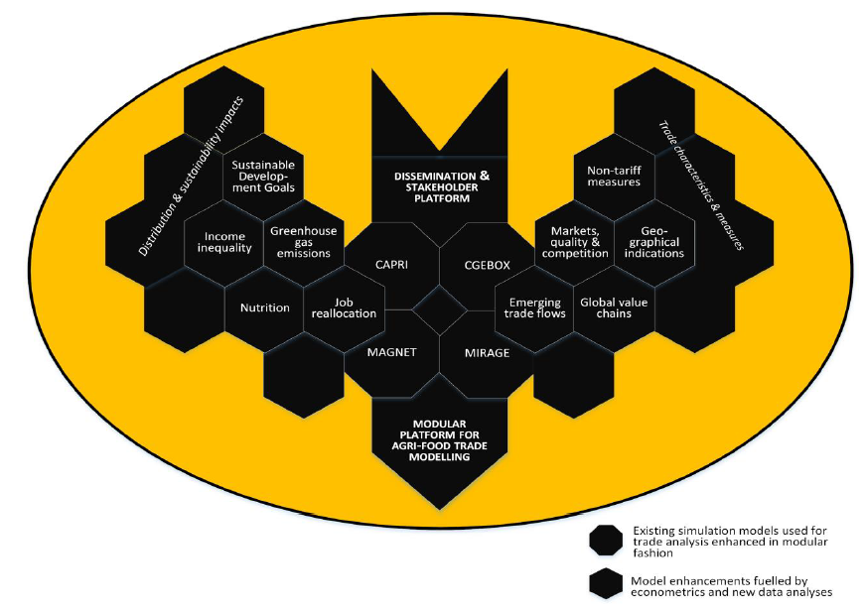
BATModel (Better Agri-Food Trade Modelling for Policy Analysis) a H2020 project (2020-2024) aims to improve trade modeling by enhancing
the empirical basis of simulation modeling through cooperation with econometricians on key topics (product differentiation, emerging trade flows, employment, SDGs)
the uptake of model improvements by deploying modules with model enhancements that are
  transferable to other models
  follow a strict protocol on coding & documentation
  open-access to reach beyond scope & lifetime of project
Improved empirical basis & uptake of model enhancements
Focus today: modular implementation

Slide 4
Define module aim
and prerequisites
for target model
Modular approach
Define clearly
interfaces
Target
model
Transferable
module
Provide solutions
to bridge namespaces
Deploy well structured,
coded and clearly
documented modules

Slide 5
Common coding guidelines
Uniform module structure: simulation equations, benchmarking code, variable initialization, …
Efficient interfacing to target models
  Module specific namespace to avoid conflicts with target model
  Use of set aliases, macros and globals in GAMS
Each module implemented in at least two target models to test and ensure transferability
Modules with documentation open source
Communication across modeling platforms
Notes:
The contents of this slide overlaps with the previous slide (#4☺ it can be eliminated (if necessary) and I already moved the image to #4

Slide 6
The template for a BATmodule documentation:
  Motivation: aim, methodology
  Mathematical notation of equations
  Interface definition: what variables passed to and calculated by the module, index spaces, etc.
  Data and parameter needs & sources
  Example interfaces to two different target models
  Technical details of the module implementation in GAMS and GEMPACK, including benchmarking
  Example applications (with code)
BATmodule contents
☑ 
☑ ∑
☑ ⬄
☑ 

Slide 7
Replace CES-based Armington for selected markets by two modules that allow for emerging trade flows:
trade cost minimization, assuming homogenous product quality
CES with commitment terms
Status:
interfaces to two GAMS models (PE & CGE) implemented
works with multiple solvers CNS/NLP/MCP
Basis to improve coding, implementation and documentation guidelines
Parallel work on application in GEMPACK and econometrics to provide suitable parameters
First module in progress: emerging trade flows
TRADE
TIME

Slide 8
















For more information and contact details visit the project website:
www.BATmodel.org
This project has received funding from the European Union’s Horizon 2020 research and innovation programme under grant agreement No. 861932.
Disclaimer: this presentation reflects only the author's view. The Research Executive Agency is not responsible for any use that may be made of the information it contains.

