Slide 1
The JRC’s DIONE model: Scientific support for Car and Van CO₂ Standards
Session 7: Using model related evidence for policy: processes and experiences
Jette Krause & Georgios Fontaras
2021 EU Conference on
Modelling for Policy support

Slide 2
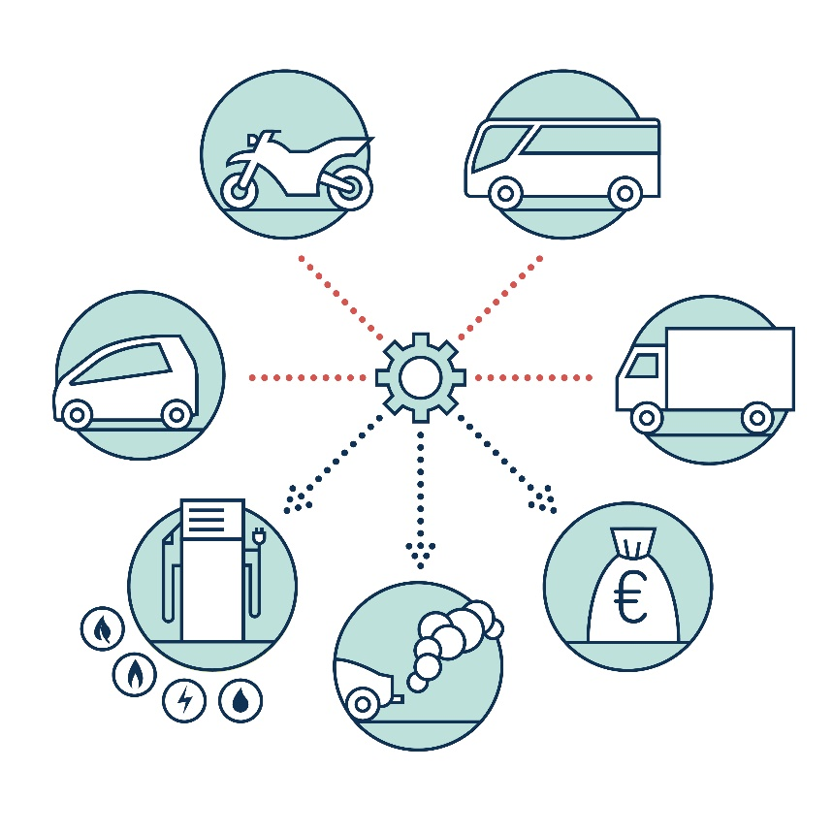
The DIONE model
Calculation of CO₂ emission reduction costs for road vehicles from the perspective of users, manufacturers and society
Calculation of CO₂ and air pollutant emissions for road vehicle fleets up to 2050
Model developed by JRC from 2015 onwards

Slide 3
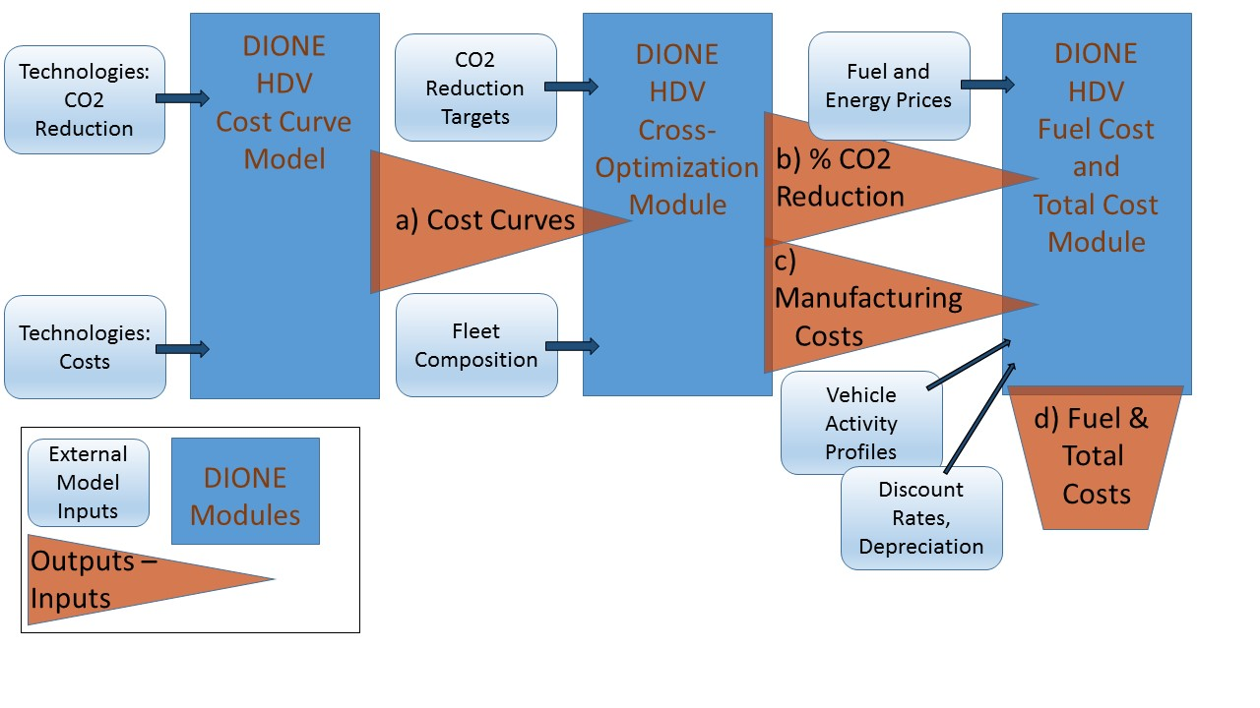
DIONE cost model scheme

Slide 4
DIONE support for Fit for 55 LDV CO₂ IA
Model extension to cover interactions of vehicle standards with other policies in the package (such as EU ETS, RED etc)
Extension to year 2040, and third vehicle user
Preparation of REF2020 scenario based cost curves for vehicle emission reduction
Roughly thirty scenarios were run for the impact assessment, varying in
CO₂ standard levels & vehicle fleet composition
mandates for zero/low emission vehicles
Euro standards
fuel/energy price trajectories

Slide 5
DIONE TCO Results - Example
Net consumer benefits increase with stricter targets and over time.
Savings in fuel/ energy expenditure during vehicle use overcompensate the higher upfront capital costs of more efficient and zero/ low-emission vehicles.
Average net economic savings from a TCO-first user (first 5 years) perspective (EUR/vehicle) resulting from the CO2 emission standards (in a MIX policy scenario context) (cars (l) and vans (r)).
Source: European Commission, Impact Assessment, Part 1; SWD(2021) 613 final.

Slide 6
DIONE model-based EU policy support
Fit for 55 package
Previous Impact Assessments
DIONE has been used for the impact assessment (IA) for cars and vans CO₂ standards within the EC’s Fit for 55 package (2021)
DIONE is presently used for an IA for trucks and busses CO₂ standards revision, due summer 2022
LDV: DIONE used for the IA for Regulation (EU) 2019/631 setting new CO₂ emission standards for cars and vans
HDV: DIONE used for the IA for Regulation (EU) 2019/1242 setting CO₂ emission standards for heavy-duty vehicles

Slide 7
The DIONE policy support process
Continuous & early involvement of JRC in ex-ante policy preparation:
Scientific support for preparatory studies
JRC DIONE model preparation and enhancement
Close cooperation during policy formulation (and negotiation):
Multiple scenario runs, ad hoc support for technical questions
Learning from Experience in-between policy cycles:
Model consolidation and further integration

Slide 8
Horizon scanning & future activities
Cooperation within the European Road Transport Research Advisory Council (ERTRAC*): Analysis of pathways for achieving 2050 carbon neutrality, employing DIONE model
Strengthening the link to other JRC tools (eg POTEnCIA, PTTMAM)
Stepwise extension of model coverage to include i) other transport modes such as aviation, maritime; ii) well-to-tank emissions; III) further life cycle elements
Aim: Enhance DIONE’s usefulness for preparatory activities related to future policy development for encompassing vehicle emissions regulation
*European technology platform which brings together road transport stakeholders to develop a common vision for road transport research in Europe

Slide 9
Thank you
© European Union 2021
Unless otherwise noted the reuse of this presentation is authorised under the CC BY 4.0 license. For any use or reproduction of elements that are not owned by the EU, permission may need to be sought directly from the respective right holders.
Notes:
Update/add/delete parts of the copy right notice where appropriate.
More information: https://myintracomm.ec.europa.eu/corp/intellectual-property/Documents/2019_Reuse-guidelines%28CC-BY%29.pdf

