Slide 1
Climate Adaptation Modelling
Modelling as a support tool for addressing the prerogatives of
climate adaptation policy – insights from the preparation of
the EU Strategy on Adaptation to Climate Change and
from the study on Adaptation modelling
2021 EU Conference on modelling for policy support:
collaborating across disciplines to tackle key policy challenges
Contributed session 3: Climate change adaptation modelling as a key
support tool for evidence-based policies in a time of planetary crisis
Presented by Claus Kondrup, Senior Expert, European Commission, DG Climate Action
Thursday 25 November 2021

Slide 2
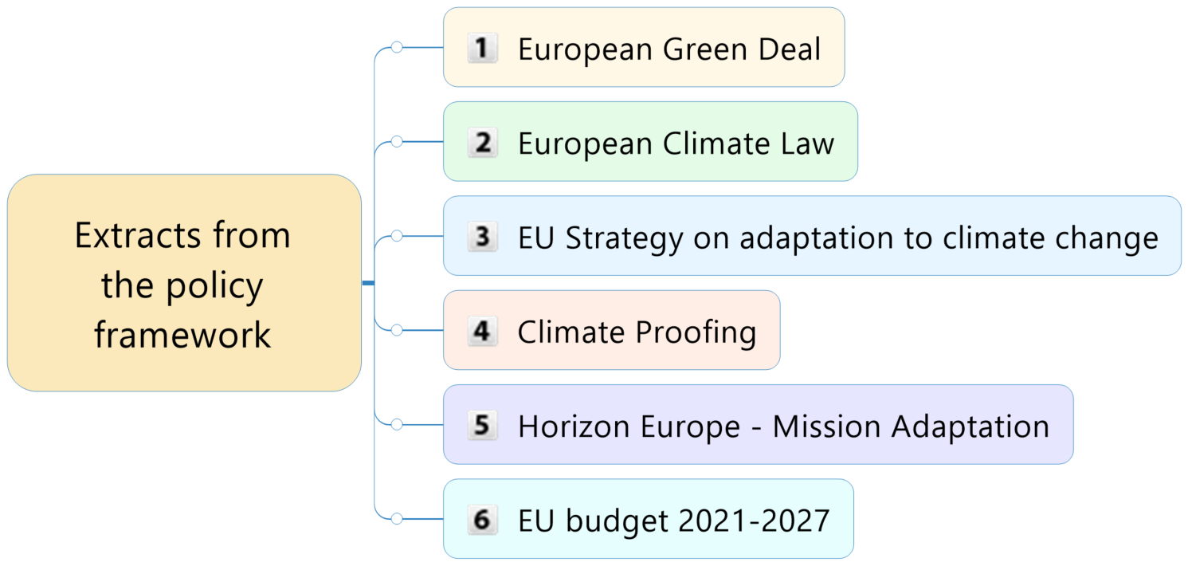

Slide 3
EU Adaptation Strategy
Objectives & thematic areas
1. Smarter adaptation | 1. Pushing the frontiers of knowledge on adaptation 2. More and better climate-related risk and losses data 3. Make Climate-ADAPT the authoritative European platform for adaptation knowledge
2. More systemic adaptation | 4. Improving adaptation strategies and plans 5. Fostering local, individual, and just resilience 6. Integrating climate resilience in national fiscal frameworks 7. Promoting nature-based solutions for adaptation
3. Faster adaptation | 8. Accelerating the rollout of adaptation solutions 9. Reducing climate-related risk 10. Closing the climate protection gap 11. Ensuring the availability and sustainability of freshwater
4. Stepping up international action for climate resilience | 12. Increasing support for international climate resilience and preparedness 13. Scaling up international finance to build climate resilience 14. Strengthen global engagement and exchanges on adaptation

Slide 4
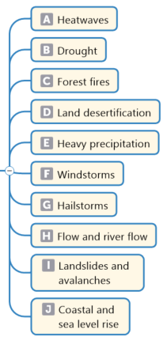
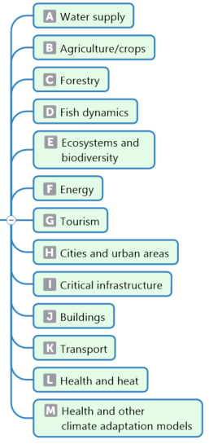
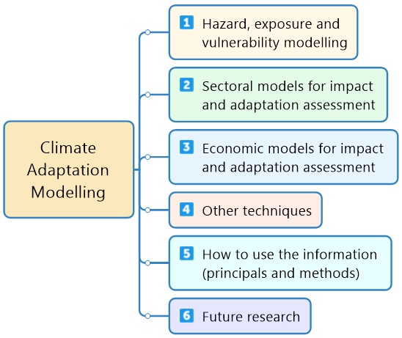
Study on climate adaptation modelling

Slide 5
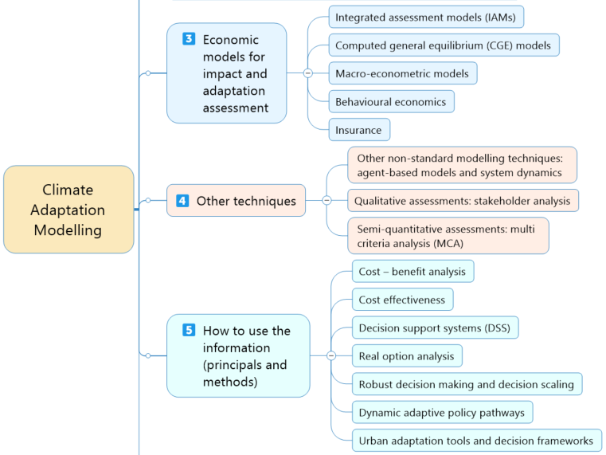

Slide 6
Annex with the
compendium of tools
Climate Adaptation Models and Tools –
Annexes – Comprehensive desk review: https://op.europa.eu/en/publication-detail/-/publication/cfa86c26-764e-11eb-9ac9-01aa75ed71a1

Slide 7
And there is more
Report on Use Cases and Rapid Analysis
  Rapid analysis for policy development, climate risks for EU investments, city adaptation plans, regional planning, …
24 cases of rapid analysis
  Forest fire, heat stress, coastal flooding, drought, flood resilience of road networks, climate impacts in Europe, attribution of extreme events, economic evaluation tools, robust adaptation options, water management, spatial adaptation planning, adaptation pathways, …
Recommended approach to analysis and modelling
  Conceptual framework for adaptation analysis
  Existing methodologies and gap analysis
  Recommendations to bridge the gaps

Slide 8
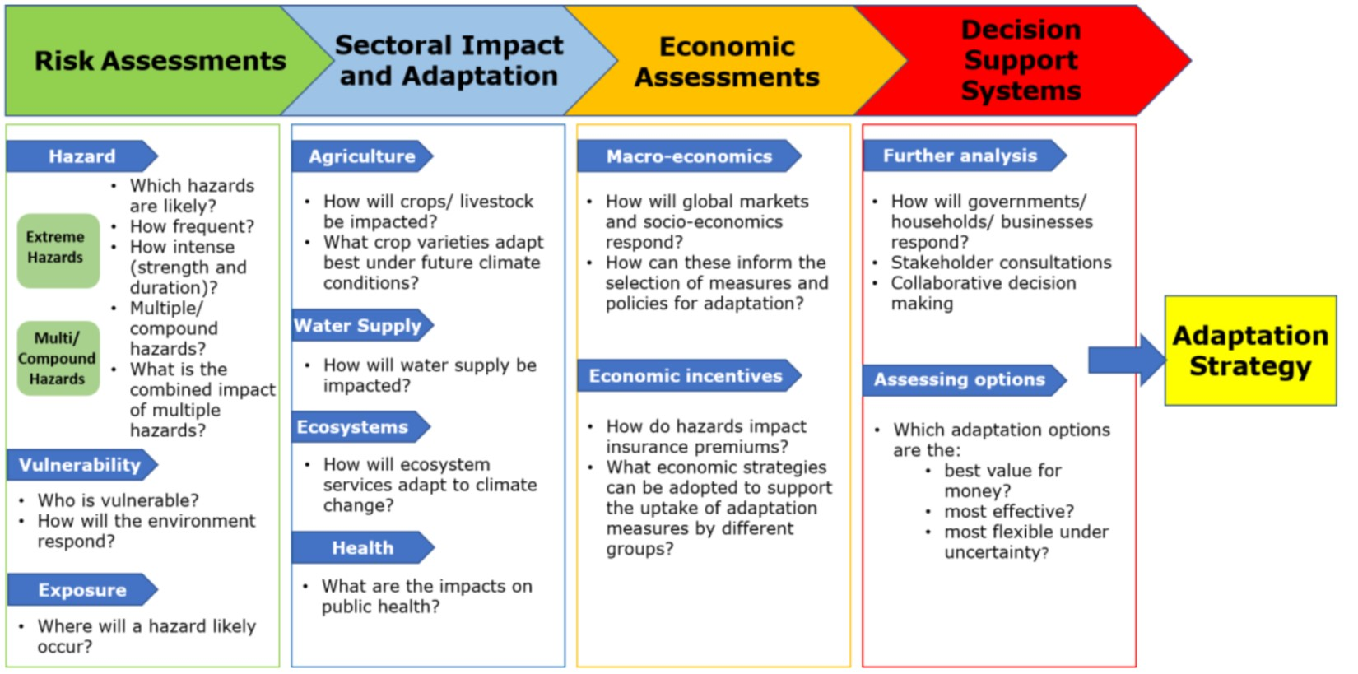

Slide 9





Thank you for your attention
ec.europa.eu/
clima/
facebook.com/
EUClimateAction
twitter.com/
EUClimateAction
pinterest.com/
EUClimateAction
youtube.com/
EUClimateAction

Slide 10
Links to the study on climate adaptation modelling
Published 24 February 2021
Climate Adaptation Models and Tools – Main Report – Comprehensive desk review: https://op.europa.eu/en/publication-detail/-/publication/9383d16e-7651-11eb-9ac9-01aa75ed71a1
Climate Adaptation Models and Tools – Annexes – Comprehensive desk review: https://op.europa.eu/en/publication-detail/-/publication/cfa86c26-764e-11eb-9ac9-01aa75ed71a1
Climate Adaptation Models and Tools – Summary – Comprehensive desk review: https://op.europa.eu/en/publication-detail/-/publication/2f9d12cd-7656-11eb-9ac9-01aa75ed71a1
Recommended approach to analysis and modelling: https://op.europa.eu/en/publication-detail/-/publication/190face7-7654-11eb-9ac9-01aa75ed71a1
Report on use cases and rapid analysis:
https://op.europa.eu/en/publication-detail/-/publication/ca870a9a-7654-11eb-9ac9-01aa75ed71a1
24 cases of rapid analysis:
https://op.europa.eu/en/publication-detail/-/publication/db6d4882-7652-11eb-9ac9-01aa75ed71a1
High-level expert workshop on climate adaptation modelling, 8-10 September 2020: https://www.cmcc.it/lectures_conferences/high-level-expert-workshop-on-climate-adaptation-modelling
and proceedings: https://link.springer.com/book/9783030862107

Slide 11
Links to the EU adaptation strategy
Published 24 February 2021
Communication: https://eur-lex.europa.eu/legal-content/EN/TXT/?uri=COM:2021:82:FIN
Press release: https://ec.europa.eu/commission/presscorner/detail/en/IP_21_663
Q & A: https://ec.europa.eu/commission/presscorner/detail/en/QANDA_21_664
Film: https://audiovisual.ec.europa.eu/en/video/I-201845
Press conference with EVP Frans Timmermans (recording):
https://audiovisual.ec.europa.eu/en/video/I-202216
Background studies: https://ec.europa.eu/clima/policies/adaptation/what_en#tab-0-2
Webinar 25-26 February 2021: https://www.cmcc.it/eu-climate-adaptation-strategy-2021 and https://www.youtube.com/playlist?list=PLqj_l70M-izDyxjFwQjLb5zjGRCRj3maX

