Slide 1
Digital Twins for Cities and Regions Global Challenges, Regional Initiatives, European Approaches
2021 EU Conference on Modelling for Policy Support
Leyla Kern, Dr. Fabian Dembski, Dr. Uwe Wössner
High-Performance Computing Center Stuttgart

Slide 2
Digitalization in planning
Global challenges
Rapid changes

Slide 3
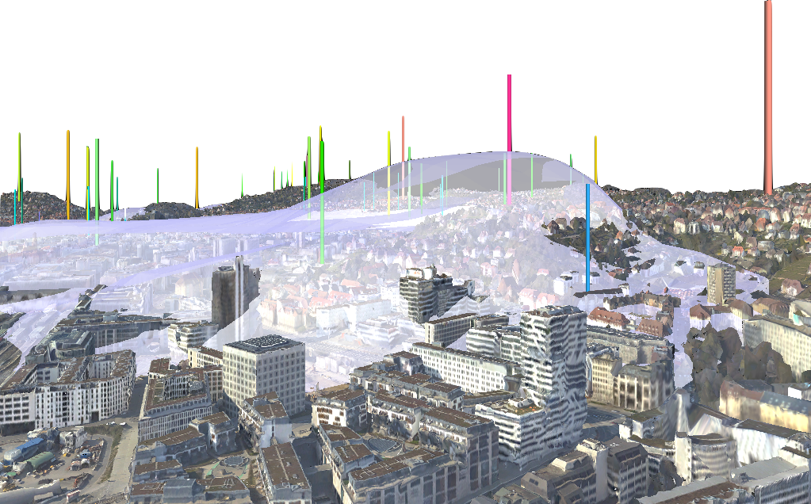
Digital Twins
Prediction
Accessibility
Optimization
Analysis
Models Data Simulations

Slide 4
Policy support
Global challenges
social
European approaches
functional
Local initiatives
ecological
economical
cultural

Slide 5
CAVE Demo
https://open-forecast.eu/2020/10/07/an-interactive-model-for-the-analysis-of-air-quality-simulations/

