Slide 1
Net-zero emission targets for major emitting countries consistent with the Paris Agreement
Heleen van Soest, Michel den Elzen, Detlef van Vuuren
PBL Netherlands Environmental Assessment Agency
Corresponding author: Heleen.vansoest@pbl.nl

Slide 2
Overview of the study
Cost-optimal 1.5 and 2 °C scenarios by IAMs
When do 10 big emitters reach net zero greenhouse gas / CO₂ in these scenarios?
How does that depend on (methodological) choices?
Which factors can explain differences between countries?
AIM, IMAGE, MESSAGE, POLES, REMIND, WITCH
BRA, CAN, CHN, EU, IND, IDN, JPN, RUS, TUR, USA
Land use, BECCS, GWP, equity
2050
GHG
2050
GHG
2050
GHG
2060
GHG?
2070
GHG
2050
GHG
2050
GHG
2060
GHG
2053
GHG?
https://www.nature.com/articles/s41467-021-22294-x

Slide 3
Brazil, USA earlier; China, EU similar to; India, Indonesia later than global average
Countries where land use is a source of emissions: net zero CO₂ (energy and industry) earlier than CO₂ (total), and vice versa where land is a ‘sink’

Slide 4
Net-zero targets consistent with cost-optimal 1.5 and 2 °C scenarios

Slide 5
Definitions, choices, equity principles matter
Allocation of negative emissions by BECCS to biomass producer vs. Country applying CCS
Land-use data according to national inventories
Equity principles vs. Cost-optimal
(GWP AR5 vs AR4)

Slide 6
Land-use according to inventories leads to earlier net zero
Models
Inventories
Forest
Inventories
Managed forest
Agriculture
Models
Notes:
First of all, there are large differences between the land-use change (LUC) emissions produced by the models (and scientific inventories) and LULUCF emissions reported by countries in their national GHG inventories^{17,18,19,20,21}. The latter focus on the balance of sinks and sources on managed land, including CO₂ uptake by forests. On the other hand, the former typically focus on direct human-induced effects of changes in vegetation type.

Slide 7
Allocation of negative emissions through BECCS to biomass producers leads to earlier net zero

Slide 8
Focus on equity vs cost-optimal: countries with lower per capita emissions/income reach net zero later
Notes:
This implies that countries with later equity-based phase-out years could receive support from countries with earlier equity-based phase-out years, to help them meet their earlier domestic targets.

Slide 9
Mitigation potential explains differences, especially negative emissions
Regression analysis shows most important factors to explain differences in phase-out years:
Potential for CCS
Potential for afforestation/reforestation
Current share transport emissions
Current share non-CO₂ emissions
Current GDP per capita
Notes:
The signs can be explained as follows: the larger the CCS capacity and afforestation, the more potential for negative emissions contributing to faster reductions and an earlier phase-out year. The higher the current share of non-CO₂ emissions, the more difficult to decarbonize so the later the phase-out. In addition, the higher the GDP per capita, the stronger the growth in emissions; thus, ceteris paribus, the later the phase-out. A higher GDP per capita could also imply greater capacity or willingness to mitigate emissions, but we only look at the default, cost-optimal case here, excluding equity considerations. The share of transport emissions showing a negative correlation is less straightforward. It seems to imply that this sector is relatively easy to decarbonize, which may hold for passenger transport, but not for freight and also not for international aviation. However, countries with a relatively large share of transport emissions often also have a relatively high GDP and smaller baseline emissions growth. A large transport share could also imply slower growth of this sector and smaller shares of other, more difficult to decarbonize sectors. All of these factors would contribute to earlier phase-out.

Slide 10
Negative emissions potential in energy supply and ARD compensates for remaining non-CO₂ emissions
Early
Average
Late
Early
Early net zero: due to potential for negative emissions

Slide 11
Recommendations
Clear definitions and agreements on data and methods needed
Land use emissions
BECCS ‘accounting’
Cost-optimal vs. ‘fair’ division of mitigation effort: other domestic targets or financial support
Determining and communicating a net-zero target:
Synergies and other national circumstances
Which equity considerations played a role
Which greenhouse gases are covered
Special attention for intended use of negative emissions

Slide 14
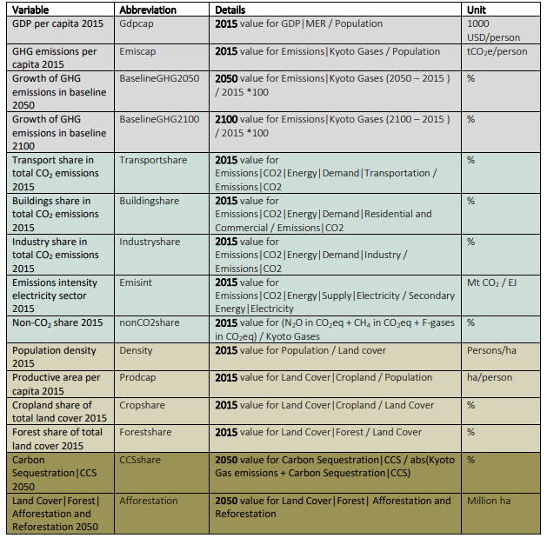

Slide 15
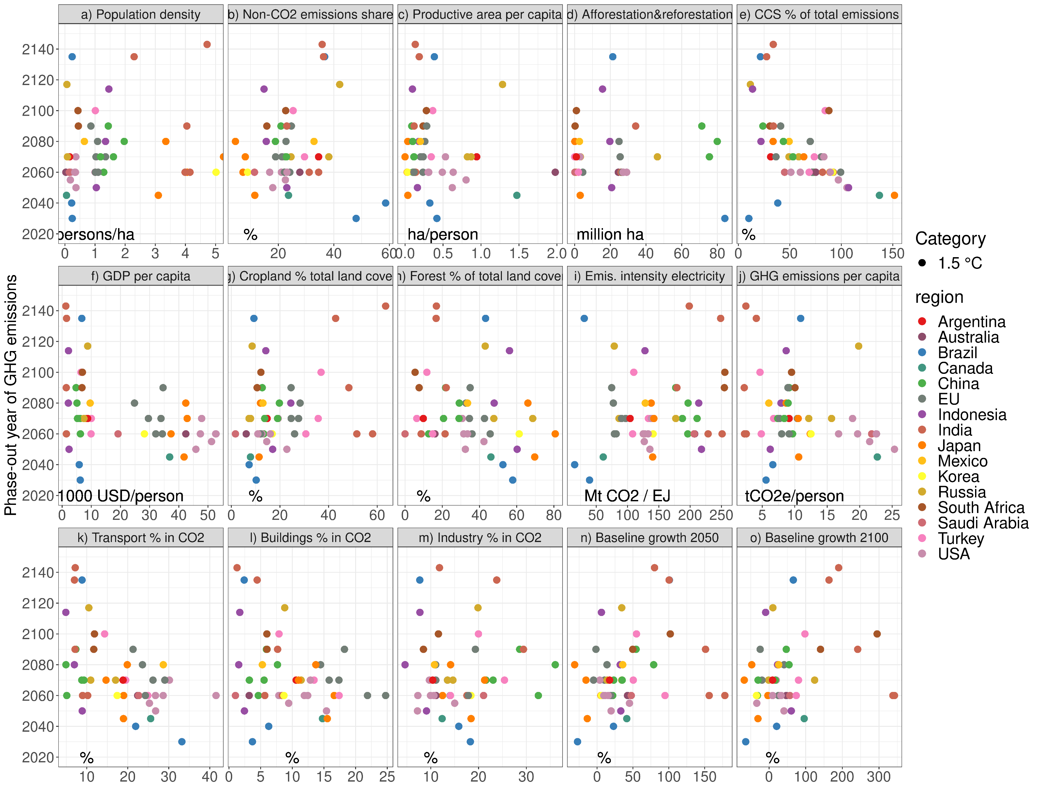

Slide 16
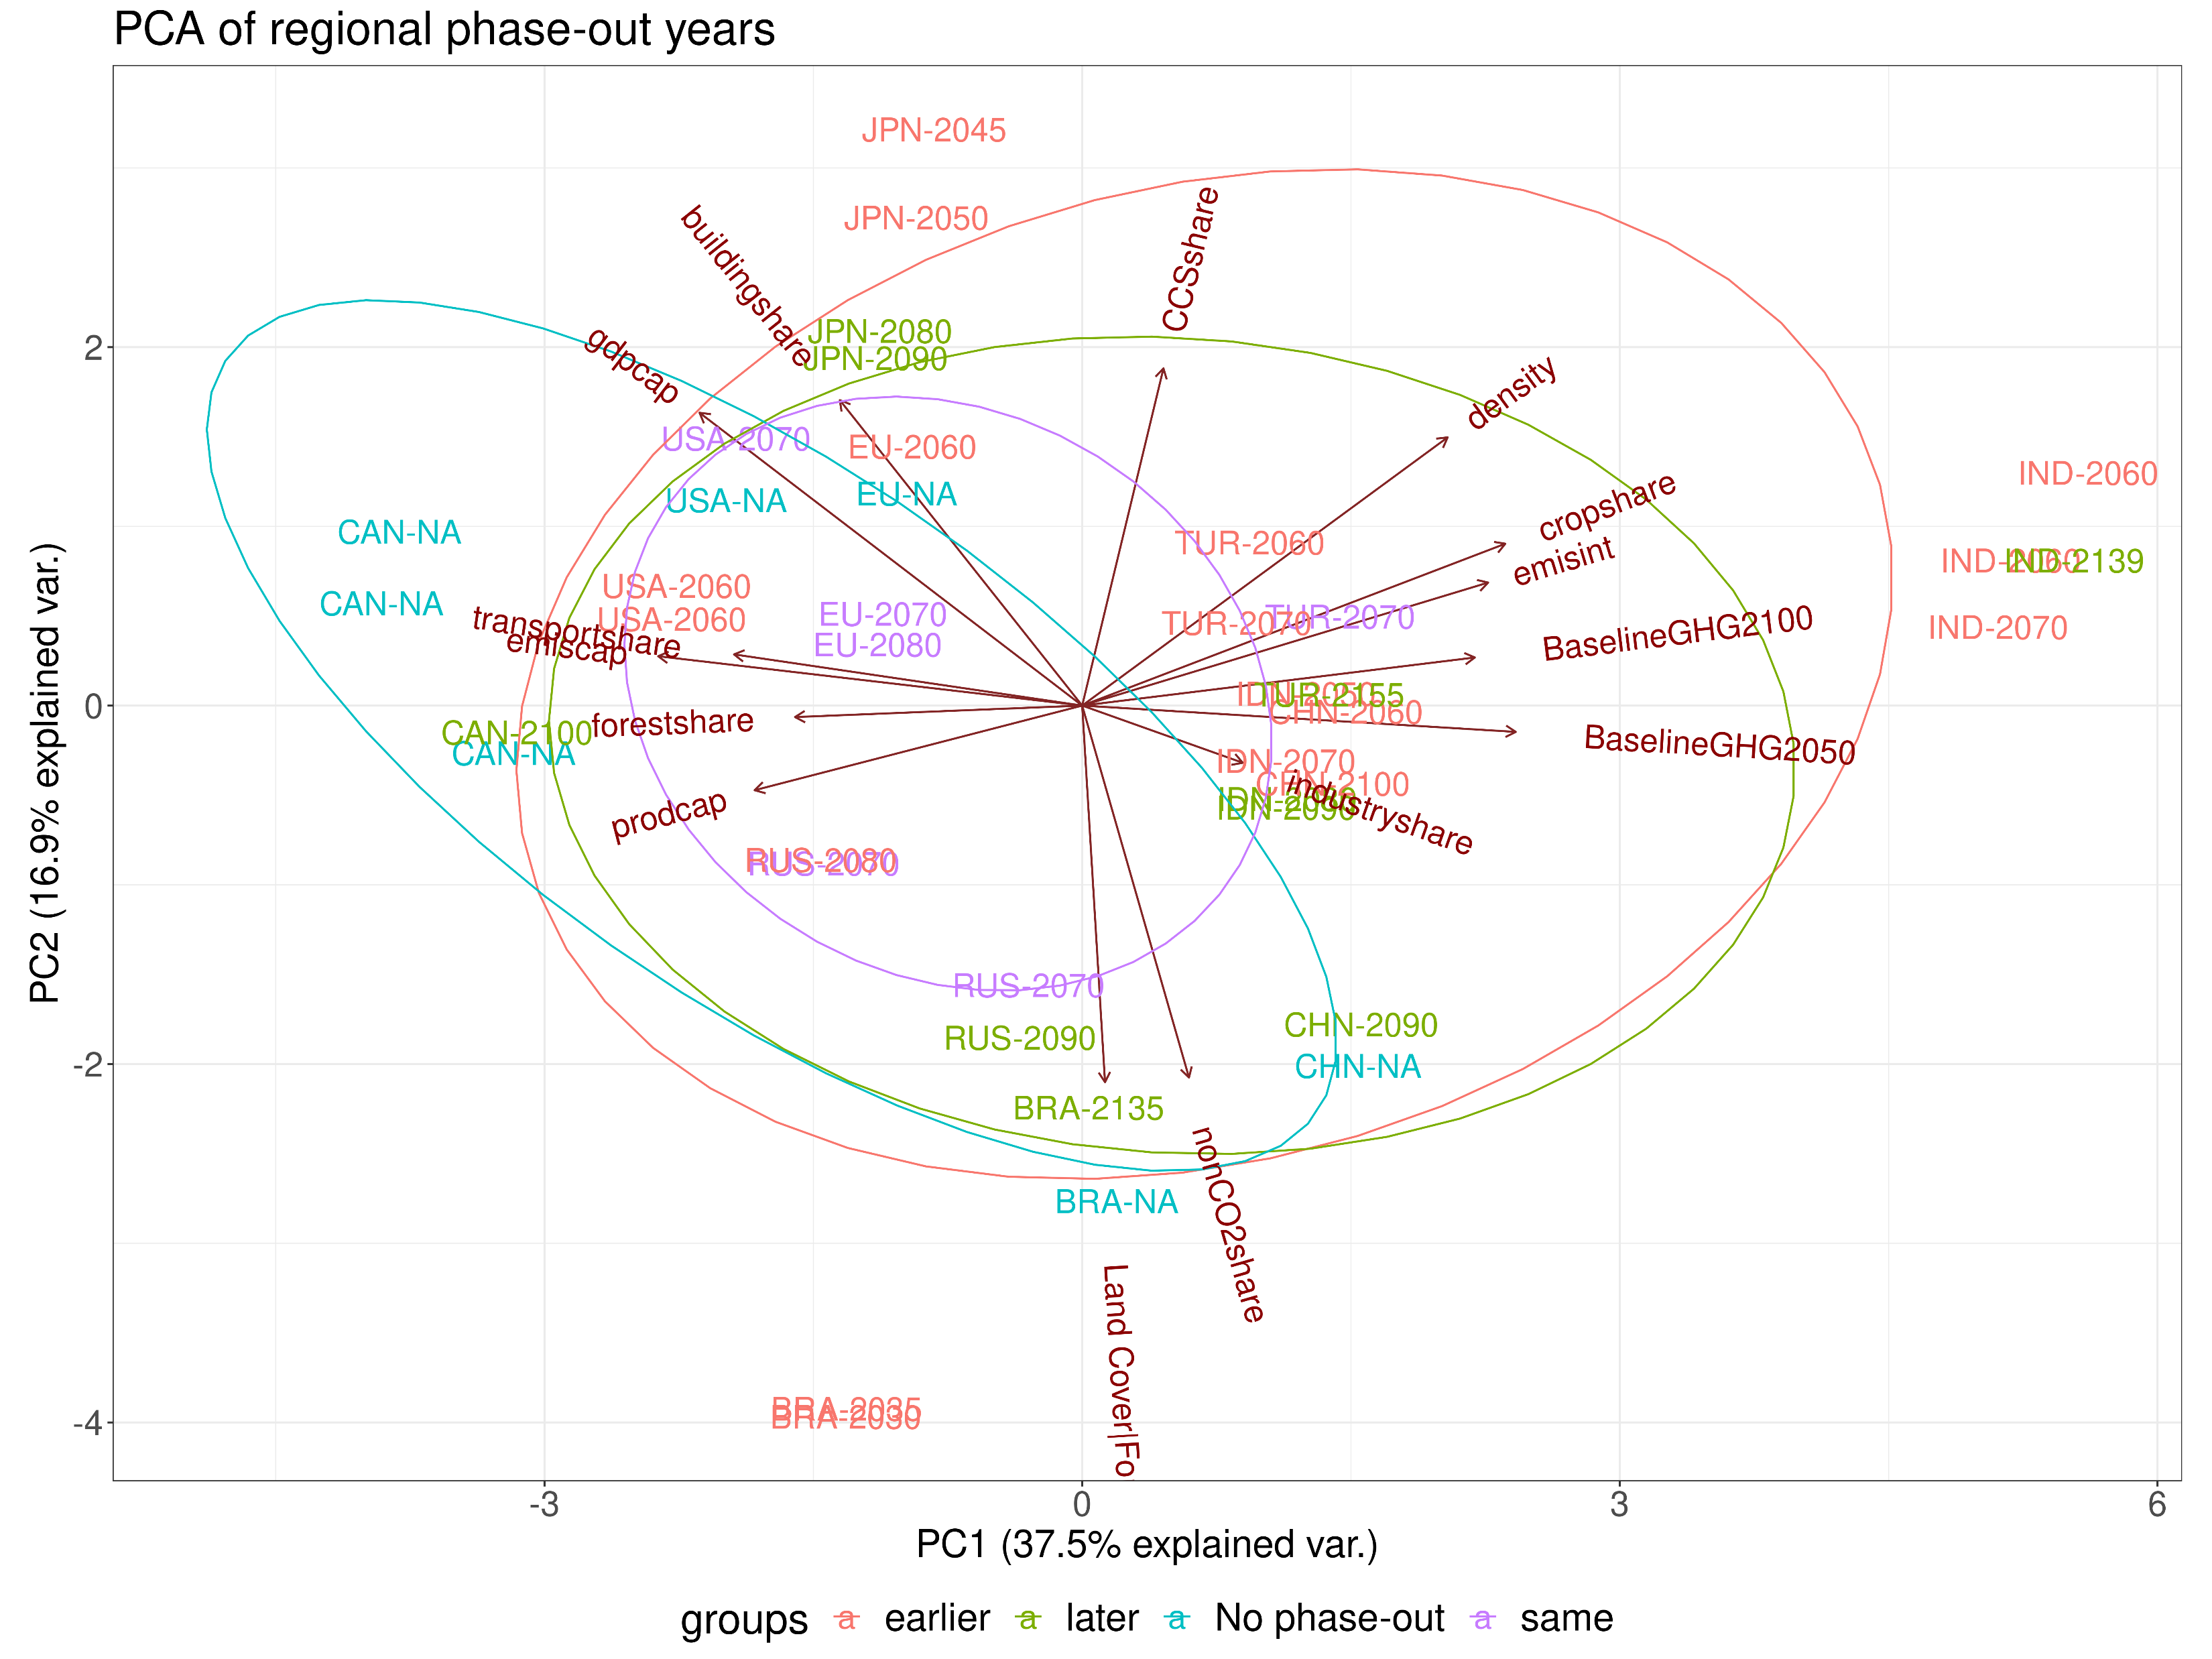

Slide 18
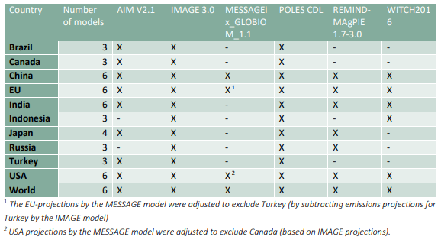

Slide 19
