Slide 1
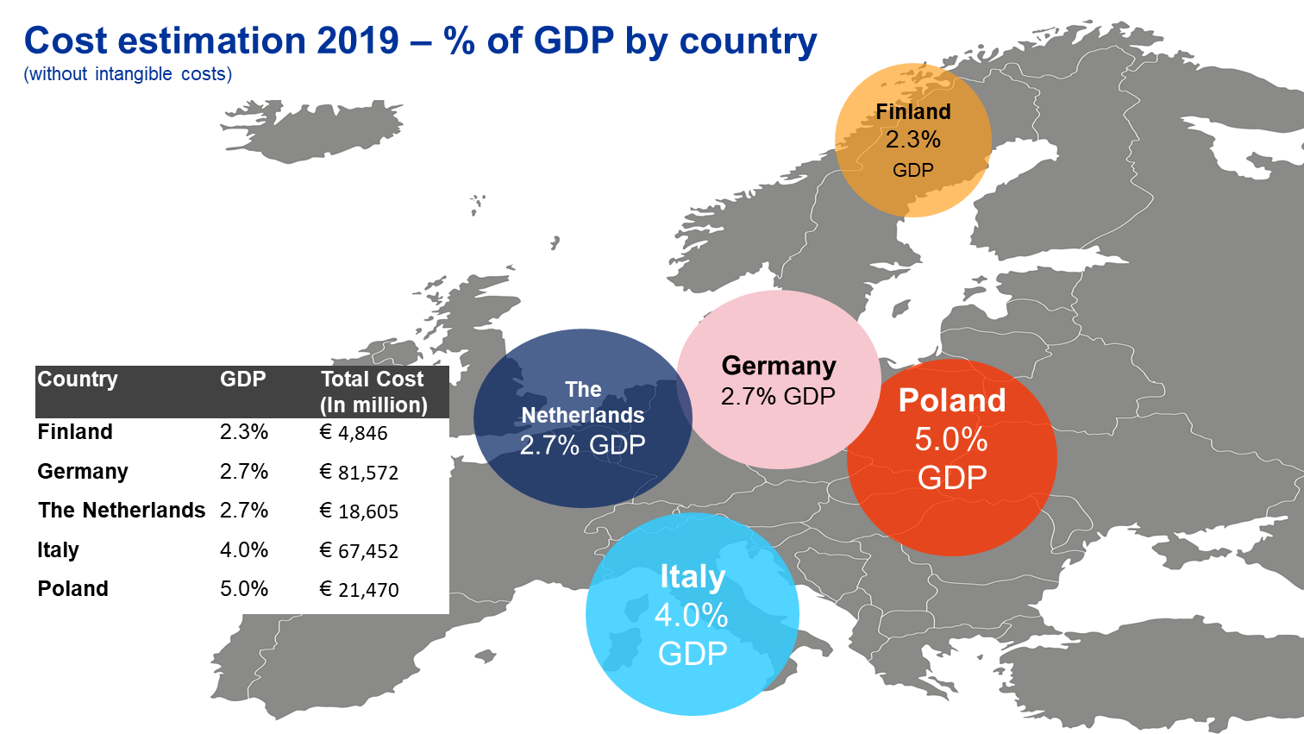
Communicating the value of occupational safety and health to policy makers: estimation of the costs of work-related injuries and diseases Dr Dietmar Elsler, EU-OSHA, Bilbao (Spain), 16/11/2019
Highlights of impact and communication
Opinion on costs and benefits of OSH from the European Economic and Social Committee, for the Finish EU Presidency in 2019
The Austrian chamber of labour published a national cost estimation following this research
Scientific publication: Economic burden of work injuries and diseases: a framework and application in five European Union countries, Springer, January 2021, BMC Public Health
European Commission’s new Strategic Framework on Health and Safety at Work
Press conference with Commissioner Schmit and Executive Vice President Dombrovskis, highlighted that there is a strong economic case for OSH and costs EU economy over 3.3% of GDP
Notes:
The aim was to increase the understanding of policy makers
Now we already have some nice feedback
Much of our work was considered in this opinion from the European Economic and Social Committee, for the Finish Presidency

