Slide 1
Bridging Ecosystem Services Accounts to
General Equilibrium models
The case of invasive alien species: from INCA to GTAP
Alessandra La Notte
Alexandra Marques
2nd biennial EU Conference on modelling for policy support 22-26 November 2021

Slide 2
How to integrate ecosystems into the economy
Three options
multiple use applicability
discipline dominance
1- Bridging
find a way to bridge existing set of models and tools in a consistent and coeherent way
2- Enlarging
create specific modules in existing models/tool to addess specific issues
3- Ad hoc integration
create ad hoc models meant to integrate selected environmental and economic variables to address specific policy issues
Notes:
Today society is facing many challenges, from energy to migration, and food to environment… These are complex challenges in a changing world.

Slide 3

Rationale behind Option#1
Use tools that talk the same language and follow the same mechanisms to bridge current advanced knowledge
Economic Unit
Economic Unit
Economic Unit
Satellite accounts
Notes:
The JRC is a Directorate-General of the European Commission under the responsibility of Mariya Gabriel, Commissioner for Innovation, Research, Culture, Education and Youth.
Its competences support also the portfolio of Vice/President Maroš Šefčovič, in charge of Interinstitutional Relations and Foresight.
Its Board of Governors assists and advises the Director-General on matters relating to the role and the scientific, technical and financial management of the JRC.
Comprised of strategy and coordination, knowledge production, knowledge management and support directorates, the JRC is spread across 6 sites in 5 different countries within the EU.

Slide 4
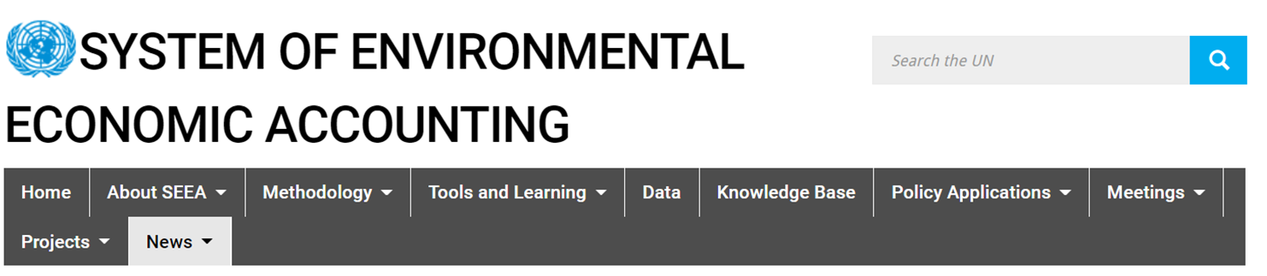
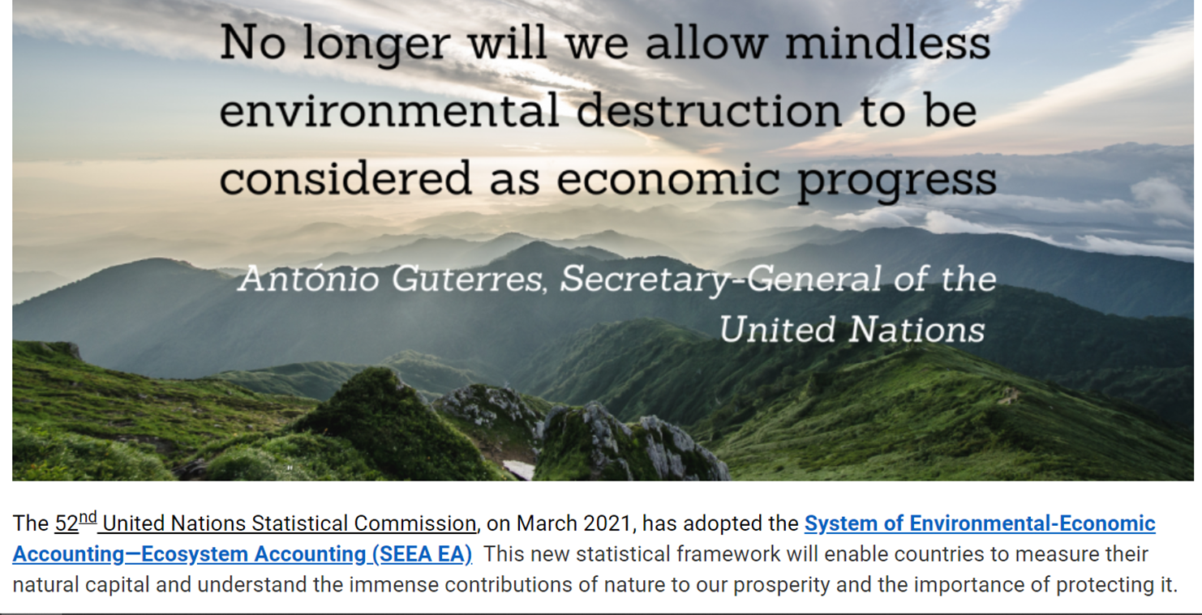
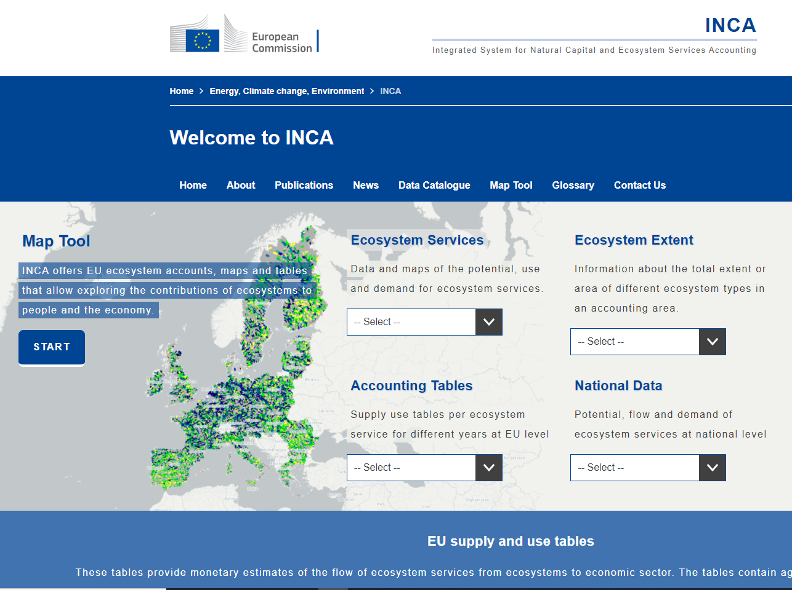
Is this tool acknowledged? Yes
Officially adopted by the UN Statistical Commission in March 2021
Are we implementing this tool in Europe?
Yes: Integrated system for
Natural Capital Accounting (INCA)

Slide 5
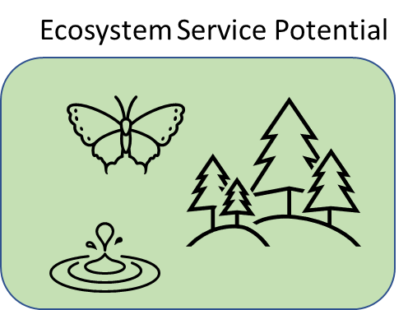
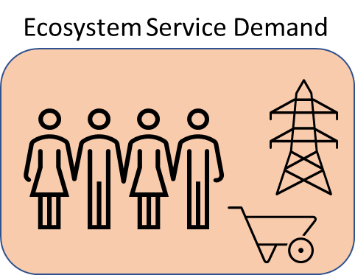

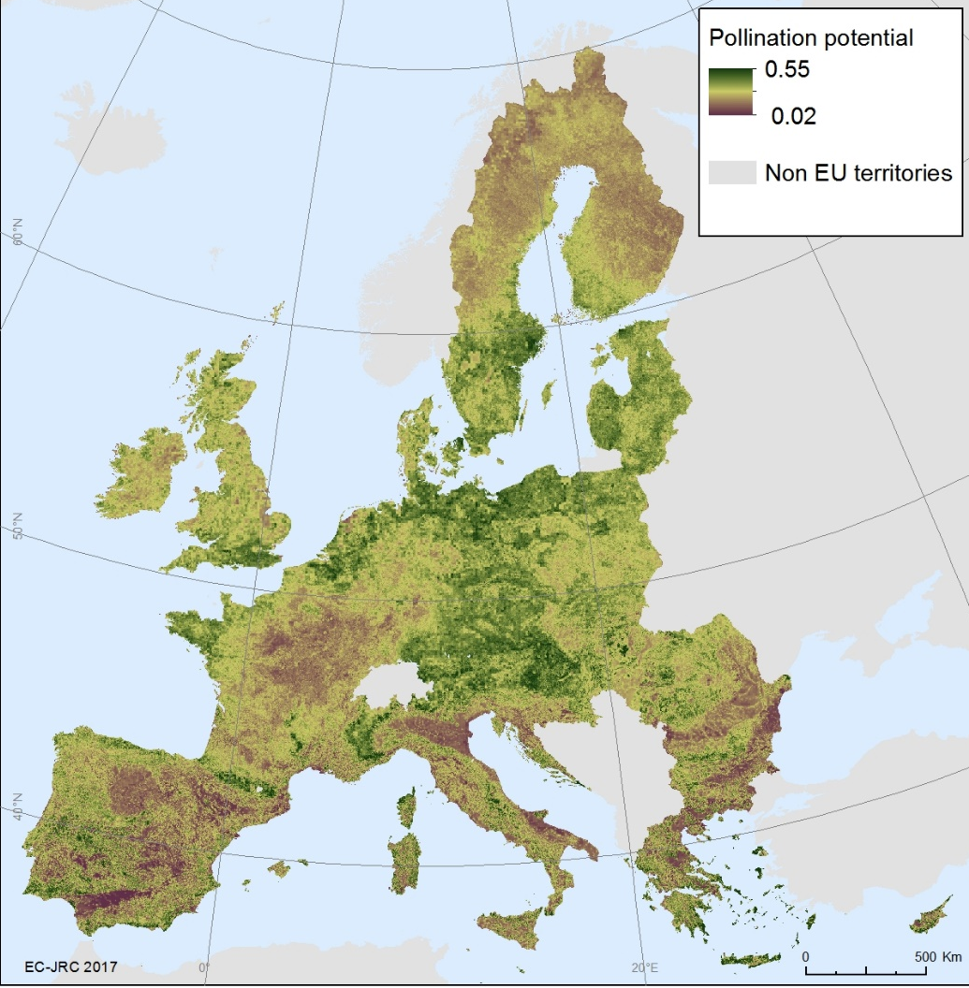
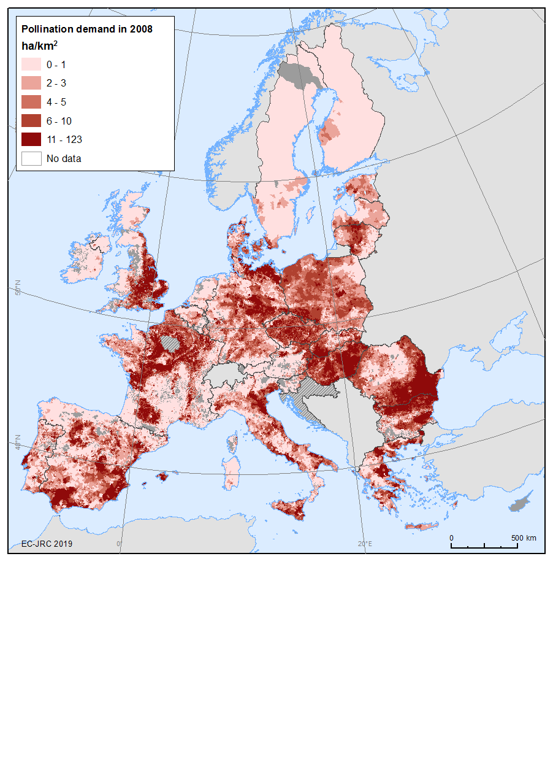

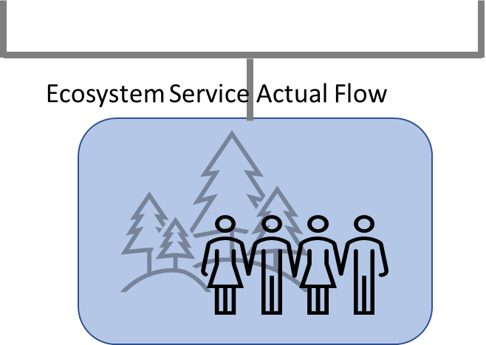




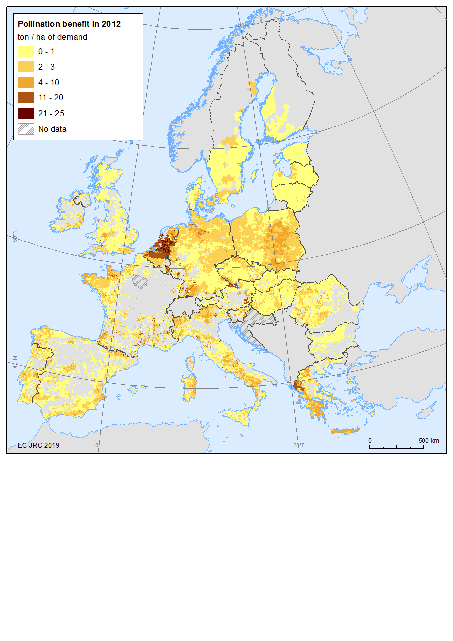



The INCA implementation:
Assessment of ES Supply and Use tables
Supply table | ET 1 | ET 2 | ...
ES 1
ES 2
ES ...
Use table | Primary | Secondary | ...
ES 1
ES 2
ES ...

Slide 6
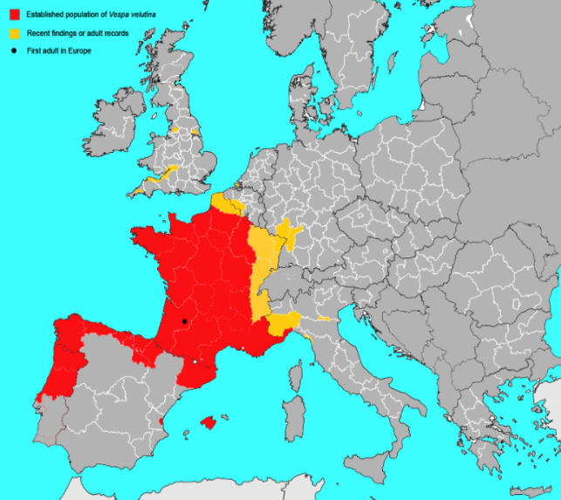
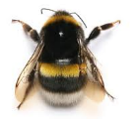
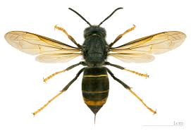
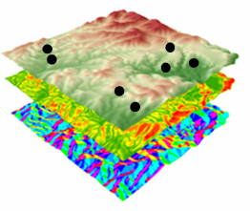
Crop pollination and the impact of the Asian hornet in the EU
Land Cover & roads
  (Food resources and nesting sites)
Irradiance & Temperature
  (Insect activity)
Distance to semi-natural areas
Expert-based model
ES Potential
ES Demand
Species occurrences
Land Cover (%)
Climate
Topography
Distance to semi-natural areas
Species-distribution model
ES Actual flow
Notes:
The new (since July 2016) structure of the JRC

Slide 7

Assessing the shock of Asian hornet on pollination contribution to crop yield (INCA)
ES Actual flow
ES Potential
ES Demand
SNA benefits
Non-SNA benefits
 | Belgium | France | Germany | Italy | Netherlands | Portugal | Spain | UK
Apples, pear and peaches | 22.15 | 0.08 | 18.39 | 3.30 | 14.55 | 2.00 | 4.22 | 16.78
Citrus fruits | - | 0.04 | - | 0.37 | - | 0.14 | 0.32 | -
Other fruits | 13.57 | 0.07 | 11.28 | 1.83 | 9.05 | 1.23 | 2.64 | 10.27
Other oilseeds | 5.13 | 0.0004 | 5.19 | 0.90 | 1.11 | 0.74 | 0.27 | 3.35
Pulses | 1.27 | 0.00 | 1.44 | 0.23 | 0.69 | 0.70 | 0.09 | 1.03
Rapeseeds | 6.78 | 0.0001 | 7.40 | 0.86 | 8.09 | - | 0.18 | 4.39
Soya | - | 0.0003 | 8.37 | 0.11 | - | - | 1.74 | -
Sunflower | - | 0.00 | 7.98 | 1.37 | 7.94 | 1.11 | 0.32 | 5.05
Flax and hemp | 1.51 | 0.00 | 1.37 | 0.60 | 0.22 | - | 0.08 | 1.02
Tomatoes | 1.35 | 0.0004 | 1.45 | 0.50 | 1.29 | 0.82 | 0.42 | 1.06
Notes:
Simplified visual showing relationship between Knowledge Production & Knowledge Management

Slide 8

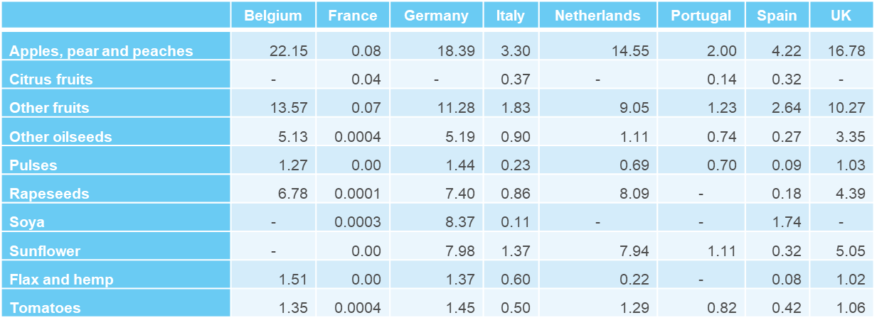
Assessing the shock of Asian hornet on pollination contribution to crop yield (GTAP)
ES Actual flow
ES Potential
ES Demand
SNA benefits
Non-SNA benefits
 | Belgium | France | Germany | Italy | Netherlands | Portugal | Spain | UK
Vegetables, fruits, pulses | 9.59 | 0.04 | 8.14 | 1.25 | 6.39 | 0.98 | 1.54 | 7.28
Oil seeds | 1.51 | 0.00 | 1.37 | 0.88 | 1.11 | 0.74 | 0.27 | 3.35
Vegetable oils & fats | 5.13 | 0.00 | 5.19 | 0.78 | 8.01 | 1.11 | 0.74 | 4.71
Plant based fibers | 6.77 | - | 7.91 | 0.60 | 0.22 | - | 0.08 | 1.02
Notes:
The JRC today

Slide 9
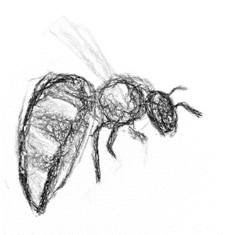
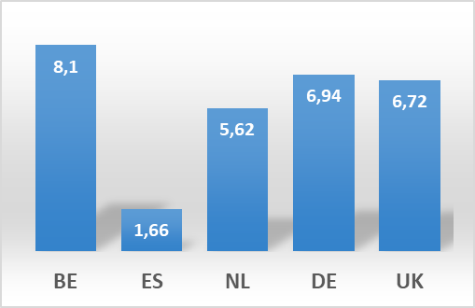

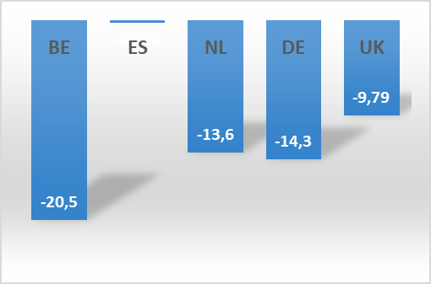

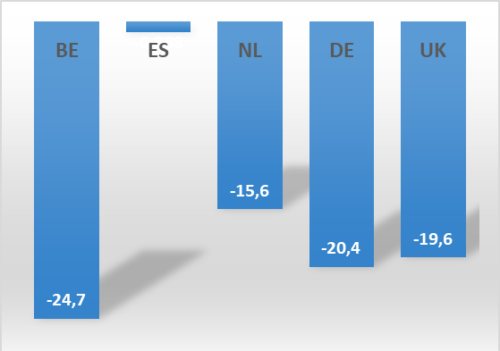

Extract information on economic impact of inaction
increase (%)
in vegetable and fruit import price
decrease (%)
in vegetable and fruit production
decrease (%)
in vegetable and fruit export

Slide 10
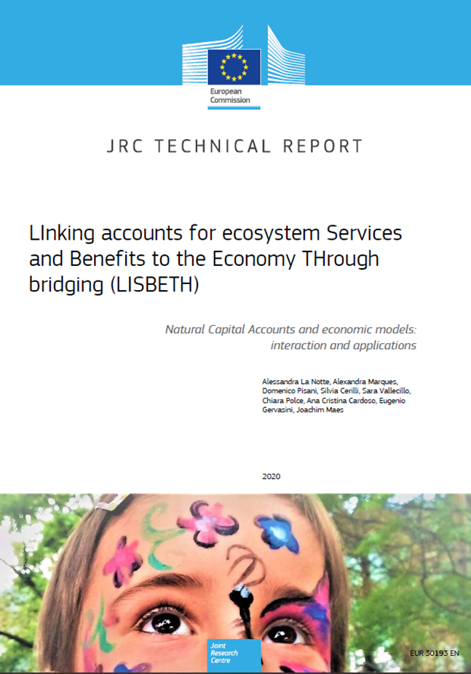
Thank you
alessandra.la-notte@ec.europa.eu
Notes:
Update/add/delete parts of the copy right notice where appropriate.
More information: https://myintracomm.ec.europa.eu/corp/intellectual-property/Documents/2019_Reuse-guidelines%28CC-BY%29.pdf

